Slide 1
Review
Object Oriented Programming (OOP) in PHP
Notes:
Session: Ghi số thứ tự session trong môn học
Session Name: ghi tên của session sẽ dạy

Slide 2
Objectives
Introduction OOP
How to work with class and object
How to work with property and method
Magic function
How to work with inheritance
Namespace in PHP
How to work with Lambda and Closure
Notes:
Mô tả nội dung mà học viên phải đạt được khi kết thúc môn học này

Slide 3
Introduction OOP

Slide 4
Introduction OOP
Object-Oriented Programming (OOP) is the term used to describe a programming approach based on objects and classes
The object-oriented paradigm allows us to organise software as a collection of objects that consist of both property and behaviour.
Notes:
Giới thiệu về OOP

Slide 5
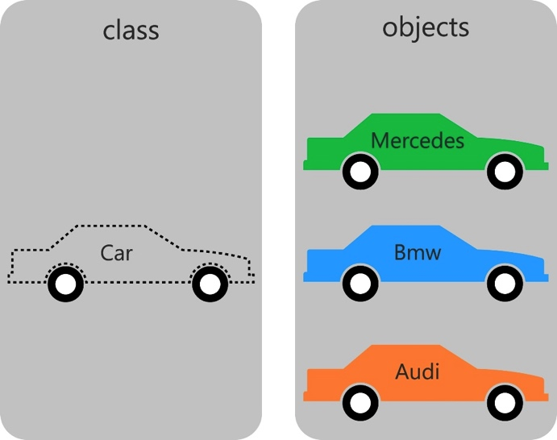
Introduction OOP (cont.)
Notes:
Giới thiệu về OOP trong PHP

Slide 6
Benefits of OOP
Reusability
Refactoring
Extensible
Maintenance
Efficiency
Notes:
Các lơi ích khi lập trình OOP

Slide 7
How to work with Class and Object

Slide 8
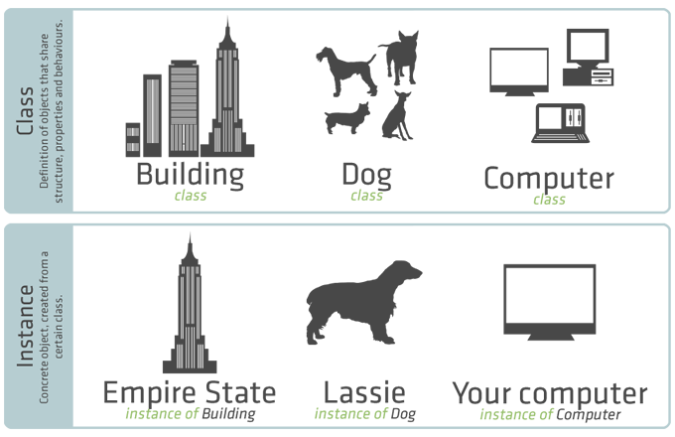
Class and Object
Notes:
Giới thiệu khái niệm class và object

Slide 9
Class and Object (cont.)
Basic class definitions begin with the keyword class, followed by a class name, followed by a pair of curly braces which enclose the definitions of the properties and methods belonging to the class.
A class may contain its own constants, variables (called "properties"), and functions (called "methods").
Class is a collection of objects. Object has properties and behaviour.
Notes:
Giới thiệu khái niệm class và object

Slide 10
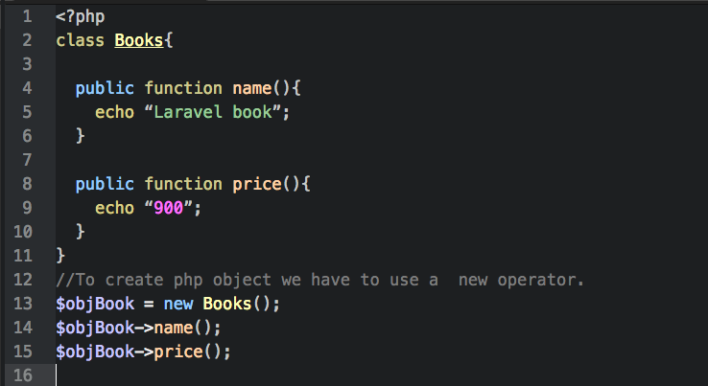
Class and Object (cont.)
Notes:
Giới thiệu khái niệm class và object

Slide 11
How to work with property and method

Slide 12
How to code properties
Class member variables are called "properties".
We may also see them referred to using other terms such as "attributes" or "fields", but for the purposes of this reference we will use "properties”
They are defined by using one of the keywords public, protected, or private, followed by a normal variable declaration

Slide 13
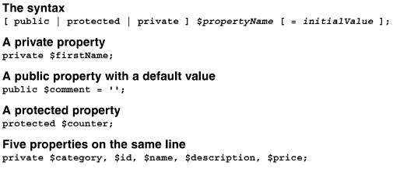
How to code properties (cont.)
How to code a property

Slide 14
How to code methods
To code a method in a class, we code one the access modifier keyword followed by the function keyword, the name of the function method, an optional parameter list in a set of parentheses, and a block of code to execute.
By default, method are public.

Slide 15
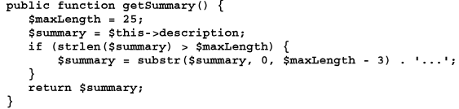
How to code methods (cont.)
How to code a method
The syntax
A public method

Slide 16
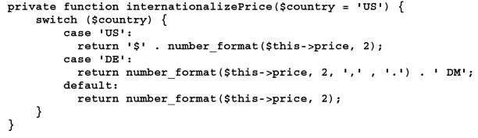

How to code methods (cont.)
A private method
A method that accesses a property of the current object

Slide 17

How to code methods (cont.)
A method that calls a method of the current object

Slide 18
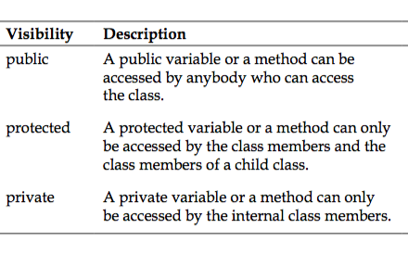
Public, private, protected keyword

Slide 19
How to work with magic method

Slide 20
Introduce magic method
The function names __construct(), __destruct(), __call(), __callStatic(), __get(), __set(), __isset(), __unset(), __sleep(), __wakeup(), __toString(), __invoke(), __set_state(), __clone() and __debugInfo() are magical in PHP classes.
You cannot have functions with these names in any of your classes unless you want the magic functionality associated with them.
Recommended that you do not use function names with __ in PHP

Slide 21
How to code constructors and destructors
A constructor method, or just constructor, is a special method that is executed when a new object is created from the class. It often initializes the properties of the object.
A destructor method, or just destructor, is a special method that’s executed when an object is no longer available for use. In other words, it is executed when there are no variables that refer to the object.

Slide 22

How to code constructors and destructors (cont.)
Within a class, the special variable named $this stores a reference to the current object
The object access operator (->) provides access to an object’s properties and methods.
How to code a constructor method
The syntax

Slide 23


How to code constructors and destructors (cont.)
The default constructor
The constructor for the Category class
The constructor for the Category class with default value

Slide 24


How to code constructors and destructors (cont.)
How to code a destructor method
The syntax
A destructor for a database class

Slide 25
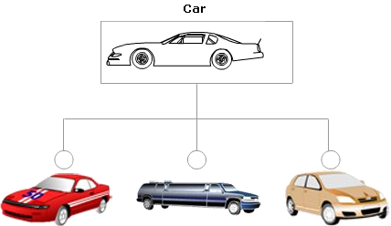
How to work with inheritance

Slide 26
How to inherit a class
Inheritance provides a way to create a new class based on an existing class. The new class inherits the properties and methods of the existing class
A class that inherits from a class is called a subclass, derived class, or child class. A class that is inherited by another class is called a superclass, base class or parent class.
A subclass can extend the superclass by adding new properties and methods.

Slide 27
Inheritance Example
Person
$firstName $lastName $phone $email + setFirstName($value) + getFirstName() …………………….
Employee
- $ssn - $hireDate +setSSN($value) +getSSN() +setHireDate($value) +getHireDate()

Slide 28
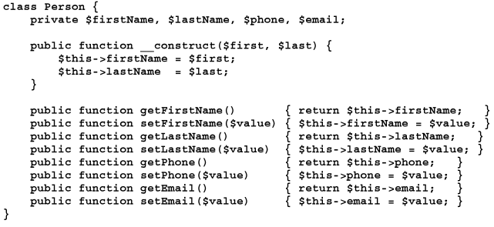
How to inherit a class (cont.)
A superclass

Slide 29
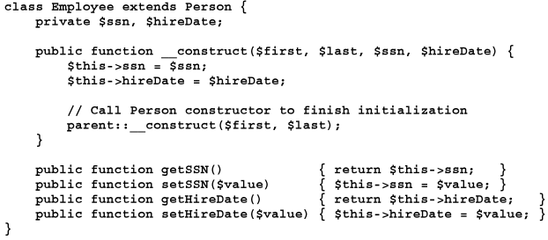
How to inherit a class (cont.)
A subclass

Slide 30
How to inherit a class (cont.)
Code that uses the subclass

Slide 31
How to create abstract classes and methods
An abstract class is a class that can’t be used to create an object.
An abstract method is a method that specifies the name and parameters for the method but doesn’t provide a code block that implements the method.
An abstract method can only be coded in an abstract class.
A concrete class is a class that can be used to create an object.

Slide 32
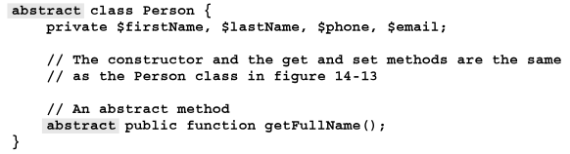
How to create abstract classes and methods (cont.)
An abstract class with an abstract method

Slide 33
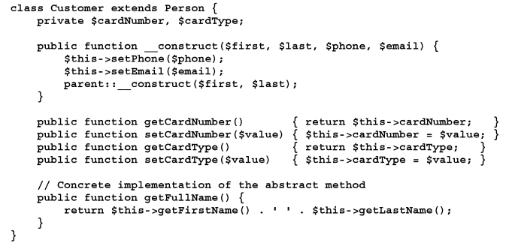
How to create abstract classes and methods (cont.)
A concrete class that implements an abstract class

Slide 34
How to create abstract classes and methods (cont.)
Code that attempts to create an object from the abstract class
Code that creates and uses an object from the concrete class.

Slide 35
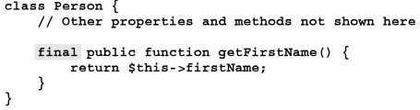
How to create final classes and methods
A final method cannot be overridden by a method in a subclass. As a result, all subclasses must use the final version of the method
A final class cannot be inherited by a subclass
How to prevent a method from being overridden
A class with a final method

Slide 36
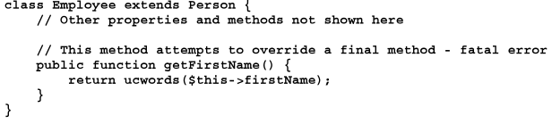
How to create final classes and methods (cont.)
A subclass that attempts to override a final method leading to a fatal error

Slide 37


How to create final classes and methods (cont.)
How to prevent a class from being inherited
A final class
A class that attempts to inherit a final class leading to a fatal error

Slide 38
How to work with interfaces
An interface defines a set of public methods that can be implemented by a class.
All methods in an interface must be public and cannot be static.
A class that implements an interface must provide an implementation for each method define by the interface
An interface can define class constants that are available to any class that implements the interface.

Slide 39



How to work with interfaces (cont.)
How to create an interface
The syntax
An interface to show an object
An interface to require two test methods

Slide 40

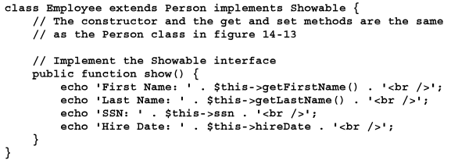
How to work with interfaces (cont.)
An interface that provides two constants
A class that inherits a class and implements an interface
A class declaration that implements three interfaces

Slide 41
How to work with Traits
Traits are a mechanism for code reuse in single inheritance languages such as PHP.
A Trait is intended to reduce some limitations of single inheritance by enabling a developer to reuse sets of methods freely in several independent classes living in different class hierarchies
A Trait is similar to a class, but only intended to group functionality in a fine-grained and consistent way.

Slide 42
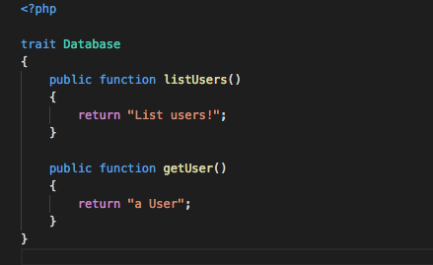
How to define a traits

Slide 43
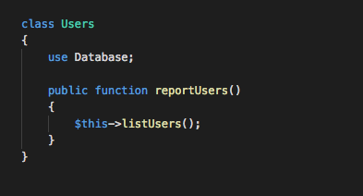
How to use a traits in Class

Slide 44
How to work with Namespace

Slide 45
Name space in PHP
In the PHP world, namespaces are designed to solve two problems that authors of libraries and applications encounter when creating re-usable code elements such as classes or functions:
Name collisions between code you create, and internal PHP classes/functions/constants or third-party classes/functions/constants.
Ability to alias (or shorten) Extra_Long_Names designed to alleviate the first problem, improving readability of source code.

Slide 46
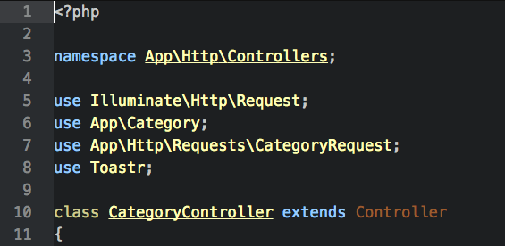
Define and use Namespace

Slide 47
How to work with Lambdas and Closures

Slide 48
What is lambda?
A Lambda is an anonymous function that can be assigned to a variable or passed to another function as an argument
If you are familiar with other programming languages like Javascript or Ruby, you will be very familiar with anonymous functions.
An anonymous function is simply a function with no name.

Slide 49
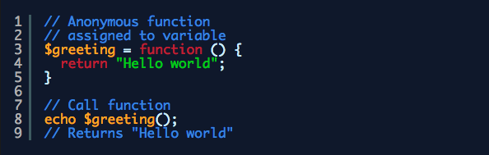
Using lambda
Because the function has no name, you can’t call it like a regular function. Instead you must either assign it to a variable or pass it to another function as an argument.

Slide 50
Why would you want to use a Lambda?
Lambdas are useful because they are throw away functions that you can use once.
Often, you will need a function to do a job, but it doesn’t make sense to have it within the global scope or to even make it available as part of your code. Instead of having a function used once and then left lying around, you can use a Lambda instead.

Slide 51
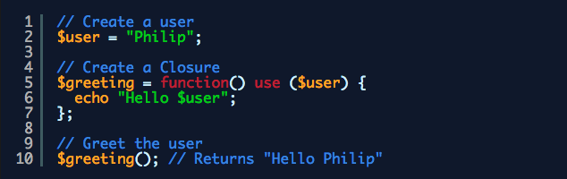
What is Closure?
A Closure is essentially the same as a Lambda apart from it can access variables outside the scope that it was created.

Slide 52
Summary
In object-oriented programming, a class defines the properties and methods of each type of object.
A constructor method, or just constructor, is a special method within a class that is used to create an object from the class.
A destructor method is a special method that’s executed when an object is no longer available for use.
Notes:
Tóm tắt lại nội dung đã học

Slide 53
Summary (2)
An object is an instance of a class.
A public property can be directly accessed by code outside of the class
A private and protected properties can’t be directly accessed by code outside the class
A method is a function that’s coded within a class.
The object access operator (->) provides access to an object’s properties and method.

Slide 54
Summary (3)
A class constant is a constant value that belongs to the class, not to objects that are created from the class.
A static property or static method is a property or method that belongs to a class, not to object created from the class.
To create a second reference to an object, you can use the equals (=) operator.
Create a copy of an object, PHP makes a shallow copy of the object

Slide 55
Summary (4)
Inheritance provides a way to create a new class based on an existing class
A class that inherits from a class is called a subclass, derived class, or child class.
A subclass can extend the superclass by adding new properties and methods.
An abstract class is a class that can’t be used to create an object.
A concrete class is a class that can be used to create a object.

Slide 56
Summary (5)
A final method can’t be overridden by a method in a subclass. A final class can’t be inherited by a subclass
An interface defines a set of public methods that can be implemented by a class.

Slide 57
Summary (5)
Traits are a mechanism for code reuse in single inheritance languages such as PHP.
A Trait is intended to reduce some limitations of single inheritance by enabling a developer to reuse sets of methods freely in several independent classes living in different class hierarchies
A Trait is similar to a class, but only intended to group functionality in a fine-grained and consistent way.

Slide 58
Summary (6)
Namespaces are designed to solve two problems that authors of libraries and applications encounter when creating re-usable code elements such as classes or functions

Slide 59
Summary (7)
A Lambda is an anonymous function that can be assigned to a variable or passed to another function as an argument
A Closure is essentially the same as a Lambda apart from it can access variables outside the scope that it was created.

