Slide 1


Chapter 3
Routing and Controllers

Slide 2

Objectives
A Quick Introduction to MVC, the HTTP Verbs, and REST
Route Definitions
Route Groups
Signing a Route
Views
Controllers
Route Model Binding
Form Method Spoofing
CSRF Protection
Redirects

Slide 3
A Quick Introduction to MVC, the HTTP Verbs, and REST

Slide 4
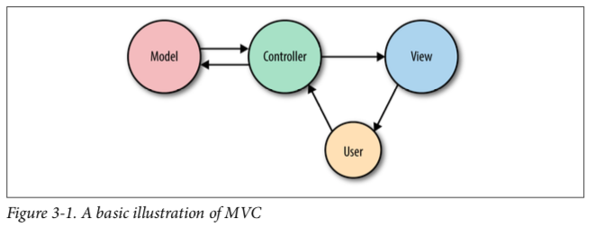
What Is MVC?

Slide 5
What Is MVC?
In MVC, you have three primary concepts:
model
Represents an individual database table (or a record from that table)—think “Company” or “Dog.”
view
Represents the template that outputs your data to the end user—think “the login page template with this given set of HTML and CSS and JavaScript.”
controller
Like a traffic cop, takes HTTP requests from the browser, gets the right data out of the database and other storage mechanisms, validates user input, and eventu‐ ally sends a response back to the user.

Slide 6
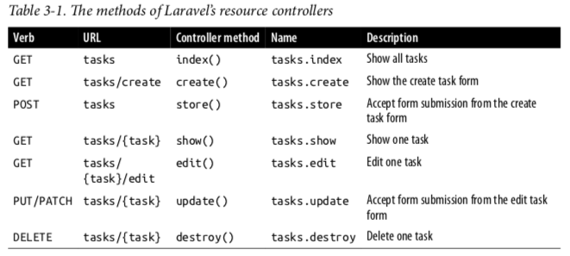
The HTTP Verbs

Slide 7
What Is REST?
REST, or REpresentational State Transfer, is an architectural style for providing standards between computer systems on the web, making it easier for systems to communicate with each other. REST-compliant systems, often called RESTful systems, are characterized by how they are stateless and separate the concerns of client and server.

Slide 8
Route Definitions

Slide 9
Route Definitions
You will define your web routes in routes/web.php and your API routes in routes/api.php.
The simplest way to define a route is to match a path (e.g., /) with a closure, as seen in below.
// routes/web.php
Route::method(‘url’, function());
Route::get('/', function () {
return 'Hello, World!';
});

Slide 10
Route Definitions
Route::get('/', function () {
return view(‘welcome’);
});
Route::get('about', function () {
return view('about');
});

Slide 11
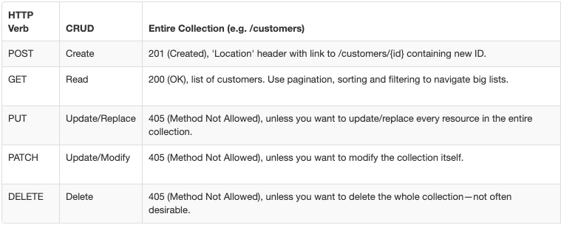
Route Verbs

Slide 12
Route Verbs
Example 3-3. Route verbs
Route::get('/', function () { return 'Hello, World!';
});
Route::post('/', function () { // Handle someone sending a POST request to this route
});
Route::put('/', function () { // Handle someone sending a PUT request to this route
});
Route::delete('/', function () { // Handle someone sending a DELETE request to this route
});
Route::any('/', function () { // Handle any verb request to this route
});
Route::match(['get', 'post'], '/', function () { // Handle GET or POST requests to this route
});

Slide 13
Route Handling
Route::method( '/url ', ‘ControllerName@methodName');
This is telling Laravel to pass requests to that url to the method of the App\Http\Controllers\ControllerName controller. This method will be passed the same parameters and treated the same way as a closure you might’ve alternatively put in its place.

Slide 14
Route Parameters
If the route you’re defining has parameters segments in the URL structure that are variable. it’s simple to define them in your route and pass them to your closure
Route::get('users/{id}/friends', function ($id) {
// code
});
You can also make your route parameters optional by including a question mark (?) after the parameter name
Route::get('users/{id?}', function ($id = 'fallbackId') {
//
});

Slide 15
Route Names
Laravel allows you to name each route, which enables you to refer to it without explicitly referencing the URL
// Defining a route with name() in routes/web.php:
Route::get(‘members/{id}', ‘MembersController@show')
->name('members.show');
// Linking the route in a view using the route() helper:
<a href="<?php echo route('members.show', ['id' => 14]); ?>">

Slide 16
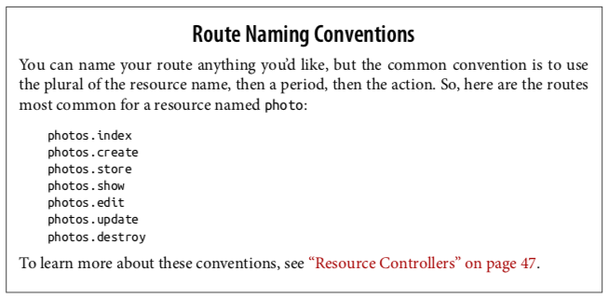
Route Names

Slide 17
Passing Route Parameters
Passing Route Parameters to the route() Helper
There are a few different ways to pass these parameters. Let’s imagine a route defined as users/userId/comments/commentId. If the user ID is 1 and the comment ID is 2, let’s look at a few options we have available to us:
Option 1:
route('users.comments.show', [1, 2])
// http://myapp.com/users/1/comments/2
Option 2:
route('users.comments.show', ['userId' => 1, 'commentId' => 2])
// http://myapp.com/users/1/comments/2

Slide 18
Route Groups

Slide 19
Route Groups
Route groups allow you to group several routes together and apply any shared configuration settings once to the entire group, to reduce this duplication.
Route::group( function () {
Route::get('dashboard', function () {
return view('dashboard');
});
Route::get('account', function () {
return view('account');
});
});

Slide 20
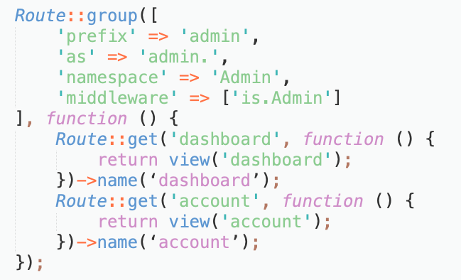
Route Group Options
Route::group([
'prefix' => 'admin',
'as' => 'admin.',
'namespace' => 'Admin',
'middleware' => ['is.Admin']
], function () {
Route::get('dashboard', function () {
return view('dashboard');
})->name(‘dashboard’);
Route::get('account', function () {
return view('account');
})->name(‘account’);
});

Slide 21
Signed Routes

Slide 22
Signed Routes
These links are composed of the normal route link with a “signature” appended that proves that the URL has not been changed since it was sent
Signing a Route :
Route::get('invitations/{invitation}/{answer}', 'InvitationController')
->name('invitations')
->middleware('signed');

Slide 23
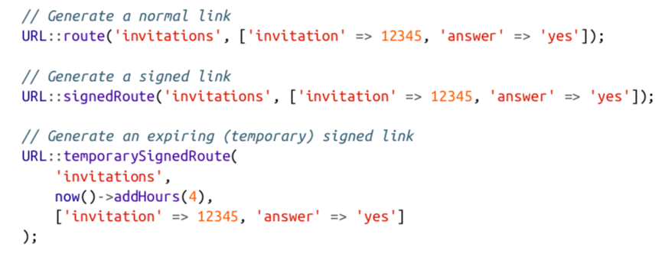
Generate a Signed Route

Slide 24
Views

Slide 25
Views
views (or templates) are files that describe what some particular output should look like. You might have views for JSON or XML or emails, but the most common views in a web framework output HTML.
Example 3-18. Simple view() usage
Route::get('/', function () { return view('home');
});
Example 3-19. Passing variables to views
Route::get('tasks', function () { return view('tasks.index')
->with('tasks', Task::all());
});

Slide 26
Controllers

Slide 27
Controllers
Controllers are essentially classes that organize the logic of one or more routes together in one place. Controllers tend to group similar routes together, especially if your application is structured in a tradi‐ tionally CRUD-like format; in this case, a controller might handle all the actions that can be performed on a particular resource.
Create a controller :
- php artisan make:controller <name controller>
Example :
php artisan make:controller TasksController -r

Slide 28
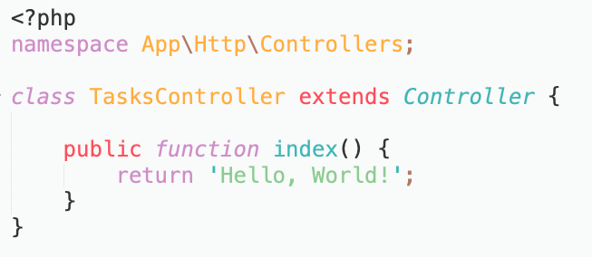
Controller
// routes/web.php
<?php Route::get('/tasks', 'TasksController@index');

Slide 29
Controller Namespacing
Namespaces are meant to deal with conflicting names of classes and also includes of class file all you have to do is just call an autoloader with a PHP PSR version declared in your composer. json.
Declare name space : namespace App\Http\Controllers\;

Slide 30
Getting User Input
There are some way to get input for user’s request.
request()-> all();
request()-> only([‘name’, ‘age’]);
request()->except([‘birthday’, ‘address’]);

Slide 31
Injecting Dependencies into Controllers

Slide 32
Injecting Dependencies into Controllers
If you prefer to inject your dependencies, or if you want to use a service that doesn’t have a facade or a helper, you’ll need to find some way to bring instances of these classes into your controller.
// TasksController.php
...
public function store(\Illuminate\Http\Request $request) {
$data = $request->only(['title', ‘description']);
Task::create($data);
return redirect('tasks');
}

Slide 33
Resource Controllers
Laravel has some conventions for all of the routes of a traditional REST/CRUD controller (called a “resource controller” in Laravel); additionally, it comes with a generator out of the box and a convenience route definition that allows you to bind an entire resource controller at once.
php artisan make:controller <NameController> --resource

Slide 34
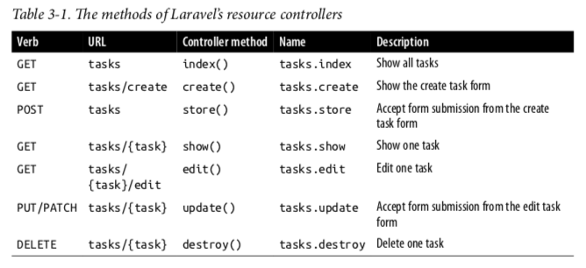
Binding a resource controller
// routes/web.php
Route::resource('tasks', ‘TasksController');

Slide 35
Route Model Binding
- php artisan route:list
Laravel provides a feature that simplifies this pattern called route model binding. This allows you to define that a particular parameter name (e.g., {conference}) will indicate to the route resolver that it should look up an Eloquent database record with that ID and then pass it in as the parameter instead of just passing the ID.
Route::get('conferences/{id}', function ($id) {
$conference = Conference::findOrFail($id);
});

Slide 36
Route Model Binding
Using an implicit route model binding
Route::get('conferences/{conference}', function (Conference $conference) {
return view('conferences.show')->with('conference', $conference);
});

Slide 37
Form Method Spoofing

Slide 38
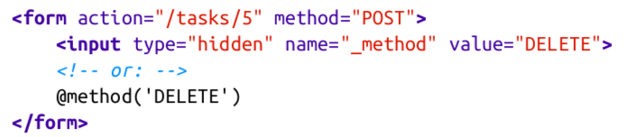
Form Method Spoofing
Sometimes you need to manually define which HTTP verb a form should send as. HTML forms only allow for GET or POST, so if you want any other sort of verb, you’ll need to specify that yourself.

Slide 39
CSRF Protection

Slide 40
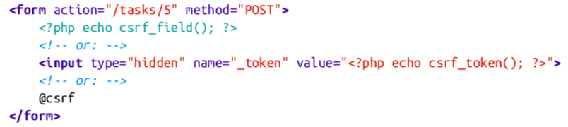
CSRF Protection
A cross-site request forgery is when one website pretends to be another. The goal is for someone to hijack your users’ access to your website, by submitting forms from their website to your website via the logged-in user’s browser.

Slide 41
Redirects

Slide 42
Redirects
- redirect()->to(path)
Route::get('redirect', function () {
return redirect()->to('home');
});
- redirect()->route(‘name route’)
Route::get('redirect', function () {
return redirect()->route('conferences.index');
});
- Redirect route with param :
Route::get('redirect', function () { return redirect()->route('conferences.show', ['conference' => 99]);
});

Slide 43
Redirects
- redirect()->back()
=>redirect, which simply redirects the user to whatever page they came from
- redirect()->with()
Route::get('redirect-with-array', function () {
return redirect('dashboard')->with(['error'=> true])
});

Slide 44
Redirects
- Redirect with form input
Route::get('form', function () { return view('form');
});
Route::post('form', function () {
return redirect('form')
->withInput() ->with(['error' => true, 'message' => 'Whoops!']);
});

Slide 45

Summary
A Quick Introduction to MVC, the HTTP Verbs, and REST
Route Definitions
Route Groups
Signing a Route
Views
Controllers
Route Model Binding
Form Method Spoofing
CSRF Protection
Redirects

Slide 46
The End

