Slide 1
Session 1
Introduction to web development with PHP

Slide 2
Objectives
The architecture of a web application
The Product Discount application
How to edit and test a PHP application
How to use NetBeans to develop a PHP application
Notes:
Mô tả nội dung mà học viên phải đạt được khi kết thúc môn học này

Slide 3
The architecture of a web application
Notes:
Mô tả nội dung chi tiết từng chuyên đề

Slide 4
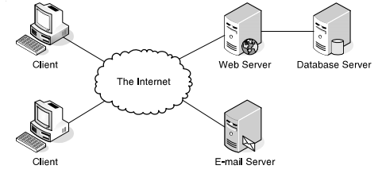
How a client–server architecture works
The architecture of a web application

Slide 5
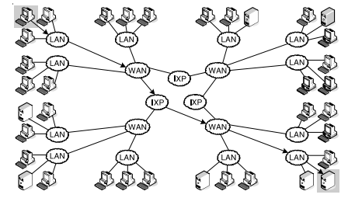
How a client–server architecture works (cont.)
The architecture of the Internet

Slide 6
How a client–server architecture works (cont.)
Web application use a client-server architecture. This architecture consists of servers that share resource with clients over a network.
A server makes resources available to other computers called clients over a network. A server can share files, printers, web sites, databases, or email.
A network uses routers to get information from the sender to its destination.

Slide 7
Terms
LAN - Local Area Network
WAN - Wide Area Network
IXP – Internet Exchange Point
ISP - Internet Services Provider

Slide 8
How static web pages are processed
Hypertext Transfer Language (HTML) is the language used to design the web pages of an application.
A static web page is an HTML document that’s stored on the web server and doesn’t change in response to user input. Static web pages have a filename with an extension of .htm or .html

Slide 9
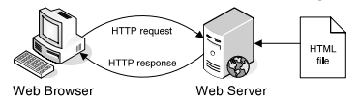

How static web pages are processed (cont.)
How a web server processes a static web page
A simple HTTP request

Slide 10
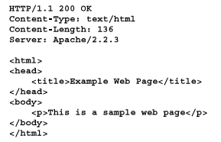
How static web pages are processed (cont.)
A simple HTTP response

Slide 11
How static web pages are processed (cont.)
Two protocols that web applications depend upon
HyperText Transfer Protocol (HTTP) is the protocol that web browsers and web servers use to communicate. It sets the specifications for HTTP requests and responses.
Transmission Control Protocol/Internet Protocol (TCP/IP) is a suite of protocols that let two computers communicate over a network.

Slide 12
How dynamic web pages are processed
A dynamic web page is a web page that’s generated by server-side program or script. The web page changes according to the information that is submitted by the web browser to the server.
A web server processes a dynamic web page with PHP

Slide 13
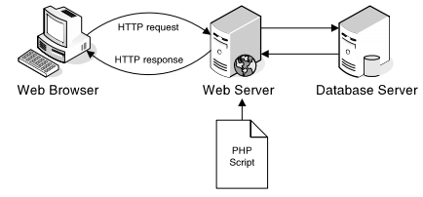
How dynamic web pages are processed (cont.)

Slide 14
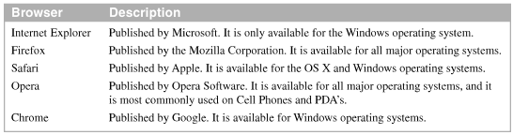
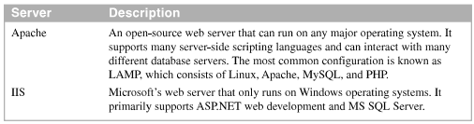
A survey of web application software
Web browser
Web servers

Slide 15
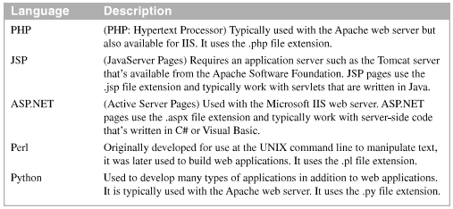
A survey of web application software(cont.)
Server-side languages

Slide 16
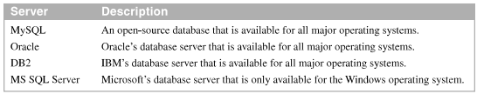
A survey of web application software (cont.)
Database servers

Slide 17
Highlights in the history of PHP
Version | Year | Description
2 3 4 5 6 7 | 1995 1998 2000 2004 N/A 2015 | This version was named Personal Home Page. This version was renamed PHP: Hypertext Processor. This version introduced the Zend Engine. This version introduced the Zend Engine 2. Support OOP, PHP Data Object extensions and other. This version was never release. This version introduced the Zend Engine 3.

Slide 18
Highlights in the history of MySQL
Version | Year | Description
3.23 4.0 4.1 5.0 5.1 5.5 5.6 5.7 | 1995 2003 2004 2005 2008 2010 2011 2017 | The original version of MySQL is released. This version introduced support for unions. This version introduced support for subqueries and prepared statement. This version introduced support for stored procedure, triggers, views and transactions. This version introduced support for row-based replication and server log table. This version changed the default storage engine to provide support for referential integrity by default. This version introduced support for working with big data. This version included security improvements and other enhancements

Slide 19
The Product Discount application

Slide 20
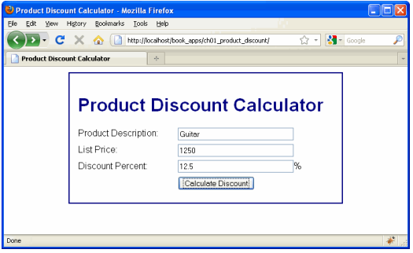
The user interface
The first page (index.html)

Slide 21
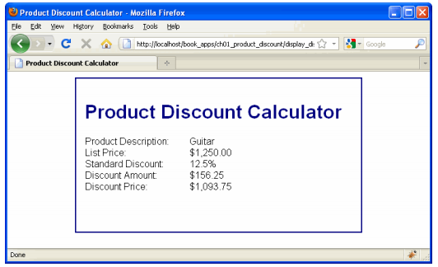
The user interface (cont.)
The second page (the response)

Slide 22
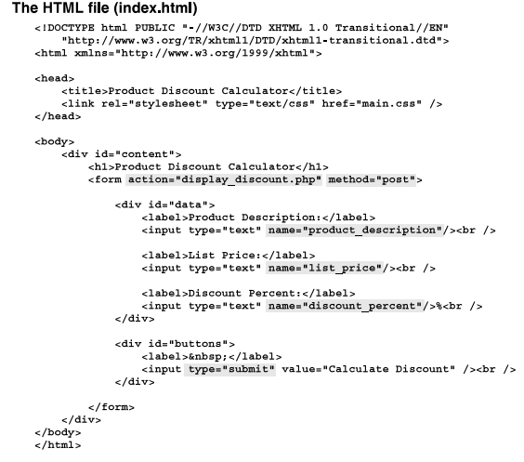
The HTML

Slide 23
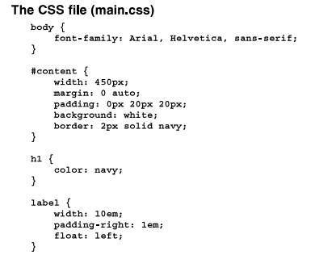
The CSS file

Slide 24
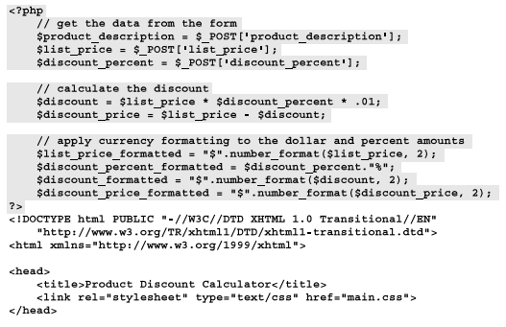
The PHP file

Slide 25
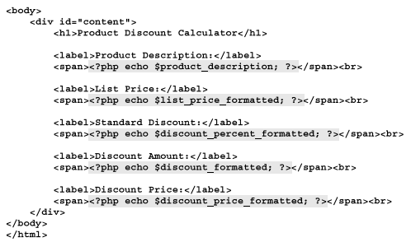
The PHP file (cont.)

Slide 26
How to edit and test a PHP application

Slide 27
How to edit a PHP page with a text editor
Use many different text editors for editing HTML, CSS, and PHP code. For window Notepad++. For Mac TextWrangler.
Open, save. Close, and start files
Change the style for comments
Notepad ++

Slide 28
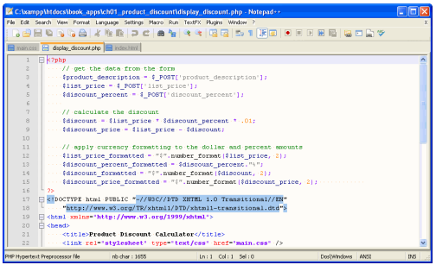
How to edit a PHP page with a text editor (cont.)

Slide 29
How to start and stop Apache and MySQL on your own computer
XAMPP is a free, open-source web server package that consists of Apache, MySQL, and interpreters for PHP and Perl.
XAMPP can be easily installed by downloading and installing one exe file.
XAMPP is available for Windows, Linux, Solaris, and Mac OS X systems (the X is XAMPP stands for cross-platform).

Slide 30
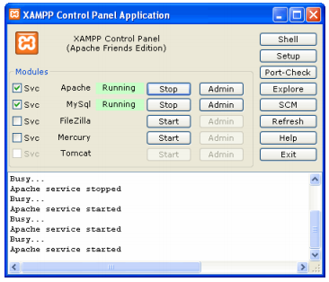
How to start and stop Apache and MySQL on your own computer (cont.)

Slide 31
How to deploy a PHP application
The deploy a PHP application so you can run it, you need to store the directories and files for the application in the htdocs directory of an Apache server that’s on your own PC, a local server, or an Internet server
The files for a PHP application usually include HTML, CSS, PHP, and image files. These files are stored in appropriate directories
The directories and files on the local server will mirror the directories and files that get uploaded to the Internet server.

Slide 32
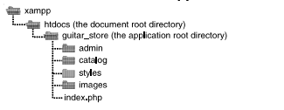
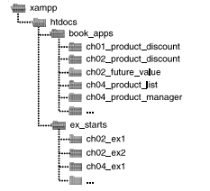
How to deploy a PHP application(cont.)
The file structure for a PHP application on a local server
The file structure for the book applications and exercise starts

Slide 33
How to deploy a PHP application (cont.)
Deploy a PHP application on a local server
Deploy the downloadable applications on a local server
Deploy an application on an Internet server

Slide 34


How to run a PHP application
To access a web page on the Internet, you can enter a Uniform Resource Locator (URL) into the address bar of your browser.
The components of an HTTP URL
URLs for requesting pages from an Internet web server

Slide 35
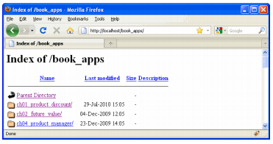
How to run a PHP application (cont.)
URLs for requesting applications from a local web server
An index of the applications in the book_apps directory

Slide 36
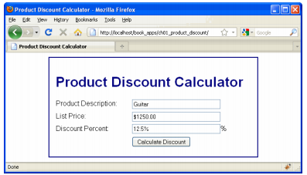
How to test and debug a PHP page
If you get an error message, read the message to help determine the cause of the error. Then, modify the PHP code and retest the page.
The Product Discount application in the Firefox browser

Slide 37
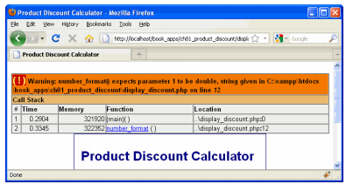
How to test and debug a PHP page (cont.)
An error displayed in the Firefox browser

Slide 38
How to test and debug a PHP page (cont.)
Test a PHP page for the first time
Make sure the Apache and MySQL servers are running
Start a web browser and enter the URL
Test the page by entering both valid and invalid data, clicking on all links, and so on
Retest a PHP page after you change the source code.
Click the Reload or Refresh button in browser. Then, test the page again.

Slide 39
How to view the source code for a web page
How to view the source code for a page in Firefox
Use the view -> page Source command
How to view the source code for a page in Internet Explorer
Use the View -> Source command
When you view the source for a web page in a web browser, the HTML code is opened in a separate window.

Slide 40
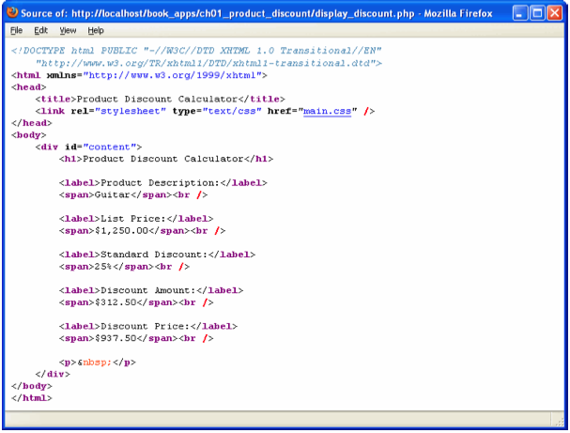
How to view the source code for a web page (cont.)
The source code for a PHP page

Slide 41
How to use NetBeans to develop a PHP application

Slide 42
How to work with PHP projects and files
NetBeans is an Integrated Development Environment (IDE) for developing PHP applications that makes it easier to create, edit, and test all of the HTML, CSS, and PHP files that you need for a web application
How to work with projects
How to work with files

Slide 43
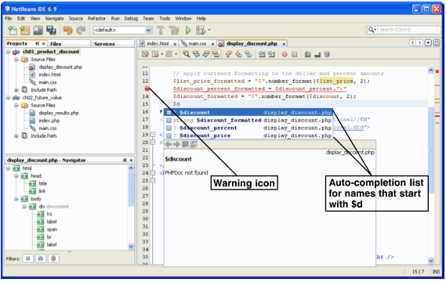
How to edit and test a PHP application
NetBeans with an auto-completion list and an error marker displayed

Slide 44
How to edit and test a PHP application (cont.)
How to edit a PHP file
How to test a PHP application
NetBeans
The auto-completion feature of NetBeans provides lists of possible entries after you enter the starting characters for an entry
Netbeans does some error checking as you enter code. Then, if you enter a statement that contains an error, NetBeans puts a red error icon at the start of the line

Slide 45
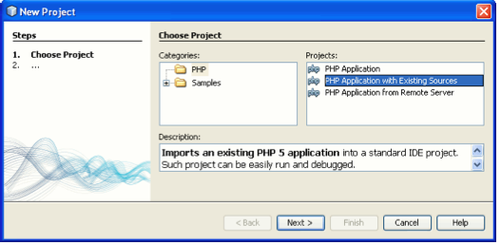
How to import and configure a PHP project
The dialog box for starting a new project

Slide 46
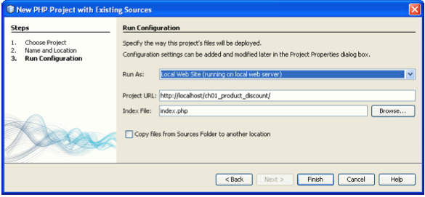
How to import and configure a PHP project (cont.)
The dialog box for configuring a project

Slide 47
How to import and configure a PHP project (cont.)
How to check the run configuration for an existing project
How to import a project

Slide 48
Summary
A web application uses an architecture that consists of clients, a web server, and a network
A Local Area Network (LAN) connects computers that are near to each other
To request a web page, the web browser sends an HTTP request
A static web page is a page that is the same each time it’s retrieved.
The HTML for a dynamic web page is generated by a server-side program or script
Notes:
Tóm tắt lại nội dung đã học

Slide 49
Summary (2)
HTML (HyperText Markup Language) is the language that defines the structure and contents of a web page. CSS (Cascading Style Sheets) is used to control how the web pages are formatted
XAMPP is a free, open-source, cross-platform web server package that consists of Apache, MySQL, and PHP and Perl interpreters
To deploy a PHP application on your own computer or a local server.

Slide 50
Summary (3)
To run a web application, you can enter the URL (Uniform resource Locator) of the application’s directory into a browser’s address bar.
To view the HTML for a web page.
To develop web page.
NetBeans is an IDE that makes it easier to edit and test PHP applications.

