Slide 1
Session 10
How to working with dates

Slide 2
Objectives
How to use timestamps to work with dates
How to use objects to work with dates
Notes:
Mô tả nội dung mà học viên phải đạt được khi kết thúc môn học này

Slide 3
How to use timestamps to work with dates

Slide 4

How to create and format timestamps
A timestamp is an integer that represents a date and time as the number of seconds since midnight, January 1, 1970 GMT.
This date and time is known as the Unix epoch
The date function

Slide 5
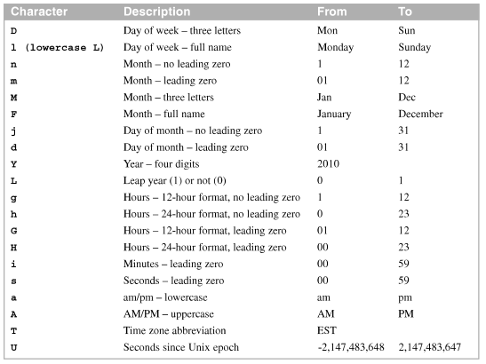
How to create and format timestamps (cont.)
Common format codes for the date() function

Slide 6
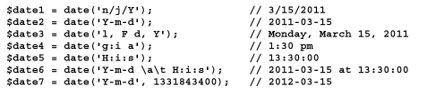
How to create and format timestamps (cont.)
How to format a timestamp

Slide 7
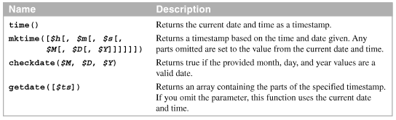
How to work with timestamps
Functions for working with timestamps

Slide 8

How to work with timestamps (cont.)
How to create a timestamp
How to validate a date
How to validate a time
A custom function for validating time
A statement that calls the custom function

Slide 9
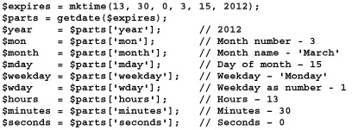
How to work with timestamps (cont.)
How to get the parts of a timestamp

Slide 10
How to use the strtotime() function
A strtotime() function is one of the most versatile date and time functions in just about any programming language.
An absolute template specifies a specific date, time, or both
A relative template specifies an offset to the base date and time.

Slide 11
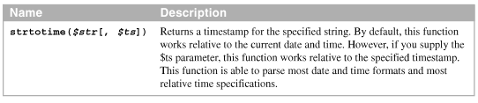
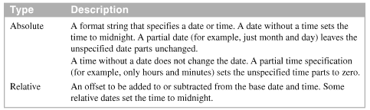
How to use the strtotime() function (cont.)
The strtotime() function
Types of templates used in strtotime

Slide 12
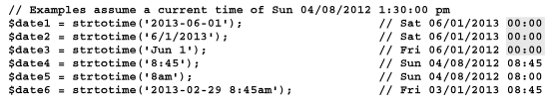
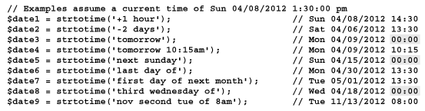
How to use the strtotime function (cont.)
How to generate a timestamp with an absolute template
How to generate a timestamp with a relative template

Slide 13

How to use the strtotime function (cont.)
How to modify a timestamp

Slide 14


Examples of working with timestamps
Determine if a year is a leap year
Display a simple message about an expiration date

Slide 15
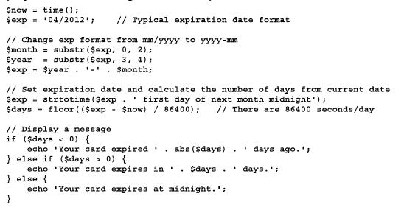
Examples of working with timestamps (cont.)
Display a detailed message about an expiration date

Slide 16
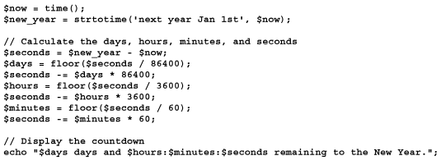
Examples of working with timestamps (cont.)
Display a countdown until the New year

Slide 17
How to use objects to work with dates

Slide 18

How to use the DateTime class
The DateTime class provides an object-oriented way to work with dates and times
How to create a DateTime object
Using the current date and time
Using a strtotime format string

Slide 19
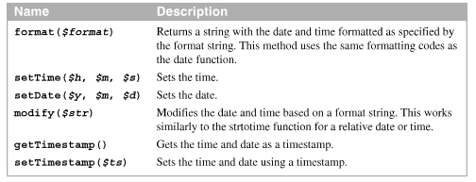
How to use the DateTime class (cont.)
Method of a DateTime object

Slide 20
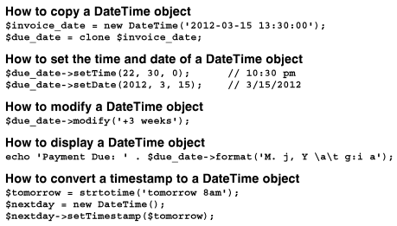
How to use the DateTime class (cont.)
How to use the methods of a DateTime object

Slide 21
How to use the DateInterval
A date interval represents a span of time, or a period of time, rather than a point in time.
Use a dateInterval object to represent a time span called a date interval.
Display a date part with a leading zero, change its format code to uppercase.
How to create a DateInterval object

Slide 22
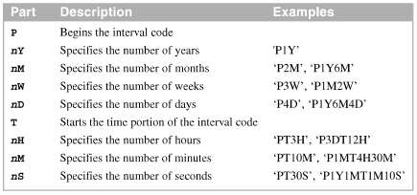
How to use the DateInterval (cont.)
The parts of the interval string
How to use interval strings

Slide 23

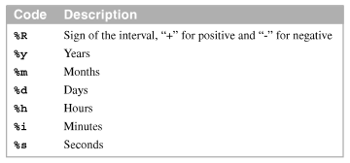
How to use the DateInterval (cont.)
The format method of a DateInterval object
Format codes for the DateInterval format method

Slide 24

How to use the DateInterval (cont.)
How to display a date interval

Slide 25
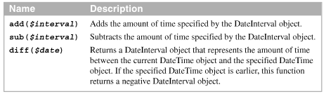

How to use the DateInterval and DateTime classes together
Methods of a DateTime object that use DateInterval objects.
How to add a dateInterval object to a DateTime object

Slide 26


How to use the DateInterval and DateTime classes together (cont)
How to subtract a DateInterval object from a DateTime object
How to determine the amount of time between two dates

Slide 27

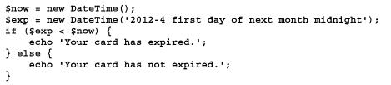
Example of working with DateTime object
Determine if a year is a leap year
Display a simple message about an expiration date

Slide 28
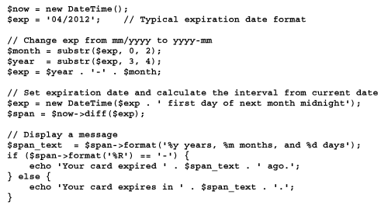
Example of working with DateTime object (cont.)
Display a detailed message about an expiration date

Slide 29
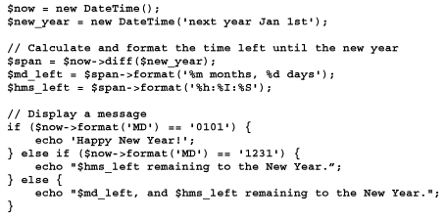
Example of working with DateTime object (cont.)
Display a countdown until the New year

Slide 30
Summary
A timestamp is an integer that represents a date and time
Use functions to create and format timestamp. You can use function to validate a date and to store the part of a date in an array
The Datetime class provides an object-oriented way to work with dates and times
A date interval is a span of time, not a point in time, that can be stored in a dateInterval object

