Slide 1
Session 2
How to code a PHP application

Slide 2
Objectives
Basic PHP skills
How to get data from a request
How to work with data: Variable and DataType
How to code control statements: If, Loop statement
The Future Value application
How to use the PHP documentation
Notes:
Mô tả nội dung mà học viên phải đạt được khi kết thúc môn học này

Slide 3
Basic PHP skills
Notes:
Mô tả nội dung chi tiết từng chuyên đề

Slide 4
How to embed PHP in HTML
To embed PHP within HTML, code a PHP tag by beginning with <?php and ending with ?>. The PHP codes are between these tag
To processing before displaying the HTML, you embed PHP before the start of the HTML document.
Use PHP to display dynamic data within an HTML, you embed PHP within the HTML.

Slide 5
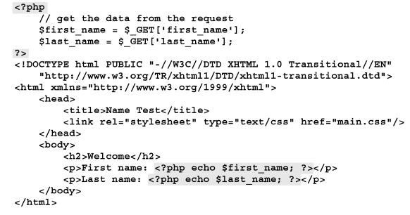
How to embed PHP in HTML (cont.)
A PHP file that includes HTML and embedded PHP

Slide 6
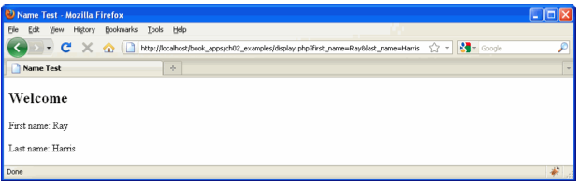
How to embed PHP in HTML (cont.)
The PHP file displayed in a browser

Slide 7
How to code comments and statements
PHP has a syntax that’s similar to the syntax of Java or JavaScript.
A statement controls the operations of a program.
A comment helps document what the code does.
To code a single-line comment, code two forward slashes (//) or a pound sign (#) and continue until the end of the line.
To code a multiple-line comment code /*…*/

Slide 8
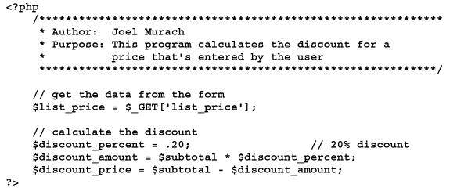
How to code comments and statements (cont.)
PHP code that includes comments and statements

Slide 9
How to code comments and statements (cont.)
Syntax rules
PHP statements end with a semicolon
PHP ignores extra whitespace in statements.

Slide 10
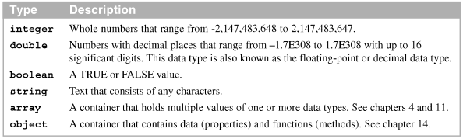
The six PHP data types
PHP provides for the six data types

Slide 11
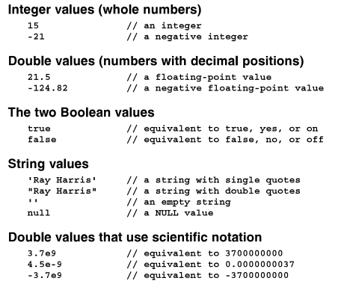
The six PHP data types (cont.)
Example

Slide 12
How to declare variables and constants
A variables stores a value that can change as the application executes
To declare a variable.
$variable_name = values
The assignment operator
= : Assigns a value to the variable

Slide 13
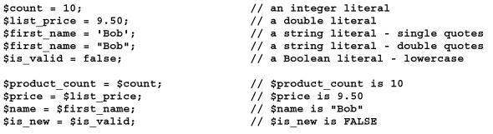
How to declare variables and constants (cont.)
Rules for creating variable names
Variable names are case-sensitive
Variable names can contain letters, numbers, and underscores
Variable names can’t contain special characters

Slide 14

How to declare variables and constants (cont.)
Variable names can’t begin with a digit or two underscores
Variable names can’t use names that are reserved by PHP such as the variables named $this that’s reserved for use with objects
The value of a constant can’t be changed. To declare a constant, use the defined function to specify the name and value of the constant

Slide 15
How to get data from a request

Slide 16

How to use the built-in $_GET array
The built-in $_GET array
When an HTML <form> tag uses the GET method to pass data to a PHP file, the values are stored in a $_GET array.
The $_GET variable is an array that contains the keys and values for the data that is passed with the HTTP request.
The $_GET variable is a superglobal variable

Slide 17
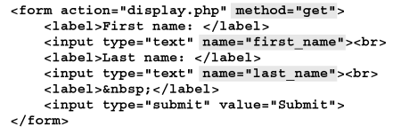
How to use the built-in $_GET array (cont.)
An HTML form that performs an HTTP GET request
The URL for the HTTP GET request with appended key/value pairs

Slide 18


How to use the built-in $_GET array (cont.)
The $_GET array that created when the GET request is received
PHP code that gets the data from the array and stores it in variables
An <a> tag that performs an HTTP GET request

Slide 19

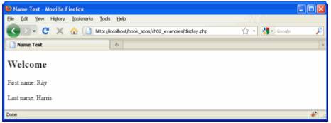
How to use the built-in $_POST array
The HTTP POST method works like the GET method but the parameters aren’t appended to the URL.
The built-in $_POST array
A PHP page for an HTTP POST request

Slide 20

How to use the built-in $_POST array (cont.)
An HTML form that specifies the POST method
PHP code that gets the data from the $_POST array
When to use the HTTP GET method
When the request is for a page that writes data to a database server
When the request can be executed multiple times without causing any problems

Slide 21
How to use the built-in $_POST array (cont.)
When to use the HTTP POST method
When the request is for a page that writes data to a database server
When executing the request multiple times my cause problems
When you don’t want to include the parameters in the URL for security reasons
When you don’t want users to be able to include parameters when they bookmark on page
When you need to transfer more than 4KB of data.

Slide 22
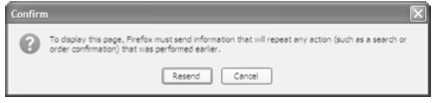
How to use the built-in $_POST array (cont.)
The Firefox dialog box that’s displayed if the user tries to refresh a post.

Slide 23
How to work with data

Slide 24
How to code string expressions
An expression can be a single value or a series of operations that result in a single value

Slide 25
How to code echo statements
The syntax for the echo statement
How to use an echo statement within HTML
How to use an echo statement to output HTML tags and data

Slide 26
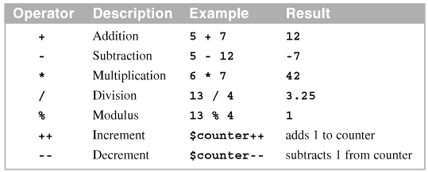
How to code numeric expressions
The operators for coding numeric expressions.
Common arithmetic operators

Slide 27
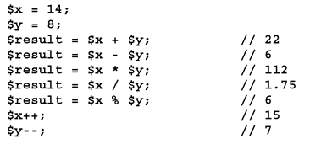

How to code numeric expressions (cont.)
Some simple numeric expressions
Statements that calculate a discount

Slide 28
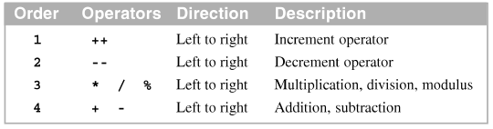
How to code numeric expressions (cont.)
The order of precedence for arithmetic expressions
Examples of precedence and the use of parentheses

Slide 29
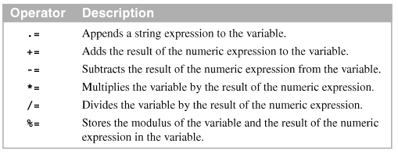
How to use the compound assignment operators
To perform an operation on a variable and assign the result to the same variable, you can use a compound assignment operators

Slide 30
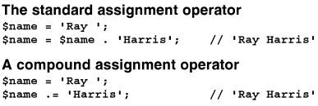
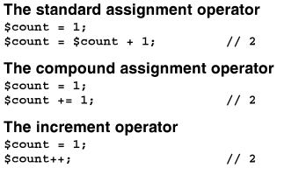
How to use the compound assignment operators (cont.)
Two ways to append string data to a variable
Three ways increment a counter variable

Slide 31
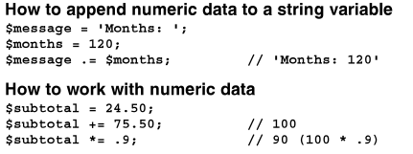
How to use the compound assignment operators (cont.)
More example

Slide 32
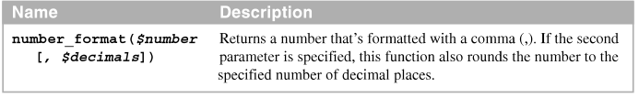

How to use some built-in function
PHP provides many built-in functions that can be used to do a wide variety of tasks.
A function for formatting numbers
Statements that format numbers

Slide 33

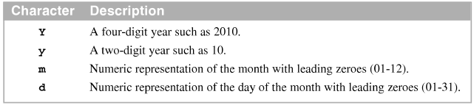
How to use some built-in function (cont)
A function for getting the current date
Commonly used characters for formatting a date
Statements that format a date

Slide 34

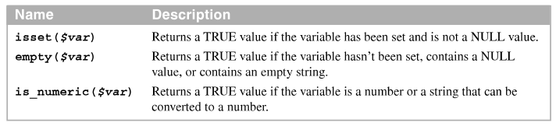
How to use some built-in function (cont.)
Three functions for checking variable values
Function calls that check variable values

Slide 35
The Product Discount application

Slide 36
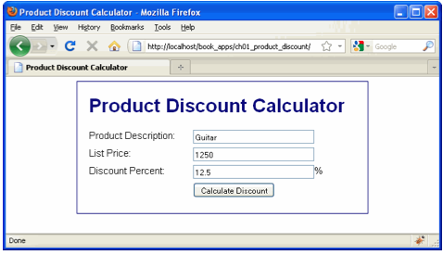
The form in the HTML file
The first page (index.html)

Slide 37
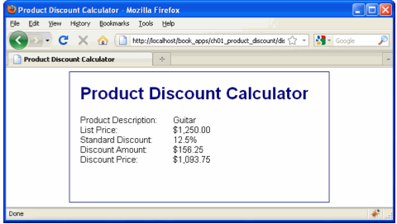
The form in the HTML file (cont.)
The second page (product_discount.php)

Slide 38
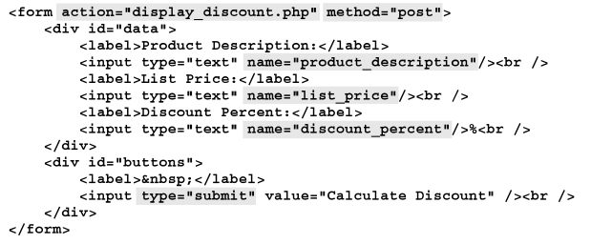
The form in the HTML file (cont.)
The code for the form on the first page

Slide 39
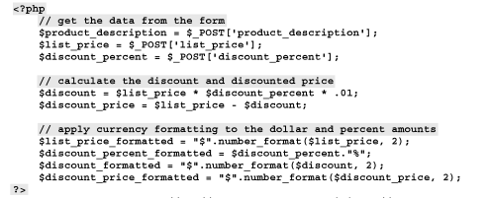
The PHP file
The PHP file (display_discount.php)

Slide 40
How to code control statements

Slide 41
How to code conditional expressions
A conditional expression uses the relational operators to compare the results of two expressions
A compound conditional expression joins two or more condition expressions using the logical operators

Slide 42
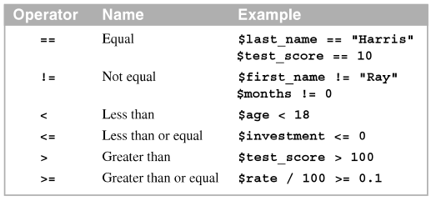
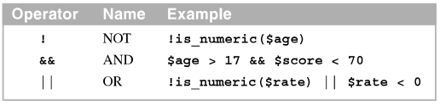
How to code conditional expressions (cont.)
The relational operators
The logical operators in order of precedence

Slide 43
How to code conditional expressions (cont.)
How the logical operators work
Both tests with the AND operator must be TRUE for the overall test to be TRUE.
At least one test with the OR operator must be TRUE for the overall test to be TRUE
The NOT operator switches the result of the expression to the other Boolean value
To override the order of precedence when two or more logical operator are used in a conditional expression, you can use parentheses.

Slide 44

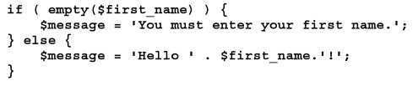
How to code if statements
An if statement starts with an if clause and include multiple else if clause and one else clause at the end.
An if statement with no other clauses
An if statement with an else clause

Slide 45
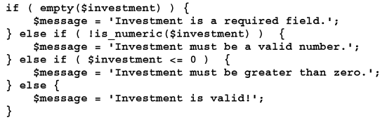
How to code if statements(cont.)
An if statement with else if and else clauses
An if statement with compound conditional expression

Slide 46
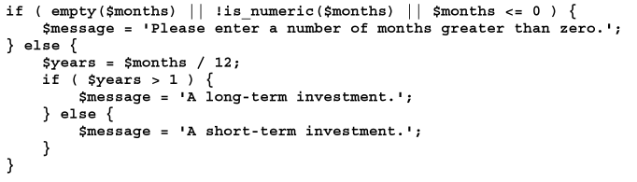
How to code if statements(cont.)
A nested if statement

Slide 47
How to code while and for statements
The while statement is used to create a while loop that contains a block of code that is executed as long as a condition is TRUE. This condition is tested at the beginning of the loop. When the condition becomes FALSE, PHP skips to the code after the while loop.
A while loop that stores the numbers from 1 through 5 in a string

Slide 48
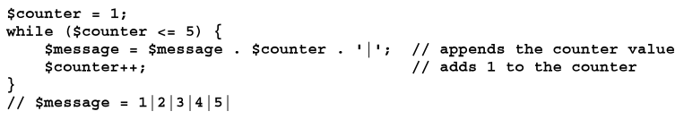
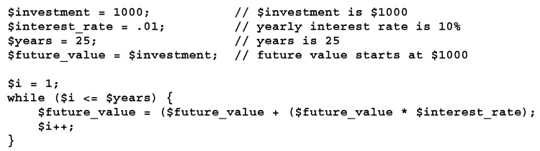
How to code while and for statements (cont.)
A while loop that calculates the future value of a one-time investment

Slide 49

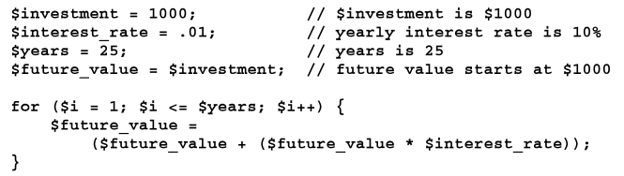
How to code while and for statements (cont.)
A for loop that stores the numbers from 1 through 5 in a string
A for loop that calculates the future value of a one-time investment.

Slide 50
How to pass control to another page
You can use the include and require functions to pass control to another web page. When that page finishes, control returns to the statement after the include or require function.
Built-in functions that you can use to pass control to another page.

Slide 51
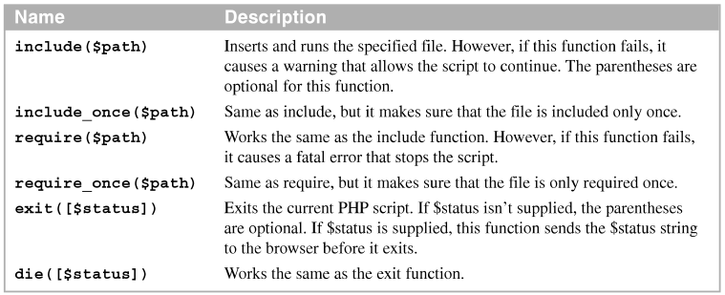
How to pass control to another page (cont.)

Slide 52
How to pass control to another page (cont.)
The include function
The require function
The exit function

Slide 53


How to pass control to another page (cont.)
How to pass control to another PHP file in the current directory
How to navigate up and down directories

Slide 54
The Future Value application

Slide 55
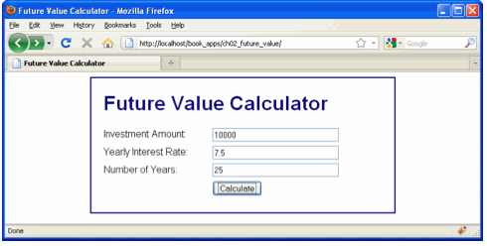
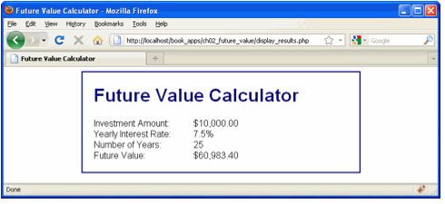
The user interface
The first page
The second page

Slide 56
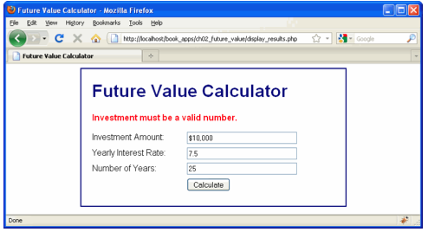
The user interface (cont.)
The first page with an error message

Slide 57
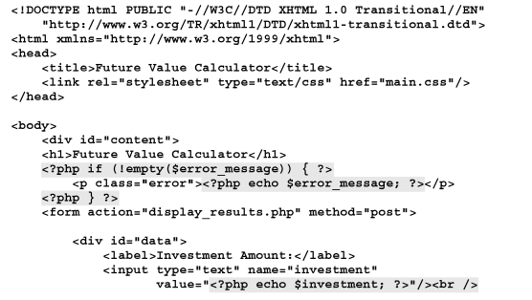
The code for the index.php file
………

Slide 58
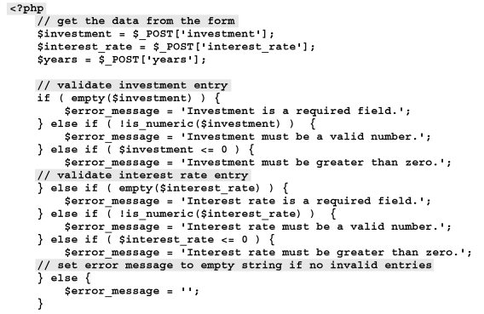
The code for the display_result.php
……….

Slide 59
How to use the PHP document

Slide 60
How to access the PHP manual

Slide 61
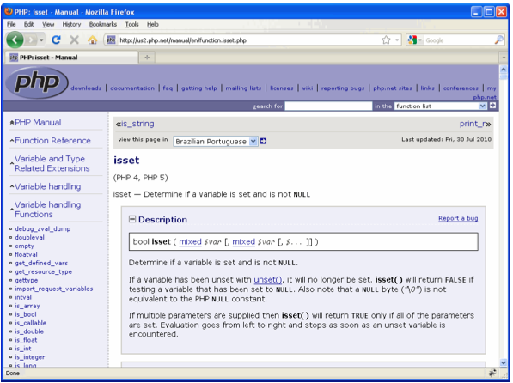
How to find the documentation you need
The URL for the PHP documentation
Documentation for the if statement

Slide 62
How to find the documentation you need (cont.)
How to access the PHP manual
How to use the PHP manual
How to find the documentation for a function when you know its name

Slide 63
Summary
Data type in PHP
Declare a variable and assign a value
Use the built-in arrays named $_GET or $_POST
Built-in functions in PHP to formatting numbers, getting the current date and checking variable values.
Use conditional expression, relational operators and logical operators.
Description and syntax of if statement, consist of if, else if and else clauses, nested if statements.

Slide 64
Summary (2)
Use while loop and for loop in PHP
The built-in include, require, and exit function can be used to pass control from one PHP page to another.

