Slide 1
Session 5
How to use the MVC pattern to organize your code

Slide 2
Objectives
How to use the MVC pattern
The Product Manager application
The Product Catalog application
Notes:
Mô tả nội dung mà học viên phải đạt được khi kết thúc môn học này

Slide 3
How to use the MVC pattern
Notes:
Mô tả nội dung chi tiết từng chuyên đề

Slide 4
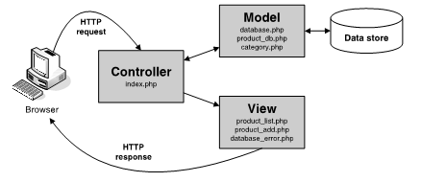
An introduction to the MVC pattern
The MVC pattern
Notes:
Mô tả nội dung chi tiết từng chuyên đề

Slide 5
An introduction to the MVC pattern (cont.)
The MVC (Model – View – Controller) pattern is commonly used to structure web applications that have significant processing requirements.
The model consist of the PHP files that represent the data of the application
The View consist of the HTML and PHP files that represent the user interface of the application
The controller consists of the PHP files that receive requests from users, get the appropriate data from the model and return the appropriate views to the user.

Slide 6

How to code the functions
The syntax
A function with no parameter that returns a PDOStatement object
function get_products(){
  Global db;
  $query = “SELECT productCode, productName, listPrice
  FROM products;
  $statement = $db->prepare($query);
  $statement->execute();
  $product = $statement->fetchAll();
  $statement->closeCursor();
  return $products;
}

Slide 7
How to code the functions(cont.)
A function with one parameter that returns an array products
function get_products_by_category($category_id){
  Global db;
  $query = “SELECT * FROM products
  WHERE products.categoryID= :category_id;
  ORDER BY productID;
  $statement = $db->prepare($query);
  $statement->bindValue(‘:category_id’,$category_id);
  $statement->execute();
  $product = $statement->fetchAll();
  $statement->closeCursor();
  return $products;
}

Slide 8
How to code the functions(cont.)
A function with four parameters that add a products
function add_product($category_id,$code,$name,$price){
  Global db;
  $query = “INSERT INTO products(categoryID,
  productCode, productName, listPrice)
  VALUES(:category_id,:code,:name,:price)”;
  $statement = $db->prepare($query);
  $statement->bindValue(‘:category_id’,$category_id);
  $statement->bindValue(‘:code’,$code);
  $statement->bindValue(‘:name’,$name);
  $statement->bindValue(‘:price’,$price);
  $statement->execute();
  $statement->closeCursor();
}

Slide 9
How to code the functions (cont.)
How to call a function
  A function call with no arguments and a returned PDOStatement object
  A function call with one argument and an array
  $products=get_products_by_category($category_id);
  A function call with four arguments and no returned value
  add_product($category_id,$code,$name,$price);

Slide 10
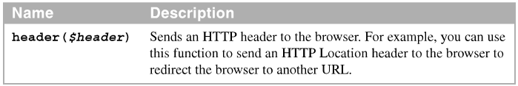
How to redirect requests
The include function to forward a request from one PHP file to another.
When you forward a request, all of the processing takes place on the server.
A built-in function that you can use to redirect a request.

Slide 11
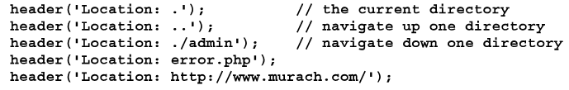
How to redirect requests (cont.)
The header function
How to redirect a request
if($action==‘delete_product’){
$product_id=filter_input(INPUT_POST,’product_id’,
FILTER_VALIDATE_INT);
if($product_id !=NULL || $product_id !=FALSE){
delete_product($product_id);
header(“Location: .”)
}
}

Slide 12
How to redirect requests (cont.)
How to redirect a request that includes a parameter
if($action==‘delete_product’){
$product_id=filter_input(INPUT_POST,’product_id’,
FILTER_VALIDATE_INT);
if($category_id !=NULL || $category_id !=FALSE ||
$product_id !=NULL || $product_id !=FALSE ){
delete_product($product_id);
header(“Location: .?category_id=$category_id”);
}
}

Slide 13
How to redirect requests (cont.)
You can use the header function to redirect to another URL.

Slide 14
The Product Manager application

Slide 15
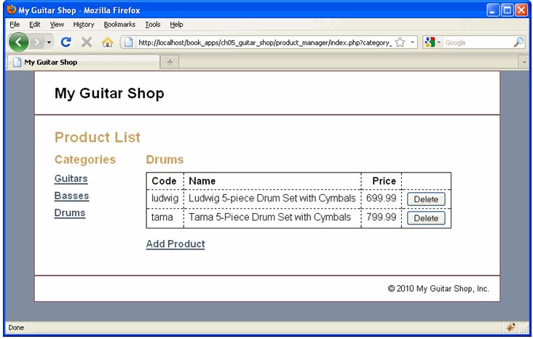
The User interface
The Product List page

Slide 16
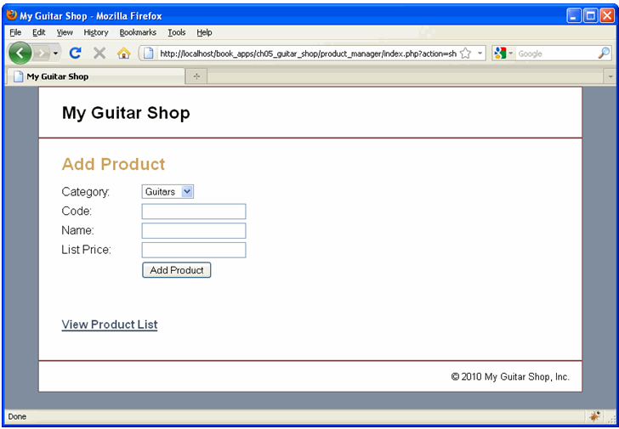
The User interface (cont.)
The Add Product page

Slide 17
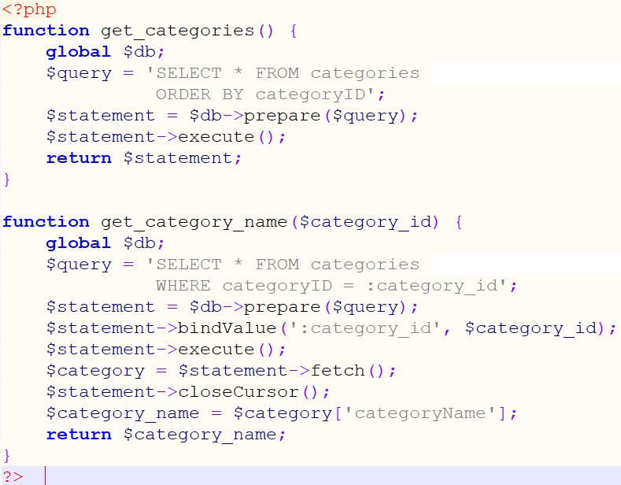
The model
The model/category_db.php file

Slide 18
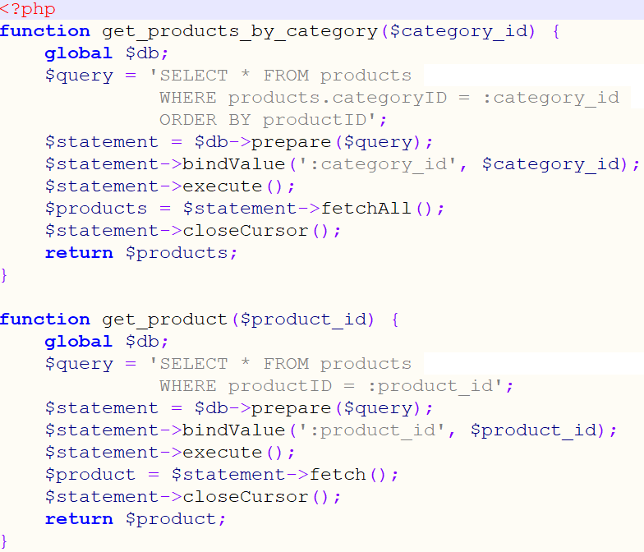
The model (cont.)
The model/product_db.php file

Slide 19
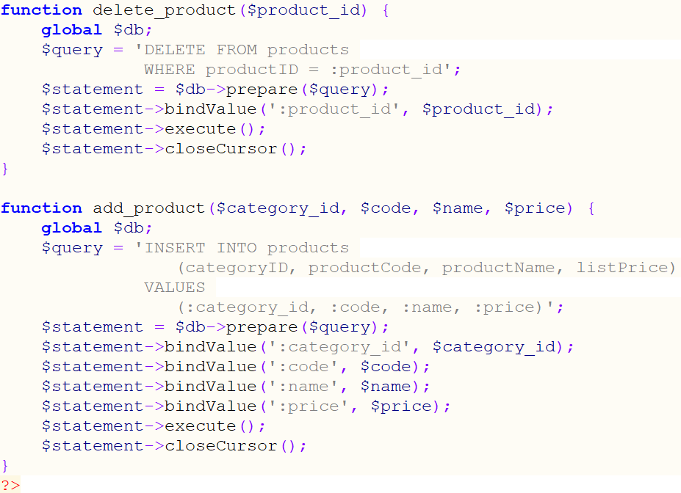
The model (cont.)

Slide 20
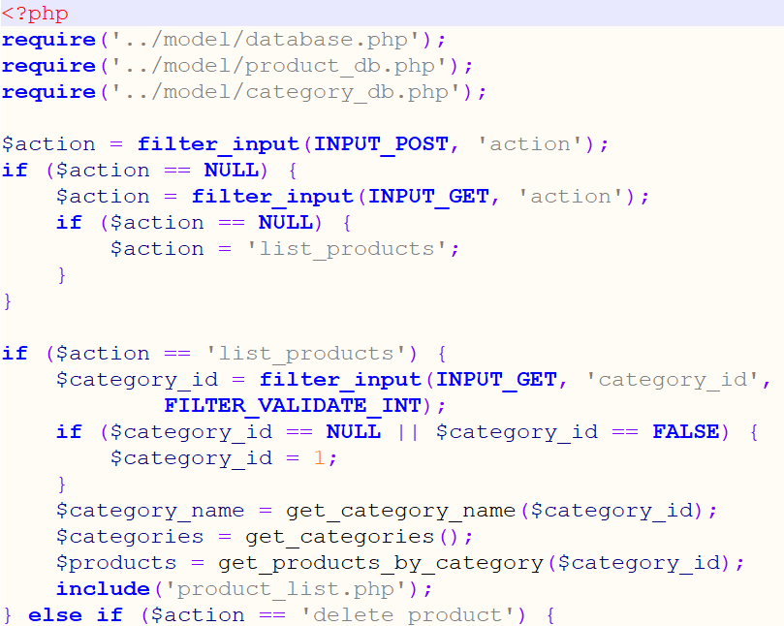
The controller
The product_manager/index.php file (the controller)

Slide 21
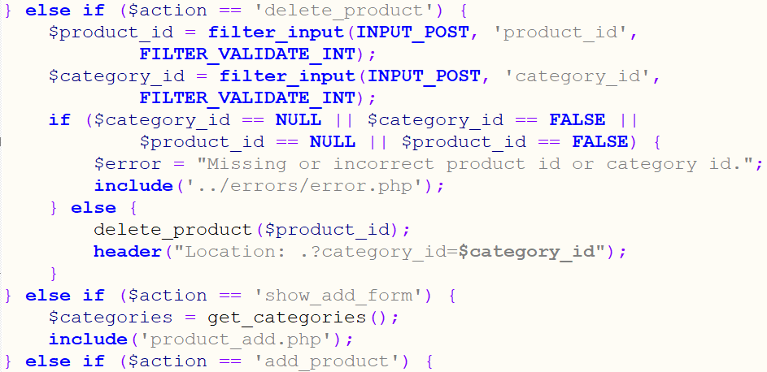
The controller (cont.)

Slide 22
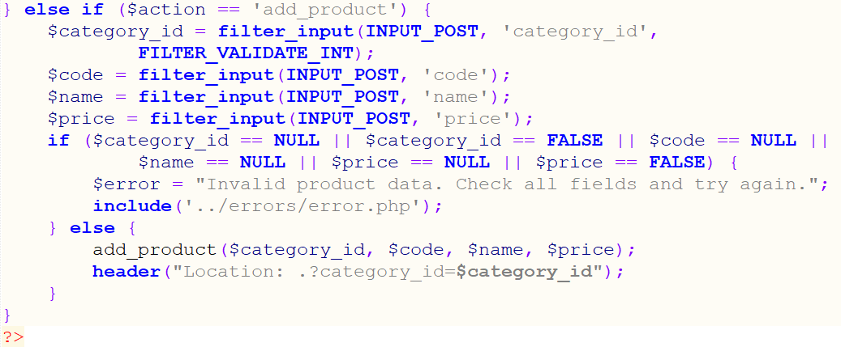
The controller (cont.)

Slide 23
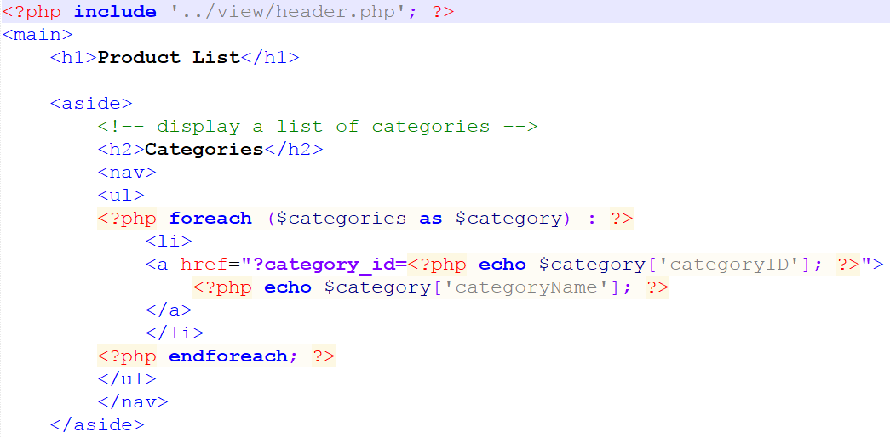
The View
The product_manager/product_list.php file

Slide 24
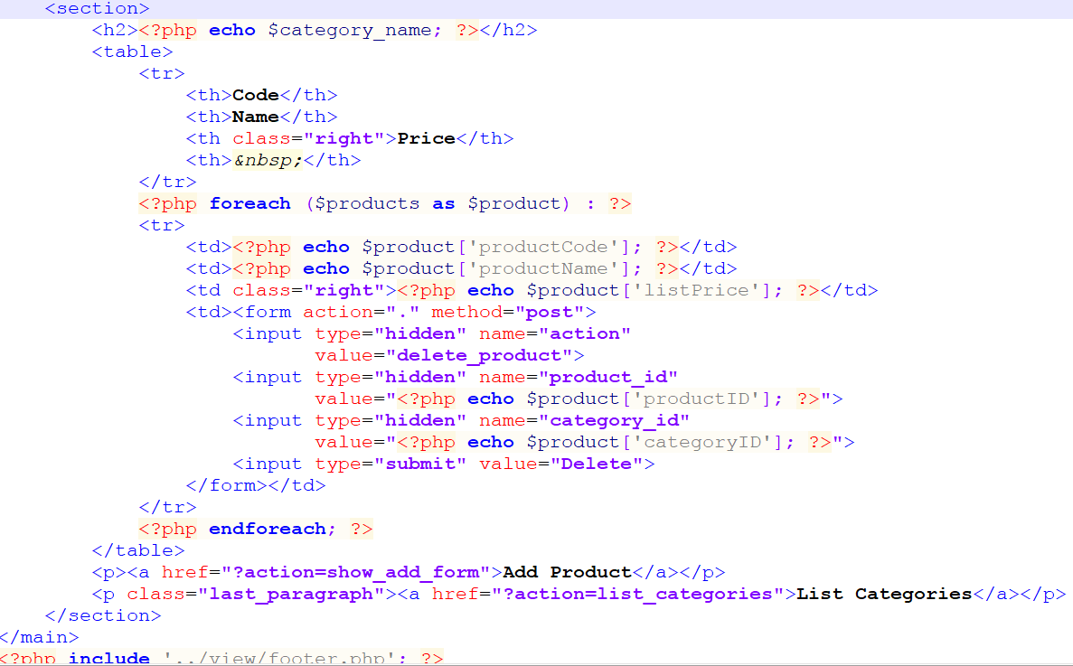
The View (cont.)

Slide 25
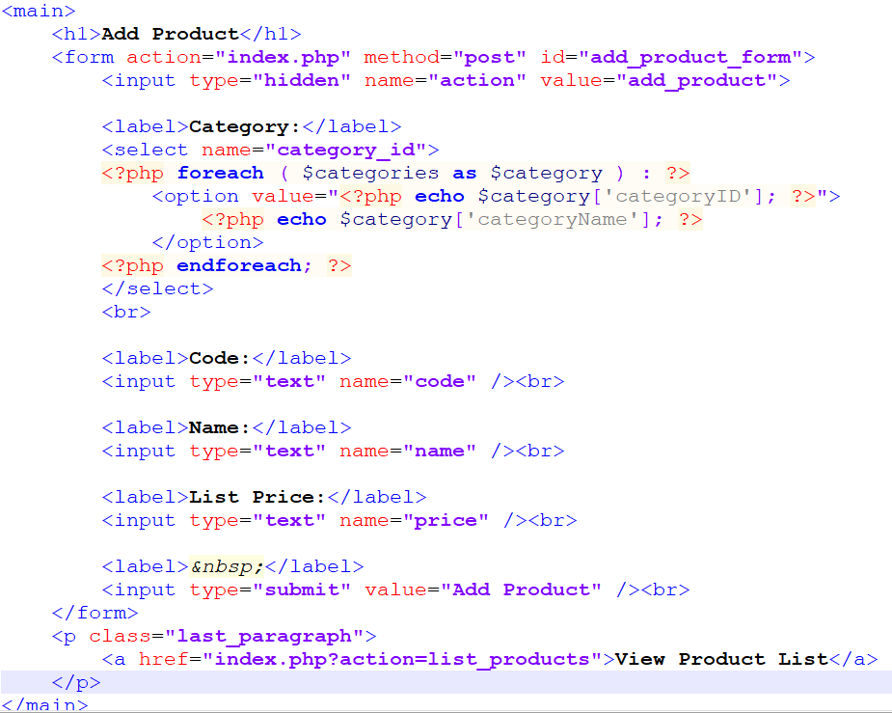
The View (cont.)
The product_manager/product_add.php file

Slide 26
The Product Catalog application

Slide 27
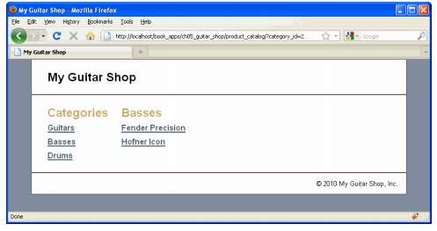
The user interface
The Product List page

Slide 28
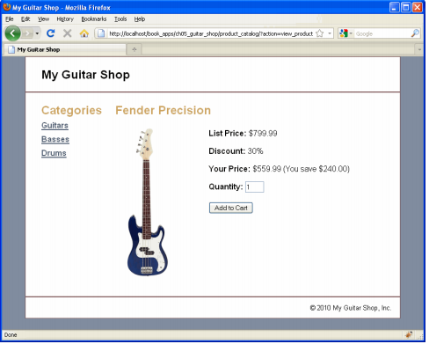
The user interface (cont.)
The Product page

Slide 29
The model
The same Model of Product

Slide 30
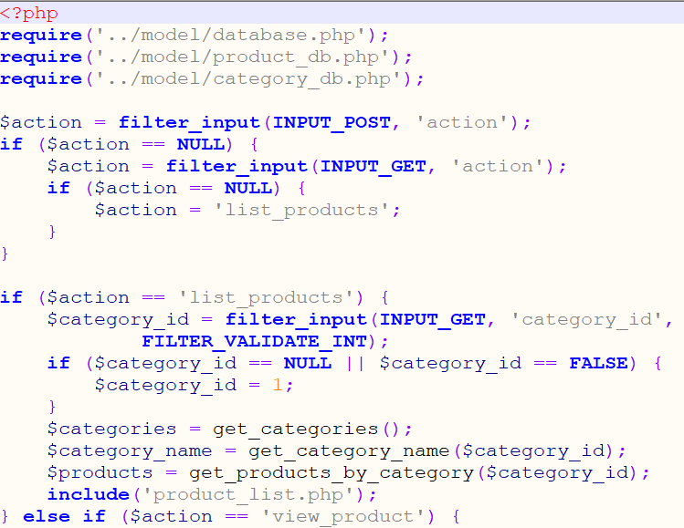
The controller
The product_catalog/index.php file

Slide 31
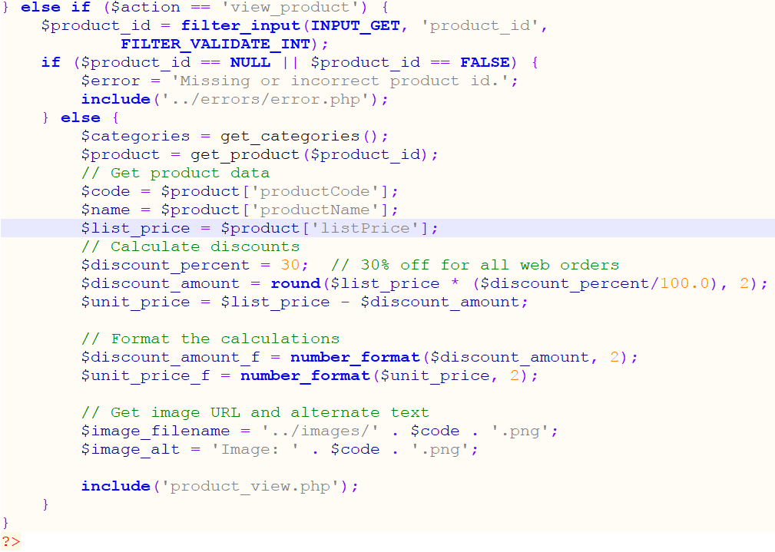
The controller (cont.)

Slide 32
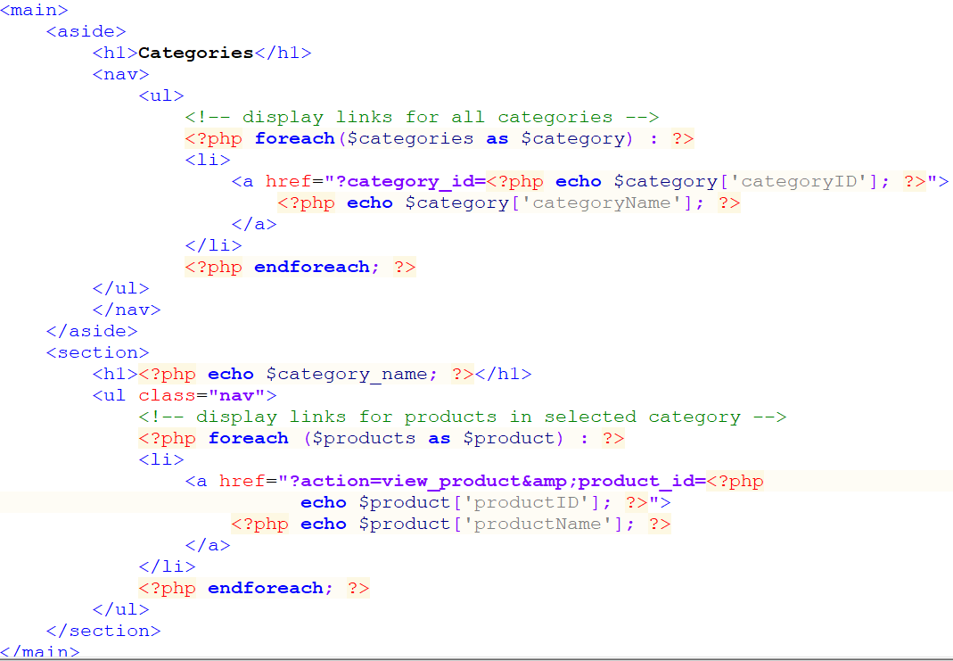
The view
The product_catalog/product_list.php file

Slide 33
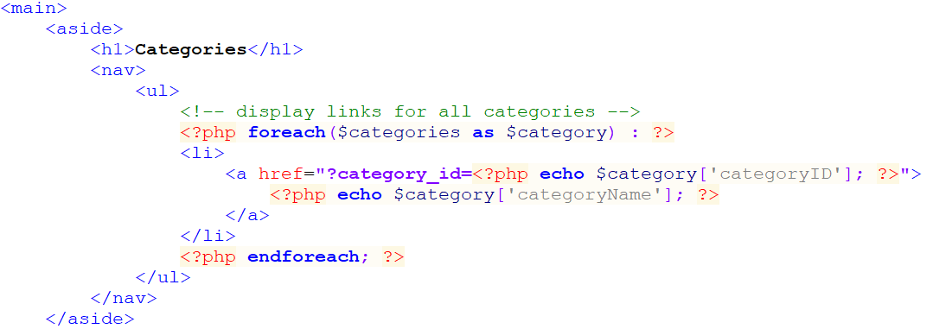
The view (cont.)
The product_catalog/product_view.php files

Slide 34
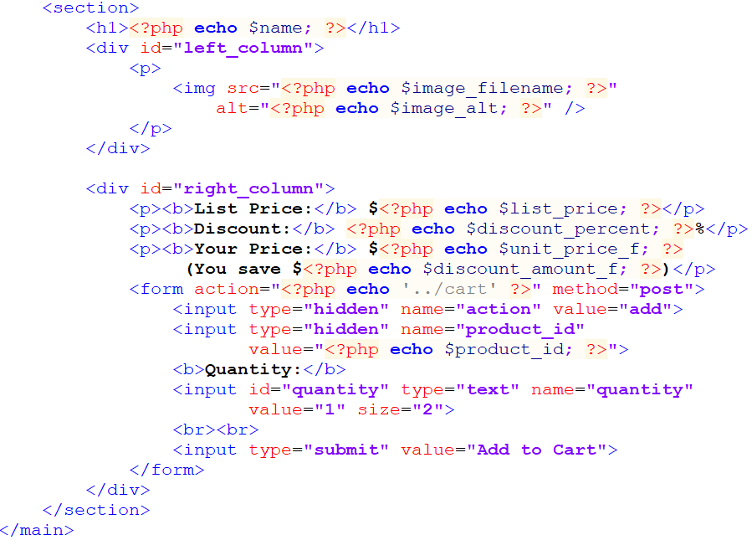
The view (cont.)

Slide 35
Summary
The MVC (Model-View-Controller) pattern is commonly used to structure web applications that have significant processing requirements
The model in the MVC pattern consists of the PHP files that represent the data of the application.
The View consists of the HTML and PHP files that represent the user interface of the application
The controller in the MVC pattern consists of the PHP files that get requests from users

Slide 36
Summary (2)
Create a function, you can code a parameter list within parentheses
A variable that’s declared outside of a function isn’t available within the function.
You can use the include function to forward a request from one PHP file to another.
You can use the header function to redirect a request to another URL.
In programming, modifying the organization or structure of an application is sometimes referred to as refactoring

