Slide 1
Session 6
How to test and debug
a PHP application

Slide 2
Objectives
An introduction to testing and debugging
How to debug with xDebug and NetBeans
Notes:
Mô tả nội dung mà học viên phải đạt được khi kết thúc môn học này

Slide 3
An introduction to testing and debugging

Slide 4
Typical test phases for a PHP application
In the first phases, as you test the user interface.
In the second phase, you should test the application with valid data.
In the third phase, you go all to make the application fail by testing every combination of invalid data and user action that you can think of.

Slide 5
The three types of errors that can occur
The goal of testing: To find all errors before the application is put into production.
The goal of debugging: to fix all errors before the application is put into production.
Three test phases
Check the user interface to make sure that it works correctly
Test the application with valid input data to make sure the results are correct
Test the application with invalid data or unexpected user actions.

Slide 6
The three types of errors that can occur (cont.)
The Three type of errors that can occur
Syntax errors
Runtime error
Logic errors

Slide 7
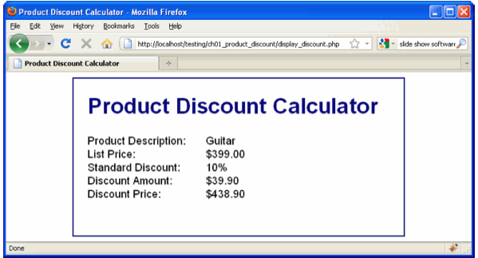
The three types of errors that can occur (cont.)
The Product Discount application with a logic error

Slide 8
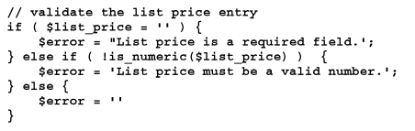
Common PHP errors
PHP code that contains errors

Slide 9
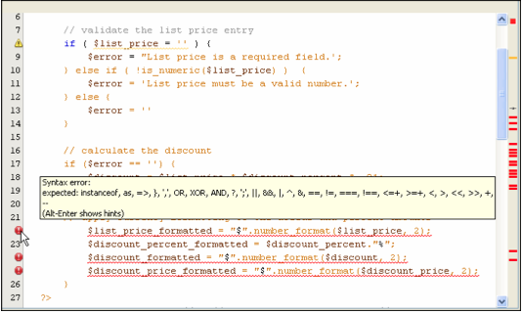
Common PHP errors (cont.)
The PHO code that contains errors in NetBeans

Slide 10
Common PHP errors (cont.)
Common syntax errors
Misspelling keywords
Forgetting an opening or closing parenthesis, bracket, brace, or comment character.
Forgetting to end a PHP statement with a semicolon
Forgetting an opening or closing quotation mark
Not using the same opening and closing quotation mark.

Slide 11
Common PHP errors (cont.)
Problems with variable names
Misspelling or incorrectly capitalizing a variable name
Using a keyword as a variable name
Problem with values
Not checking that a value is the right data type before processing it.
Using one equal sign instead of two when testing for equality.

Slide 12
An easy way to trace the execution of your PHP code
An easy way to trace the execution of a PHP application is to insert echo statements at key points in the code.
The echo statement can display the values of variables or display messages that indicate what portion of the code is being executed.
The incorrect value displayed, there is a good chance that you have a logic error between the current echo statement and the previous one.

Slide 13
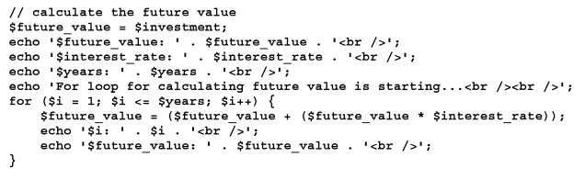
An easy way to trace the execution of your PHP code (cont.)
PHP with echo statements that trace the execution of the code

Slide 14
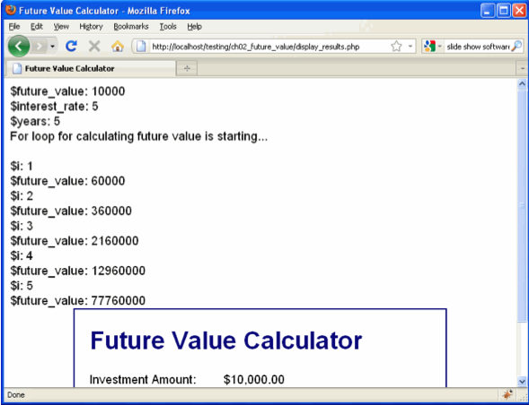
An easy way to trace the execution of your PHP code (cont.)
The data displayed in a browser

Slide 15
How to debug with xDebug and NetBeans

Slide 16
How to set and remove breakpoints
A code editor window with a breakpoint

Slide 17
How to set and remove breakpoints (cont.)
A breakpoint is indicated by a small red square.
Set a breakpoint.
Remove a breakpoint
Use the Debug Main project button on the toolbar to begin debugging.
When you begin debugging, NetBeans may display a dialog box that asks you want to debug.

Slide 18
How to step through code
When you run an application with the debugger, it stops when it encounters the first PHP statement in the application.

Slide 19
How to inspect variables
When you being a debugging session, NetBeans stops on the first PHP statement that it encounters.
At this point, you can use the buttons in the debugging toolbar to continue program execution.

Slide 20
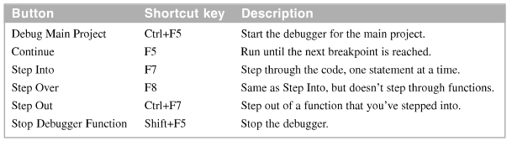
How to inspect variables (cont.)
The toolbar buttons and shortcut keys for stepping through the code

Slide 21
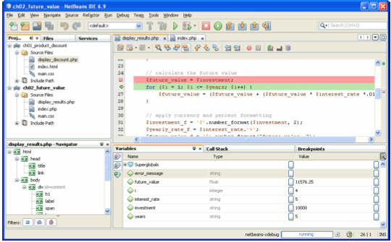
How to inspect variables (cont.)
A debugging session with variables displayed

Slide 22
How to inspect the stack trace
The Call Stack window show the stack trace, which is a list of function in the reverse order in which they were called.
A debugging session with a stack trace displayed.

Slide 23
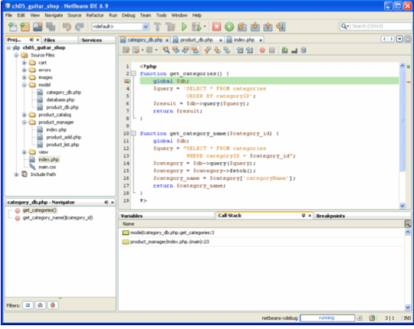
How to inspect the stack trace (cont.)

Slide 24
Summary
The goal of testing is to find all the errors in an application.
The goal of debugging is to fix all the errors before the application is put into production.
Three type of errors can occur when you test an application: syntax errors, runtime errors, and logic errors.
You can trace the execution of an application by inserting echo statement at appropriate.

Slide 25
Summary (2)
XAMPP includes a debugger known as xDebug that can be used with an IDE like Netbeans.
You can set breakpoints when you use a debugger.
You can get a stack trace when you use a debugger.

