Slide 1
Session 8
How to code control statements

Slide 2
Objectives
How to code conditional expressions
How to code the selection structures
How to code the iteration structures

Slide 3
How to code conditional expressions

Slide 4
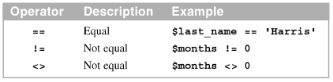
How to use the equality and identity operators
The equality operators perform type coercion. Type coercion converts data from one type to another.
The identity operators do not perform type coercion.
The equality operators

Slide 5
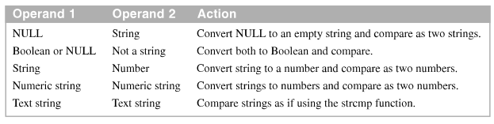
How to use the equality and identity operators (cont.)
PHP Type Coercion Rules

Slide 6
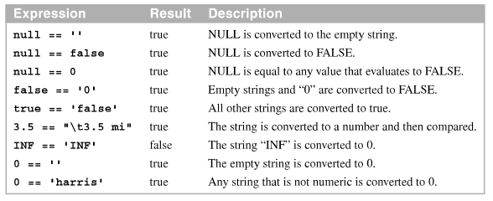
How to use the equality and identity operators (cont.)
Unusual results with the equality operator

Slide 7

How to use the equality and identity operators (cont.)
The identity operators

Slide 8
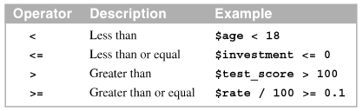
How to use the relational operators
The Relational operators perform type coercion when the two values are of different types.
The relational operators

Slide 9

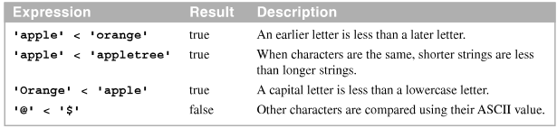
How to use the relational operators (cont.)
Comparing strings to numbers with the relational operators
Comparing strings with the relational operators

Slide 10
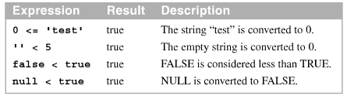
How to use the relational operators (cont.)
Unusual with the relational operators

Slide 11
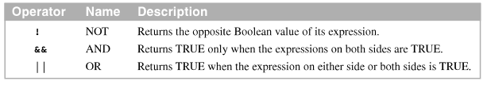
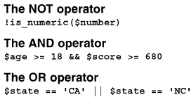
How to use the logical operators
The logical operators
The logical operators in compound conditional expressions

Slide 12
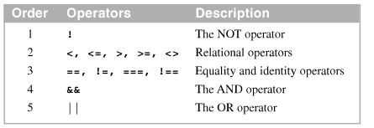
How to use the logical operators (cont.)
The order of precedence for operators in conditional expressions

Slide 13
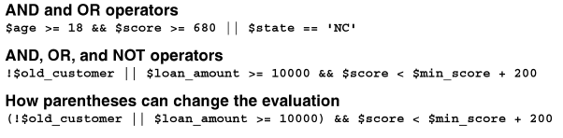
How to use the logical operators (cont.)
The logical operators in complex conditional expressions

Slide 14
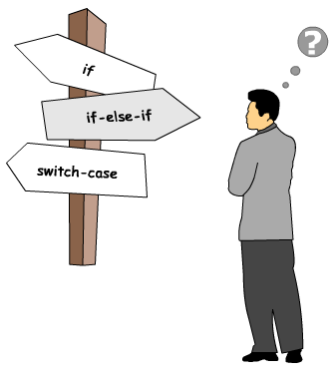

How to code the selection structures
Selection structure statements enable us to change the flow of the program
Selection structure statements supported by PHP:

Slide 15
if Statement
Syntax:
if (booleanExpression)
{statements}
[else if (booleanExpression)
{statements}]
[else {statements}]

Slide 16

How to code if statement with else clauses
When you have one statement after an if statement or an else clause.
An if clause with one statement and no braces
An if clause with one statement and braces
If and else clauses with one statement each and no braces

Slide 17
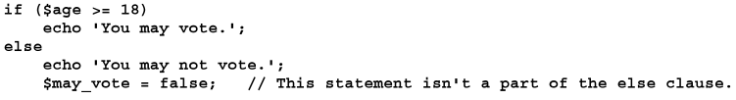
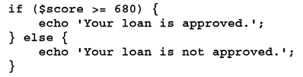
How to code if statement with else clauses (cont.)
Why you should always use braces with else clauses
Braces make your code easier to modify or enhance

Slide 18
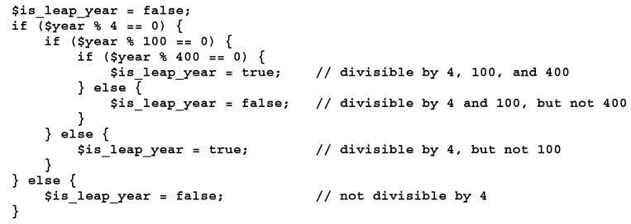
How to code if statement with else clauses (cont.)
A nested if statement to determine if a year is a leap year

Slide 19

How to code if statements with else if clauses
When coding an else if clause, you can code the else and if keywords with space or elseif no space.
An if statement with one else if clause

Slide 20
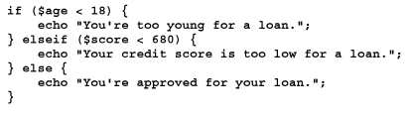
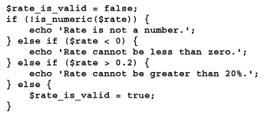
How to code if statements with else if clauses (cont.)
An if statement with an else if and an else clause
An if statement with two else if clauses and an else clause

Slide 21
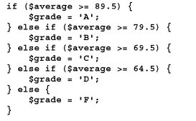
How to code if statements with else if clauses (cont.)
An if statement to determine a student’s letter grade

Slide 22
How to use the conditional operator
The conditional operator is PHP’s only ternary operator.
A ternary operator has three operands. This operator provides a compact way to code an if statement.
Syntax of the conditional operator

Slide 23
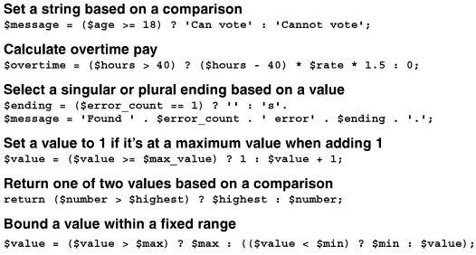
How to use the conditional operator (cont.)
Examples of using the conditional operator

Slide 24


How to use the conditional operator (cont.)
The first example rewritten with an if statement
The last example rewritten with an if statement

Slide 25
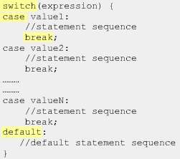
Switch-case statement
switch-case statement is used when a variable need to be compared against different values

Slide 26
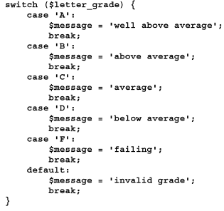
How to code switch statements
A switch statement is a convenient way to express a certain form of if statement.
A switch statement with a default case

Slide 27
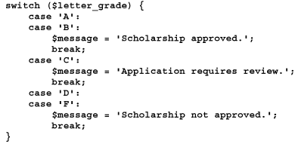
How to code switch statements (cont.)
A switch statement with fall through

Slide 28
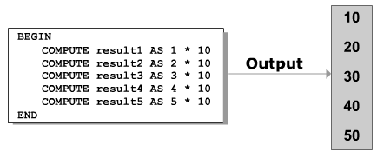
How code the iteration structures

Slide 29
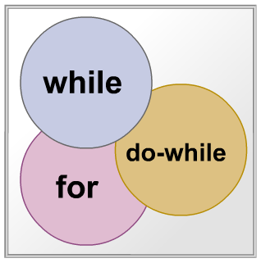
Types of Loops
A loop comprises a statement or block of statement s that are execute repeatedly until a particular condition evaluate to true or false

Slide 30
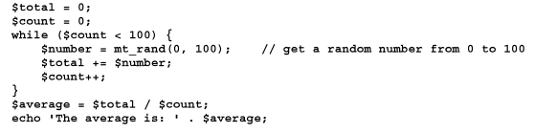
How to code while loops
The while statement executes the block of statements within its braces as long as its conditional expression is TRUE.
A while loop that finds the average of 100 random numbers

Slide 31

How to code while loops (cont.)
A while loop that counts dice rolls until a six is rolled

Slide 32
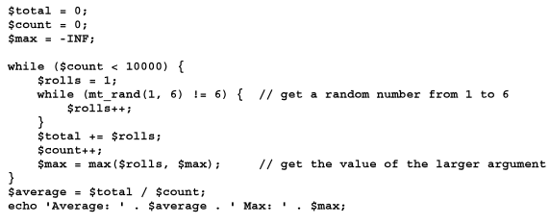
How to code while loops (cont.)
Nested while loops that get the average and maximum rolls for a six

Slide 33

How to code do-while loops
The do-while statement executes the block of statements within its braces as a long as its conditional expression is TRUE.
The condition is tested at the end of the do-while loop.
A do-while loop counts dice rolls until a six is rolled.

Slide 34
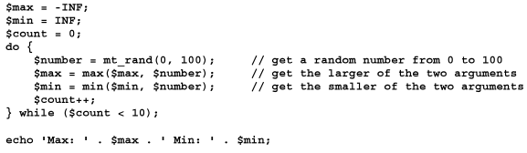
How to code do-while loops (cont.)
A do-while loop to find the max and min of 10 random values

Slide 35
How to code for loops
A for loop provides a convenient way to code a loop that requires a counter variable.
The for statement is useful when you need to increment or decrement a counter that determines how many times the for loop is executed

Slide 36
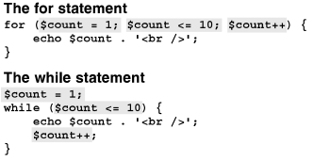
How to code for loops (cont.)
The for statement compared to the while statement

Slide 37


How to code for loops (cont.)
A for loop to display even numbers from 2 to 10
A for loop to display all the factors of a number

Slide 38
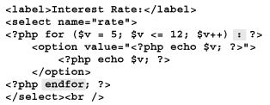
How to code for loops (cont.)
A for loop that uses the alternate syntax to display a drop-down list

Slide 39
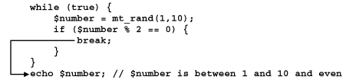
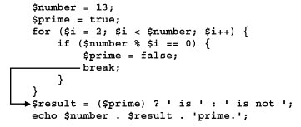
How to use the break and continue statements
The break statement ends a loop. In other words, it jumps out of the loop.
The break statement in a while loop
The break statement in a for loop

Slide 40
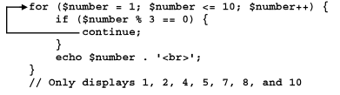
How to use the break and continue statements (cont.)
The continue statement ends the current iteration of a for or while loop, but allow the next iteration to proceed. In other words, it jump to the start of the loop.
The continue statement in a for loop

Slide 41
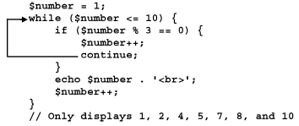
How to use the break and continue statements (cont.)
The continue statement in a while loop

Slide 42
Summary
The equality use type coercion. The identity operators don’t use type coercion.
Use equality operators, identify operators, relational operators, logical operators, and arithmetic operators.
Use the selection structure and switch statement to implement the case structure.
Use iteration structure are while loops, do-while loops, and for loops.

Slide 43
Summary (2)
The alternate syntax for a for loop is useful when you’re generating HTML code.
The break and continue statements are used to exit from a loop or to restart one.

