Slide 1
Session 9
How to work with
strings and numbers

Slide 2
Objectives
How to work with strings
How to work with numbers
Other skills for working with strings and numbers

Slide 3
How to work with strings

Slide 4

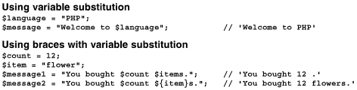
How to create strings
There are four ways to create strings.
Assign strings with single quotes
Assign strings with double quotes

Slide 5


How to create strings (cont)
Assign a string with a heredoc
Assign a string with a nowdoc

Slide 6
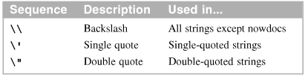
How to use escape sequences
Escape sequences provide a way to insert special characters into text strings. These escape sequences work differently depending on the type of the string.
Escape sequences only used in some strings

Slide 7
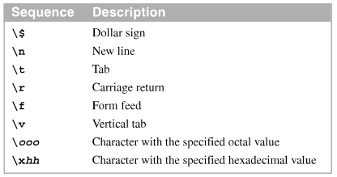
How to use escape sequences (cont.)
Escape sequences used in double-quoted

Slide 8
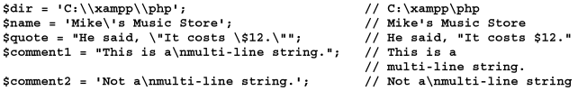
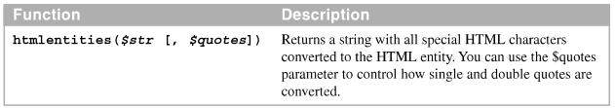
How to use escape sequences (cont.)
Examples of escape sequences with single quotes
The htmlentities function

Slide 9
How to use escape sequences (cont.)
Examples of the htmlentities function
An example that doesn’t use the htmlentities function
An example that uses the htmlentities function

Slide 10
How to work with string length and substrings
The length of a string is the number of characters in the string
A substring is a part of another string
To specify the position of a character from the left side of a string, use a positive integer value where 0 is the first character, 1 is the second character, and so on. To specify a position from the right side, use a negative integer value.

Slide 11
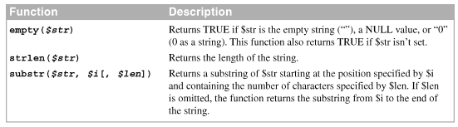
How to work with string length and substrings (cont.)
Functions for working with string length a substrings

Slide 12


How to work with string length and substrings (cont.)
Code that checks a string to determine if a string is empty
Code that gets the length of a string and two substrings

Slide 13


How to work with string length and substrings (cont.)
Code that formats a phone number in two ways
Code that displays each letter in a string on a separate line

Slide 14
How to search a string
You can use functions find the search string and return an integer that indicates the position where the string was found.
You must use the identity operator (===) or (==).

Slide 15
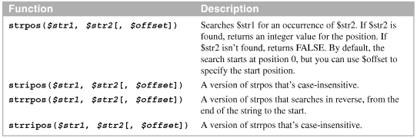

How to replace part of a string
Functions that search a string
Code that searches a string for spaces

Slide 16

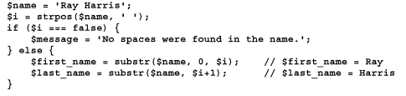
How to replace part of a string (cont.)
Code that searches a string for a substring
Code that splits a string into two substrings

Slide 17

How to replace part of a string (cont.)
Functions that replace part of a string
Code that replaces periods with dashes in a phone number
Code that replaces one string with another string

Slide 18
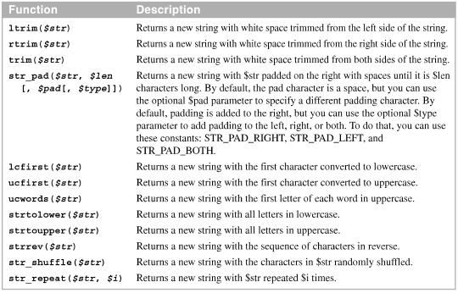
How to modify strings
Functions that modify strings

Slide 19
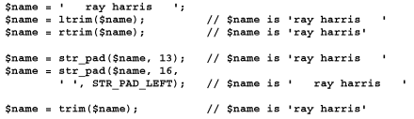

How to modify strings (cont.)
Code that trims and pads s string
Code that works with capitalization

Slide 20
How to modify strings (cont.)
Code that changes the sequence of the characters
Code that repeats a string

Slide 21
How to convert strings to and from arrays

Slide 22
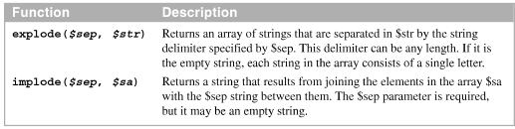
How to convert strings to and from ASCII values
The ASCII character set is a set of characters that provides for most characters, numbers, and symbols in the English language.
This characters set has an integer value that corresponds with each character
Functions that convert between strings and arrays

Slide 23

How to convert strings to and from ASCII values (cont.)
How to convert a string to an array
How to convert an array to a string
How to convert an array to a tab-delimited string

Slide 24



How to convert strings to and from ASCII values (cont.)
Functions that convert between strings and ASCII integer values
How to convert an integer value to a character
How to convert a character to an integer value

Slide 25
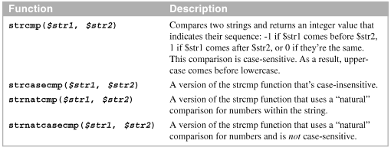
How to compare strings
You can use the compare function to determine the sequence of two strings.
Functions that compare two strings

Slide 26
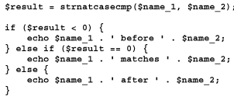
How to compare strings (cont.)
How a case-sensitive comparison works
How a “natural” number comparison works
How to compare two strings

Slide 27
How to work with numbers

Slide 28

How to assign integers
An integer is a number without a fractional part. Integer are also called whole numbers.
An integer may be positive, negative, or zero.
To assign an integer value, you can use decimal (base 10), octal (base 8), or hexadecimal (base 16) values.
How to assign a decimal value (base 10)

Slide 29
How to assign integers (cont.)
How to find the maximum and minimum integer values (base 10)
How to assign an octal value (base 8)
How to assign a hexadecimal value (base 16)

Slide 30
How to assign floating-point values
A floating-point number is a number with fractional part. Floating point numbers are also called floats, doubles, or real numbers.
A floating-point number has a bout 14 digits of precision and the exponent can typically range from -307 to 308.
The constants named INF and –INF represent infinite values

Slide 31


How to assign floating-point values (cont.)
How assign floating-point values
Using normal notation
Using exponential notation

Slide 32



How to assign floating-point values (cont.)
Two functions for working with infinity
Working with infinity
Getting an infinite value
Testing for an infinite value

Slide 33
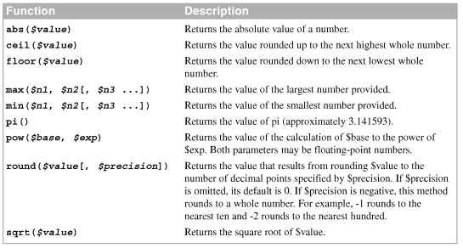
How to use the math functions
Common mathematical functions

Slide 34

How to use the math functions (cont.)
How to round a number
How to get the square root of a number
How to work with exponents

Slide 35


How to use the math functions (cont.)
How to calculate the distance between two points
How to place a maximum bound on a number

Slide 36
How to generate random numbers
Functions that generate random numbers
Function | Description
rand( $min, $max ) | Return a random integer between $min and $max.
mt_rand( $min, $max) | Work like rand() function, except that is uses the Mersenne Twister algorithm which is faster and more random than rand() function.
random_int( $min, $max ) | Work like rand() function, except that it return a random integer that’s cryptographically secure.

Slide 37
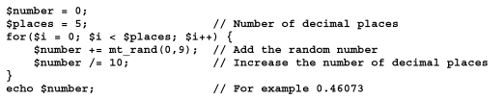
How to generate random numbers (cont.)
How to simulate a random dice roll
How to generate a random value between 0 and 1 with 5 decimal places

Slide 38
Other skills for working with strings and numbers

Slide 39
How to use the sprintf function to format strings and numbers
Within a sprintf function, the format string can contain one or more format codes
A format code always begins with the % sign and ends with a character that specifies the data type for the value
To code a percent sign (%) within a format string, code two percent signs.

Slide 40

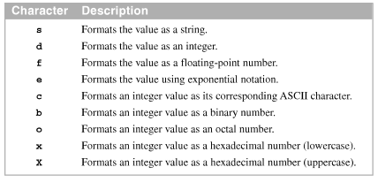
How to use the sprintf function to format strings and numbers (cont.)
The sprintf function
Data type code

Slide 41
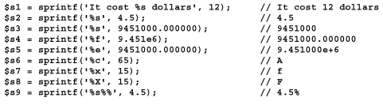
How to use the sprintf function to format strings and numbers (cont.)
A sprintf function that formats two values
How to use sprintf to convert numbers to strings

Slide 42
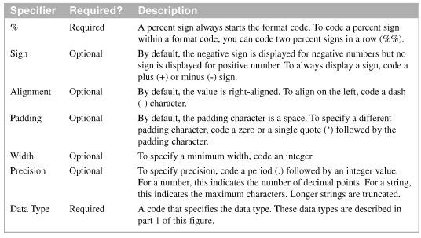
How to use the sprintf function to format strings and numbers (cont.)
The parts of a format code

Slide 43
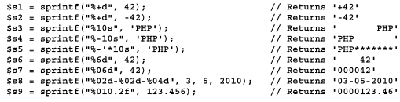

How to use the sprintf function to format strings and numbers (cont.)
How to use the optional specifies
How to generate a random HTML color

Slide 44
How to convert strings to numbers
Use type casting to convert, or cast, a value from one type to another.
Use the intval and floatval functions to convert a value from one type to another.
Converting strings to numbers, any text after the number is ignored.
Converting strings to float-point values, the string can use exponential notation.

Slide 45

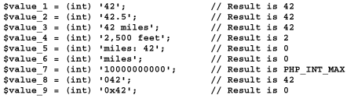
How to convert strings to numbers (cont.)
Two functions for converting strings to numbers
How to convert a string to an integer
Using type casting
Using the intval function

Slide 46

How to convert strings to numbers (cont.)
How to convert a string to a floating-point number
Using type casting
Using the floatval function

Slide 47
Summary
When you use PHP, you can create strings by using single quotes, double quotes with variable substitution, heredoc syntax, and nowdoc syntax
Escape sequences provide a way to insert special characters into text string
PHP provides many function for working with strings, including for getting the length and substrings of a string; for searching and replacing strings; for trimming, padding, and modifying strings; for converting strings to and from arrays
Notes:
Tóm tắt lại nội dung đã học

Slide 48
Summary(2)
And formatting strings based on format codes
PHP provides functions for working with both integer and floating-point number; function for generating random numbers
Use type casting to convert a string to an integer or floating-point number.

