Slide 1

Chapter 4
How to use CSS
to format the elements of a web page

Slide 2
Objectives
An introduction to CSS
How to specify measurements and colors
How to code selectors
How to work with Cascading Style Sheets
How to works with text
A web page that uses an external style sheets

Slide 3
An introduction to CSS

Slide 4
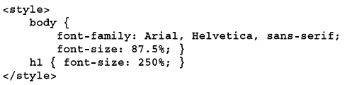
The ways to provide CSS style for a web page
The ways to provide style
Use an external style sheet by coding a link element in the head section
Embed the styles in the head section
Use the style attribute to apply styles to a single element
Notes:
Mô tả nội dung chi tiết từng chuyên đề

Slide 5

The ways to provide CSS style for a web page
A head element that includes two style sheets
The sequence in which styles are applied
From the first external style sheet to the last
How to specify the medium that an external; style is for
Notes:
Mô tả nội dung chi tiết từng chuyên đề

Slide 6
How to specify measurements
and colors

Slide 7
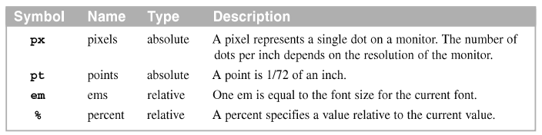
To specify measurements
You use units of measure to specify a variety of CSS properties, including font-size, line-height, width, margin, and padding
Common units of measure
rem | rems | relative | One rem is equal the font size for the root element.
Notes:
Mô tả nội dung chi tiết từng chuyên đề

Slide 8
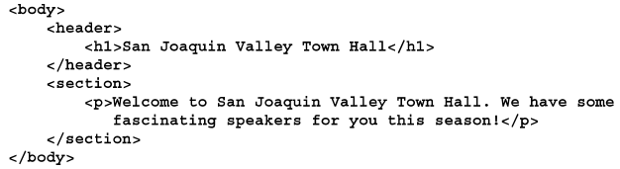
To specify measurements (cont.)
The HTML for a web page
Notes:
Mô tả nội dung chi tiết từng chuyên đề

Slide 9
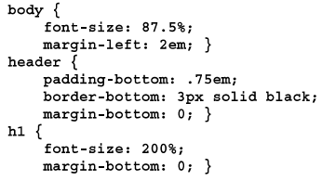
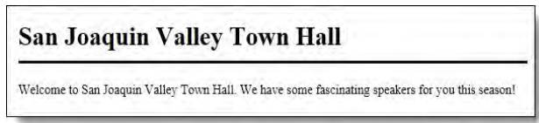
To specify measurements (cont.)
-The CSS that uses relative units of measure with a fixed border
The web page in a web browser
Notes:
Mô tả nội dung chi tiết từng chuyên đề

Slide 10
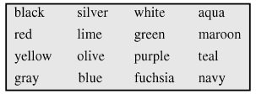
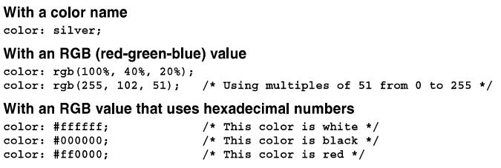
To specify colors
All browser support the 16 color names shown above
Three ways to specify colors
Notes:
Mô tả nội dung chi tiết từng chuyên đề

Slide 11
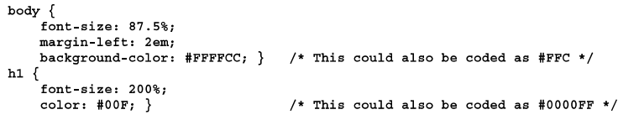
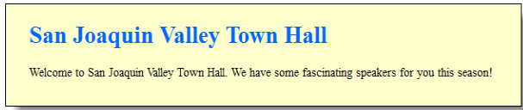
To specify colors (cont.)
CSS that uses hexadecimal values to specify colors
The HTML in web browsers
Notes:
Mô tả nội dung chi tiết từng chuyên đề

Slide 12
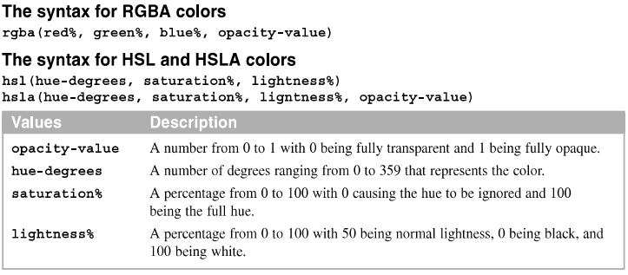
To use the CSS3 color specifications
CSS3 also provides 147 more keywords for colors that are generally support by modern browser.
The ways to CSS3 colors
Notes:
Mô tả nội dung chi tiết từng chuyên đề

Slide 13
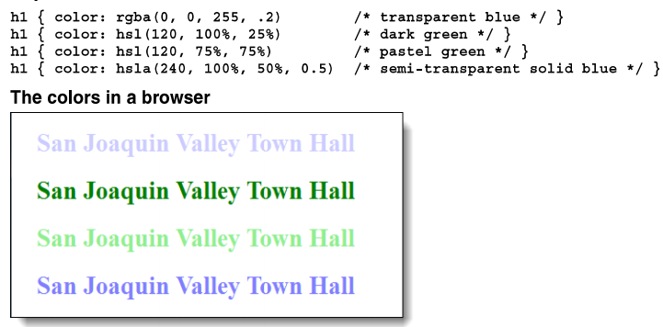
Example
Notes:
Mô tả nội dung chi tiết từng chuyên đề

Slide 14
How to code selectors

Slide 15
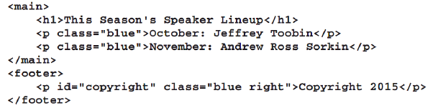
To code selectors for all elements, element types, ids, and classes
HTML that can be selected by element type, id or class
Notes:
Mô tả nội dung chi tiết từng chuyên đề

Slide 16
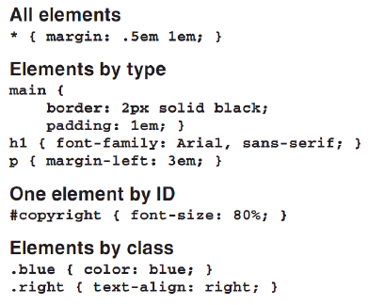
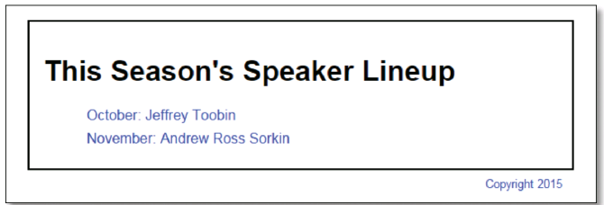
To code selectors for all elements, element types, ids, and classes (cont.)
CSS rule sets that select by element type id, and class
Notes:
Mô tả nội dung chi tiết từng chuyên đề

Slide 17
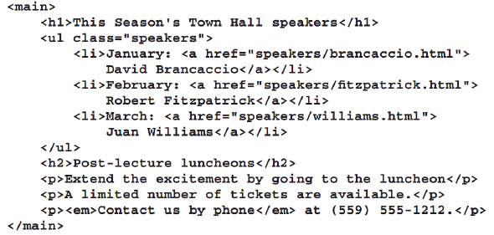
To code relational selectors
HTML that can be selected by relationship
Notes:
Mô tả nội dung chi tiết từng chuyên đề

Slide 18
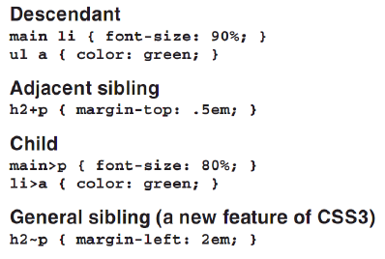
CSS rule sets with relational selectors
Notes:
Mô tả nội dung chi tiết từng chuyên đề

Slide 19
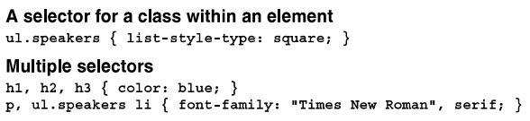
To code attribute selectors
To code a selector for an element and class, code the element name, a period and the class name
To code multiple selectors for the same rule set, use commas to separate the selector
Combinations of selectors
Notes:
Mô tả nội dung chi tiết từng chuyên đề

Slide 20
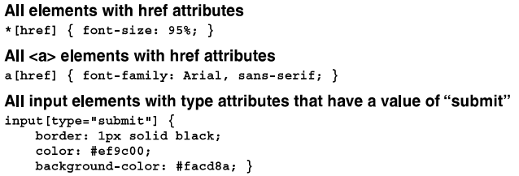
To code attribute selectors (cont.)
- Attribute selectors
Notes:
Mô tả nội dung chi tiết từng chuyên đề

Slide 21
How to work with Cascading Style Sheets
Cascading Style Sheets refer to fact that more than one style sheet can applied to a single web page.
The rule is determine which takes precedence .
Notes:
Mô tả nội dung chi tiết từng chuyên đề

Slide 22

How the cascade rules work
How to identify a rule as important
The cascade order for applying CSS rule sets
Important rules in a user style sheet
Important rules in a web page
Normal rules in a web page
Normal rules in a user style sheet
Default rules in the web browser
Notes:
Mô tả nội dung chi tiết từng chuyên đề

Slide 23
How to determine the specificity of a selector
An id the most specific
A class, attribute selector, or pseudo-class selector is less specific
An element or pseudo-element selector is least specific
Notes:
Mô tả nội dung chi tiết từng chuyên đề

Slide 24
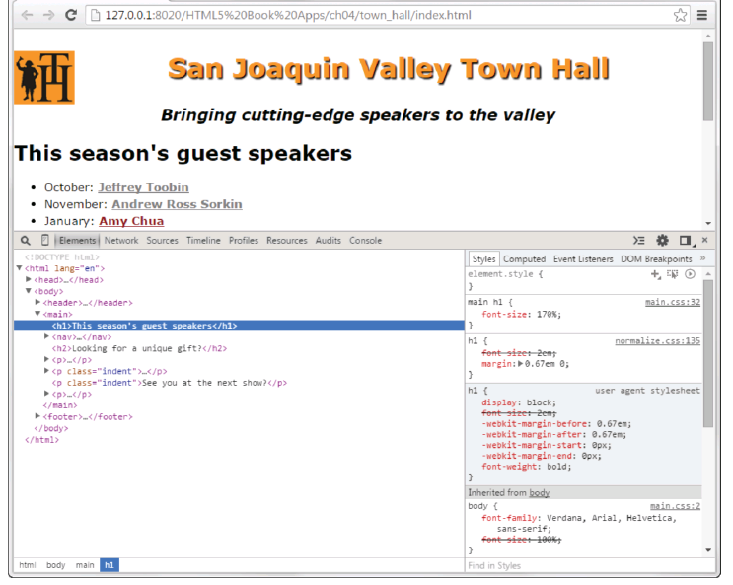
How to use the developer tools to inspect the styles that have been applied
Press F12 key to display the panel for tools

Slide 25
How to work text

Slide 26
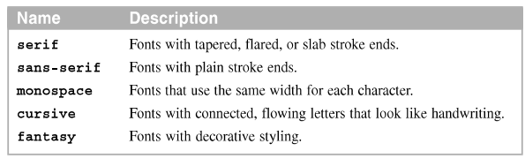
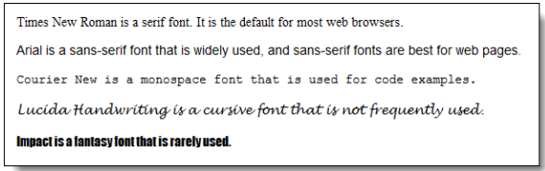
To set the font family and font size
The five generic font families
Example
Notes:
Mô tả nội dung chi tiết từng chuyên đề

Slide 27


To set the font family and font size (cont.)
How to specify a font family
How to specify the font size
A font family rule in the body element that is inherited by all descendent
Notes:
Mô tả nội dung chi tiết từng chuyên đề

Slide 28
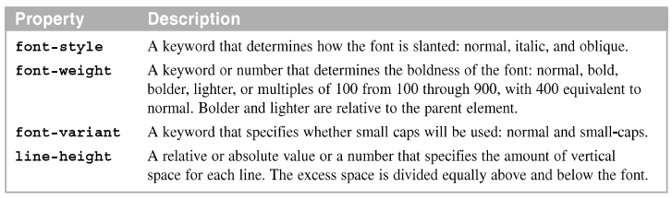

To set the other properties for styling fonts
Other properties for styling fonts
How to specify font styles and variants
Notes:
Mô tả nội dung chi tiết từng chuyên đề

Slide 29



To set the other properties for styling fonts (cont.)
How to specify font weights
How to specify line height
The syntax for the shorthand font property
How to use the shorthand font properties
Notes:
Mô tả nội dung chi tiết từng chuyên đề

Slide 30
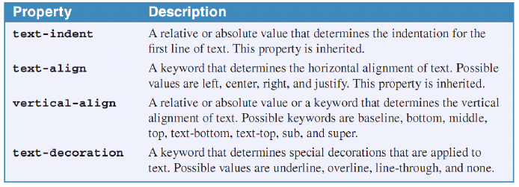
How to indent and align text
The text-indent and text-align properties are often used with text, and the vertical-align property is often used with table
Properties for indenting, aligning and decorating text
Notes:
Mô tả nội dung chi tiết từng chuyên đề

Slide 31
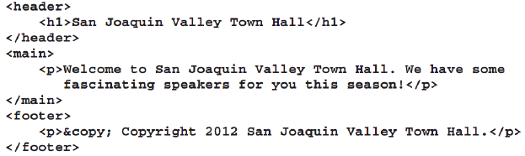
How to indent and align text (cont.)
The HTML for a web
Notes:
Mô tả nội dung chi tiết từng chuyên đề

Slide 32
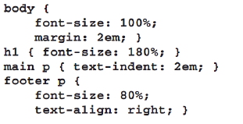
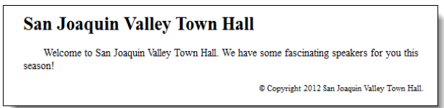
How to indent and align text (cont.)
CSS that specifies a text indent and horizontal alignment
The HTML in a web browser
Notes:
Mô tả nội dung chi tiết từng chuyên đề

Slide 33
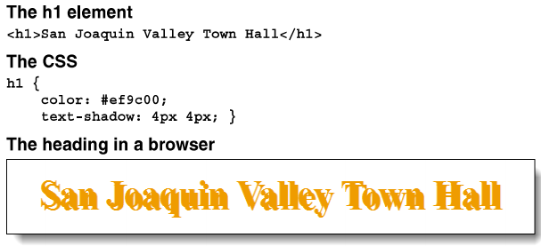
To use CSS3 to add shadows to text
The syntax of the text-shadow property
Two examples
Notes:
Mô tả nội dung chi tiết từng chuyên đề

Slide 34
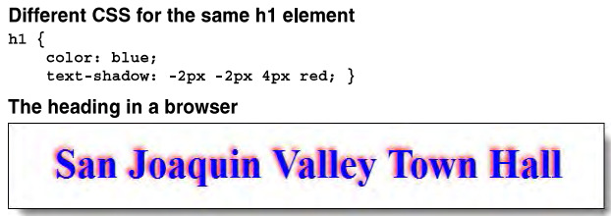
To use CSS3 to add shadows to text (cont.)
- Different CSS for the same h1 element
Notes:
Mô tả nội dung chi tiết từng chuyên đề

Slide 35
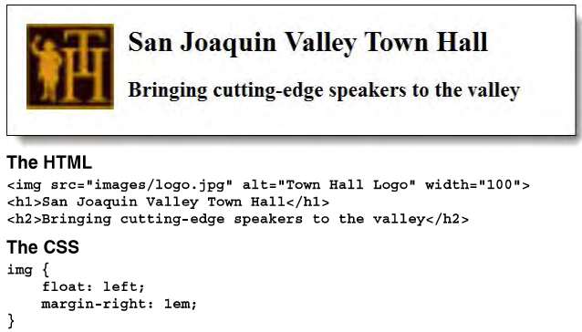
To float an image so text flows around it
- An image that has been floated to the left of the headings that follow
Notes:
Mô tả nội dung chi tiết từng chuyên đề

Slide 36
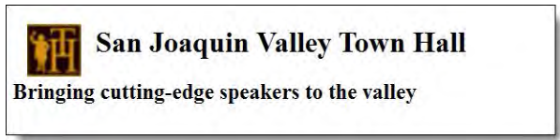
To float an image so text flows around it
The page if the width of the image is reduced to 60
The property that will stop the floating before a subsequent element
Section { clear: left ;}
Notes:
Mô tả nội dung chi tiết từng chuyên đề

Slide 37
A web page that uses
an external style sheet

Slide 38

The page layout
Notes:
Mô tả nội dung chi tiết từng chuyên đề

Slide 39
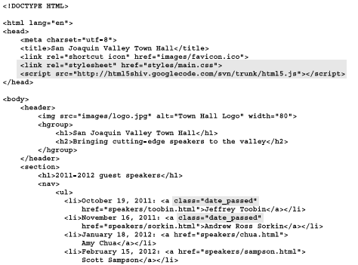
The HTML file
Notes:
Mô tả nội dung chi tiết từng chuyên đề

Slide 40
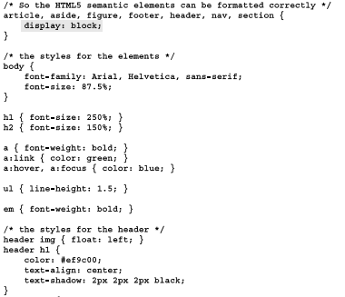
The CSS file
Notes:
Mô tả nội dung chi tiết từng chuyên đề

Slide 41
Summary
External style sheet and using style attribute of an inline element
CSS rule set
Most graphic designer
CSS selectors for element type, id, class, relations and attribute
Pseudo-class selector and Pseudo-elements selector
Shorthand properties
Use indent, align, transform and decorate the text properties
Float properties
Notes:
Tóm tắt lại nội dung đã học

