Slide 1
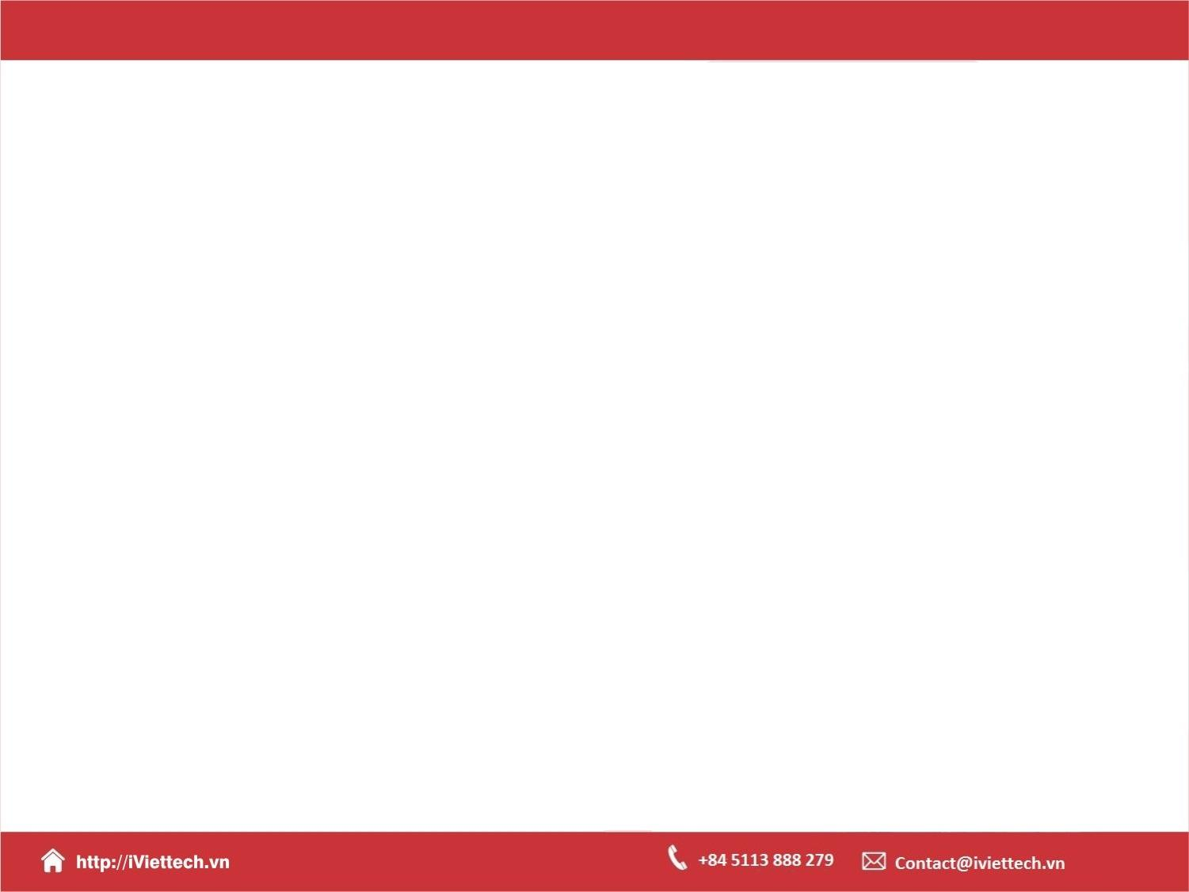
Chapter 9
How to use Flexible Box Layout for page layout and RWD
Notes:
Session: Ghi số thứ tự session trong môn học
Session Name: ghi tên của session sẽ dạy
https://developer.mozilla.org/en-US/docs/Web/CSS/CSS_Flexible_Box_Layout/Ordering_Flex_Items
https://css-tricks.com/snippets/css/a-guide-to-flexbox/ (Ok)

Slide 2
Objectives
Getting started with Flexible Box Layout
How to set flexbox properties
A responsive web page that uses flexbox

Slide 3
Getting started with Flexible Box Layout
The Flexible Box Layout or flex, it provides a more efficient way to layout , align, and distribute space among the elements with container
The Flexible Box Layout Module, makes it easier to design flexible responsive layout structure without using float or positioning.
Notes:
Session: Ghi số thứ tự session trong môn học
Session Name: ghi tên của session sẽ dạy

Slide 4
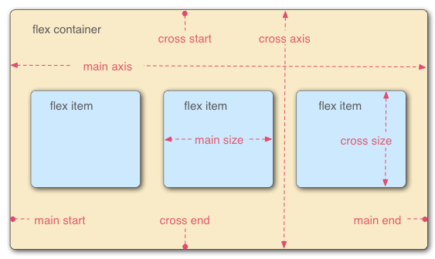
An introduction to flexbox
A flexbox is container that contains one or more flex items.
Flexbox uses two axes a main axis and a cross axis
By default the main axis goes left to right & cross axis is top to bottom.

Slide 5

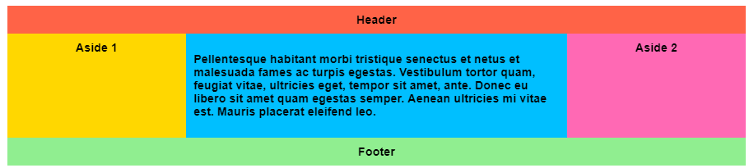
An introduction to flexbox (Cont.)
Flexbox is supported by all modern desktop and mobile browsers.
Layout web page, navigation menu using flexbox.

Slide 6
How to create your first flexible box
Set the display property for a block element to either flex or flex-inline. Then, the block element will become a flex container, many block-level child elements within the container will become flex items.
To change the direction, you use the flex-direction property.

Slide 7
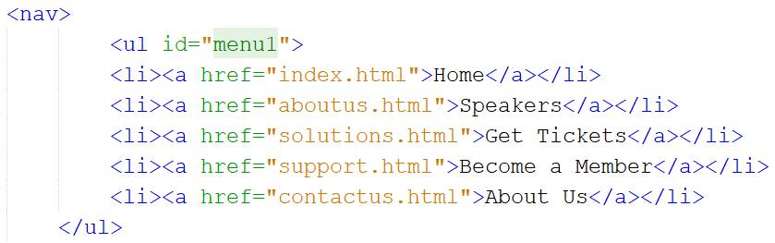
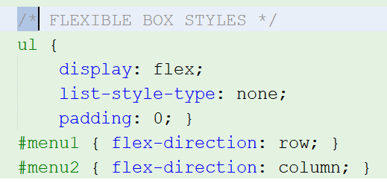
How to create your first flexible box (cont.)

Slide 8
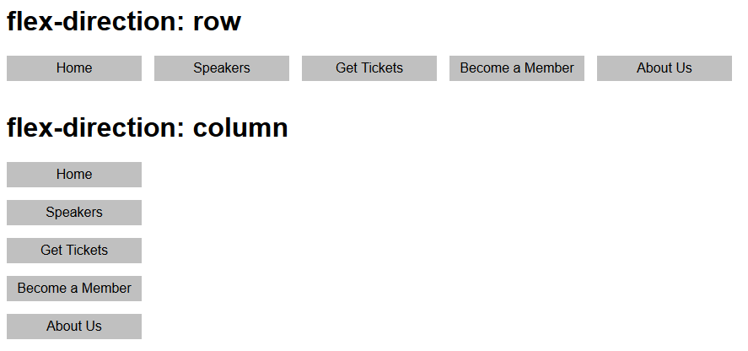
How to create your first flexible box (Cont.)

Slide 9
How to set flexbox properties
Notes:
Session: Ghi số thứ tự session trong môn học
Session Name: ghi tên của session sẽ dạy

Slide 10
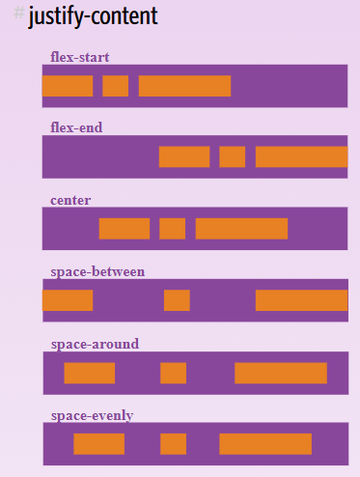
How to align flex items along the main axis
You use the justify-content property.

Slide 11
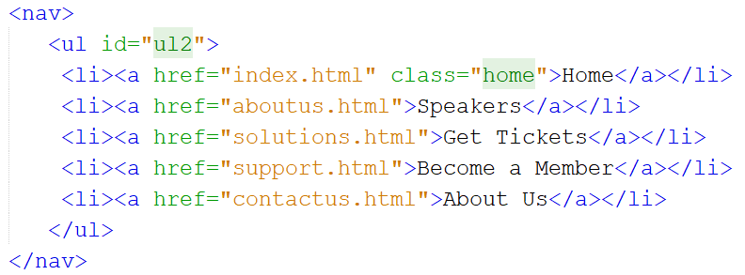
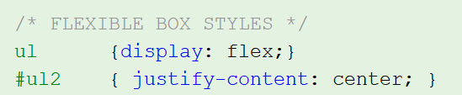
How to align flex items along the main axis (Cont.)

Slide 12
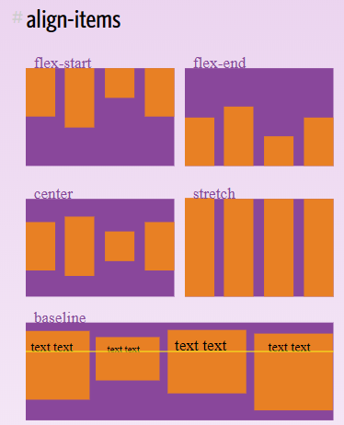
How to align flex items along the cross axis (Cont.)
You use the align-items and align-self properties.

Slide 13
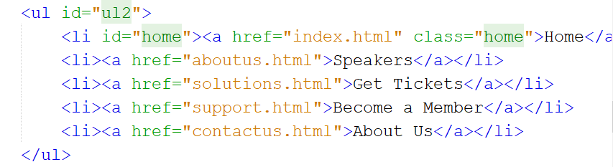
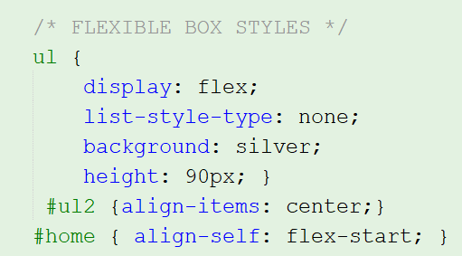
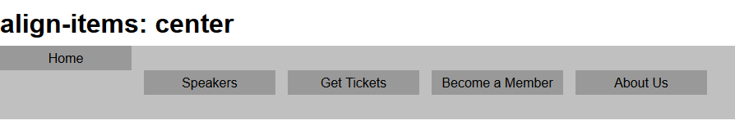
How to align flex items along the cross axis (Cont.)

Slide 14
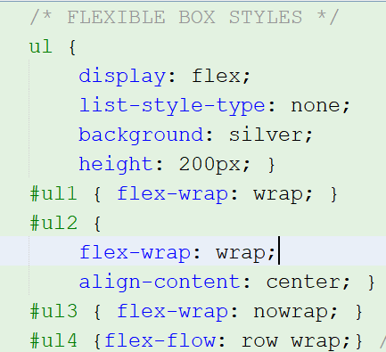
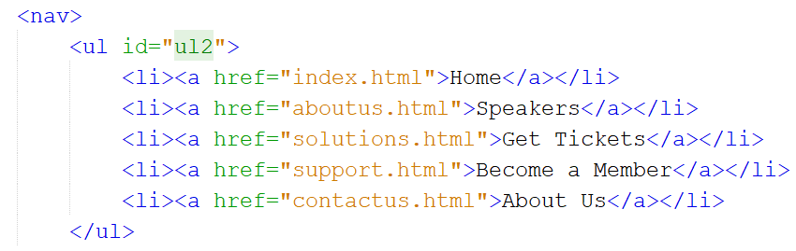
How to wrap & align wrapped flex items
You use the flex-wrap, align-content, flex-flow properties.

Slide 15
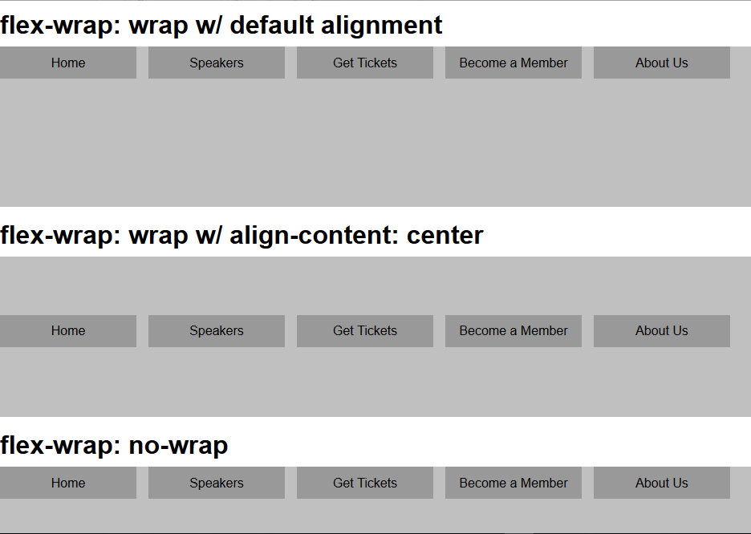
How to wrap & align wrapped flex items (Cont.)

Slide 16
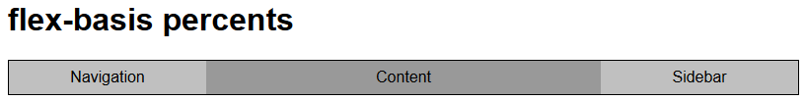
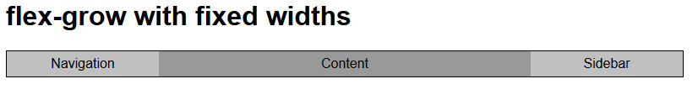
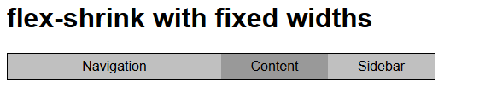
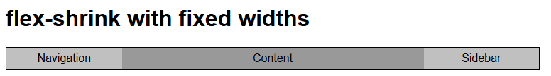
How to allocate space to flex items
You use four properties: flex-basis, flex-grow, flex-shrink, flex. (page 335).

Slide 17
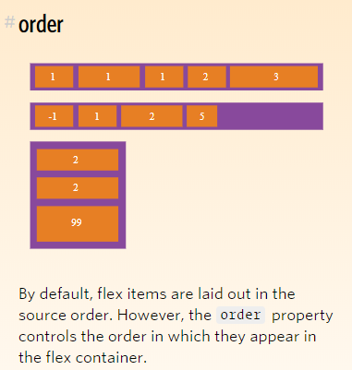
How to change the order of flex items
If you change order in which the flex items within a container, you use the order properties.

Slide 18
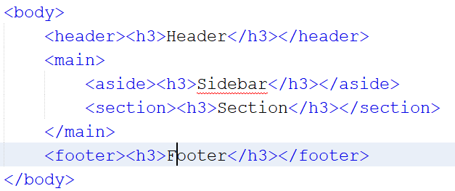
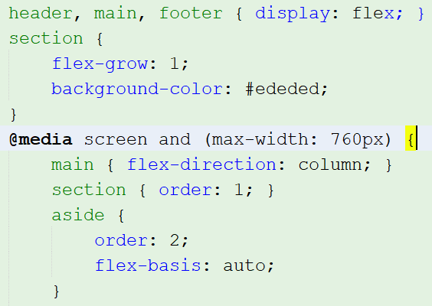
How to change the order of flex items (Cont.)

Slide 19
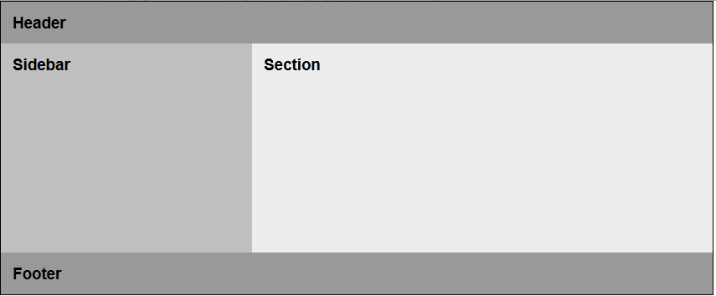
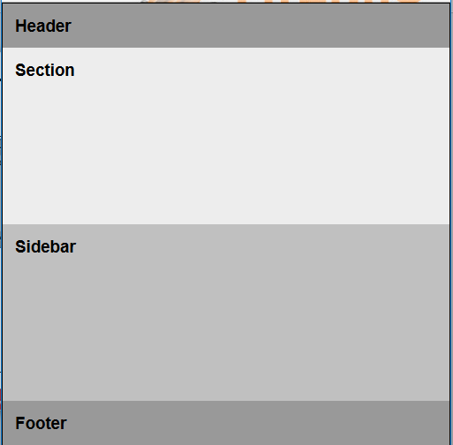
How to change the order of flex items (Cont.)

Slide 20
A responsive web page that uses flexbox (Page 340 - 347)
Notes:
Session: Ghi số thứ tự session trong môn học
Session Name: ghi tên của session sẽ dạy

Slide 21
Summary
In this chapter, you learned how to use Flexible Box Layout. This CSS3 module makes it relatively easy to layout the elements of a page without using floats.
Notes:
Tóm tắt lại nội dung đã học

