Slide 1

Chapter 7
How to work with lists and links, and navigation menus
Notes:
Session: Ghi số thứ tự session trong môn học
Session Name: ghi tên của session sẽ dạy

Slide 2
Objectives
How to code lists
How to format lists
How to code links
How to create navigation menus
Notes:
Mô tả nội dung mà học viên phải đạt được khi kết thúc môn học này

Slide 3
How to code lists
Notes:
Mô tả nội dung chi tiết từng chuyên đề

Slide 4

How to code unordered lists
By default, an unordered list is displayed as a bulleted list, but you can change the bullets.
Elements that create unordered lists
Notes:
Mô tả nội dung chi tiết từng chuyên đề

Slide 5
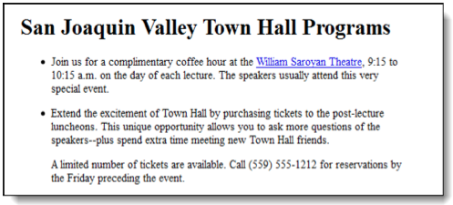
How to code unordered lists (cont.)
The lists in a web browser

Slide 6
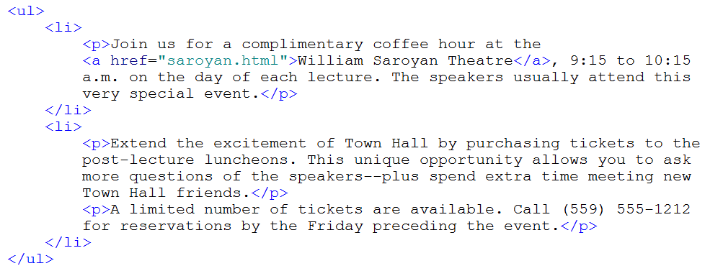
How to code unordered lists (cont.)

Slide 7
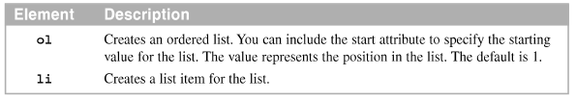
How to code ordered lists
By default, an ordered list is displayed as a number list, you can change
Elements that create ordered lists

Slide 8
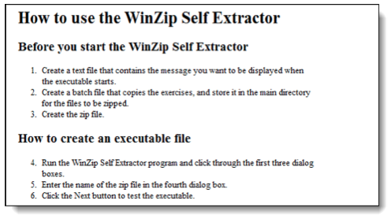
How to code ordered lists (cont.)
The list in a web browser

Slide 9
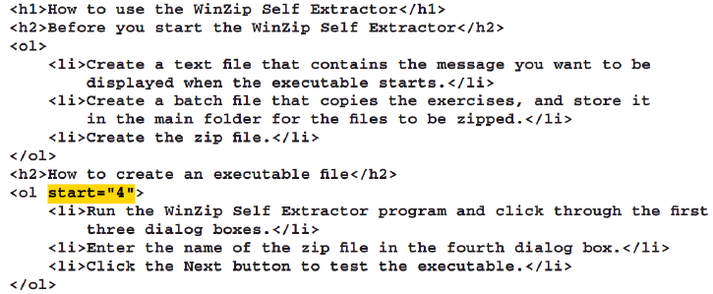
How to code unordered lists (cont.)

Slide 10
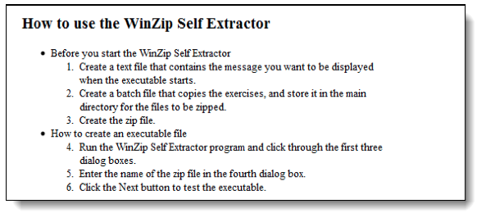
How to code nested lists
You can nest list by coding one list as an item for another list
The list in a web browser

Slide 11
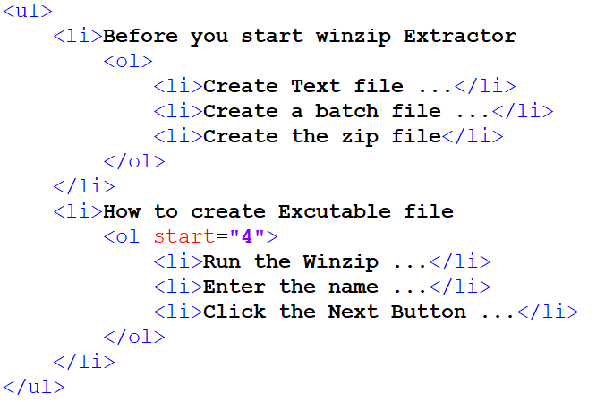
How to code nested lists(cont.)

Slide 12
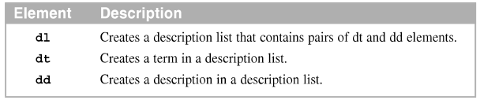
How to code description lists
A description list consists of terms and descriptions for those terms. In HTML4, this type of list was called a definition list
Elements that create description lists

Slide 13
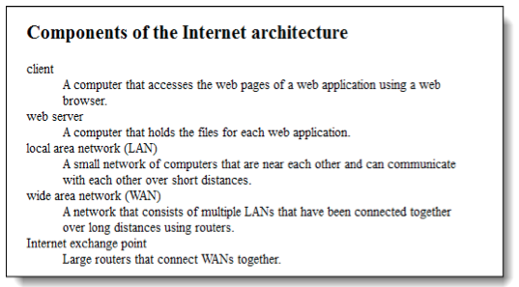
How to code description lists (cont.)
The list in a web browser

Slide 14
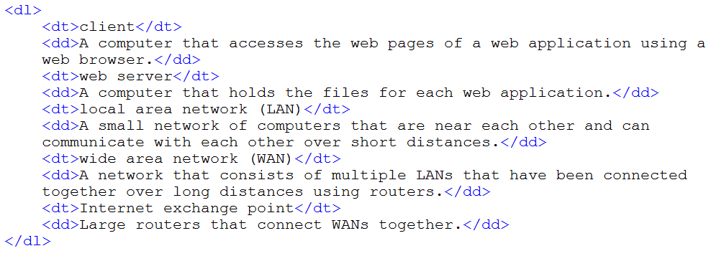
How to code unordered lists (cont.)

Slide 15
How to format lists

Slide 16
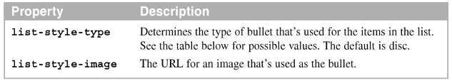
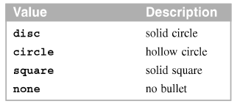
How to change the bullets for an unordered list
Properties for formatting unordered lists
Value for the list-style-type property of an unordered list

Slide 17
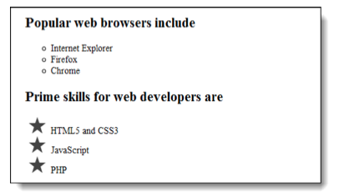
The lists in a web browser

Slide 18
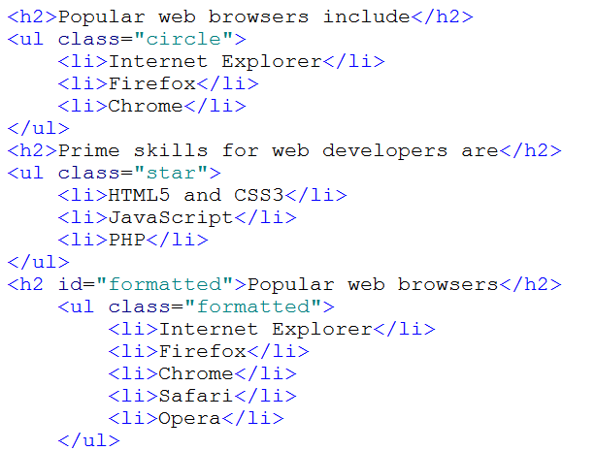
How to code unordered lists (cont.)

Slide 19
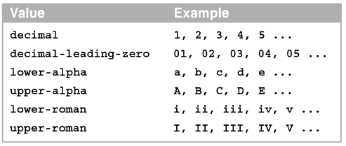
How to change the numbering system for an ordered list
Common values for the list-style-type property of an ordered list

Slide 20
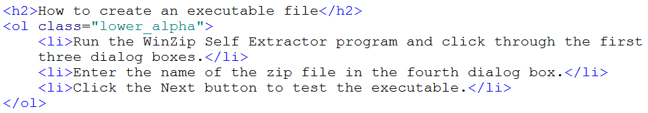
How to change the numbering system for an ordered list(cont.)

Slide 21
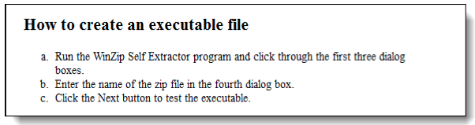
How to change the numbering system for an ordered list(cont.)
The list in a web browser

Slide 22
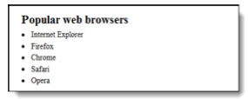
How to change the alignment of list items
Use margins and padding to control the indentation for the items in an ordered or unordered list, and to control the space between the bullets or numbers and the text that follows
The list in a web browser

Slide 23
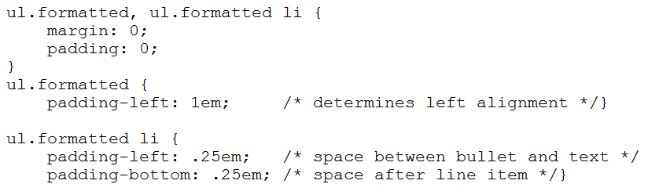
How to code unordered lists (cont.)

Slide 24
How to code links

Slide 25
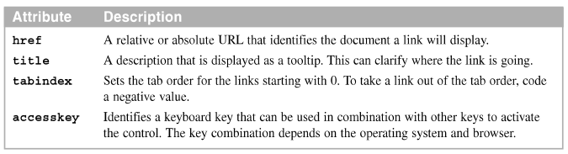
How to links to another page
Use the <a> element to create a link that loads another web page.
Four attributes of the <a> element
A link that starts an email message

Slide 26
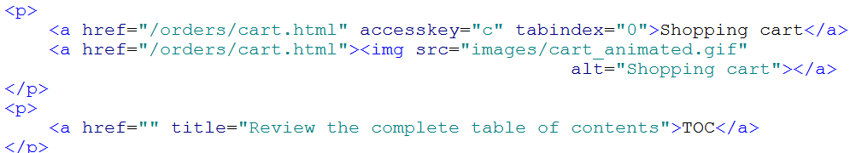
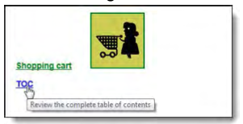
How to links to another page
The text and image links in a web browser

Slide 27
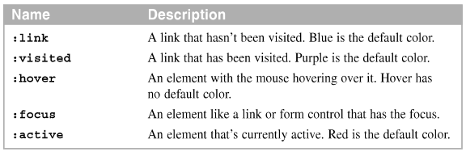
How to format links
Apply the same formatting for the :hover and :focus selectors.
Common CSS pseudo-classes for formatting links

Slide 28
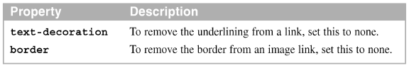

How to format links (cont.)
The properties for removing underlines and borders
The links in a web browser with the focus on the third link

Slide 29
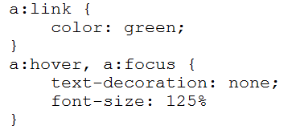
Code Example

Slide 30
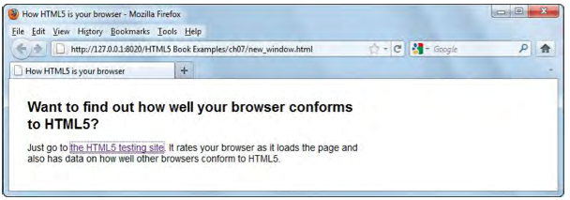
How to use a link to open a new browser window or tab
Use the target attribute of the <a> tag to specify where the document referred to in a link should be loaded.
The HTML in one browser tab

Slide 31
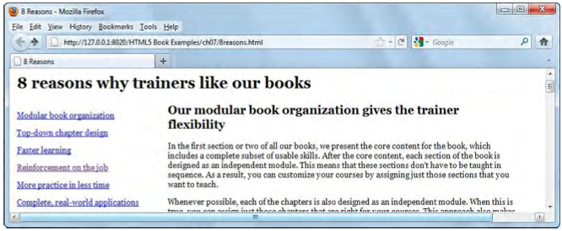
How to create and link to placeholders
To create a placeholder, use the id attribute of the <a> tag.
A web page that provides links to topics on the same page

Slide 32
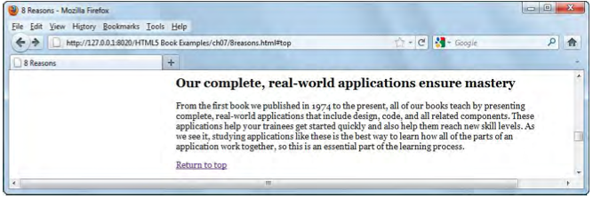
How to create and link to placeholders (cont.)
The portion of the page that’s displayed when the sixth link is clicked

Slide 33
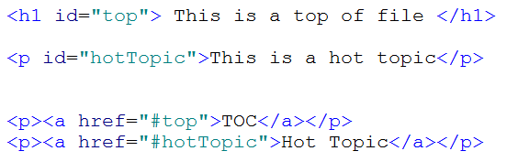
Code Example

Slide 34
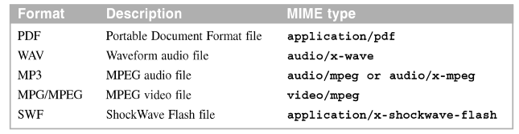
How to link to a media file
Special media players may be required to play a media file in a browser.
Popular media formats an MIME types

Slide 35

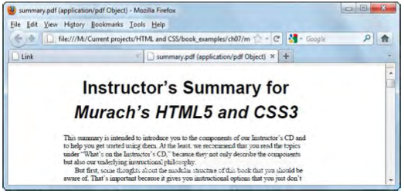
How to link to a media file(cont.)
Two of the popular media players
The PDF file displayed in a browser

Slide 36
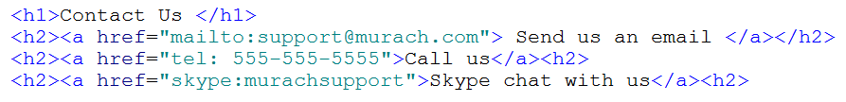
Create email, phone and skype links

Slide 37
How to create navigation menus

Slide 38
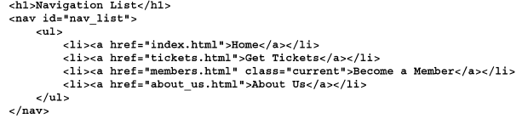
How to create a vertical navigation menu
HTML for a vertical navigation menu is best coded as a series of <a> elements within the li elements of an unordered list
The HTML for the navigation list

Slide 39
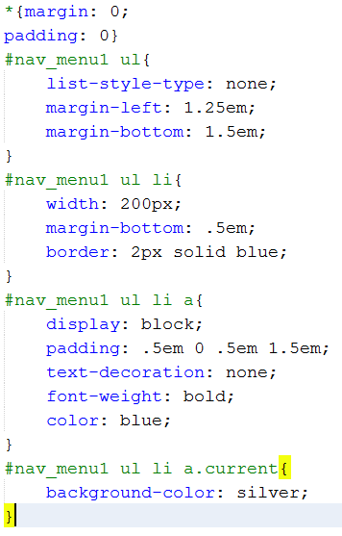
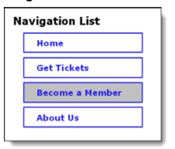
How to create a vertical navigation menu (cont.)
A navigation list

Slide 40
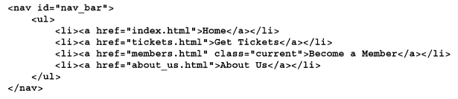
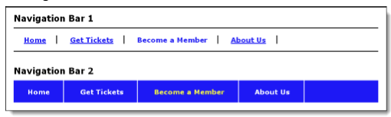
How to create a horizontal navigation menu
The HTML for the navigation bar
Two navigation bars

Slide 41
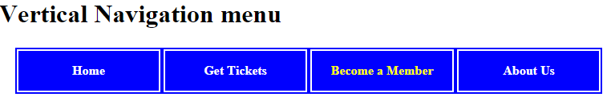
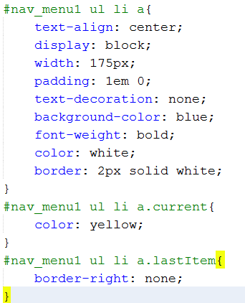
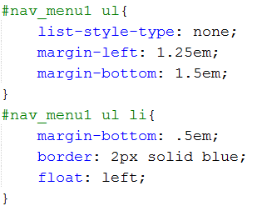
How to create a horizontal navigation menu (cont)

Slide 42
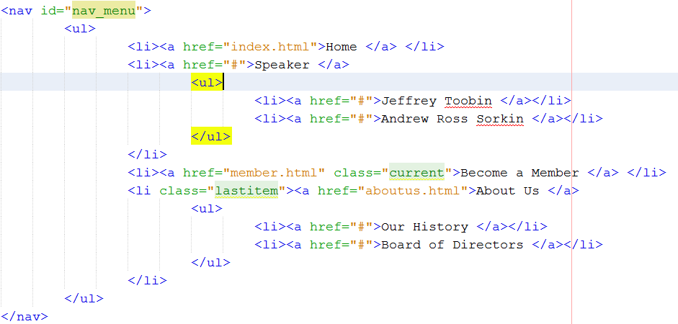
Create a 2 tier navigation menu
To create a multi – tier navigation menu, you code a nested list.

Slide 43
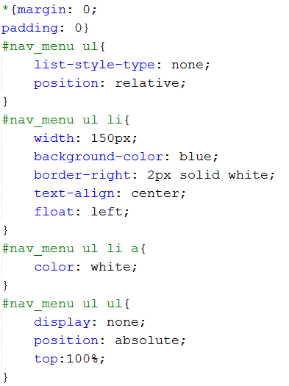
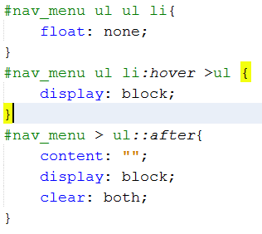
Create a 2 tier navigation menu(2)

Slide 44
Summary
An unordered list displayed as a bullets
An ordered list it displayed as a numbered list
A description list consists of terms and descriptions
Use <a> tag to create links.
Use pseudo-code selectors in CSS to change the default colors for links and to change the styles when the mouse hovers over a link.
Create a navigation bar and create links to a media file
Notes:
Tóm tắt lại nội dung đã học

Slide 45
Discussion
Notes:
Trả lời câu hỏi WHY?

