Slide 1
VinaSaver Co. Ltd
VECTOR
DATABASE
tuong.bui@vinasaver.vn

Slide 2
WHAT IS A VECTOR DATABASE ?
A vector database is a specialized database system designed to store, manage, and query high-dimensional vectors (embeddings), which are numerical representations of unstructured data such as text, images, audio, or video.
How it Works
Raw data (text, images, audio…) is transformed into vectors using AI models (embedding models).
Each vector represents a point in a high-dimensional space (hundreds to thousands of dimensions).
The database enables:
Similarity search (finding the most similar vectors)
Approximate Nearest Neighbor (ANN) search for fast retrieval

Slide 3
WHAT IS A VECTOR EMBEDDING?
Vector Embedding is the process of mapping data (text, images, audio, etc.) into a high-dimensional numerical vector space where semantically similar items are positioned close to each other.
Each item → a dense vector representation
Distance (cosine, Euclidean, etc.) → similarity
Widely used in: semantic search, recommendation systems, clustering, NLP tasks

Slide 4
WHY YOU NEED VECTOR DATABASE?
1. Semantic Search (Search by Meaning)
Problem:
Keyword search fails with natural language
Example: “camera for parking lot at night” ≠ exact keywords
Solution (Vector DB):
Convert text → embeddings
Search by semantic similarity
2. Image Similarity Search
Problem:
Cannot search images using keywords only
Users may not know how to describe an image
Solution:
Convert image → vector embedding
Compare similarity between images
Result:
Find visually similar products
Works with image, not text

Slide 5
WHY YOU NEED VECTOR DATABASE?
Problem: Limitations of LLMs
LLMs (e.g., OpenAIGPT)
Do not store all knowledge
Cannot access real-time or private data
May generate incorrect answers (hallucination)
Solution: Retrieval-Augmented Generation (RAG)
Concept:
Combine AI with external knowledge retrieval
How it works:
Query
→ Convert to embedding
→ Search in Vector Database
→ Retrieve relevant context
→ Send context to AI
→ Generate accurate answer

Slide 6
ROLE OF VECTOR DATABASE - MCP SERVER
Role of Vector Database
Stores embeddings of documents/data
Performs semantic similarity search
Returns the most relevant context
Role of MCP Server
Orchestrates the whole process
Connects AI ↔ Vector Database ↔ APIs
Handles:
Query routing
Data transformation
Tool execution

Slide 7
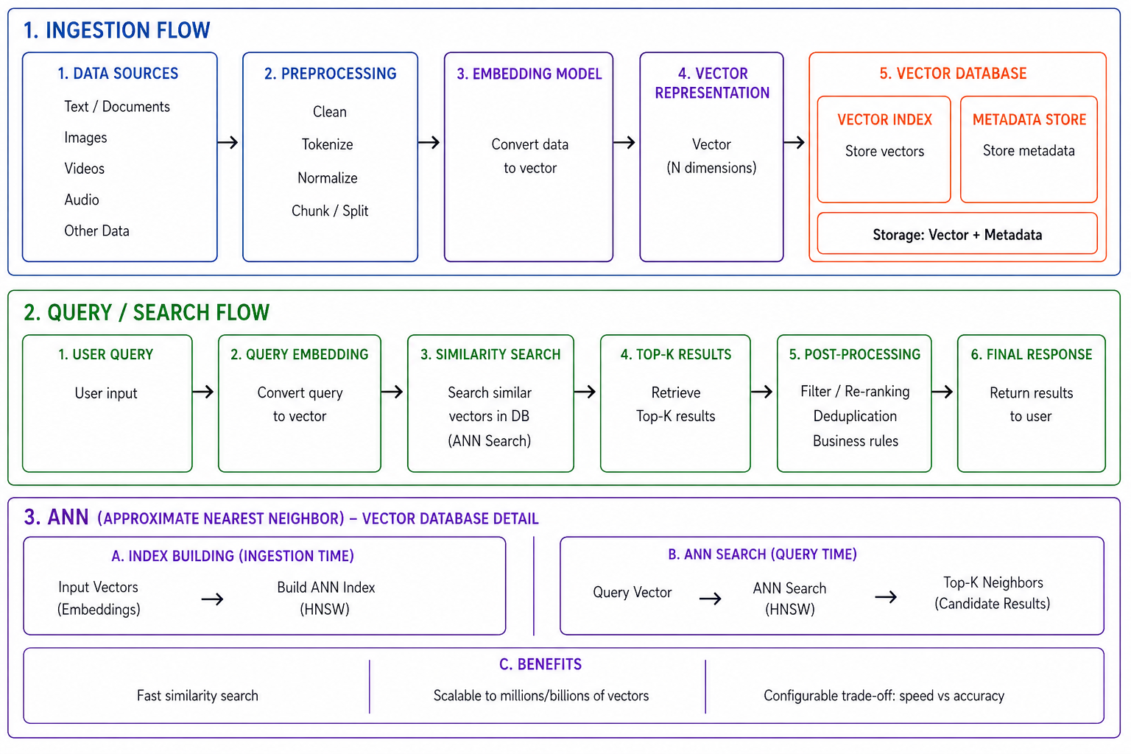

Slide 8
FULL ARCHITECTURE FLOW
User Query
→ User enters a question
AI (LLM)
→ Receives the request (insufficient data)
MCP Server
→ Orchestrates and decides to query the Vector DB
Embedding Query
→ Converts the query into a vector
Vector Database
→ Performs semantic similarity search
Return Context
→ Returns relevant data
AI Generate
→ Generates answer based on context
Final Response
→ Returns result to the user

Slide 9
TEXT → VECTOR (EMBEDDING PIPELINE)
Text Input
↓
Tokenization
↓
Text Preprocessing
↓
Model Encoding (BERT / Sentence Transformer)
↓
Vector Representation (Embedding)

Slide 10
TEXT → VECTOR (EMBEDDING PIPELINE)
1. Text Input
Raw text or sentence
Example: "How to learn AI?"
2. Tokenization
Split text into tokens (words or subwords)
Example:
"learning" → ["learn", "##ing"]
3. Text Preprocessing
Normalize input (lowercase, clean text)
Padding / truncation for fixed length
4. Model Encoding
Convert tokens → IDs → vectors
Process through Transformer layers
Capture contextual meaning
5. Pooling (Important)
Combine token vectors into one vector
Common methods:
CLS token
Mean pooling
6. Vector Output
Dense vector (e.g., 384–1024 dimensions)
Example:
[0.12, -0.98, 0.33, ...]

Slide 11
TOP MODELS DO THIS BEST.
BERT (Transformer – Token Level)
Text → Tokenization → Token IDs → Embedding Matrix → Transformer → Token Vectors
Sentence Transformer (Sentence Level)
Text → Tokenization → Token IDs → Embedding Matrix → Transformer → Pooling → Sentence Vector
CLIP (Multimodal)
Text → BPE Tokenization → Token IDs → Embedding Matrix → Transformer → Text Vector

Slide 12
COMPARE WITH ELASTICSEARCH
Elasticsearch (Keyword Search)
Searches based on exact keywords
High performance, fast & optimized
Works best with structured data
Requires manual setup for synonyms
Limited context understanding
Common uses:
→ Logs, filtering, traditional search
Vector Search (Semantic Search)
Searches based on meaning (semantics)
Understands natural language & intent
Automatically handles synonyms & similarity
Strong context awareness
Slightly slower (depends on ANN indexing)
Common uses:
→ AI search, chatbots, recommendations

Slide 13
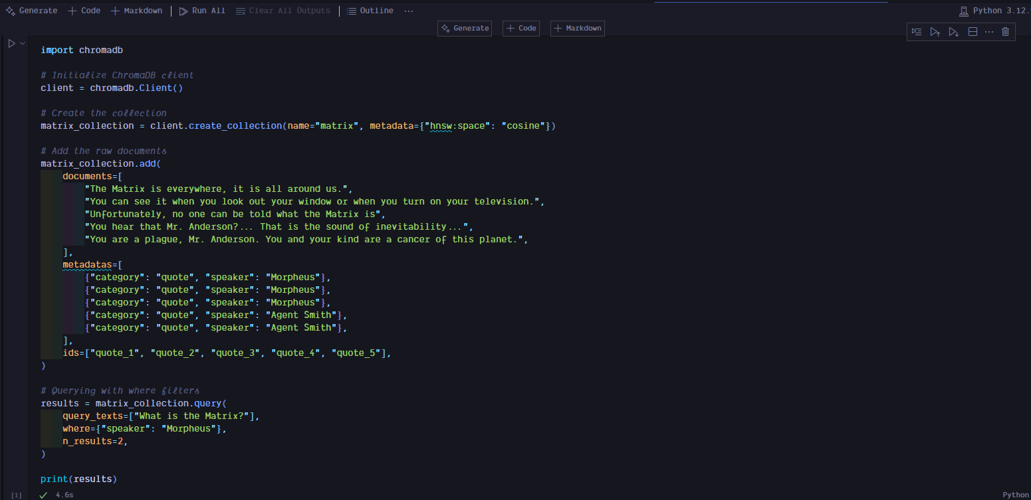
INSTALL CHROMADB FOR PYTHON
Installation
pip install chromadb
Basic Usage

Slide 14
WHAT IS A CHROMA DB ?
What is Chroma DB?
Open-source vector database
Stores embeddings (vectors)
Enables semantic search
Commonly used in RAG systems
Key Features
Easy to use (Python-first)
Built-in embedding support
Fast similarity search
Works locally (no server needed)

Slide 15
THANK YOU

