Slide 1

Eric Lindemulder, Mark Tupala, Devin Hanchar, Anna Basler

Slide 2

“Databases are tools; they are the means to an end. Each database has its own story and its own way of looking at the world. The more you understand them, the better you will be at harnessing the latent power in the ever-growing corpus of data at your disposal.”

Slide 3

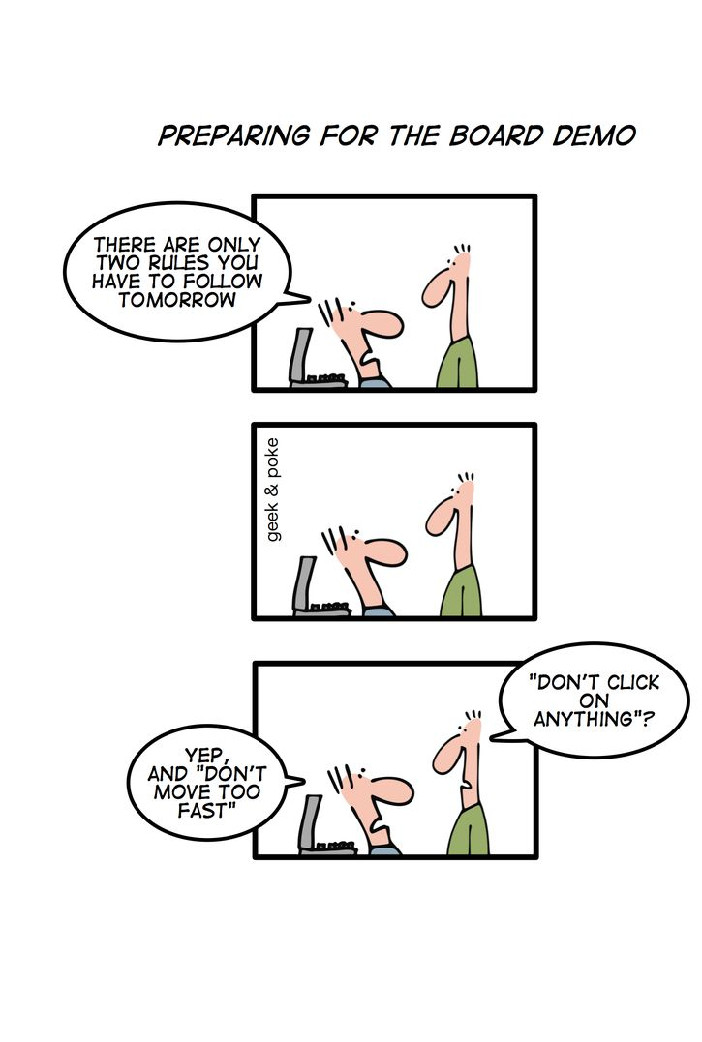
NoSQL == “Not only SQL”
A new genre of databases
Most but not all are:
  Non-relational
  Distributed
  Open-source
Allows for larger scales of data

Slide 4

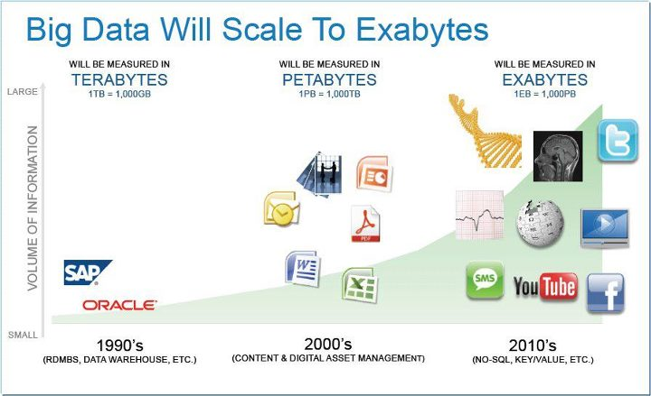
Cost effective management of data coming from the web and mobile applications
Good for analysis of large data from the web.

Slide 5

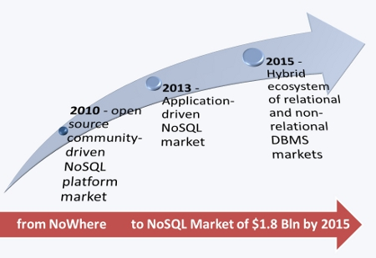
NoSQL started in 2000’s
Gained popularity in 2009
Case Studies
  BigTable – 2006 paper by Google
  Dynamo – 2007 paper by Amazon
  CouchDB – started 2005, Apache 2008

Slide 6

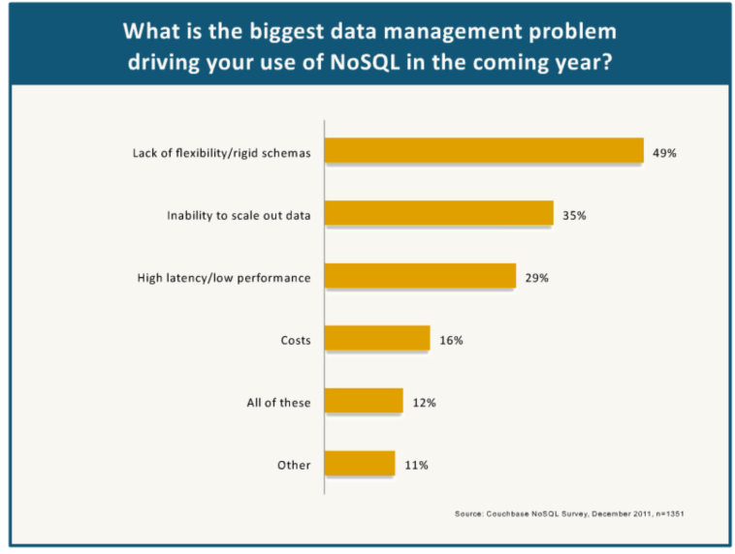
Scalability
- designed from the ground up for distributed scaling
Cheaper
- ‘horizontal’ scaling cheaper than ‘vertical’ scaling
- open-source
- no need for expensive DBAs? (Debatable)
Programmer Productivity
- but only for certain tasks! (unstructured/changing data)
- no object-relational mismatch

Slide 7

Relaxes consistency to gain this performance
- sometimes this is simply not an option
Can be worse for programmer productivity!
- NoSQL means having ‘No SQL’!
- must write functions (usually map-reduce)
- whenever schema enforcement > flexibility
Still very new
- less tools, commercial support, experienced developers…

Slide 8


Open Source
Data stored as JSON literals
Designed to “Replicate” to not-always-online systems
  e.g. cellphones

Slide 9

Database knows nothing about the data:
  No updates
  No constraints (e.g. uniqueness)
  Database design is easy (there isn't one)
  Lightning fast load/store
  Very storage intensive
No concept of a “transaction”
  Load/store as atomic operation
  No rollback/commit/safety checks

Slide 10

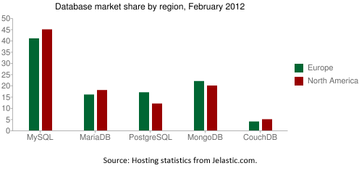
Probably not...
  Open Source is an advantage
  CouchDB has failed to gain widespread acceptance even among NoSQL users
  High storage costs on the backend
  CouchDB is essentially an API for flat file parsing – we can do better

Slide 11


Google's in-house storage system
Data indexed by “row keys”, “column keys”, and timestamps (you set the row and column keys)
Extremely scalable over large data sets and effective load distribution

Slide 12

Column and row keys defined by user
  “Takes some practice” to get used to, according to Google
  Use column key to group similar data, row key to uniquely id within table?
Data stored as byte streams
  No sanity checks
Designed for extreme scalability
  Large data sets, multiple servers

Slide 13
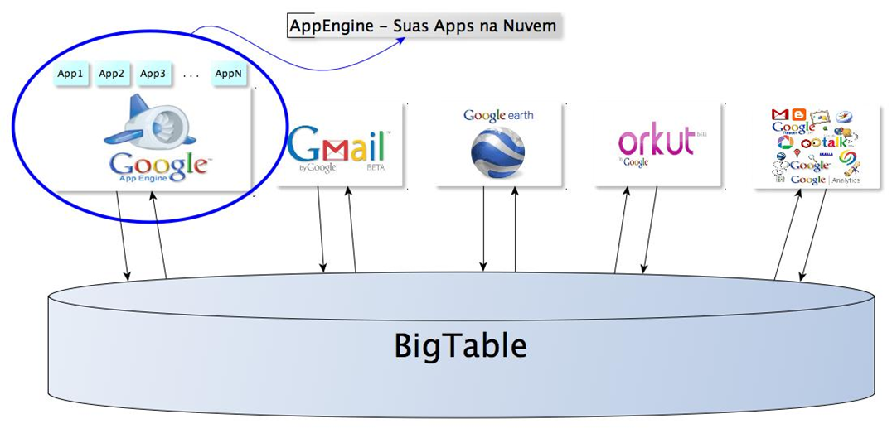
Numerous Google apps have BigTable running in the background.

Slide 14

Can we?
  Only available to Google applications
But if we could:
  Some learning curve required
  Normal drawbacks of NoSQL
  Extremely scalable
Are we concerned about storage capacity and server performance?
  Then let's learn BigTable

Slide 15

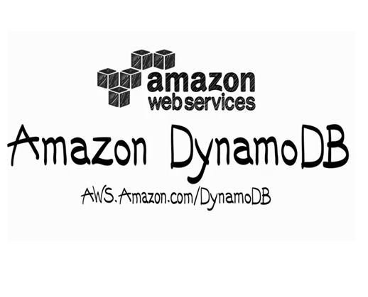
Amazon's proprietary storage system
Data stored as key and list of values
Very simple API (get, put)

Slide 16

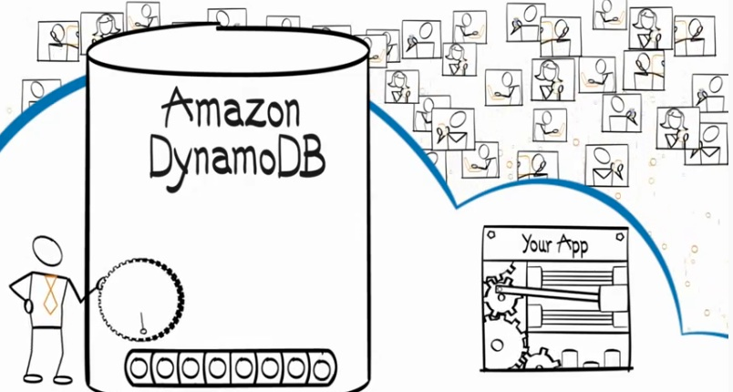
High cost for storage, low cost for queries
  Good for repeated querying of small data sets
Searches on non-key values are possible, but prohibitively expensive
Schema-less tables

Slide 17

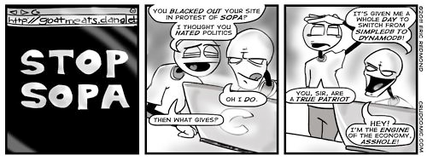
Is our data set relatively small?
Are we querying our server frequently?
Is query speed a concern?
If you answered “yes” to all of the above...

Slide 18

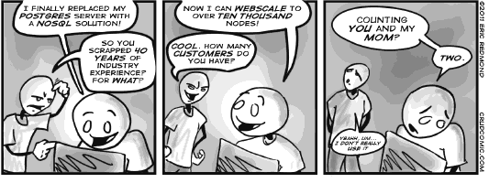
NoSQL is meant to complement, and not replace RDBMS.

