Slide 1

One Stop destination for Startups, Mentors, Investors and Community (Integrated & Interactive platform)
Introduction
1

Slide 2
Problem Statement - SIH
2
There are many success stories around startup now a days. Presently, there is no online platform for mentorship of startups. Mentoring and guidance are very critical for early stage startups. Online platform may help in reaching out to startups at grass root level including college students. So, we looking for software solution for
creating startups and mentors community. This can help Startups with market trends, etc.
helping startups to reach to mentors in required domain
possible help to startups to reach at grass root level, colleges for talent based on different criteria

Slide 3
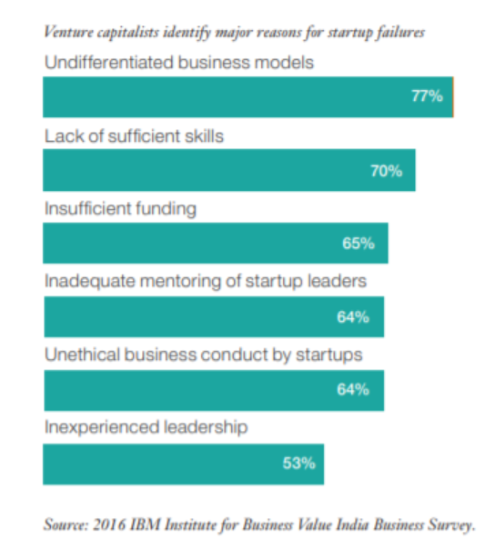
Problem Decoded
3
90%
Startups fail within the first five years of foundation

Slide 4
Solution- Kick Startup
4
An integrated and interactive web application
Vision
To enable Make in India concept by supporting entrepreneurial spirit at grass-root level
Mission
To empower and enable Entrepreneurs (E³). Kick-Startup will act as an interactive/ social-media/ easy to use platform exclusively designed for our Start-Ups
USP
One Stop platform for mentoring, funding and launch-pad for end products / ready marketplace
Launchpad for testing ideas- real time feedback from community
Employment generation for community
Target Users
Primary users are Startups and Mentors
Secondary users are Investors and Community members

Slide 5
Market Landscape
5
50 K
12-15%
40 K
Number of startups
in India
Projected year
on year growth rate
for startups in India
New jobs out
of 1.6 Lacs
created by startups
Data Source: 2018 data, Startup India

Slide 6
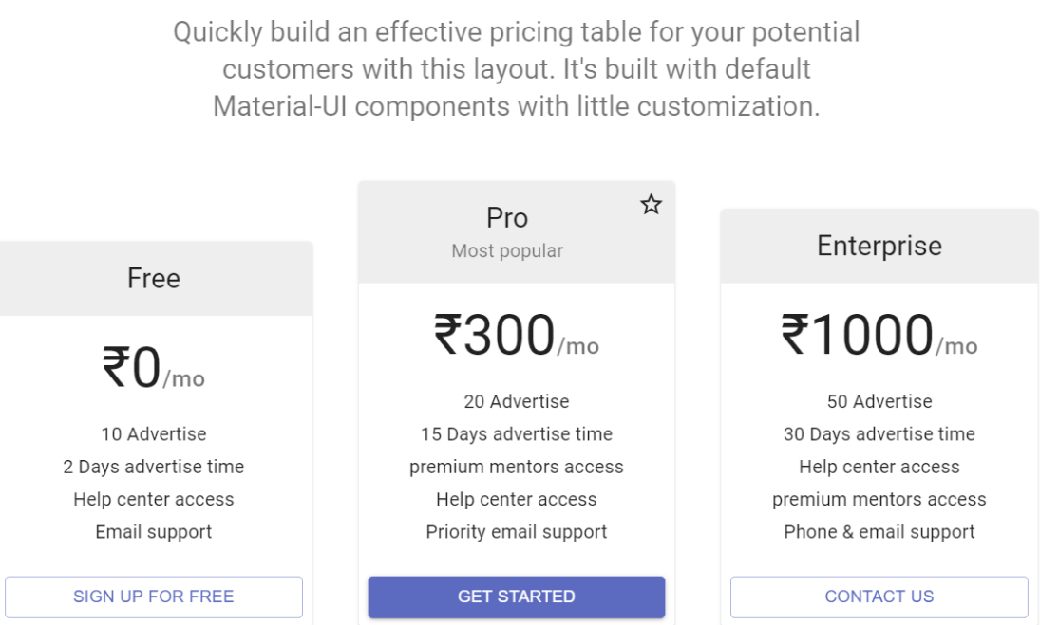
Business Model
6
2
3
1

Slide 7
Marketing Campaign to enhance the outreach of our product
7
Start-Ups
Mentors
Investors
Free registration/Sign-Up
Tap-in this segment through:
Campaigns in colleges/Institutes
Word-of-Mouth
Search Engine Optimization
Tying up with Incubators Cells of the Organizations/ Institutes
Partnership during Start-Up /Entrepreneur Summits
Startups will be provided monetary benefits on getting registrations on the app through referral links
Webinar to be conducted with few esteemed panelists
Advertisements on news media/digital media
Free registration/Sign-Up
Mentors can list the expected incentive range at the time of sign-up / can also change it during the course of mentorship
Tap in this segment through:
Connect with Domain/Industry experts through Professional network/ Institute Alumni Groups
To leverage on existing network to expand it further via word of mouth or referrals
Advertisements on news media
Digital media
Free Registration/Sign-Up
Tap in this segment through:
Webinar to be conducted with few esteemed panelists
Virtual Ideathon- where buddying startups will showcase their ideas
Advertisements on news media
Quarterly report/dashboard publish to our existing network, to get more traction and expansion in the network
Partnership with Corporates/Institutes
Digital media
Community
Influencer Marketing- Bloggers competition to publicize the forum
Word of Mouth
Search Engine Optimization (SEO) –keyword usage
Partnership with Incubator Cells or Entrepreneur groups in the Corporates/ Academic Institutes

Slide 8
Features for users
8
Startup
Mentor
Mentoring
Access to community forum
Funding
Connect with startup
Employment generation
Credible Rating System
Dedicated
marketplace
Notes:
Competitive Advantage wrt Form/Features/UI for Community

Slide 9
Features for users
9
Investor
Community
Network of Like-Minded Users
Access to unique/novel ideas
Gamification and rewarding mechanism to top contributors
Jobs (pay per task model)
Access to community forum
Proof of Concept
Real time feedback
Dedicated market place for startups
Advertisement of finished end product
Notes:
Competitive Advantage wrt Form/Features/UI for Community

Slide 10
Roadmap - future scope
10
Market research reports, Market trend dashboards
Application services for:
1. Patents (Inventions)
2. Trade Information (Information)
3. Trademark (Brand)
Segmentation of Investors
basis the funding capacity & credibility:
1. Platinum
2. Gold
3. Silver
Incubator

Slide 11
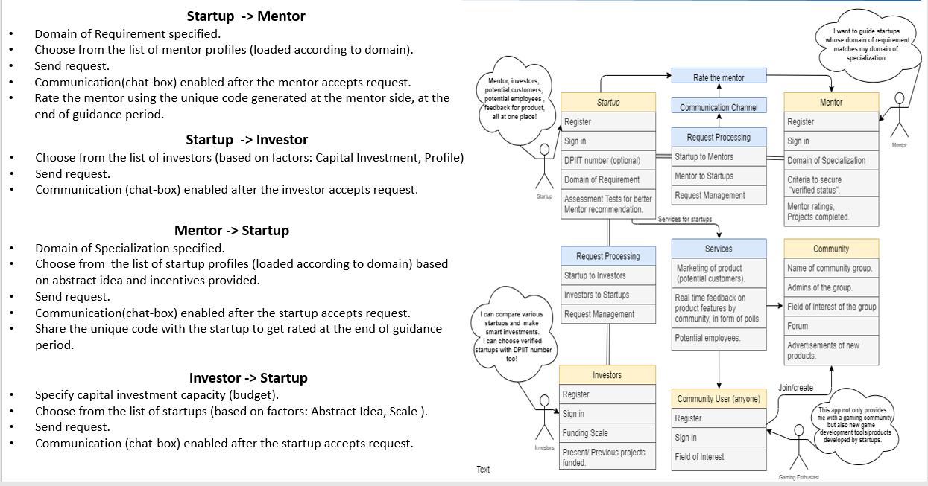
Operation
11

Slide 12
Product Prototype Demo
12
Walkthrough of the web application

