Slide 1
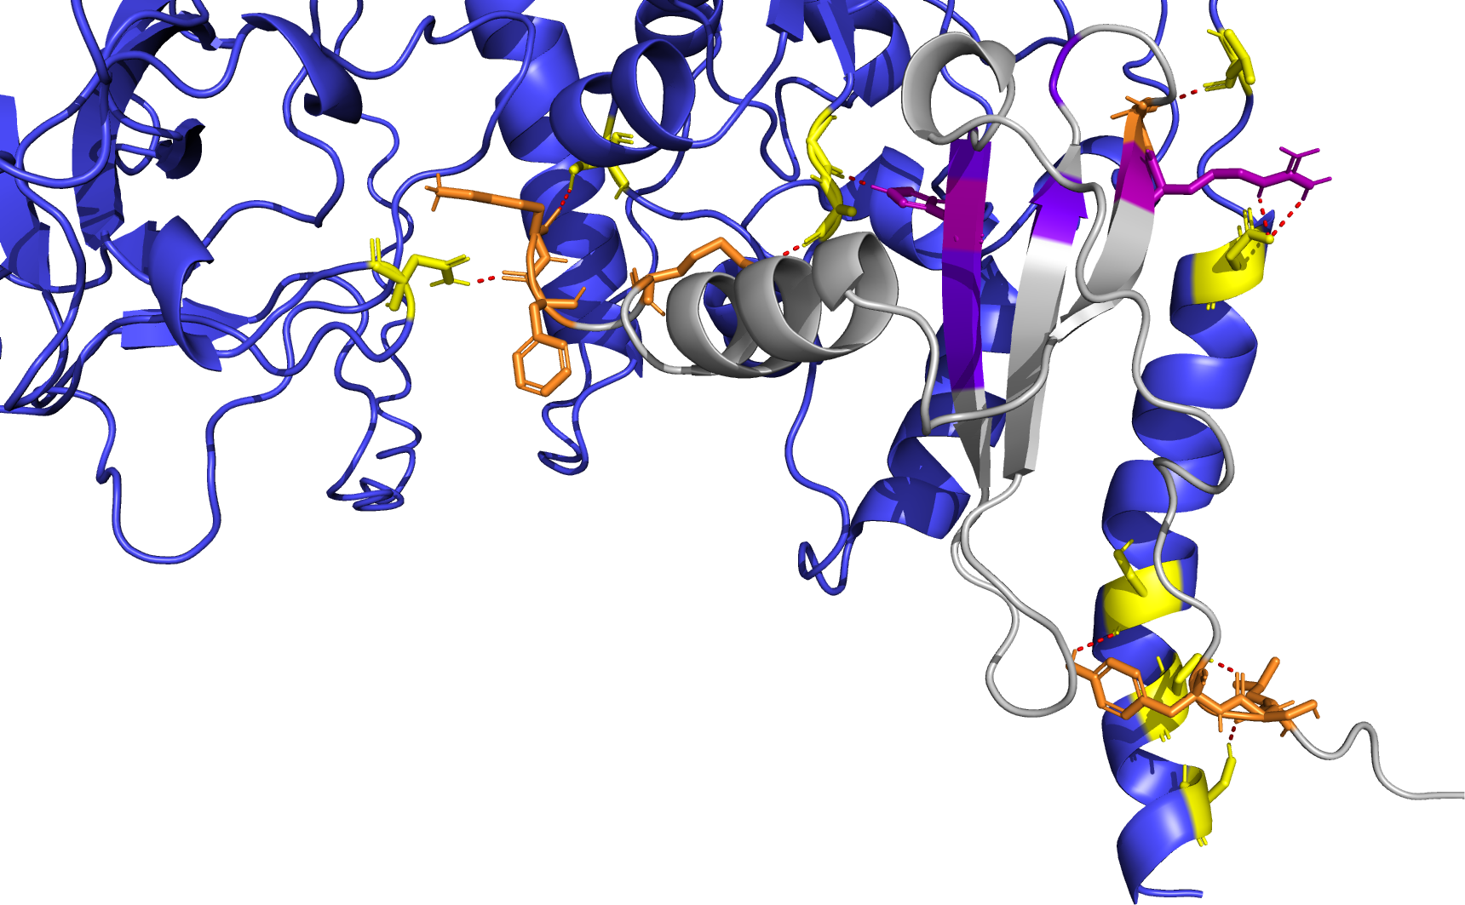
L395
G335
N46
R47
K71
S310
H25
A336
K68
D399
N77
F70
S410
L5
Y7
S413
S6
S416

Slide 2
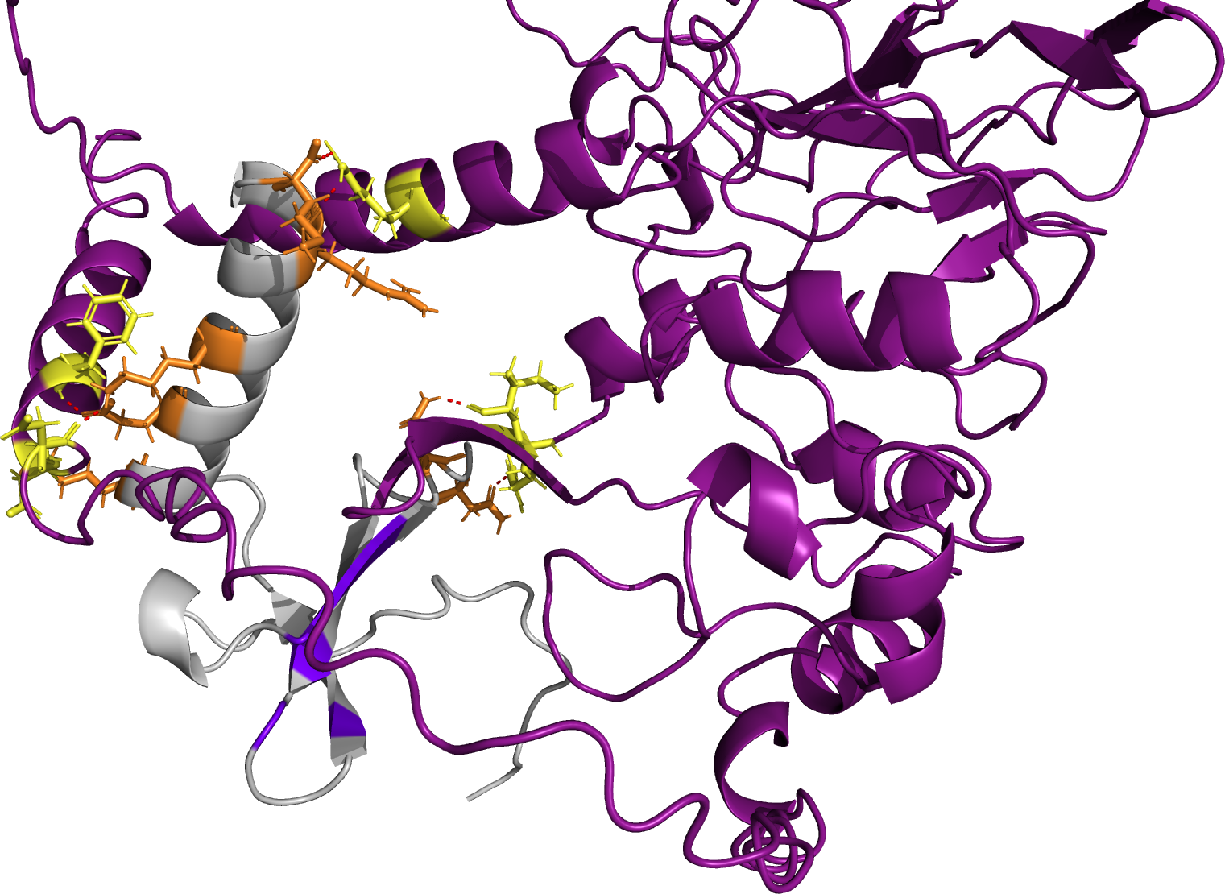
M72
R226
R69
F403
K64
I320
D399
N30
E60
D401
K56
R319
N33

Slide 3
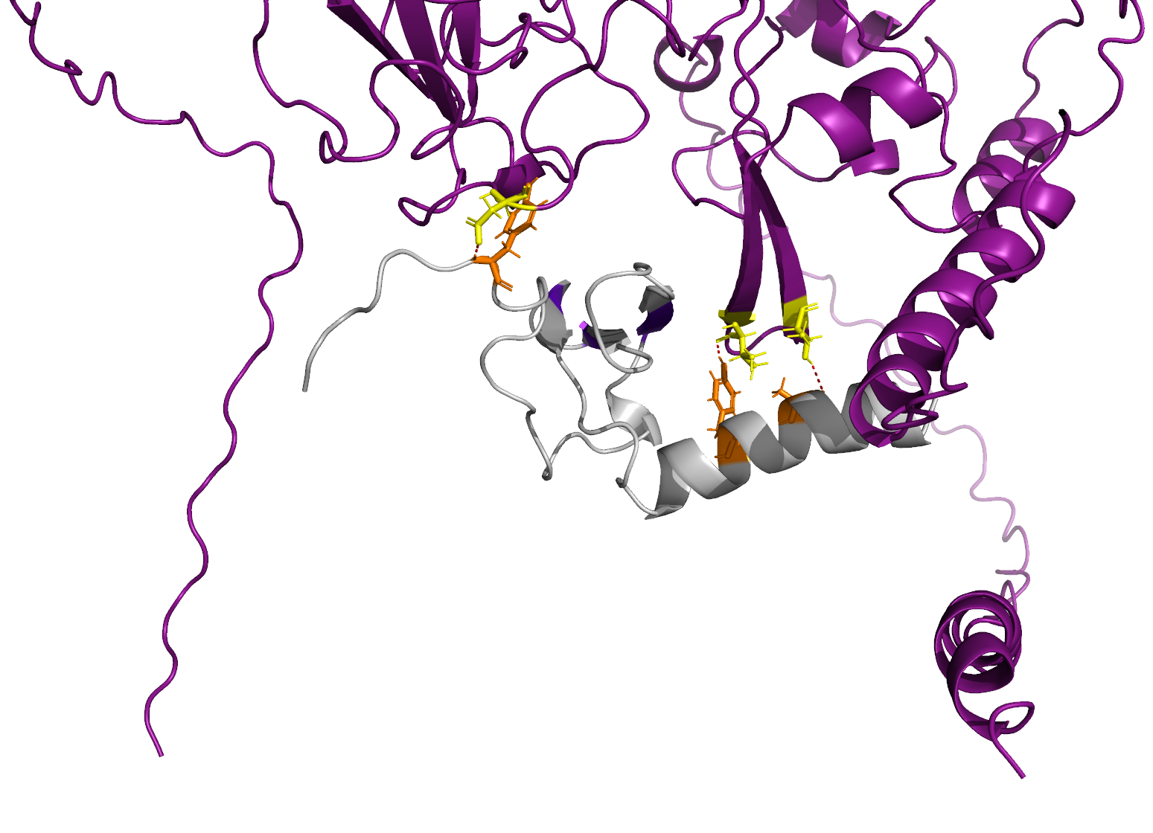
D144
Y7
V324
T329
A65
Y61

Slide 4
L395
G335
N46
M72
R226
R47
K71
S310
D144
H25
A336
Y7
D399
R69
V324
N77
K68
F403
K64
T329
I320
F70
D399
N30
E60
A65
D401
K56
Y61
R319
S410
N33
L5
Y7
S413
S6
S416
HADDOCK-predicted interface
(Best van der Waals Energy)
AlphaFold2 Multimer-predicted interface
(Best AlphaFold2 and GDock Confidences)
AlphaFold2 Multimer-predicted interface
(Best AlphaFold2 Confidence)

Slide 5
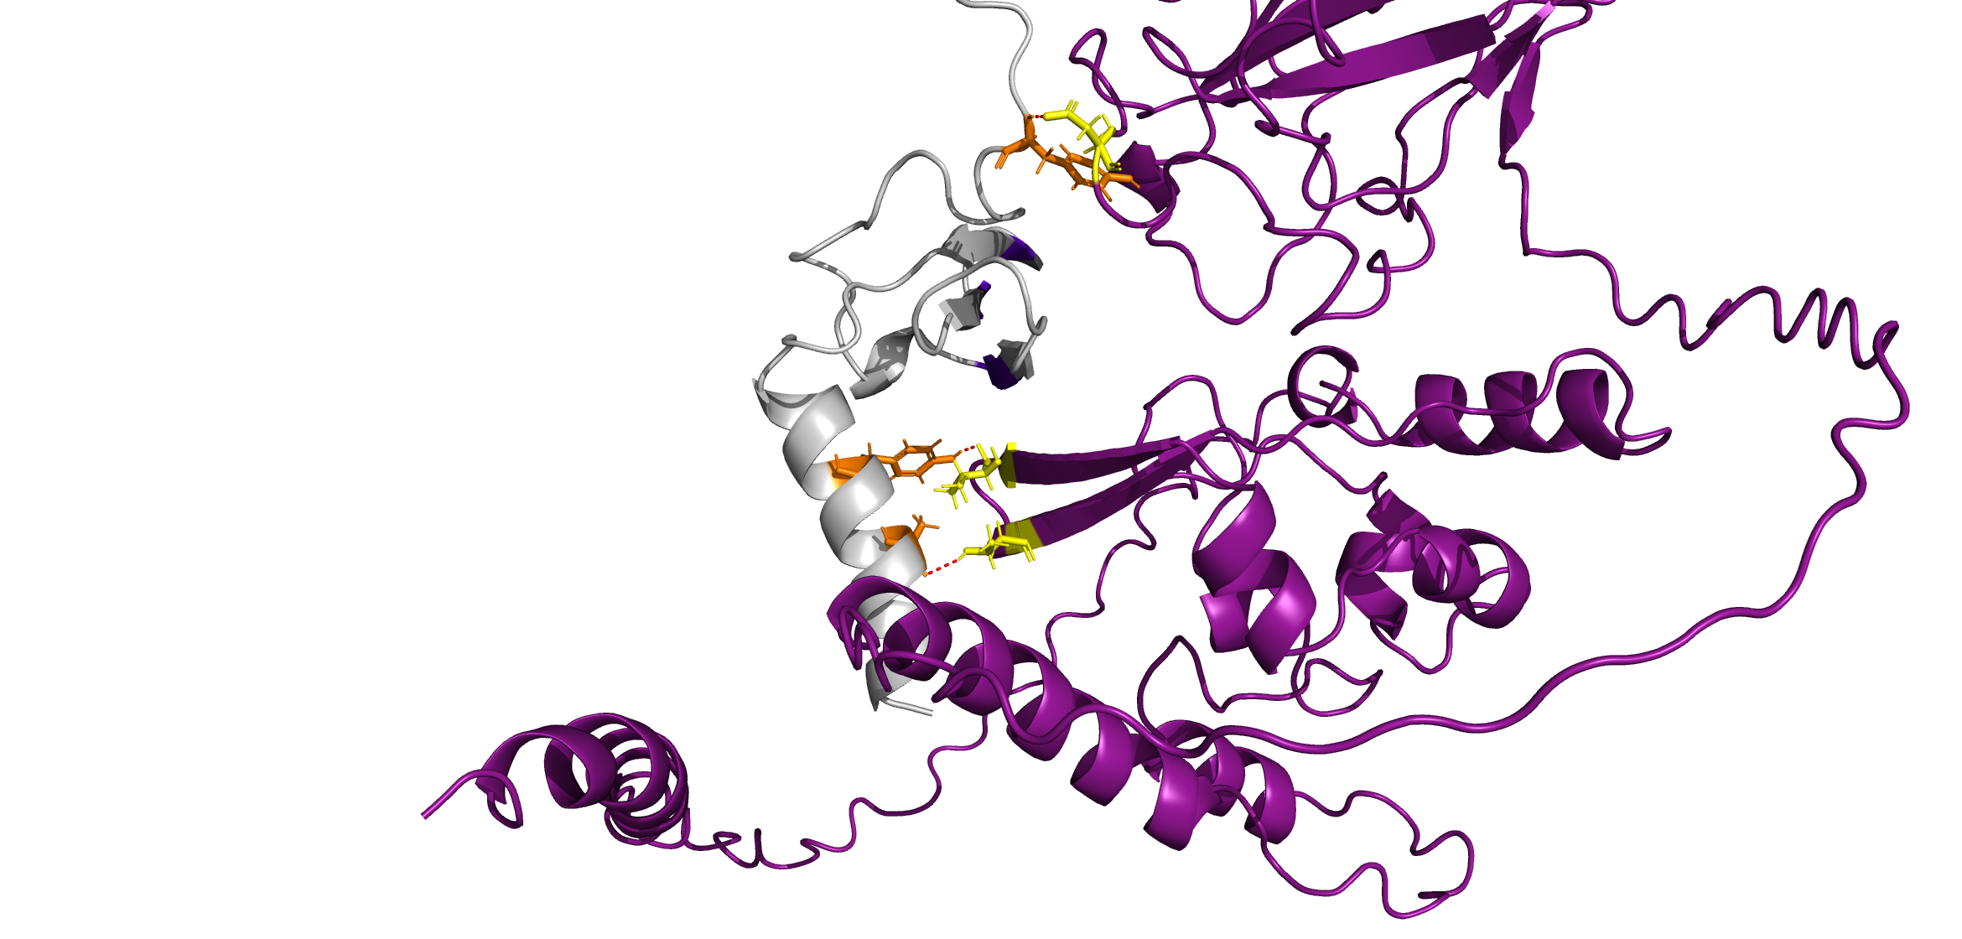
L395
G335
N46
M72
R226
D144
R47
K71
S310
Y7
H25
A336
D399
R69
N77
K68
F403
K64
I320
F70
Y61
D399
N30
V324
E60
D401
K56
T329
R319
S410
N33
A65
L5
Y7
S413
S6
S416
HADDOCK-predicted interface
(Best van der Waals Energy)
AlphaFold2 Multimer-predicted interface
(Best AlphaFold2 and GDock Confidences)
AlphaFold2 Multimer-predicted interface
(Best AlphaFold2 Confidence)

