Slide 1
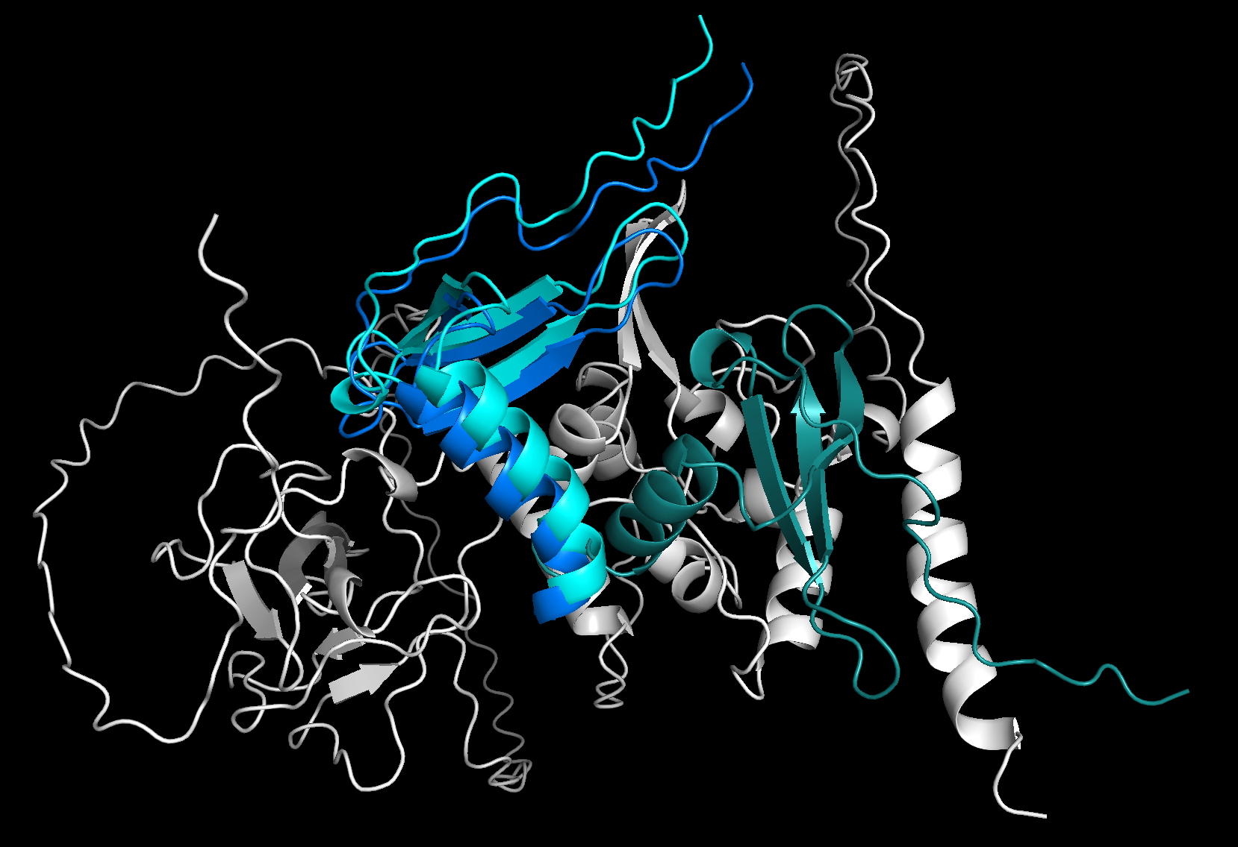
SARS-CoV-2 WA-1
w/ CXCL12beta
25% Run, Best
VDW: -70.82
100% Run, 2nd Best
VDW: -64.38
100% Run, Best
VDW: -100.03

