Slide 1
SARS-CoV-2 Nucleocapsid-Cytokine Docking
Tuple & MITLL

Slide 2
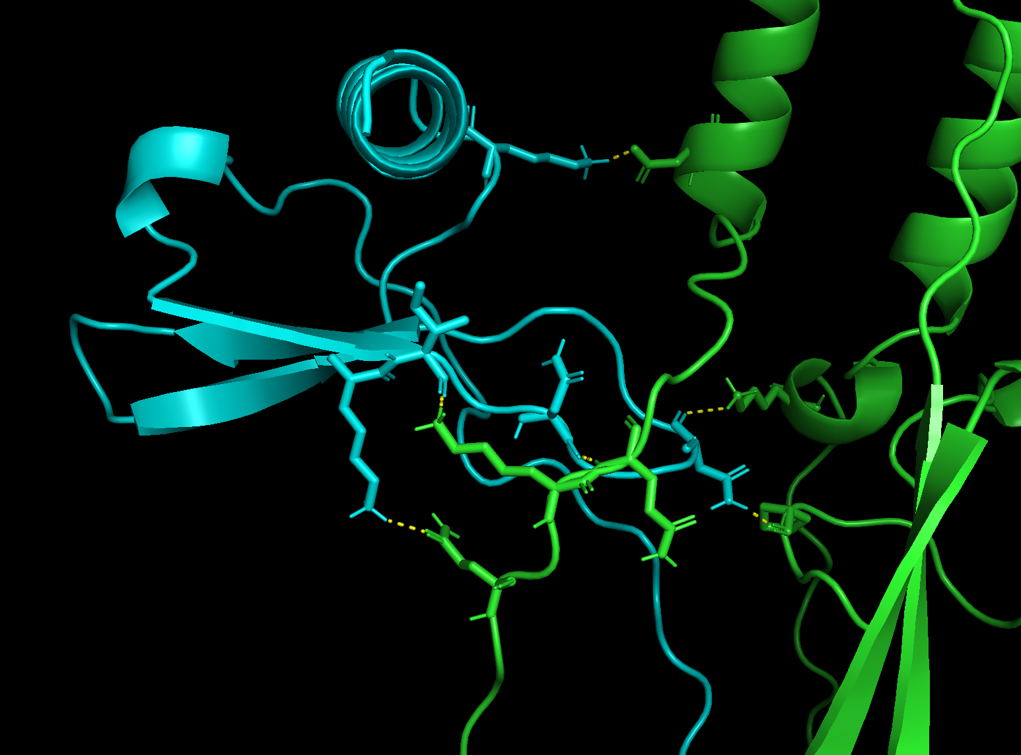
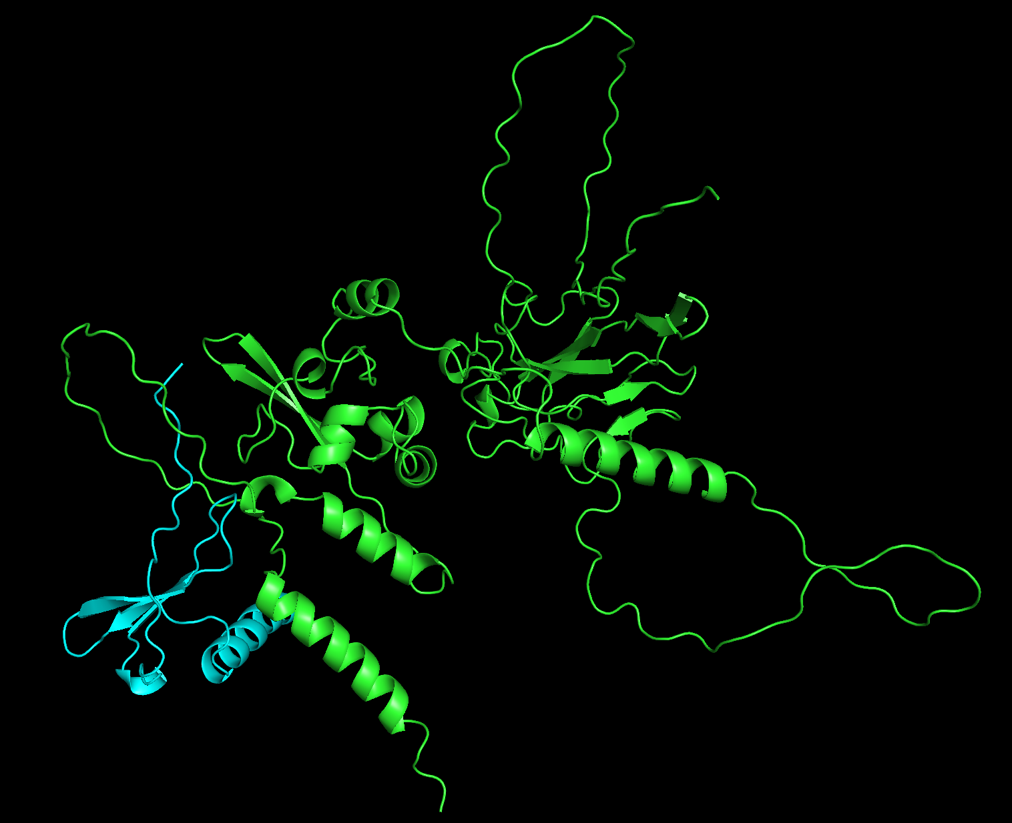
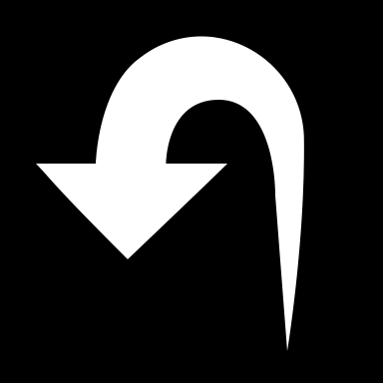
Manual Test: Wu-1 N + CXCL12β
HADDOCK 2.4
w/o AIR restraints
HADDOCK score | -45.7 +/- 7.8
Cluster size | 3
Van der Waals energy | -27.5 +/- 3.1
Electrostatic energy | -130.6 +/- 43.1
Desolvation energy | 7.9 +/- 2.7
Restraints violation energy | 0.0 +/- 0.0
Buried Surface Area | 1069.0 +/- 113.7
K54
D399
I28
N30
K361
K27
N33
K388
P279
Q386
Q389

