Slide 1
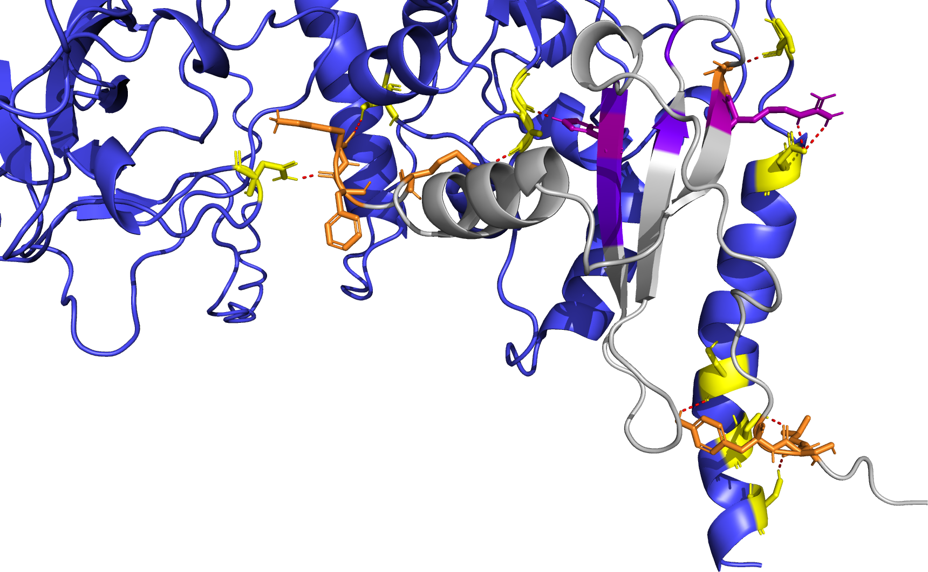
L395
G335
N46
R47
K71
S310
H25
A336
K68
D399
N77
F70
S410
L5
Y7
S413
S6
S416

