Slide 1
A Team Project Management System with Integrated AI
COURSE PROJECT · COMPUTER ENGINEERING K23A
Kanban + Scrum + AI assistant, usable from the keyboard and even offline
Phạm Văn Huynh · Đàm Đức Đôn · Phạm Minh Tú
Supervisor: Hà Thị Thanh
ICTU · 2026
Notes:
Good morning. We are Huynh, Đôn and Tú. Our project is a project management system built for small teams like ours, with Kanban, Scrum and an AI assistant built in.

Slide 2



The problem: student teams manage work badly
Chat & Excel
Big tools
Busy work
Tasks get lost in messages. No status, no deadlines, no owner.
Jira is heavy and online-only. Scrum reports and AI cost money.
Writing reports, meeting minutes and plans eats the team’s time.
2 / 14
Notes:
Our own team had this problem. We tracked work in chat and spreadsheets, lost tasks, and had no idea who was blocked. Jira and Trello help, but they are heavy, need the internet all the time, and charge for Scrum reports and AI.

Slide 3




Our solution: one web app, four ideas
Keyboard-first
every action has a shortcut
Kanban + Scrum
board, sprints, burndown
Works offline
data saved on your device first
AI assistant
summaries, minutes, planning
3 / 14 · English & Vietnamese interface
Notes:
So we built a web app around four ideas. Everything can be done from the keyboard. It supports both Kanban and Scrum. An AI assistant does the boring management writing. And it keeps working when the network drops, because data is saved in the browser first.

Slide 4
Roles belong to the project, not the account
Sign up with only name, email, password. No role is chosen.
Action | PM | Member
Create, move tasks | Yes | Yes
Comment, use AI | Yes | Yes
Invite, change roles | Yes | No
Run sprints | Yes | No
Create a project → you are its PM. Invite others → they join as Member after accepting.
The server checks every request. A non-member gets “not found”.
4 / 14 · The same person can be PM in one project and Member in another
Notes:
An account has no power by itself. Power comes from the project: whoever creates a project is its PM, invited people are Members once they accept. The same student can lead one project and be a member of another. And the server enforces this on every request, not just the buttons on screen.

Slide 5
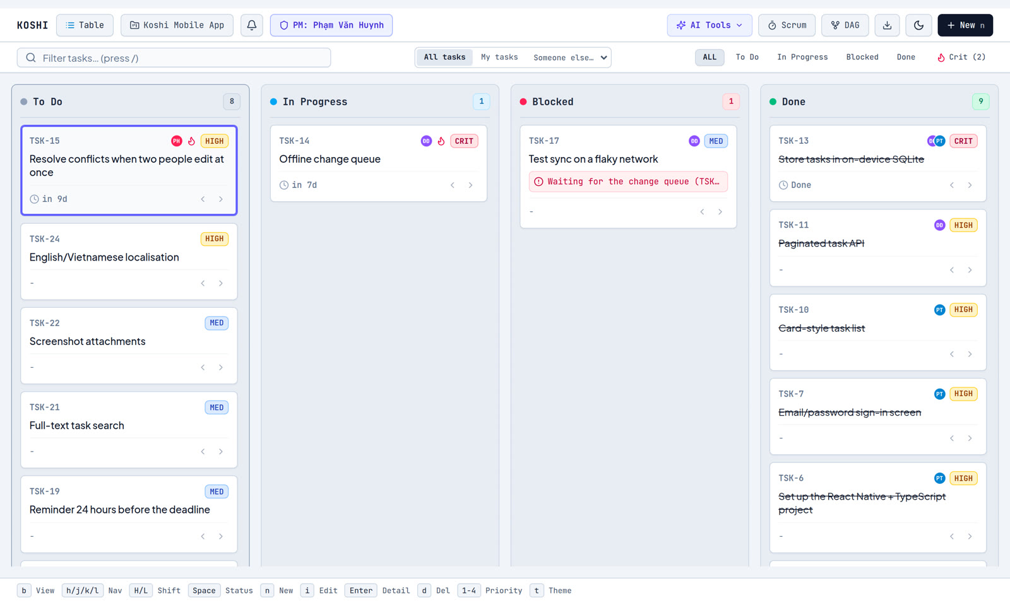
The board: see every task at a glance
4 columns
To Do → In Progress → Blocked → Done
Deadline first
late work rises to the top
Keys, no mouse
h j k l move · Space changes status
5 / 14 · A flame marks tasks on the critical path
Notes:
This is the main screen. Four columns, one card per task. Each card shows the owner, priority and deadline, and cards are sorted by deadline so overdue work is never buried. You can do everything with the keyboard: move with h j k l, press Space to change status, n for a new task. The flame icon means the task is on the critical path, which I will explain later.

Slide 6
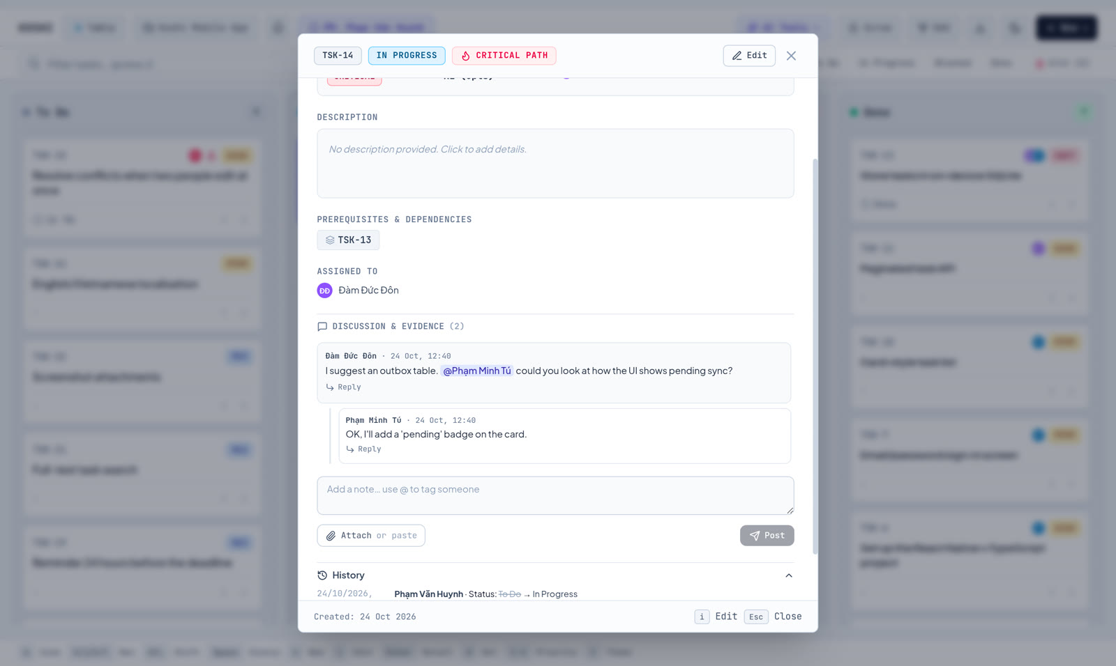
Inside a task: the team talks in one place
Several people can share one task
@mention a teammate → they get a notification
Proof of done: attach a screenshot when finished
History: who changed what, and when
6 / 14
Notes:
Opening a task shows everything about it. A task can have several people. Discussion happens here, with mentions and replies, so nothing is lost in chat. When a task is finished you can attach proof, like a screenshot. And the history shows every change and who made it, which helps a lot when several people edit the same board.

Slide 7

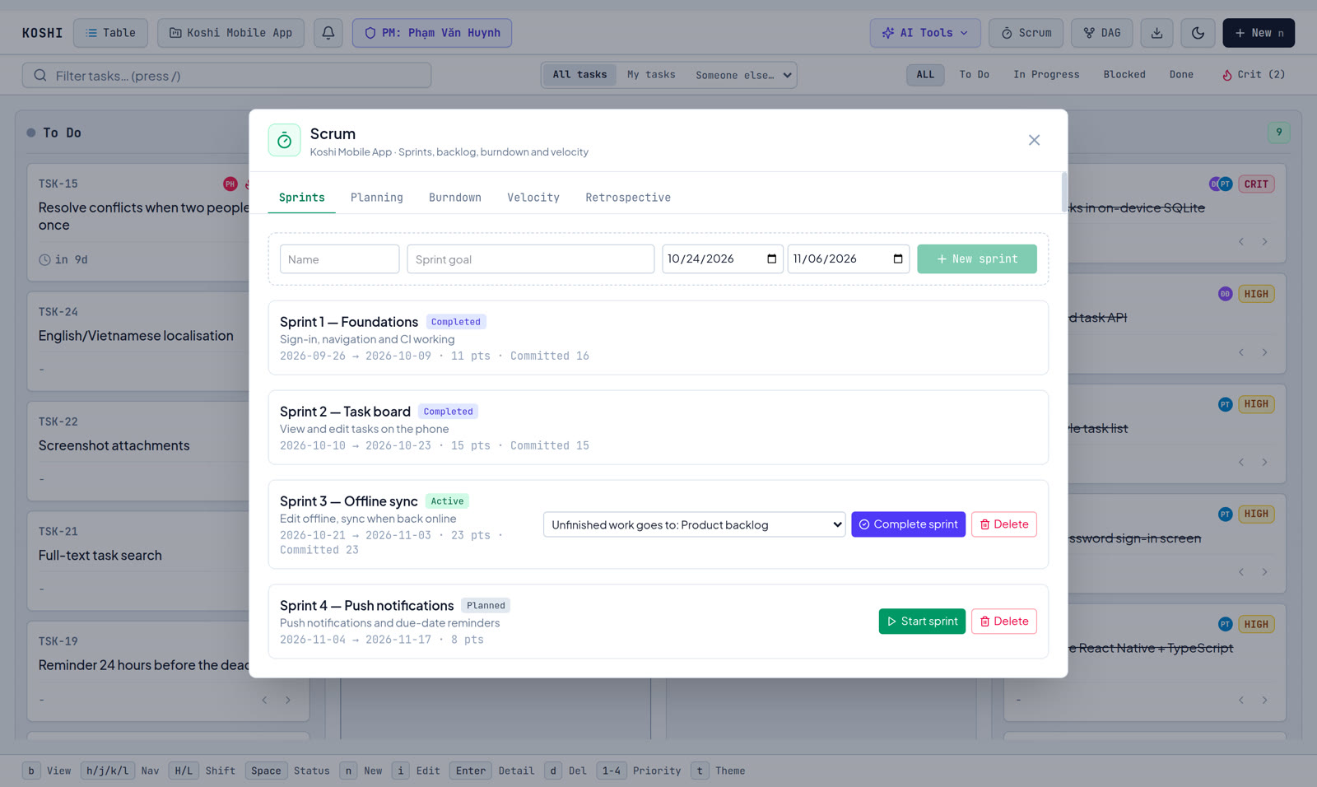
Scrum: work in short sprints
Planned
Active
Completed
PM picks tasks from the backlog
Team works; points are the promise
Unfinished work moves on
Only one sprint runs at a time. Only the PM can start or finish it.
7 / 14 · Suggested by our supervisor
Notes:
Our supervisor suggested supporting Scrum, so we did. Work is split into sprints of about two weeks. A sprint is first planned: the PM pulls tasks from the backlog. When it starts, the system remembers how many points the team promised. When it ends, anything unfinished goes to the next sprint or back to the backlog, nothing is deleted.

Slide 8
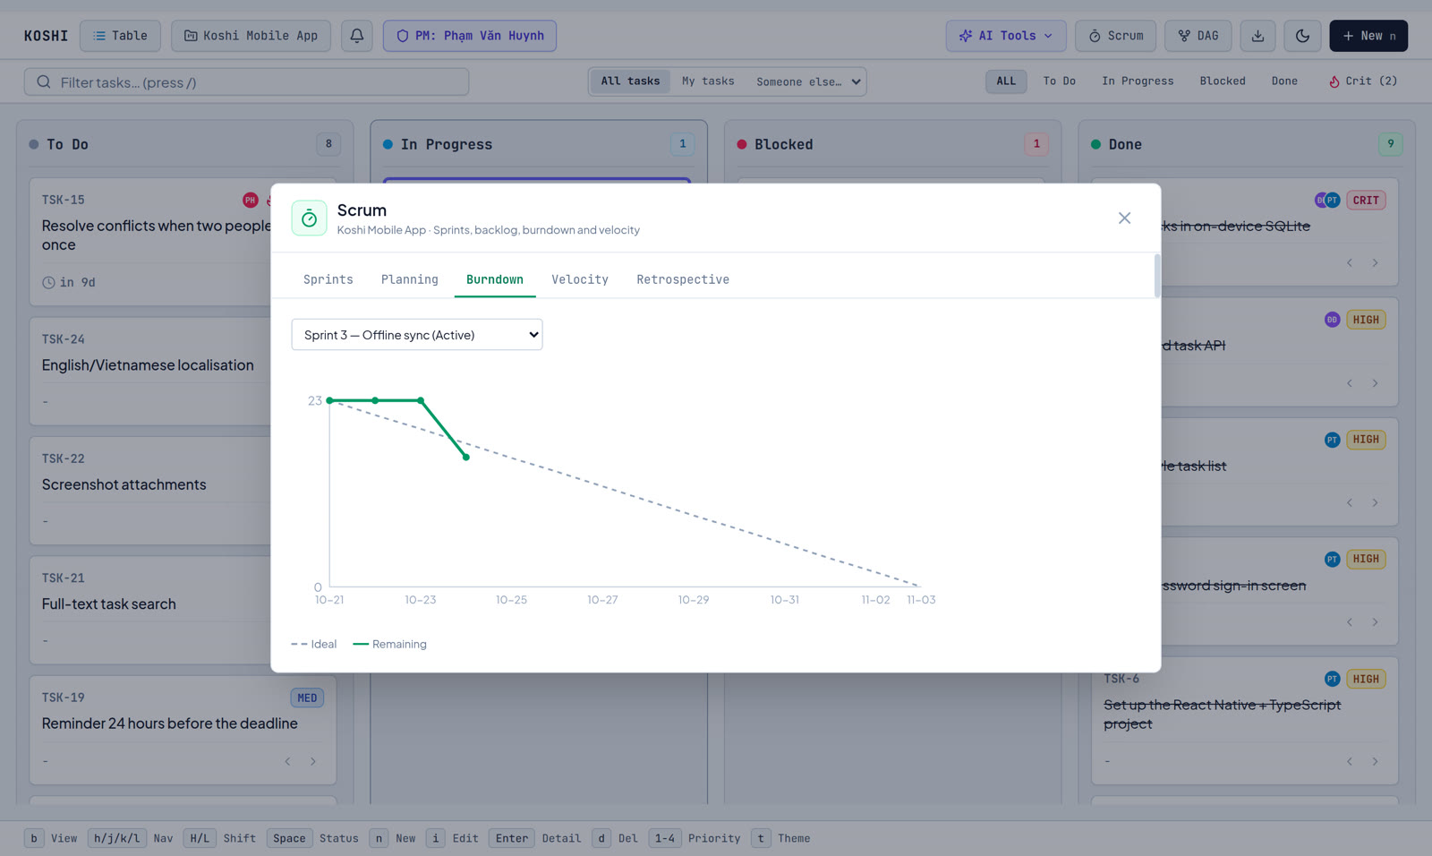
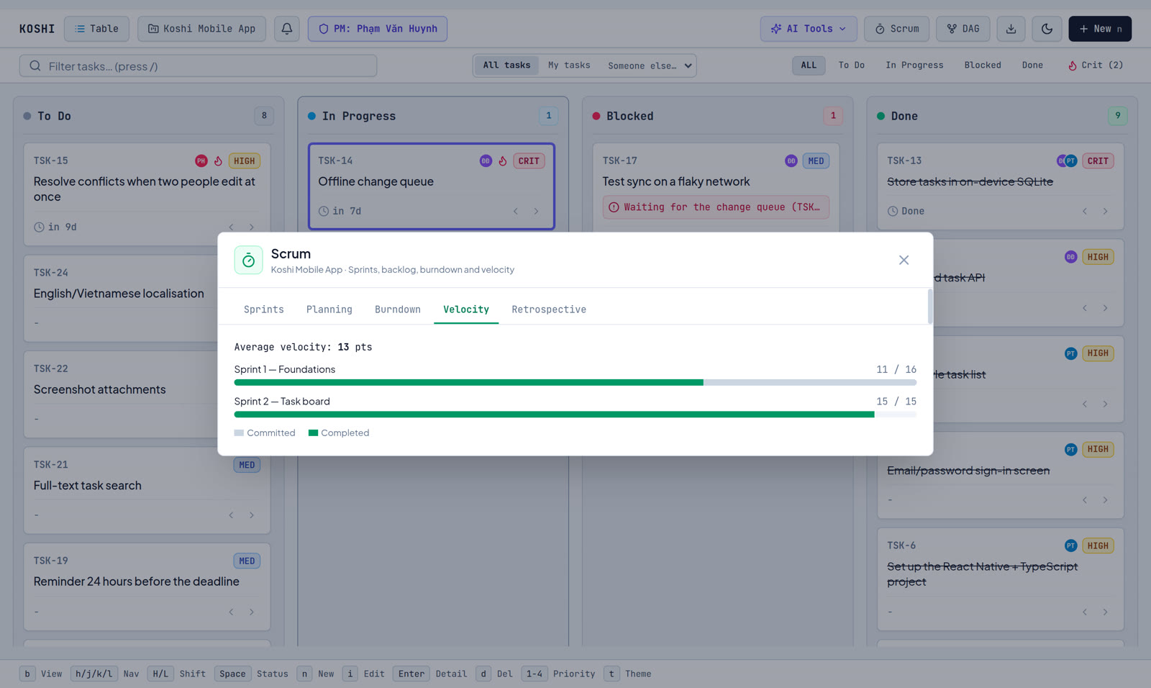
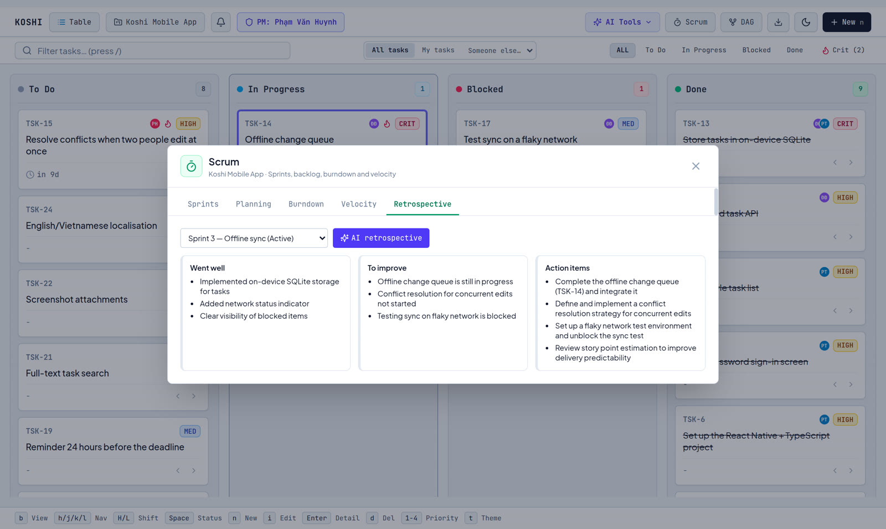
Sprint charts show if we are on track
Burndown
Velocity
AI retrospective
Work left each day vs. the ideal line
Points promised vs. points done
What went well, what to fix, next actions
8 / 14
Notes:
Three charts tell the team how the sprint is going. Burndown: how much work is left each day compared with the ideal straight line. Velocity: how many points we promised and how many we actually finished, so the next promise is realistic. And at the end, the AI writes a retrospective from the sprint's real numbers: what went well, what to improve and concrete next steps.

Slide 9
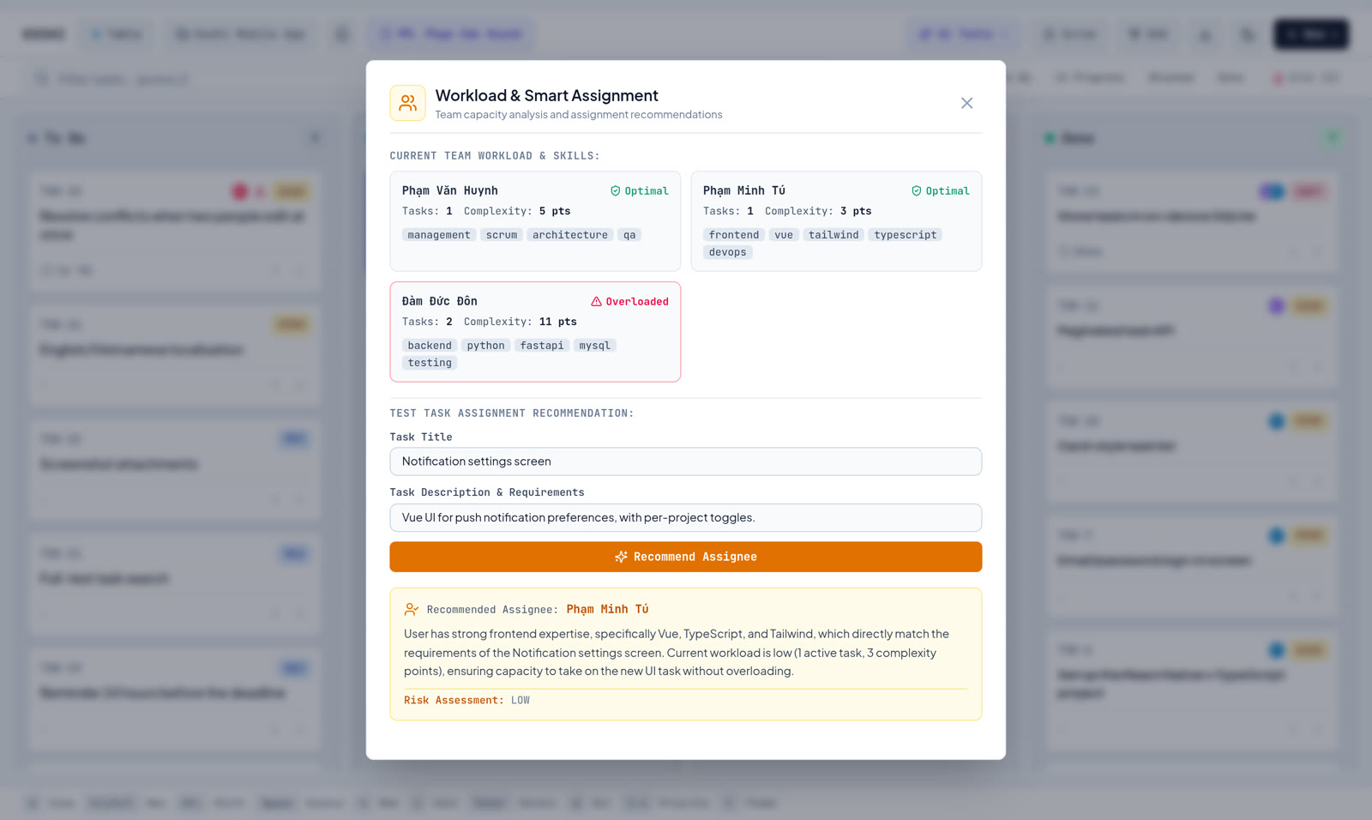
AI does the boring management work
You give | AI returns
The board | Weekly progress summary
Meeting notes | Tasks, owners, decisions
A new task | Best person to do it
A big goal | Sub-tasks + order
A finished sprint | Retrospective
9 / 14 · Groq cloud model · if AI is down, a rule-based answer is used, so it never breaks
Notes:
Five AI features. Give it the board and it writes the weekly report. Paste meeting notes and it extracts tasks, owners and decisions. Describe a new task and it suggests who should take it, based on skills and current workload. Give it a big goal and it breaks it into ordered sub-tasks. And the sprint retrospective. We use a model on Groq. If the AI service fails, a rule-based answer from the project data is returned instead, so the feature never crashes. Answers always come back in the language of the interface.

Slide 10
No internet? Your work is still there
Every change is saved in the browser first, then sent to the server.
Personal project
Team project
Keep editing offline. Syncs when back online.
Read-only offline, so two people never overwrite each other.
10 / 14 · “Local-first” design
Notes:
The app is local-first. Every change goes to the browser's own database first, so the screen reacts instantly, then it is sent to the server. If you lose the connection on a personal project you just keep working. On a shared project we switch to read-only, because two people editing offline would overwrite each other and we chose safety over cleverness.

Slide 11

How it is built
MySQL
Browser
10 tables, versioned migrations
Server
Vue 3 app + local copy (IndexedDB)
Python FastAPI, 51 API endpoints
AI (Groq)
gpt-oss-120b model
Runs in Docker; published through a Cloudflare Tunnel — no open ports, HTTPS included.
11 / 14
Notes:
Technically it is a classic three-part system. The browser runs a Vue 3 app and keeps a local copy of the project. The server is Python with FastAPI, about fifty endpoints. Data lives in MySQL, and the server calls the AI model on Groq. Everything runs in Docker containers, and a Cloudflare tunnel publishes it on the internet without opening any port on our router.

Slide 12
Tested, not just “it works on my machine”
177
442
32
53
server tests, all pass
interface tests, all pass
end-to-end checks on the live site
issues found and recorded
Example: the “AI” task splitter never called the AI — only a real-model test found it.
12 / 14 · Tests run automatically on every push (GitHub Actions)
Notes:
We took testing seriously. 177 tests on the server, 442 on the interface, and a script that checks 32 things on the live website, including the AI. We even tested our tests: we broke the code on purpose and made sure a test failed. Testing and review found 53 issues, each recorded with its cause. My favourite: the AI task splitter never actually called the AI, it returned the same template every time. Only testing against the real model revealed that.

Slide 13
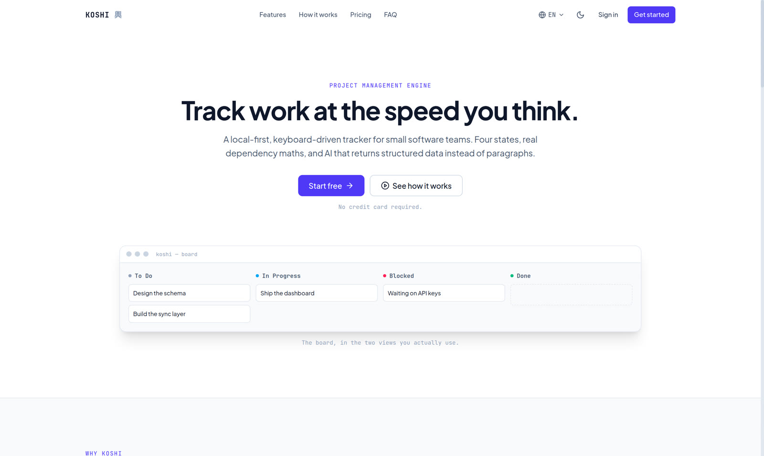

Results: live and ready to use
koshi.huynhca.com
Roles per project, Kanban, Scrum
5 AI features, never crash
English & Vietnamese
Next: offline editing for teams, mobile app, Git integration
13 / 14 · Demo accounts available on request
Notes:
The system is live on the internet at koshi dot huynhca dot com, and our team tested it there. Everything we planned works: roles per project, Kanban, Scrum, the five AI features, and both languages. Next we would like teams to edit offline too, build a mobile app, and link tasks to Git commits. Now a short live demo.

Slide 14
Thank you!
Questions & live demo
Phạm Văn Huynh · Đàm Đức Đôn · Phạm Minh Tú — Computer Engineering K23A
Notes:
Thank you for listening. We are happy to answer questions, and we can show the live system now.

