Slide 1

COMP398 – Final Year Project II
Fastfood e-Order System
2Fi Business Solutions Limited
Project Advisor:
Team Member:
Date:
Professor Frederick H. Lochovsky
Chuang Hon Kuen, Jason
Lau Hon Kwan, Kwan
Ling Yuk Yan, Bennett
26th April, 2006

Slide 2

Overview
Background and motivation
Sponsor and project introduction
Application description
Hardware/software
Database design
Implementation issues
Testing
Problems encountered
Lessons learnt
Conclusion
Demo
Q & A Session
Presenter: Ling Yuk Yan, Bennett

Slide 3
Background and motivation
Hong Kong Fast food culture
Take-away orders (Phone)
  Time-consuming and error-prone method
New way of making fast food orders (E-Commerce)
  More ways to make an order, the more business can be covered
Therefore, a web-based fast food electronic ordering system has been developed
Presenter: Ling Yuk Yan, Bennett

Slide 4
Sponsor
Our sponsor - 2Fi Business Solutions Limited
  A company that provides IT solutions to other organizations
  President: Raymond Woo
Presenter: Ling Yuk Yan, Bennett

Slide 5
Project introduction
Objective of the system
  Provide an effective way
    accept online orders, manage information (food items and orders) and provide post-sales analysis reports for managers
  Attract people to try and increase efficiency of the ordering process
  Display different languages on user interface
    Use the system globally
Presenter: Ling Yuk Yan, Bennett

Slide 6
Application description
Customer
  View menu with food items and set meals
  Make order (Or use the quick order list)
    Food items has food options and swap fixed items to other food items at a price
  Maintain personal information
Manager
  Generate the Sales & Profit report and view the rating analysis of food items and set meals
    Decision making for purchasing
Presenter: Ling Yuk Yan, Bennett

Slide 7
Application description
Restaurant staff
  Maintain customer, staff, banner and branch information
  Maintain food items, set meals, orders, food item options and menu information
  Maintain promotion (Two strategies)
    Buy a certain quantities of food items or set meals at a price
    Buy a certain quantities of food items or set meals to have food items with discount.
Presenter: Ling Yuk Yan, Bennett

Slide 8
Hardware/Software
Software:
Operating System | Fedora 5
Web Server | Tomcat 5.5
Database Server | MySQL 5.0
Runtime Environment | Java Runtime Environment 5.0
Development tools | Eclipse
Web Browser | Internet Explorer 6.0
Hardware:
CPU | Pentium 4 3GHz
Main Memory | 1GBytes
Storage | 100GBytes (Database Server only) 40GBytes (Application Server & Client Machine)
Network | 100Mb Ethernet connection and leased line
Presenter: Ling Yuk Yan, Bennett

Slide 9
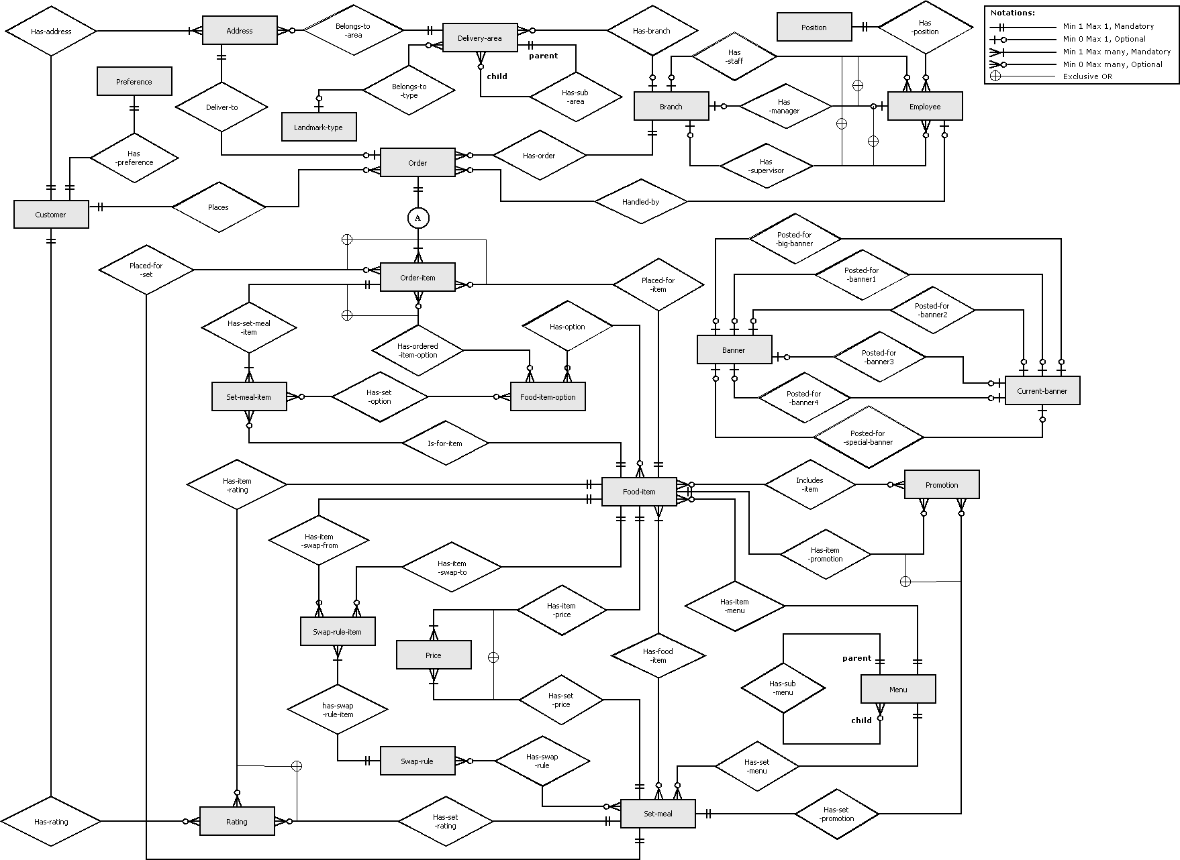
Database Design
Delivery
Customer
Order
Food
Presenter: Chuang Hon Kuen, Jason

Slide 10
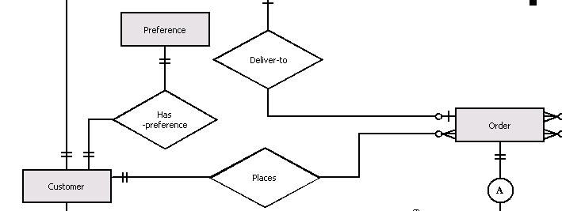
Database Design - Customer
Preference stores system environment for Customer
- such as default language of the user interface
Presenter: Chuang Hon Kuen, Jason

Slide 11
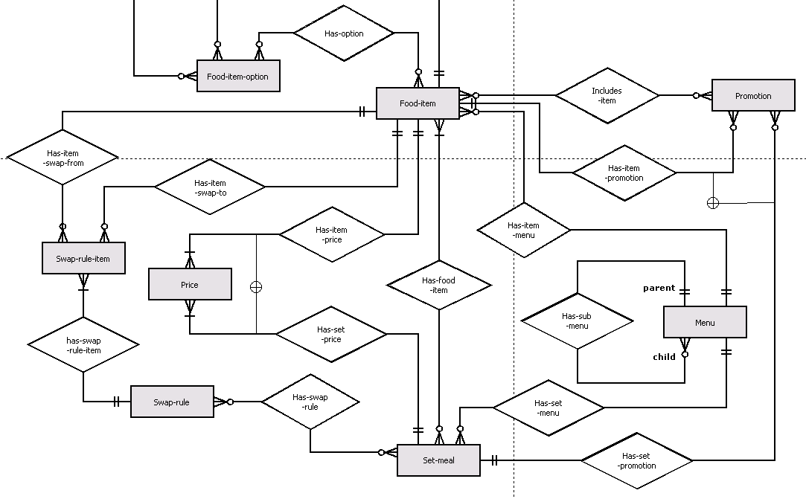
Database Design - Food
Presenter: Chuang Hon Kuen, Jason

Slide 12
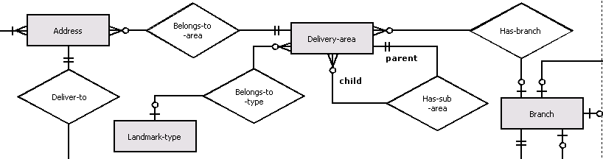
Database Design - Delivery
Implementation issues
- Framework used
- i18n, UI dynamically
- Mapping
Presenter: Chuang Hon Kuen, Jason

Slide 13
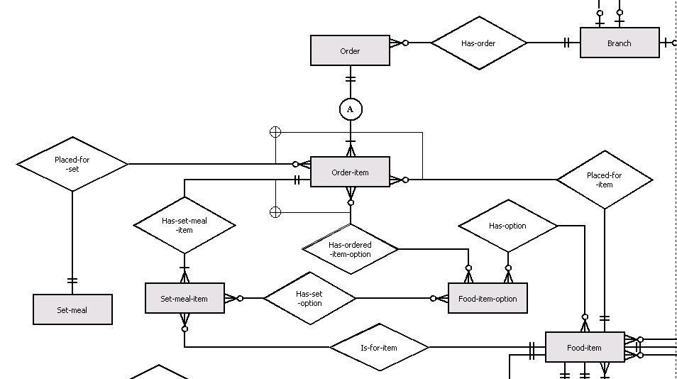
Database Design - Order
Presenter: Chuang Hon Kuen, Jason

Slide 14
System Implementation
Java as programming language
MVC Model
  HTML view by JSP
  Logic control by WebWork Framework
  Data storage and retrieval Management by Spring Framework
  Mapping Java Object in RDBMS by Hibernate
Benefits
  Debug & Maintain the system systematically
Presenter: Chuang Hon Kuen, Jason

Slide 15
System Implementation (cont.)
Internationalization
  supports multiple language of user interface.
  new language file can be added to support new language of user interface.
Dynamic form generation & validation
  by JavaScript from user browsers
  Without refreshing page to provide user-friendly user interface for data input.
Presenter: Chuang Hon Kuen, Jason

Slide 16
Testing
The following tests is applicable to our system
  Unit Testing
  Performance Testing
  User Interface Testing
  Security and Access Control Testing
  Installation Testing
  Acceptance Testing
Presenter: Lau Hon Kwan, Kwan

Slide 17
Problems encountered
Internationalization (i18n)
  Different language, different encoding, even different format
Calculating the correct price of orders
  Many factors affecting the price
Generating JavaScript dynamically
  User Interface
  Validation
Presenter: Lau Hon Kwan, Kwan

Slide 18
Lessons learnt
Capturing requirement without a real application domain
  This is a project for a software house, not a restaurant
Communication skills
  Help us to do the right thing
Organization skills
  Help us to do the things with efficiency
Presenter: Lau Hon Kwan, Kwan

Slide 19
Conclusion
We have discussed…
  The background of the project
    Sponsor
    Application description
    Hardware / Software
  The database and the implementation of the system
    Framework
    Mapping
    i18n
    Dynamic UI
  Testing
  Problems encountered
  Lessons learnt
Presenter: Lau Hon Kwan, Kwan

Slide 20
Demo
Overview
Management Side
  Maintain Customer Info.
  Maintain Restaurant Info.
  Maintain Food and Set Meal
  Analysis and Reporting
Customer Side
  Maintain Account
  Order Process

Slide 21
COMP398 – Final Year Project II
Q&A Session

Slide 22
COMP398 – Final Year Project II
Thank You!
End of presentation

