Slide 1
Continuous Mandatory Ventilation Controller
Project 2019

Slide 2
Deep Sleep Mode
2019-03-22 21:54
uC active : > 30 mA
Deep sleep : 5.7 mA
Deep sleep w/o sensor : 5.7 mA
Deep sleep w/o sensor & RF : 4.5 mA
pin | description
1 | NC
2 | GPIO16
3 | RST
Quiescent
Current 5 mA!
Deep sleep
mode activated

Slide 3
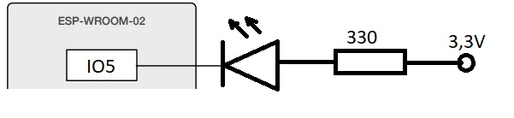
User LED
1.9V
ESP8266
GPIO5
5V

Slide 4
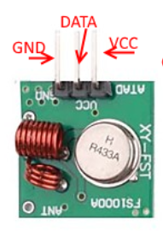
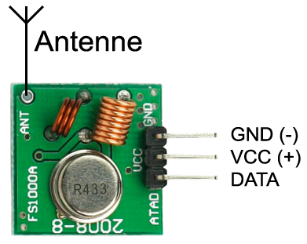
RF433 Connector
pin | description
1 | 5V
2 | key
3 | NC
4 | GPIO14 (data)
5 | GND
Board
RF433

Slide 5
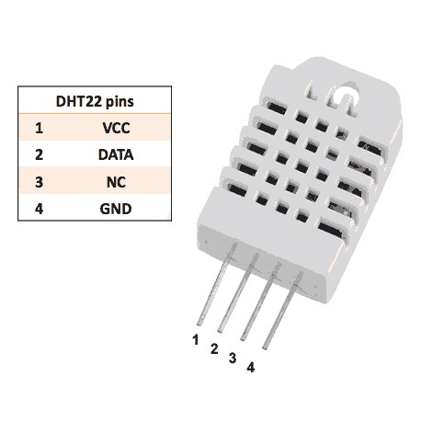
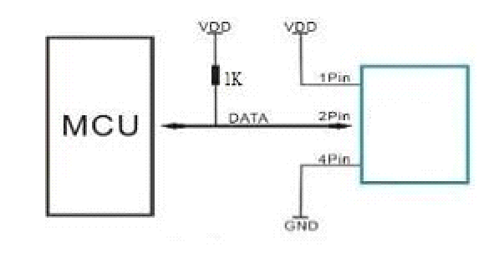
DHT22 Connector
pin | description
1 | 3.3V
2 | GPIO12
3 | key
4 | key
5 | GND
Board
Sensor
DHT22

Slide 6
Electrical Connection
220V
CMV Controller
220V
433 MHz
433 MHz
Interruptor
CMV Motor
Triple
Interruptor
DIO
++++
++
Neutral

Slide 7
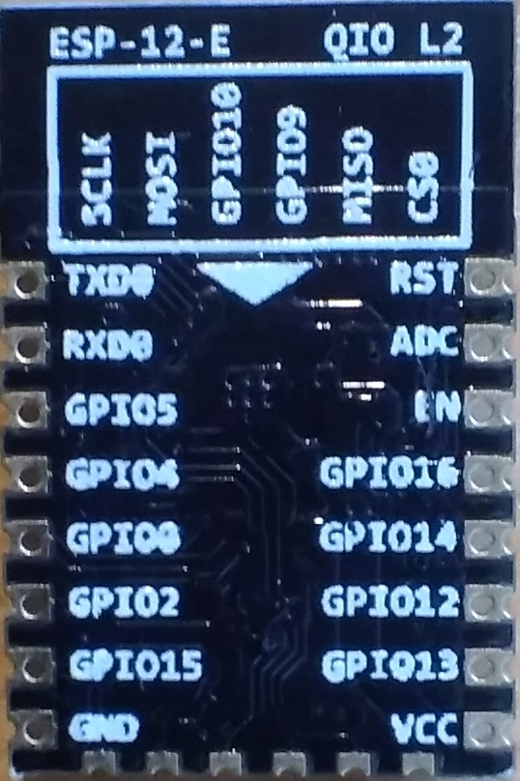
Annex. ESP8266 pinout

