Slide 1
Object Detection and YOLO

Slide 2
01
02
03
CubiCasa5K
YOLO
Model Deployment

Slide 3
Cubicasa5K
01

Slide 4
Cubicasa5K
Dataset contains 5000 samples (80% training + 10% testing + 10% validation)
Samples annotated for 80 floor plan objects
They used SVG for annotation
It’s based on CNN
They used Nvidia GeForce GTX TitanX GPU for training
They train the model 300 epochs for 3 hours
The average accuracy for rooms is 69.8 while it was 61.5 for small icons

Slide 5
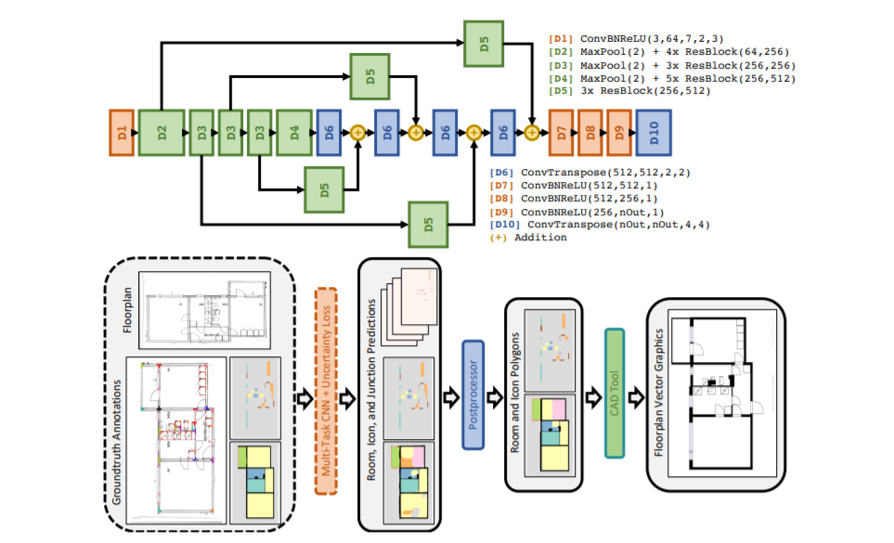
Cubicasa5K – CNN Architecture

Slide 6
YOLO
02

Slide 7
YOLO (You Only Look Once)
RCNN, SSD, YOLO
YOLOv4 being a single staged object detector works more accurate and faster than Two staged detectors like R-CNN, Fast R-CNN.
It detects 65 FPS
In YOLO a single convolutional network predicts the bounding boxes and the class probabilities for these boxes.

Slide 8
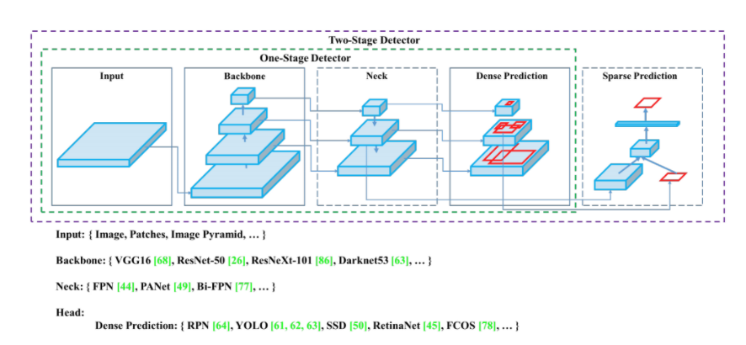
YOLO Architecture
YOLOv4 is designed based on recent research findings, using CSPDarknet53 as a Backbone, SPP (Spatial pyramid pooling) and PAN (Path Aggregation Network) for what is referred to as “the Neck”

Slide 9
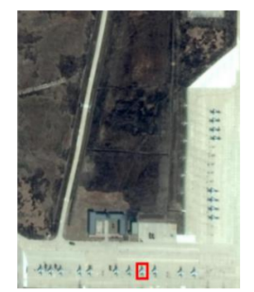
YOLO Drawbacks
It is not good for very small objects
“Expanding Receptive Field YOLO for Small Object Detection”

Slide 10
YOLO Papers
YOLOv4: Optimal Speed and Accuracy of Object Detection
https://arxiv.org/pdf/2004.10934.pdf
Expanding Receptive Field YOLO for Small Object Detection
https://iopscience.iop.org/article/10.1088/1742-6596/1314/1/012202/pdf

Slide 11
Model Deployment
03

Slide 12
THANKS

