Slide 1
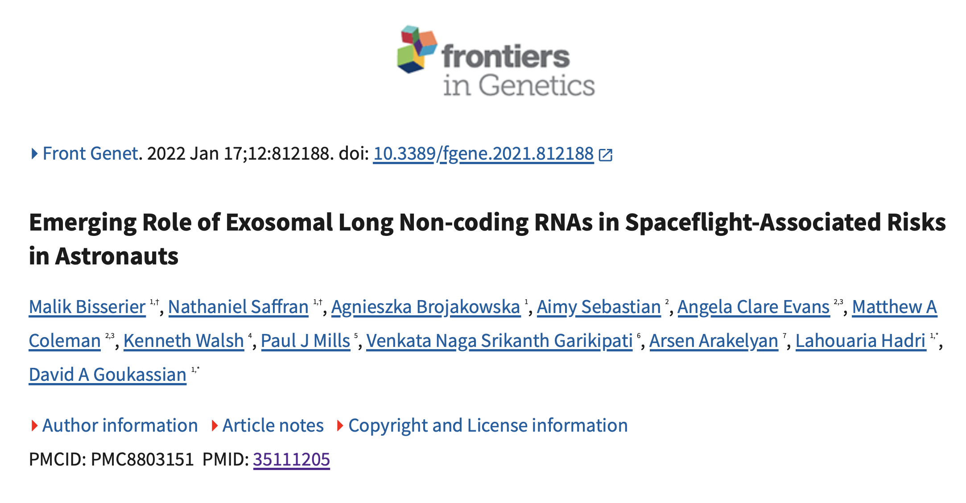

Slide 2
Motivation
Spaceflight exposes astronauts to many physiological stressors
Long non-coding RNAs are known to regulate gene expression
Possible circulating biomarkers.
Questions:
Do exosomal lncRNA profiles change after spaceflight ?
Can these lncRNAs be linked to disease-related pathways or astronaut health risks?

Slide 3



OSD-481 study
Step 1
Astronauts Blood Sample
Sample Collection (n=3):
Pre-flight: 10 days before launch
Post-flight: 3 days after landing
Notes:
Blood was collected from the same three astronauts at two time points: L-10, which means 10 days before launch, and R+3, which means 3 days after return.

Slide 4




OSD-481 study
Step 1
Step 2
Astronauts Blood Sample
Plasma exosomes Isolation
Sample Collection (n=3):
Pre-flight: 10 days before launch
Post-flight: 3 days after landing
Notes:
Exosomes were isolated from blood plasma, RNA was purified from the exosomes,

Slide 5

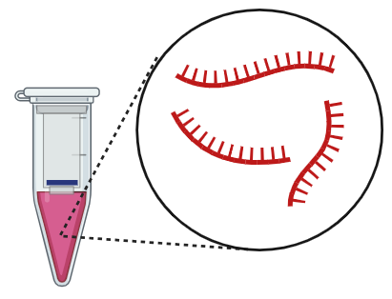
OSD-481 study
Step 1
Step 2
Step 3
Astronauts Blood Sample
Plasma exosomes Isolation
Quantitate exosome cargo
mRNAs
miRNAs
IncRNAs
Sample Collection (n=3):
Pre-flight: 10 days before launch
Post-flight: 3 days after landing
Notes:
and then RNA sequencing was performed.

Slide 6

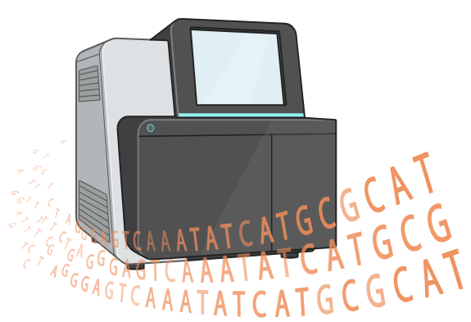
OSD-481 study
Step 1
Step 2
Step 3
Step 4
Astronauts Blood Sample
Plasma exosomes Isolation
Quantitate exosome cargo
Profiling and Computational analysis
RNA Isolation
mRNAs
RNA-sequencing
miRNAs
IncRNAs
Identification of differentially expressed mRNA
Sample Collection (n=3):
Pre-flight: 10 days before launch
Post-flight: 3 days after landing
Notes:
and then RNA sequencing was performed.

Slide 7
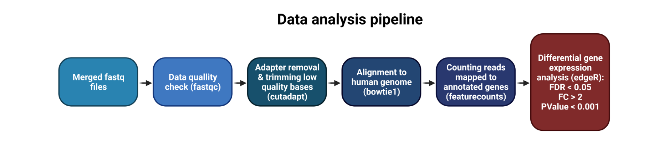

Slide 8
Replication Trials
Several pipeline branches were tested because the method description was not specific enough to reproduce the exact output.
Main trials: 1-STAR with GENCODE v38;
2- STAR with GENCODE v37;
3- FeatureCounts with primary-only counting;
4- FeatureCounts allowing multimapping reads;
5- FeatureCounts allowing multi-overlap reads and fractional counting;
6- Bowtie1 alignment branch because the workflow figure suggested Bowtie alignment.”

Slide 9
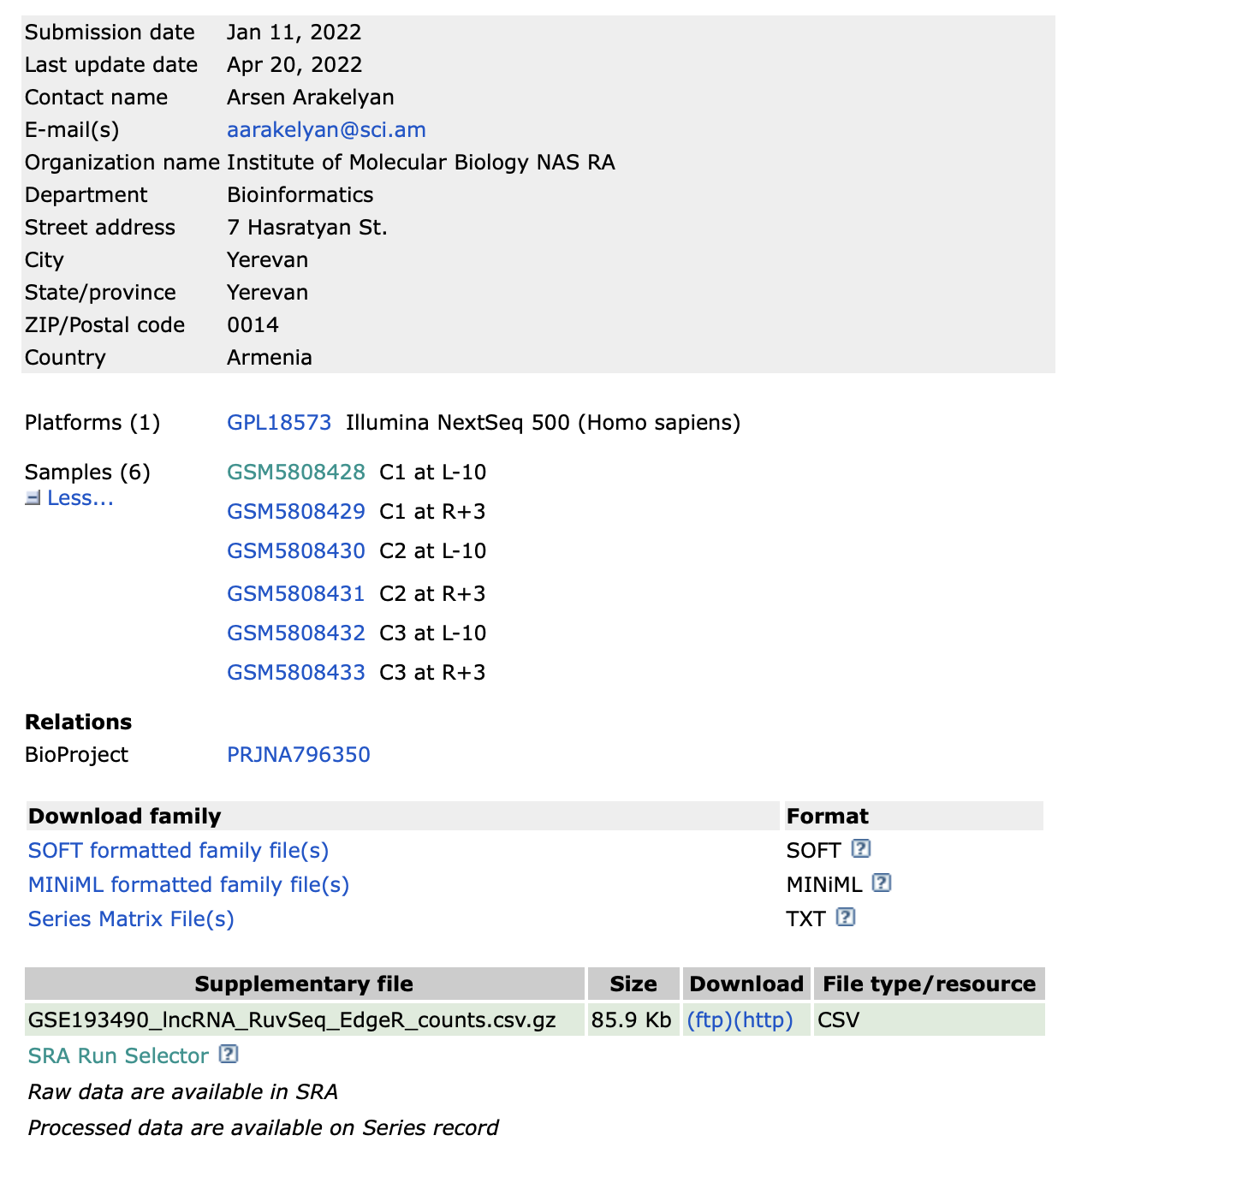
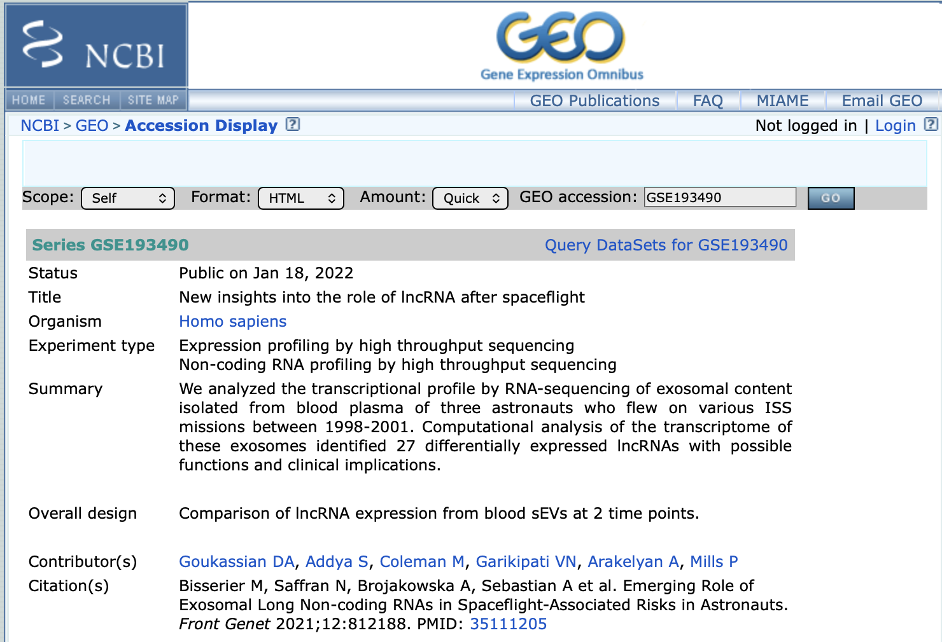

Slide 14
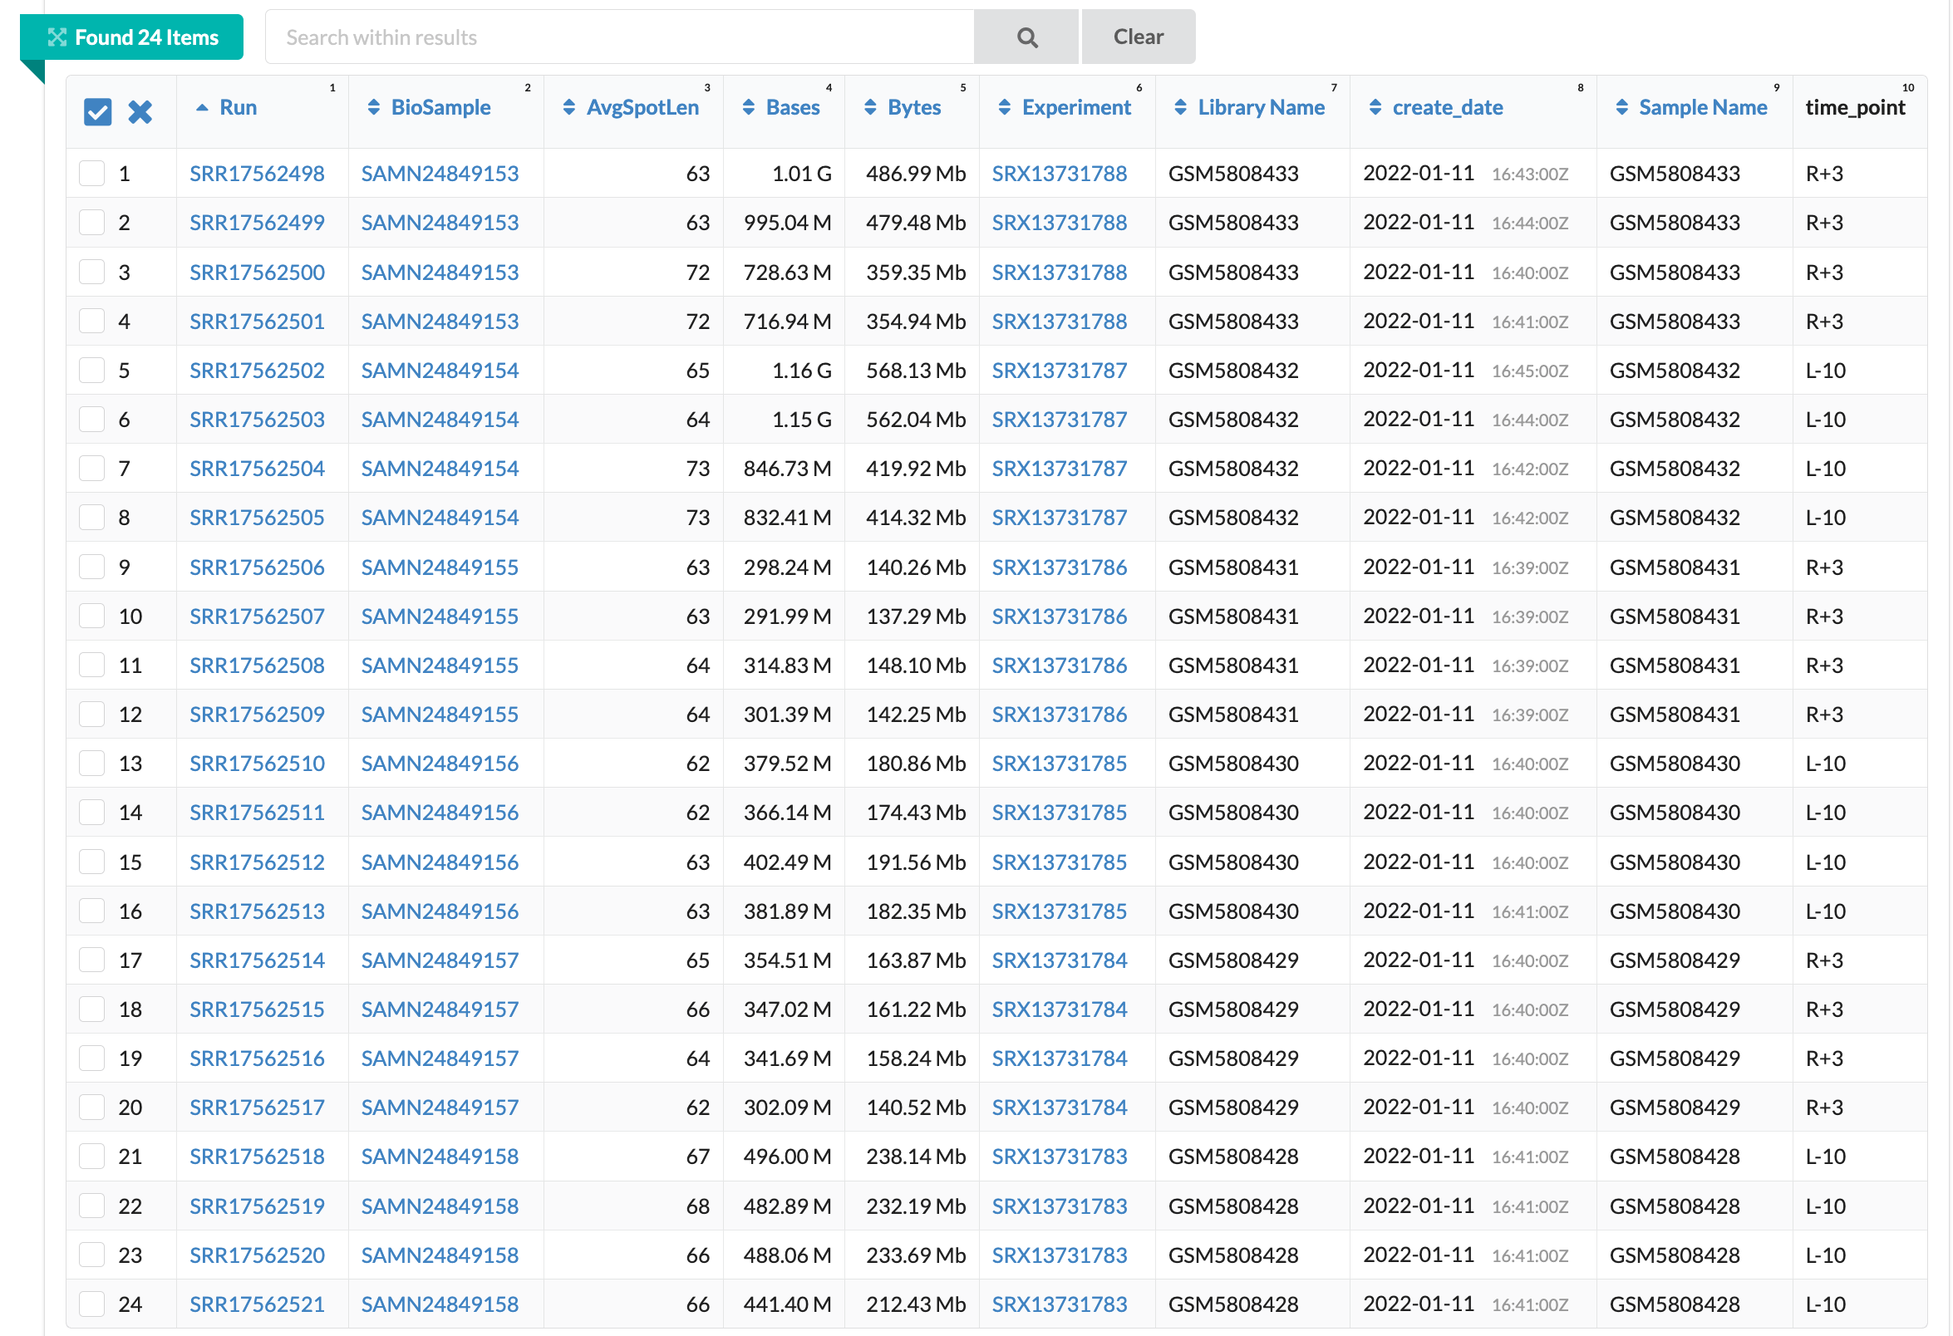

Slide 15
Replication problems
1-The authors say they used GENCODE v38, but many of the lncRNA IDs in the GEO processed table and in the paper’s top genes were not present in GENCODE v38. When I scanned GENCODE releases, these IDs were more consistent with GENCODE v37.
2- The supplementary text says the reads were aligned with STAR, but the workflow diagram suggested Bowtie.
3- The paper mentions edgeR, but the GEO processed file name and the supplementary context suggest RUVSeq + edgeR.
4- The paper doesn’t clearly describe exactly how cis- and trans-regulatory target genes of differentially expressed lncRNAs were identified when used for enrichment analysis.

Slide 16
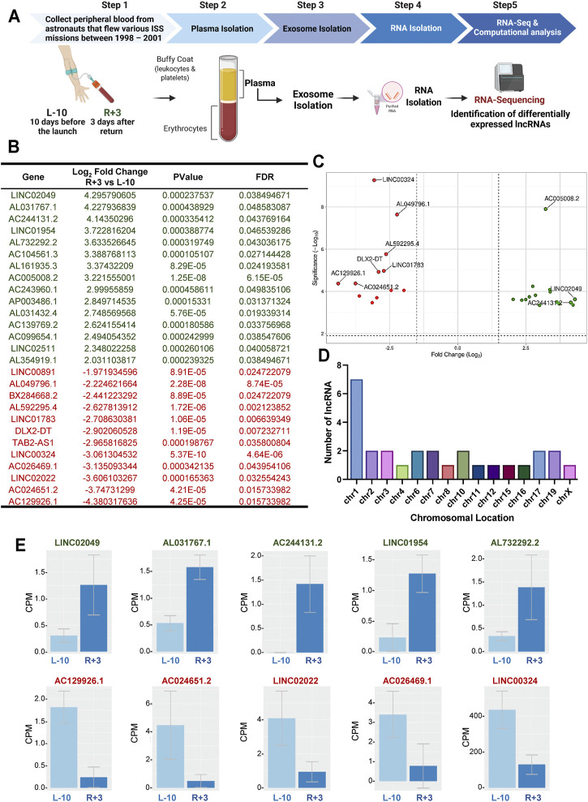
Paper results

Slide 17
Replication Trials
1- Full Replication trial: staring from the raw RNA-seq files.
2- Partial Replication trial: starting from the GEO-derived lncRNA counts

Slide 18
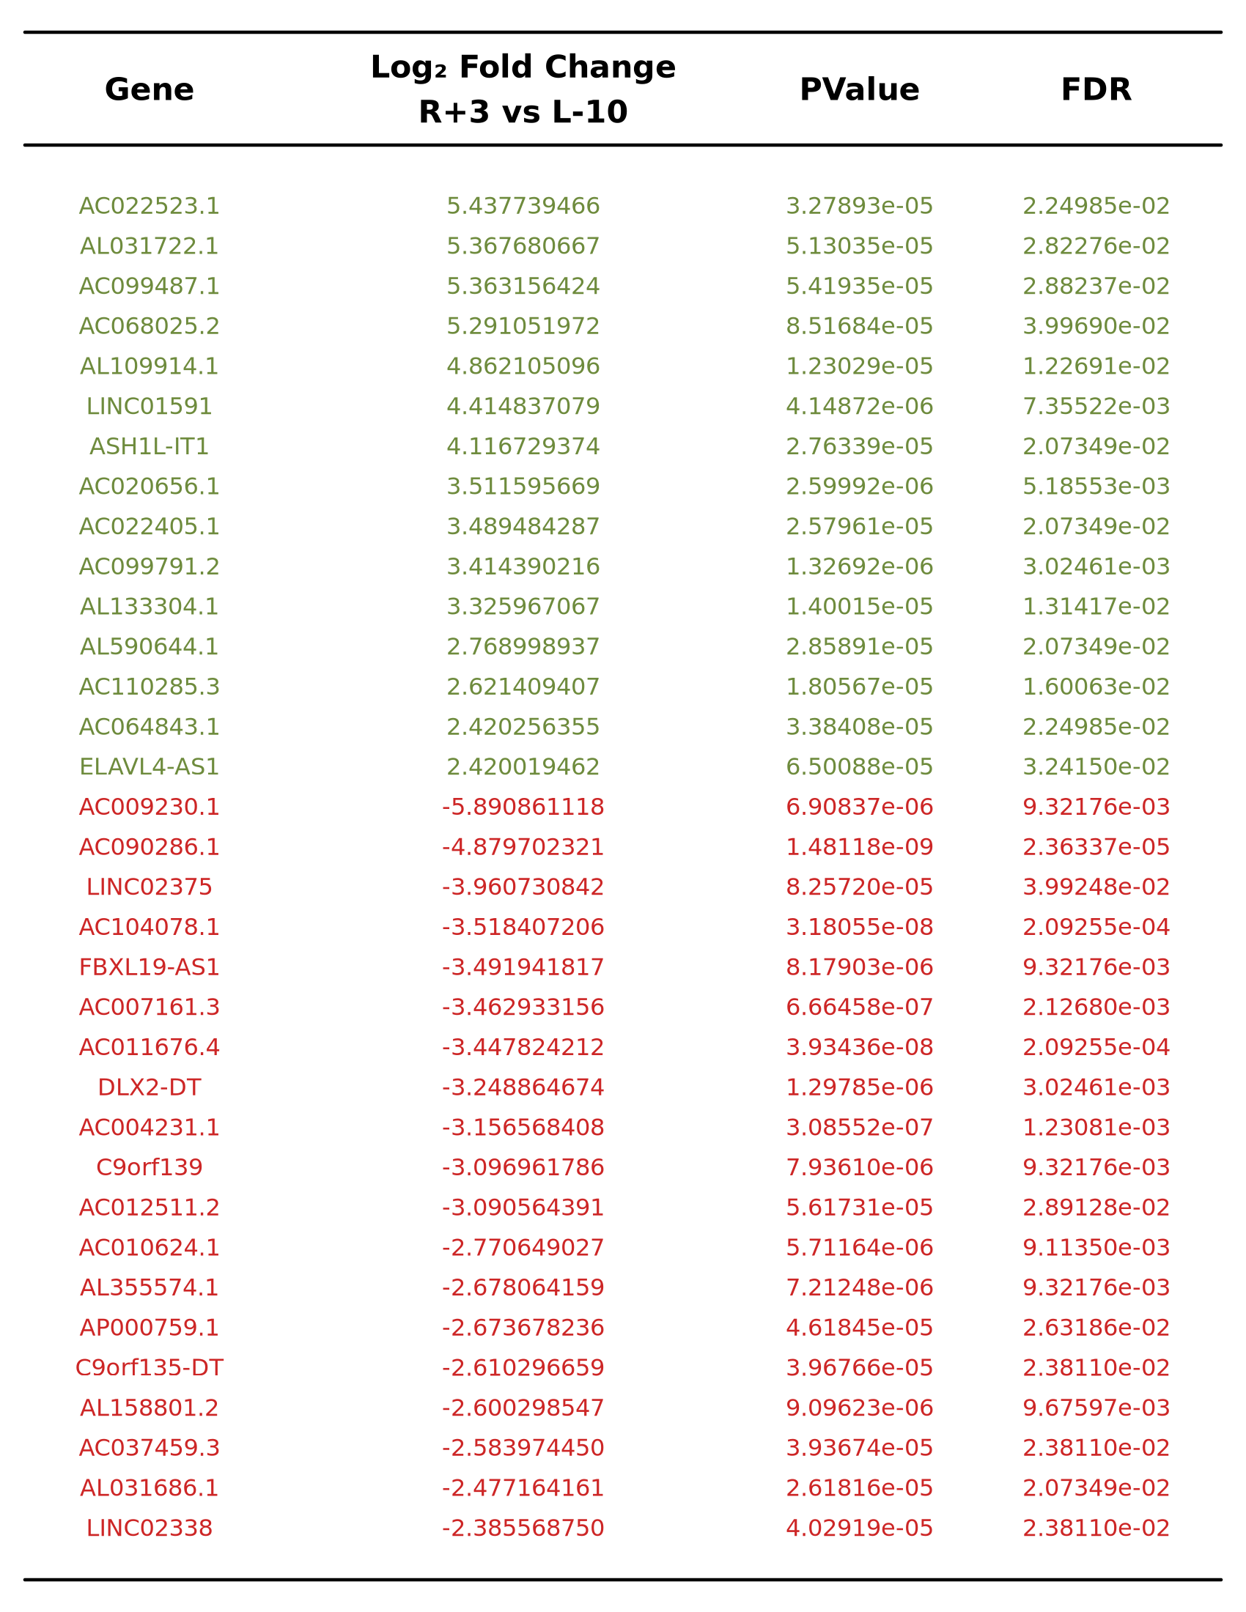
Original Paper
Replication

Slide 19
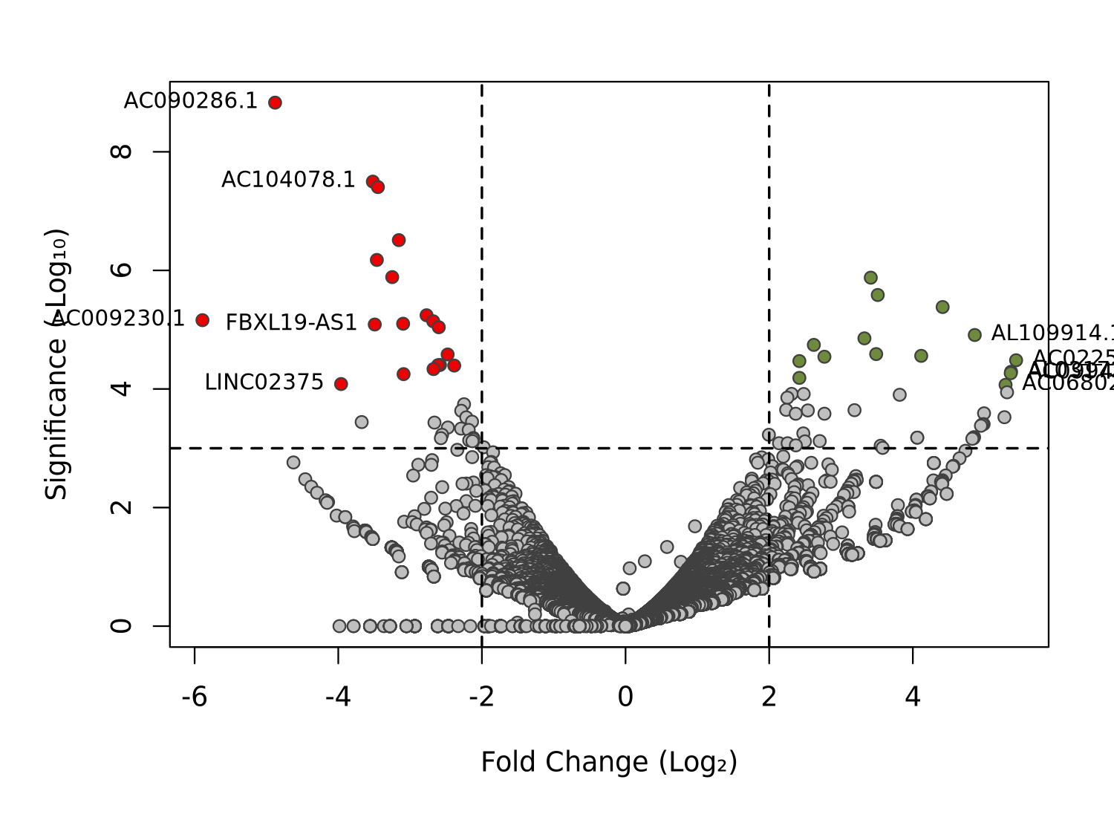
Original Paper
Replication

Slide 20
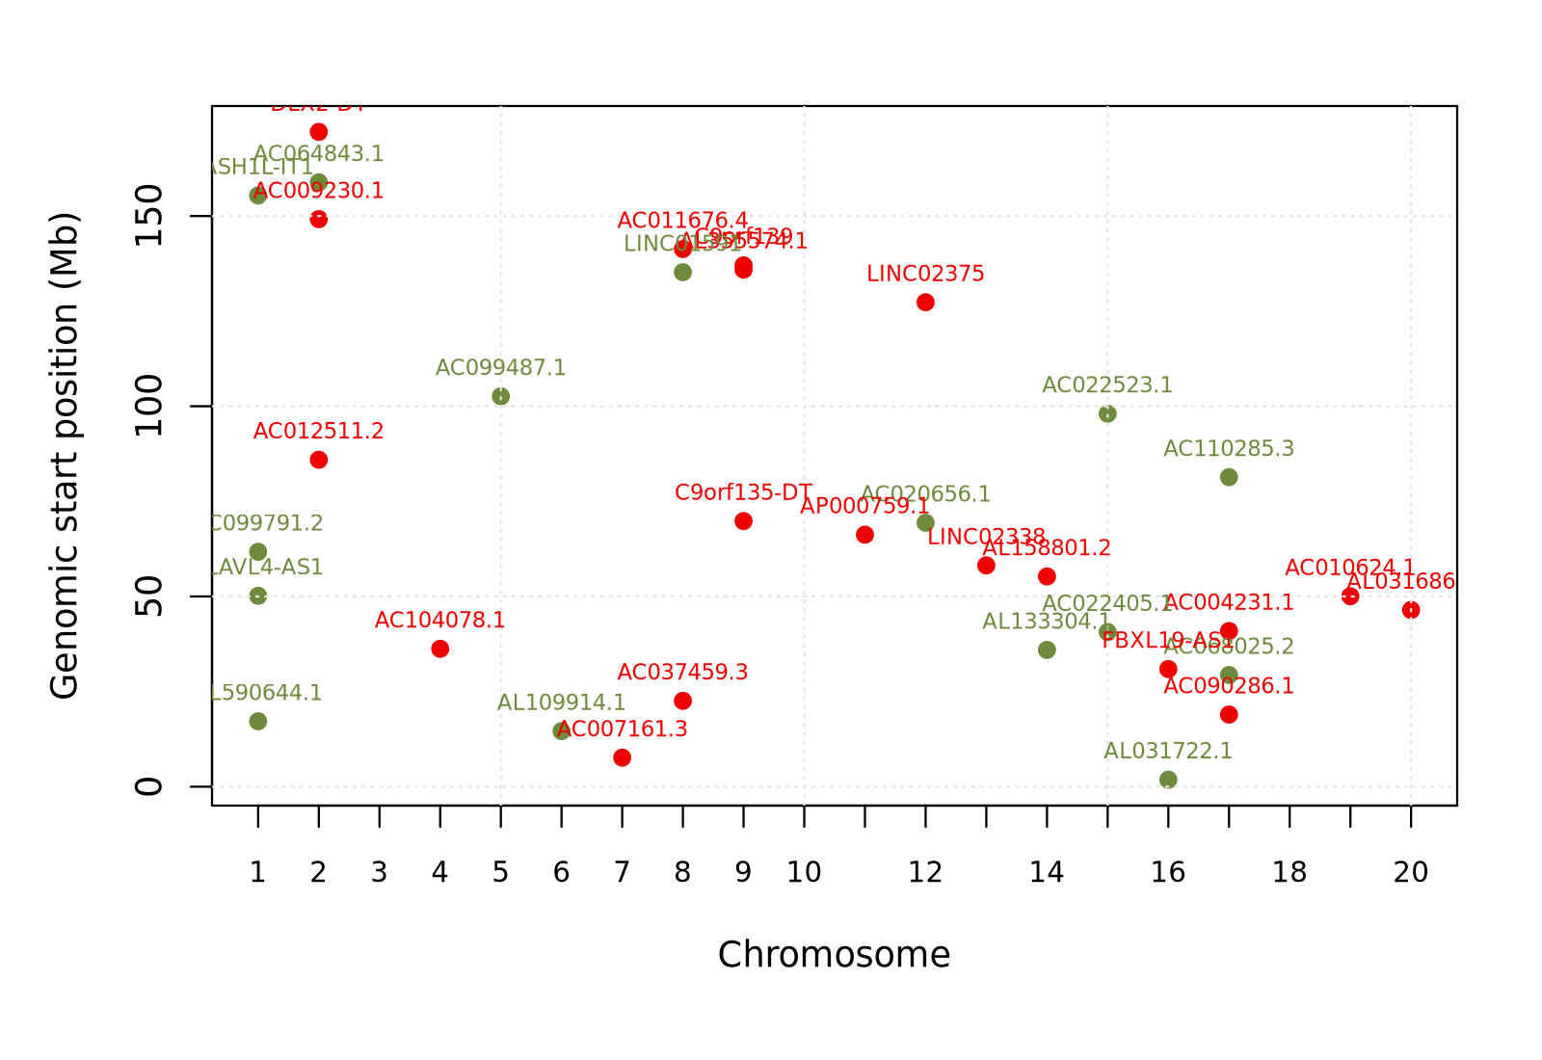
Original Paper
Replication
Notes:
“Panel E in the paper shows normalized counts, or CPM, for the top five up-regulated and top five down-regulated lncRNAs. The two bars represent L-10 and R+3. The purpose of this panel is to make the direction of change easier to see: up-regulated genes should have higher CPM at R+3, while down-regulated genes should have lower CPM at R+3.”
“In our version, I created the same type of panel using our derived counts. The top row shows the top five up-regulated genes based on the largest positive log2 fold change. The bottom row shows the top five down-regulated genes based on the most negative log2 fold change.”
“This figure helps us explain a key point: even when we create the same style of figure, the genes selected from our raw-derived analysis are different from the paper’s selected genes. That supports the conclusion that our reconstructed count matrix does not reproduce their original differential-expression result.”

Slide 21
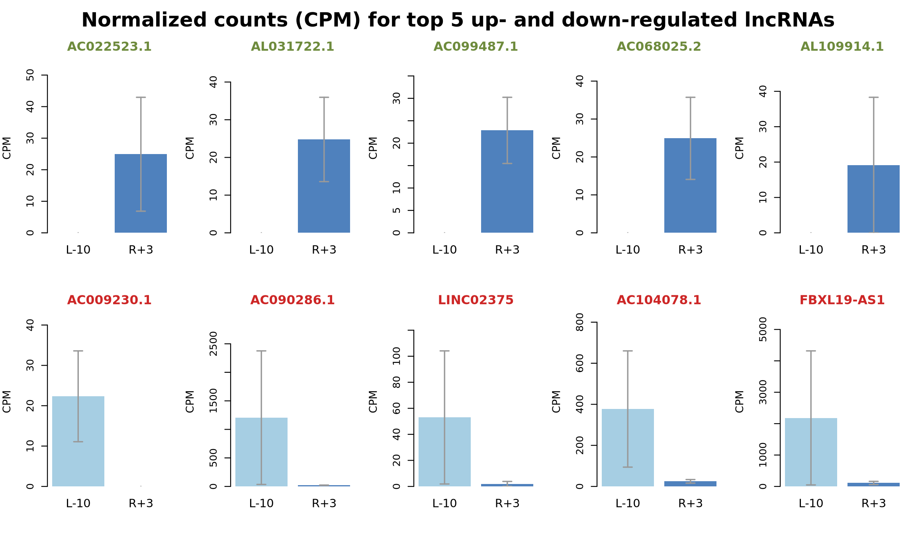
Original Paper
Replication
Notes:
Panel E in the paper shows normalized counts, or CPM, for the top five up-regulated and top five down-regulated lncRNAs. The two bars represent L-10 and R+3. The purpose of this panel is to make the direction of change easier to see: up-regulated genes should have higher CPM at R+3, while down-regulated genes should have lower CPM at R+3.”
In our version, I created the same type of panel using our derived counts. The top row shows the top five up-regulated genes based on the largest positive log2 fold change. The bottom row shows the top five down-regulated genes based on the most negative log2 fold change.
This figure helps us explain a key point: even when we create the same style of figure, the genes selected from our raw-derived analysis are different from the paper’s selected genes. That supports the conclusion that our reconstructed count matrix does not reproduce their original differential-expression result.

Slide 22
Partial Replication Trial Results
Done using the GEO processed count matrix, rather than rebuilding counts from raw FASTQ files.
This got closer to the paper’s reported signal.
For example, using the GEO processed table with RUVSeq and edgeR recovered paper-like behavior for some of the reported genes.

Slide 23
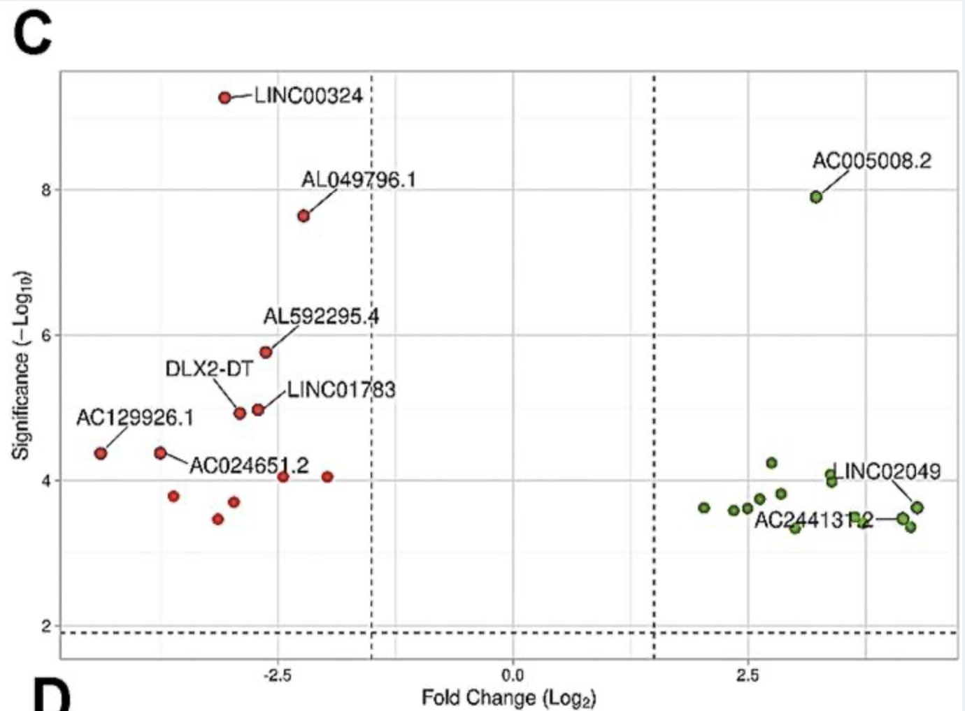
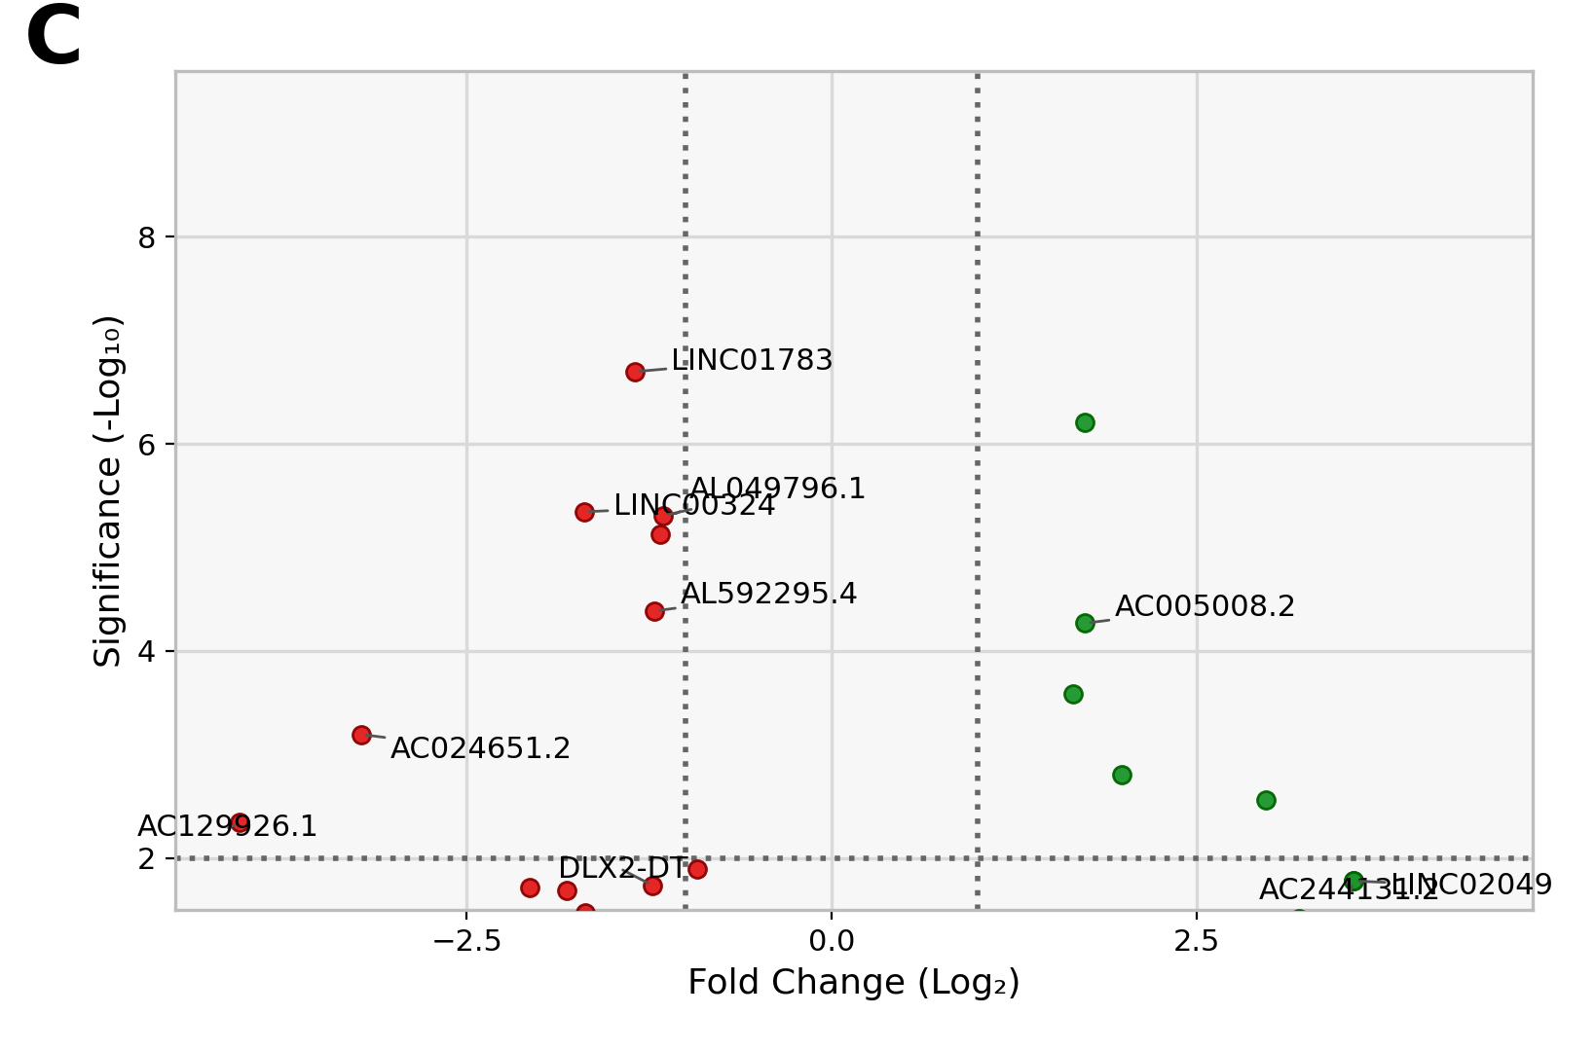
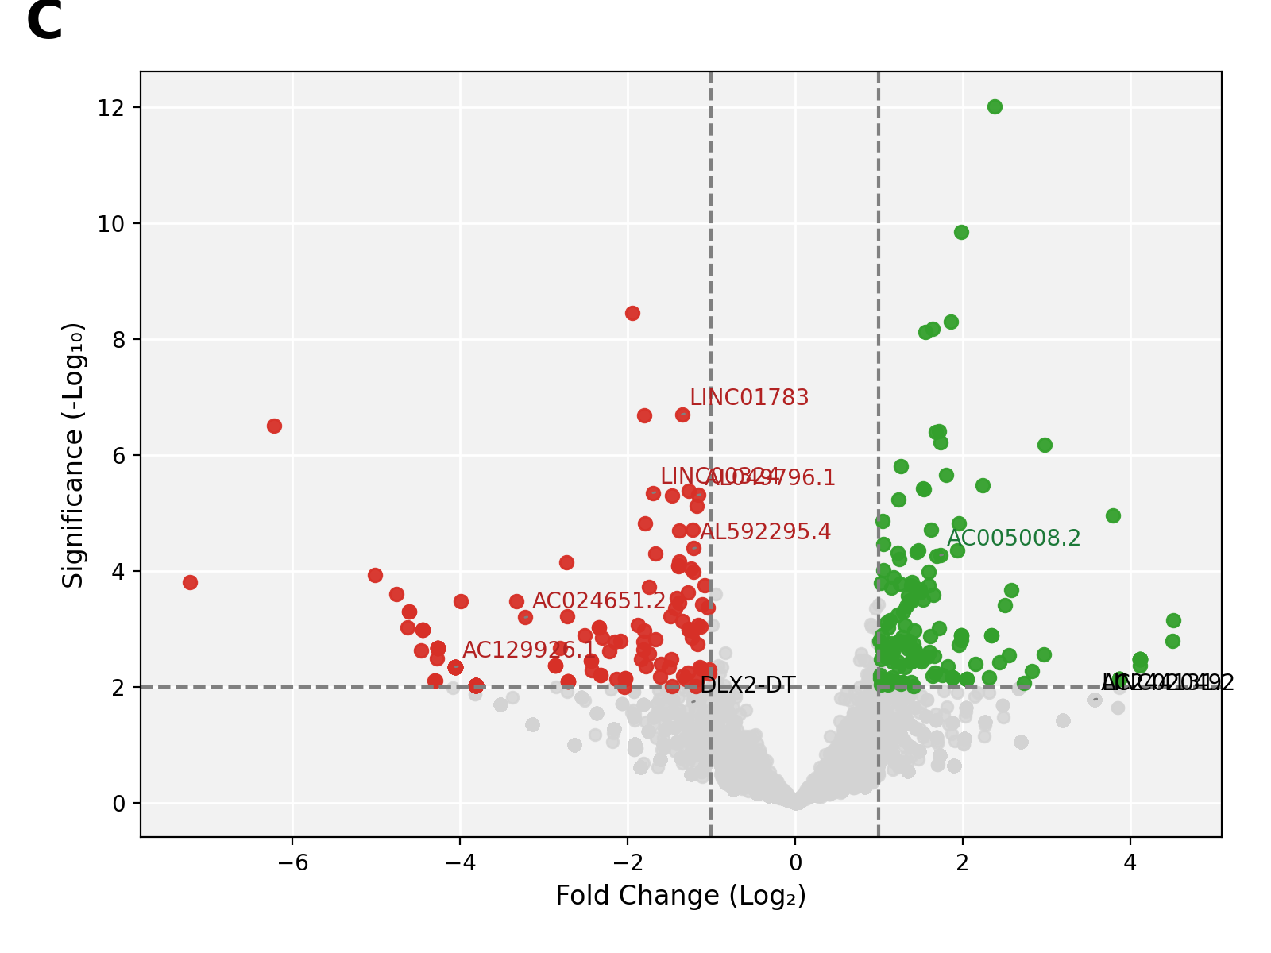
Original Paper
Partial Replication Trial Results
Applied the same differential expression criteria reported in the paper:
FDR < 0.05
Fold Change > 2
P-value < 0.001
Using these exact filters, only 10 genes met all three criteria.
The remaining 17 genes reported in the paper did not satisfy at least one of the three stated criteria in our replicated analysis.
Replication

Slide 24
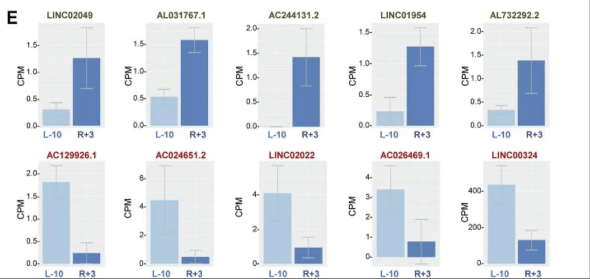
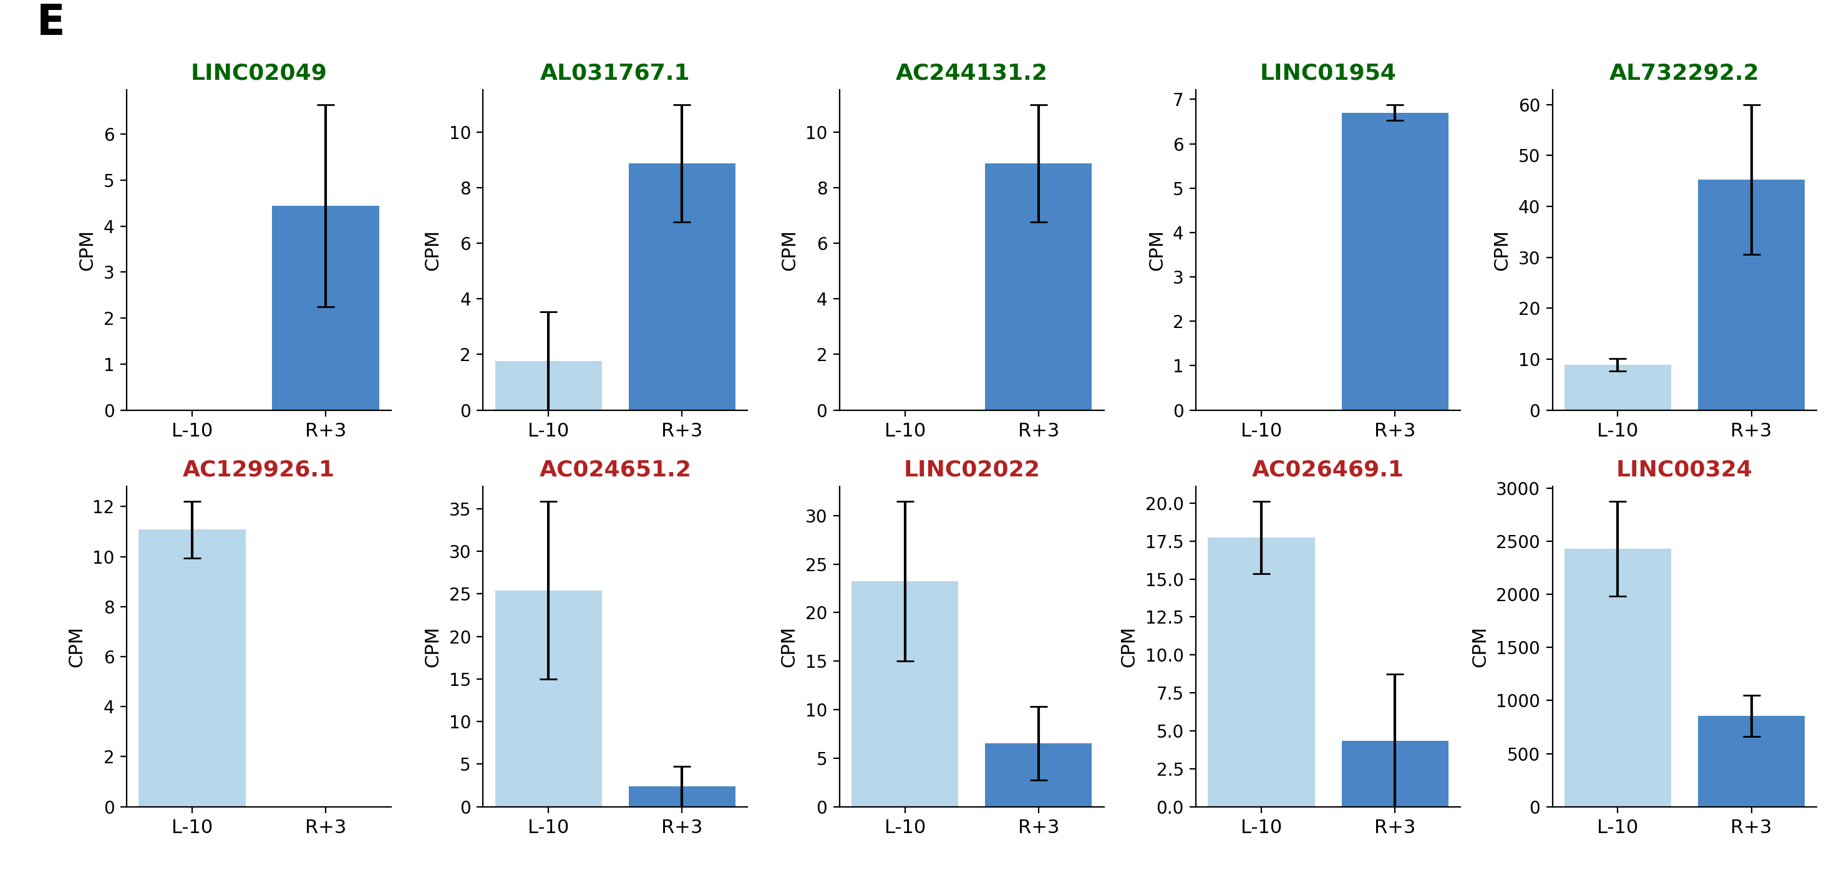
Partial Replication Trial Results
Original Paper
Replication

Slide 25
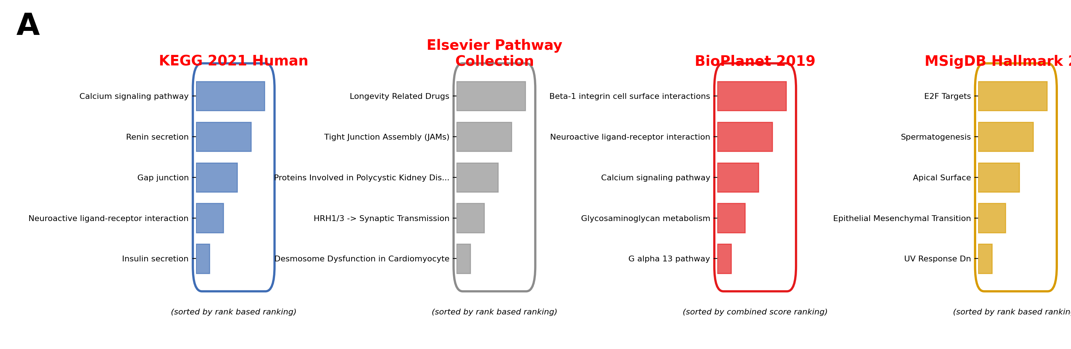
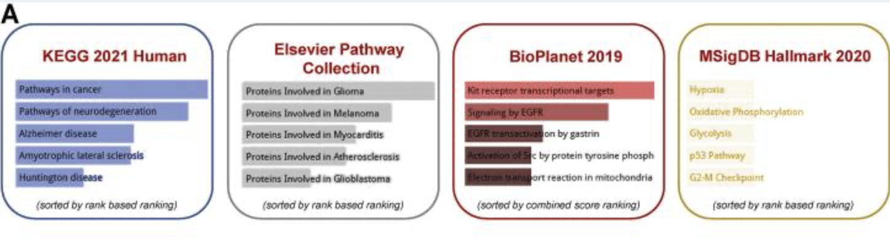
The paper states that cis- and trans-target genes of DE lncRNAs were identified.
The exact method, database query, cutoffs, and final target-gene list were not provided.
We attempted to replicate this step using known lncRNA annotation resources and the databases referenced in the paper.
Some target genes were recoverable, but many were not clearly traceable to the reported analysis.
This unclear step makes the enrichment and regulatory-network results difficult to replicate exactly.
Replication
Original Paper

Slide 26
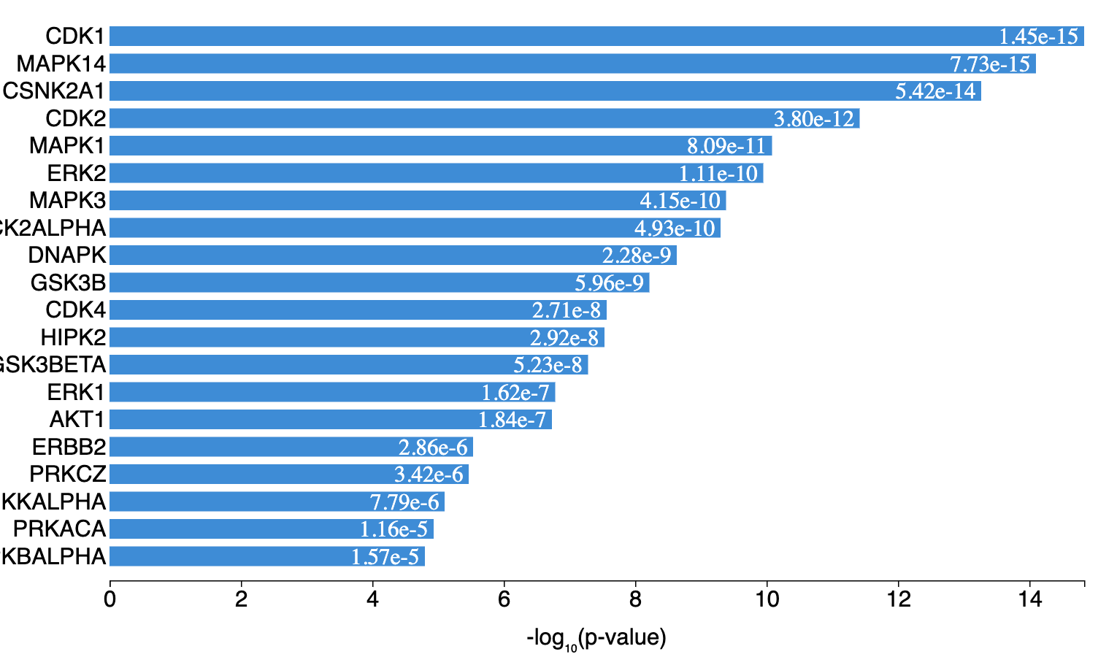
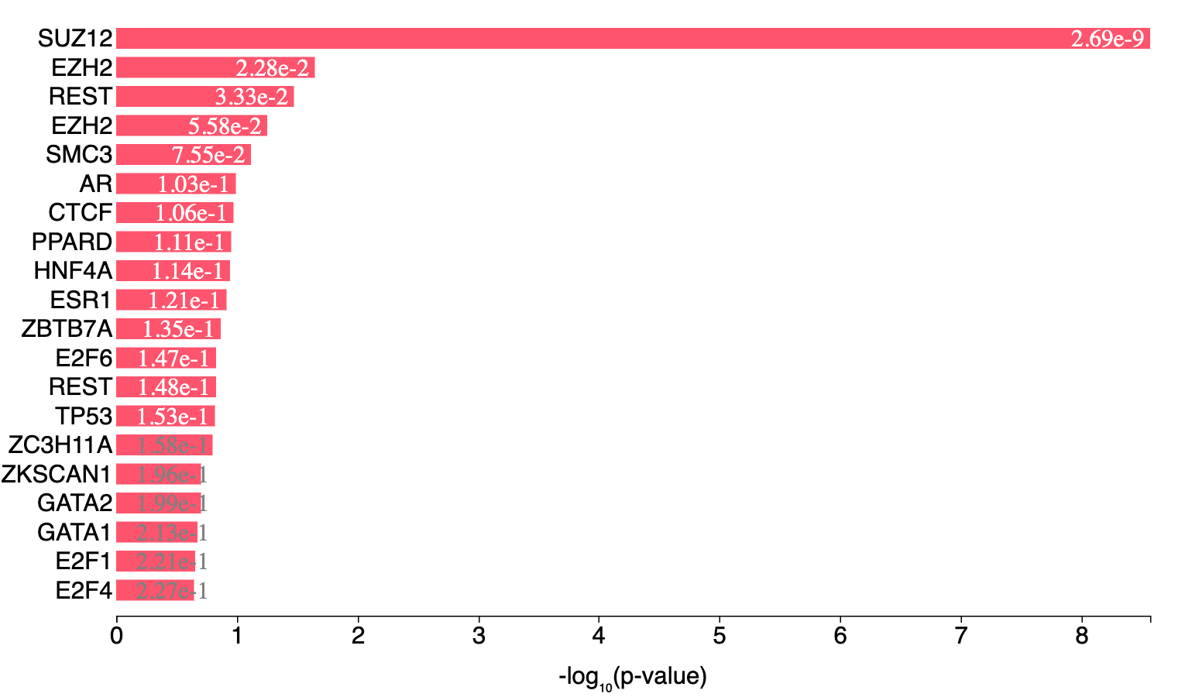
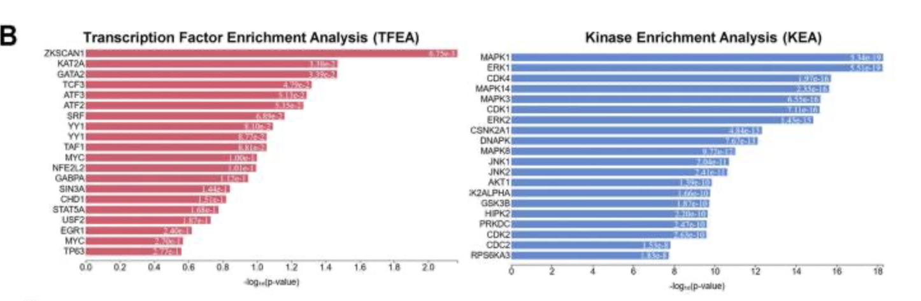
The paper states that cis- and trans-target genes of DE lncRNAs were identified.
The exact method, database query, cutoffs, and final target-gene list were not provided.
We attempted to replicate this step using known lncRNA annotation resources and the databases referenced in the paper.
Some target genes were recoverable, but many were not clearly traceable to the reported analysis.
This unclear step makes the enrichment and regulatory-network results difficult to replicate exactly.
Replication
Original Paper

Slide 27
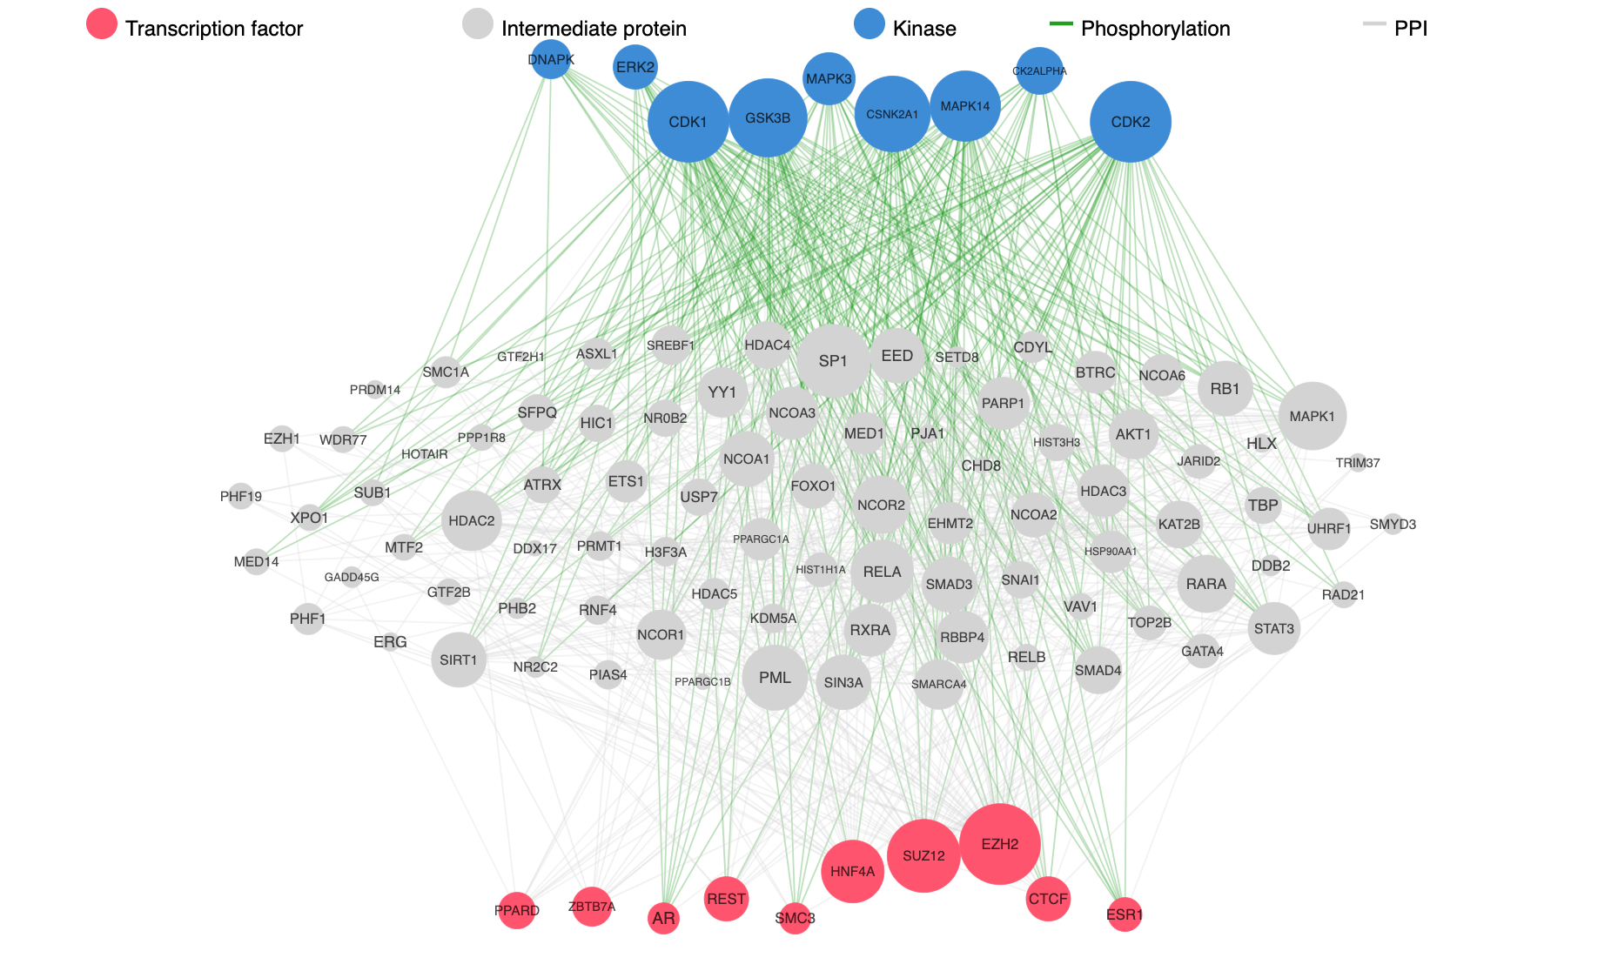
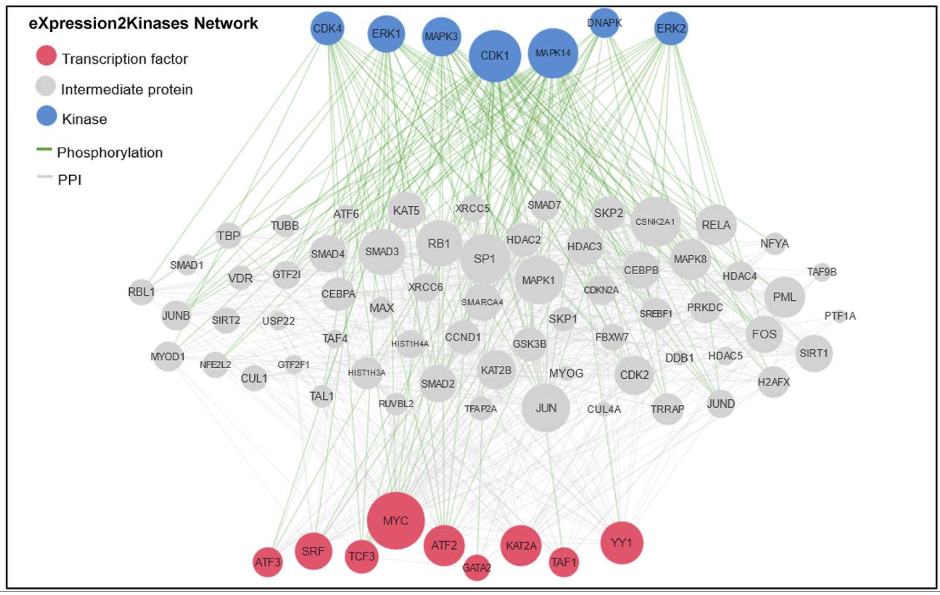
Original Paper
Replication

Slide 28
Conclusion
The most important limitation is that the exact upstream count-generation pipeline is not fully recoverable from the paper.
GENCODE v38 did not match many of the reported lncRNA IDs, STAR and Bowtie1 gave different count behavior, featureCounts settings strongly changed the results, and the cis/trans target-gene definition for enrichment was not described in enough detail.

Slide 29
Conclusion
Among all raw-data pipelines I tested, the closest was STAR with GENCODE v37 and featureCounts using multimapping, multi-overlap, fractional counting.
But even this best pipeline did not recover the same top differentially expressed lncRNAs as the paper.
Therefore, my final interpretation is that the paper’s reported results likely depend on undocumented annotation, counting, filtering, or post-processing choices.

Slide 30
Conclusion
Even in the partial replication trials, the results were not perfectly identical to the paper table for every lncRNA.
This suggests that there may be additional post-processing steps, hidden filtering choices, or exact statistical settings that were not fully described.
The full published count matrix is still not exactly reproducible from the methods description alone.

Slide 31
Take-Home Message
The broad biological story of the paper is clear. However, from a computational reproducibility perspective, the methods are incomplete.

Slide 32
Future work
I would recommend contacting the authors for the exact scripts, annotation file, featureCounts parameters, RUVSeq/edgeR code, and cis/trans gene-mapping rules.

