Slide 1
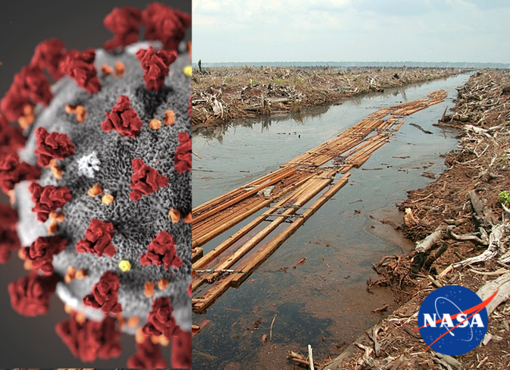
COVID-DeforestAlert

Slide 2
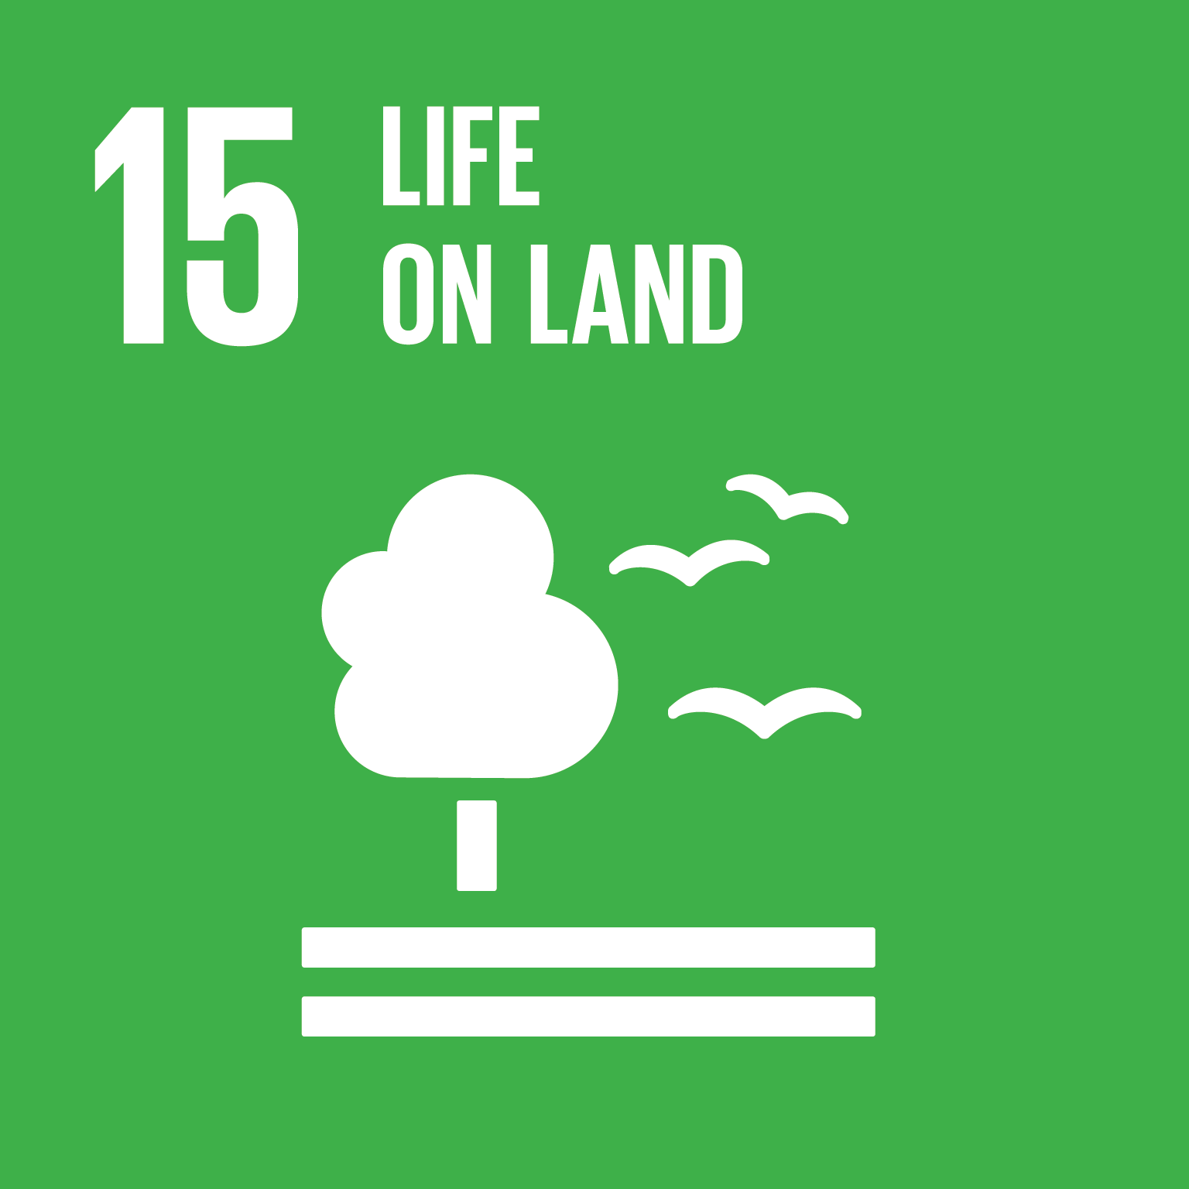
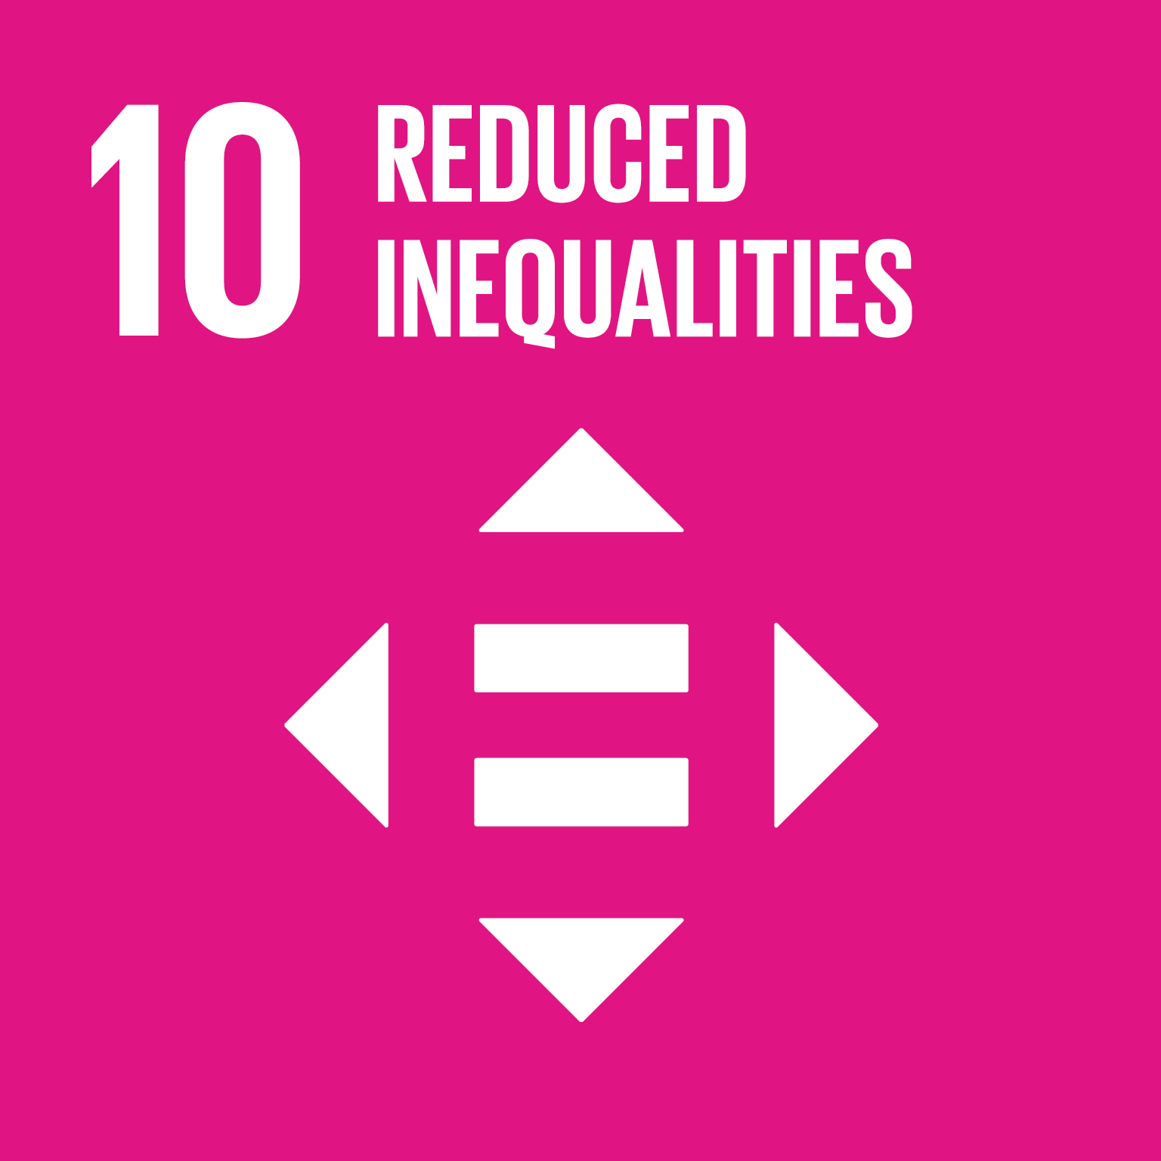
The Problem
Sustainable Development Goals addressed
Conservationists claim that there has been an increase in deforestation in Brazil and Colombia since COVID-19 disruption
Are these claims true?
What is the cause?
What measures would protect forests and people?
Protect both human and natural life
Focus on low- and middle-income countries

Slide 3
Methodology
NASA Landsat 8 satellite data
30m Satellite imagery
Global Forest Watch alerts
Likely deforestation events
COVIDeforestAlert

Slide 4
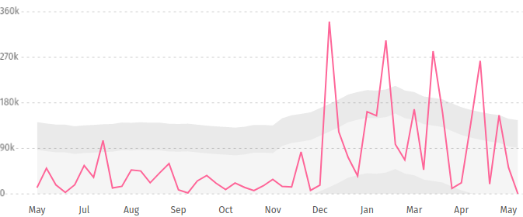
Results
Unusually high deforestation rates for this time of year in Colombia y axis: number of deforestation alerts (trend in grey)
Has a bad season been excaberated by loss of income to buy fuel due to COVID?
Global Forest Watch website (Hansen et al., High-Resolution Global Maps of 21st-Century Forest Cover Change, 2013)

Slide 5

Solution
Link to website (click here to access)
Monitor for deforestation using satellite imagery
Look for correlation with COVID cases and other factors
Work with groups on the ground to protect forests and people
  e.g. provide aid in the form of cooking fuel/efficient cookstoves

