Slide 1
Smart device system Project
Azizbek 201939234
Tolibjon 201939233

Slide 2
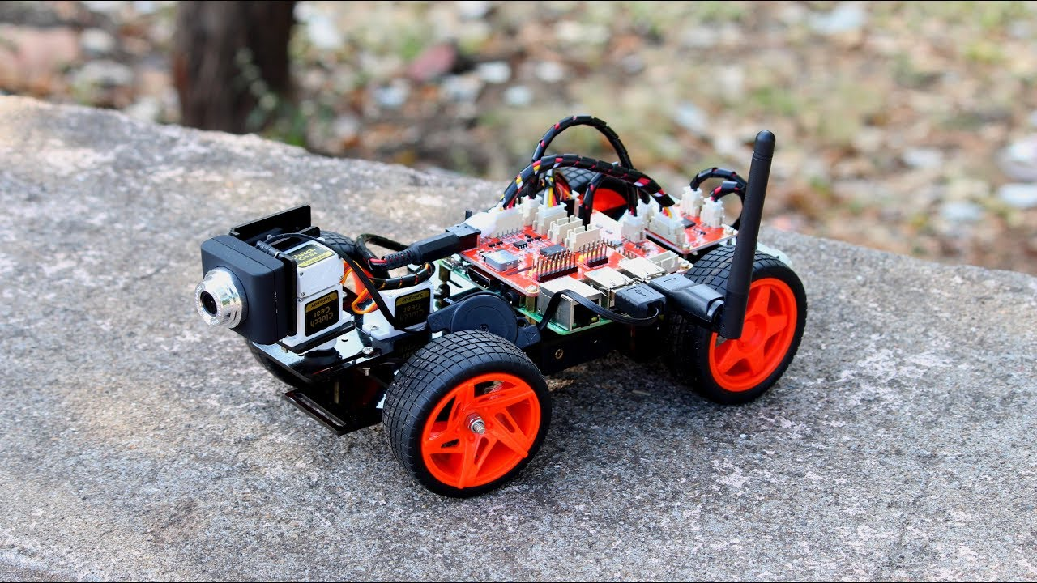
Raspberry pi half ready Toy car

Slide 3

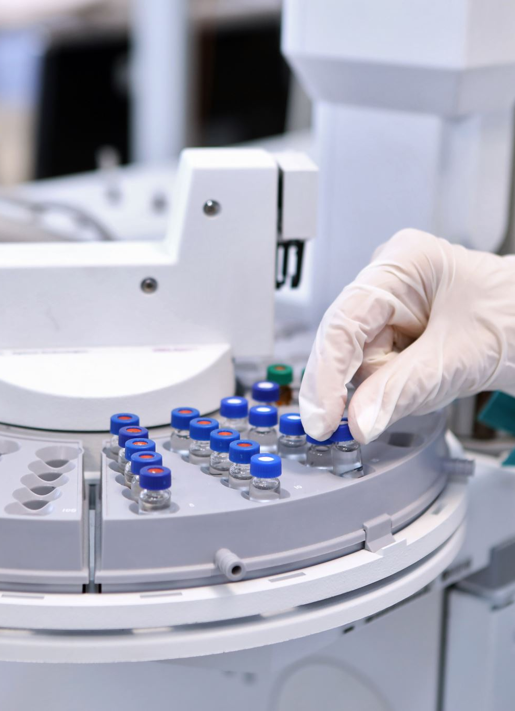
The car
The purpose to create this machine is primarily as an assistant to doctors, as we all witness those past years, we had a pandemic disease which acquire social distance among the people, so the doctor must take care his patients regularly, with the help of machine we created it might be little easy to do that, because we can manage that car remotely, we installed a little camera so we can see live video of patient and we can even give them a medicine, if necessary.

Slide 4
To create that machine what we need
A tool box
Camera
Raspberry pi
Toy car
Sensor
Keyboard
Mouse
Monitor
HDMI cable
And some coding , we use Python as the programming language, since it is one of the easiest languages to understand

Slide 5
Little more about how we do it
We control that machine by webpage from distance, so we use flask flamework
Python programming language
Web based control
And our car runs with two engines

Slide 6





Thank you

