Slide 1
eBook Shop
Sequence Diagram
State Chart
Activity Diagram
Group: 03
Group Members:
1005033
1005037
1005038
1005058
1005059

Slide 2
Outline of the presentation
Subsystems
Sequence Diagram
Activity Diagram
State Chart

Slide 3
Subsystems
Book Inventory
Order and Delivery
Employee Management
User and Branch Review

Slide 4
1. Book Inventory Use Case Glossary:
Use-case ID > Name | Description | Participant Actors and roles
1.1>Order and Collection | Contact with publisher, order for new books and collect books from them | BMGR, STF BMGR contacts with MB, MB orders PBS, PBS will provide book and STF will get book to shop
1.2> Update Book List | Book list is updated according to new arrival of books | BDMGR will update book database
1.3> View Book List | Book list is viewed | USR, MB, BMGR

Slide 5
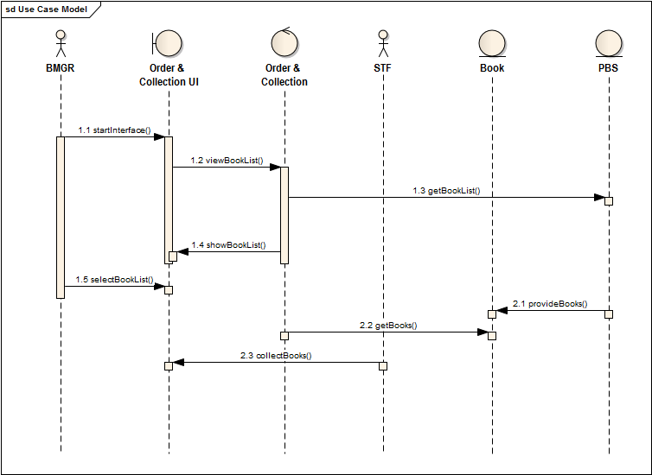
Sequence Diagram 1.1: Order and Collection

Slide 6
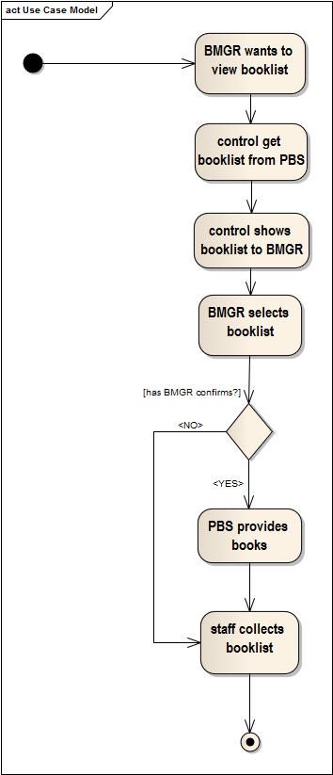
Activity Diagram 1.1: Order and Collection

Slide 7
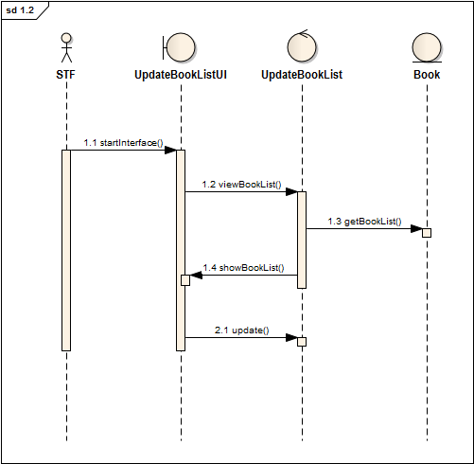
Sequence Diagram 1.2: Update Book List

Slide 8
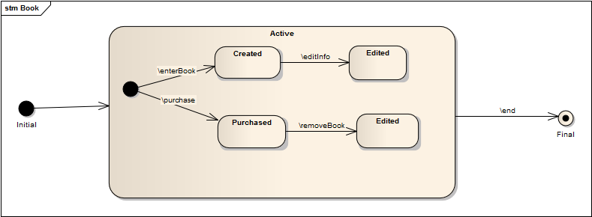
State Chart: Book

Slide 9
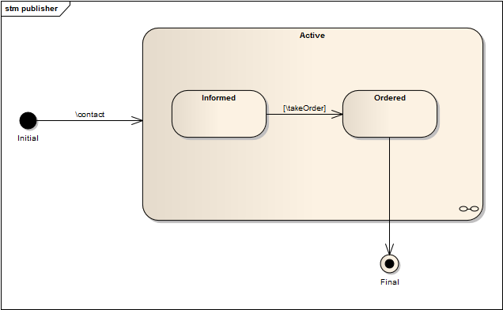
State Chart: Publisher

Slide 10
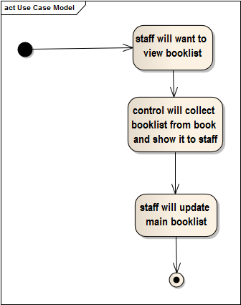
Activity Diagram 1.2: Update Book List

Slide 11
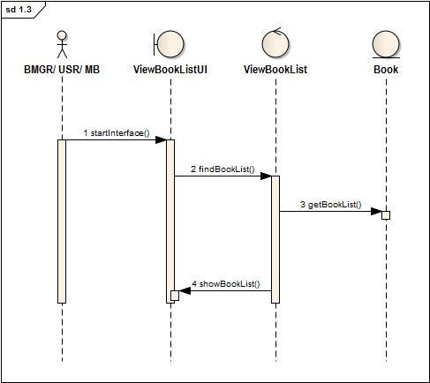
Sequence Diagram 1.3: View Book List

Slide 12
State Chart: Book

Slide 13
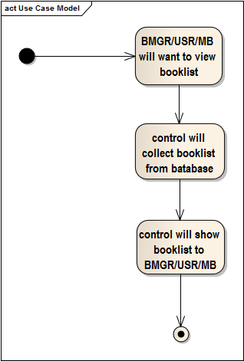
Activity Diagram 1.3: View Book List

Slide 14
2. Order and Delivery Use Case Glossary:
Use-case ID > Name | Description | Participant Actors and roles
2.1>Place Order | An order is placed for a book by customer | USR, BOMGR USR orders for book, BOMGR accepts & process order
2.2> Delivery Process | Ordered book is delivered to the customer | BOMGR, USR, STF BDMGR delivers the book to USR by STF
2.3> Update Book List | Book list is updated | STF

Slide 15
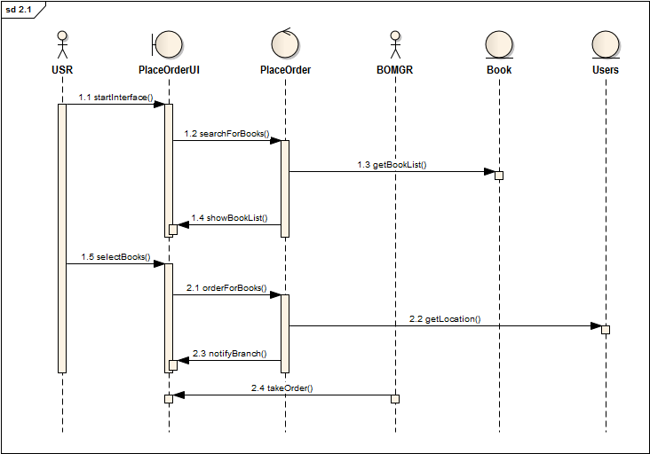
Sequence Diagram 2.1: Place Order

Slide 16
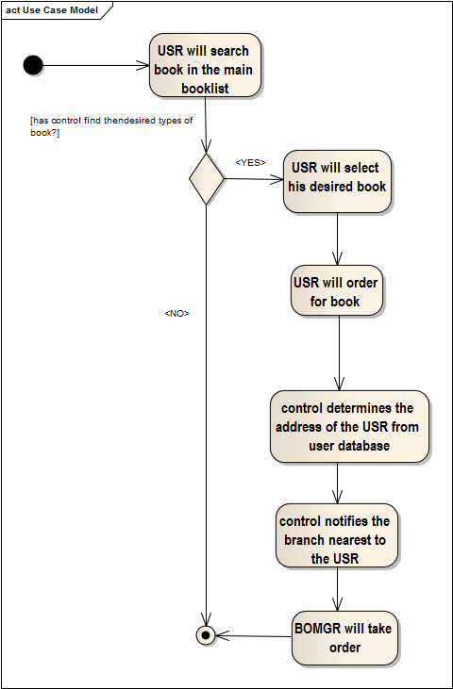
Activity Diagram 2.1: Place Order

Slide 17
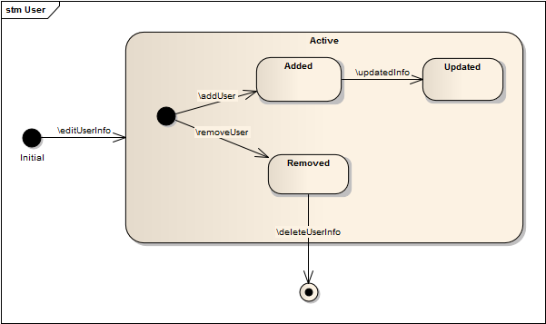
State Chart: User

Slide 18
State Chart: Book

Slide 19
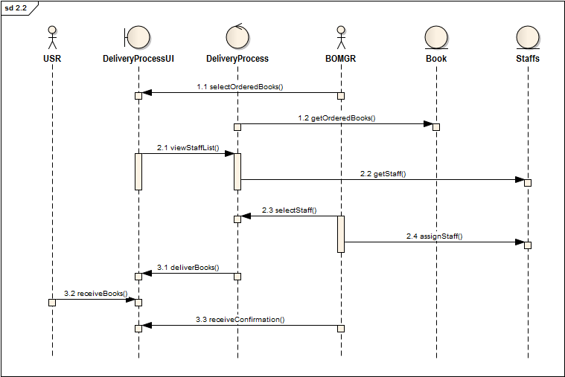
Sequence Diagram 2.2: Delivery Process

Slide 20
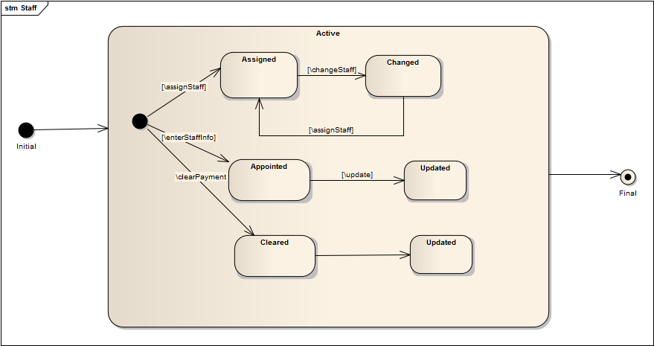
State Chart: Staff

Slide 21
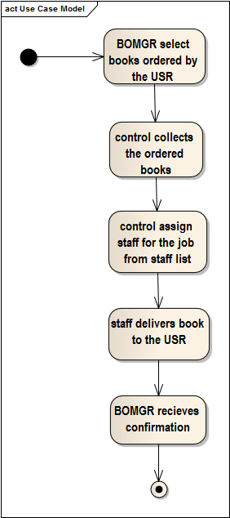
Activity Diagram 2.2: Delivery Process

Slide 22
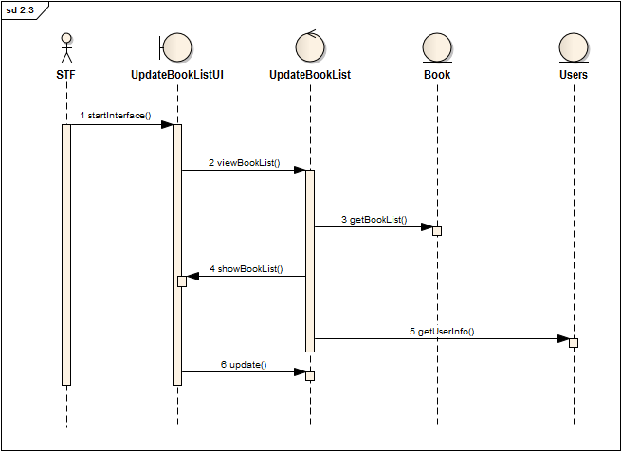
Sequence Diagram 2.3: Update Book List

Slide 23
State Chart: User

Slide 24
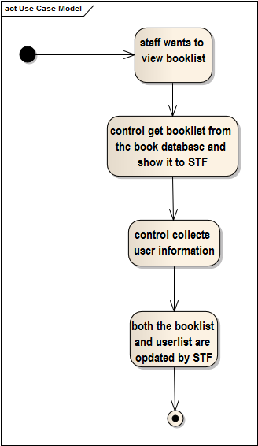
Activity Diagram 2.3: Update Book List

Slide 25
3. Employee Management Use Case Glossary:
Use-case ID > Name | Description | Participant Actors and roles
3.1>Add New Employee | STF gets appointed | STF, BMGR, MB STF applies for job, BMGR creates list of applicants, MB selects STF
3.2> Application | Applicants applies to Main Branch then Main Branch forwards to particular Branches | MB, STF
3.3> Payment and Bonus | Management of monthly payment and bonus for the staffs of a particular branch | BMGR, STF BMGR provides payment and bonus to STF

Slide 26
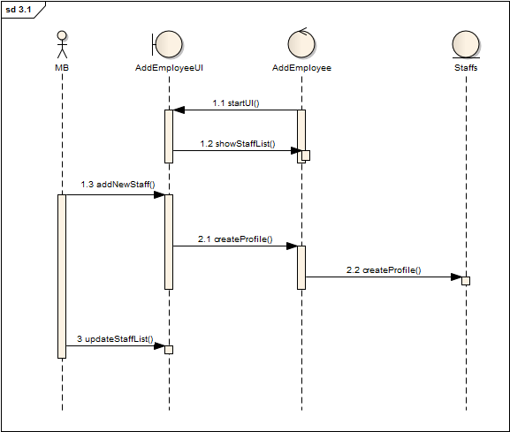
Sequence Diagram 3.1: Add New Employee

Slide 27
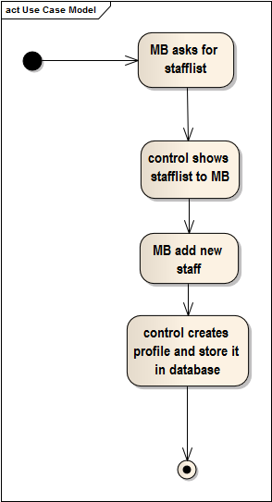
Activity Diagram 3.1: Add New Employee

Slide 28
State Chart: Staff

Slide 29
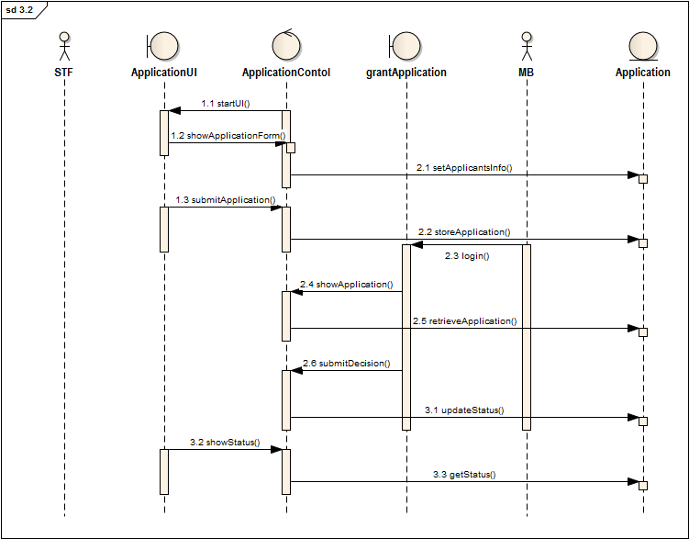
Sequence Diagram 3.2: Application

Slide 30
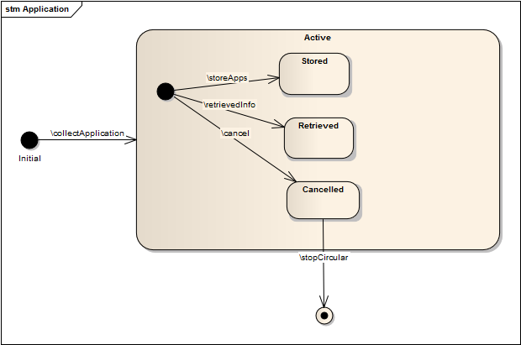
State Chart: Application

Slide 31
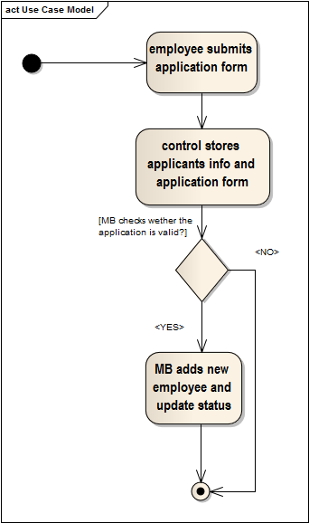
Activity Diagram 3.2: Application

Slide 32
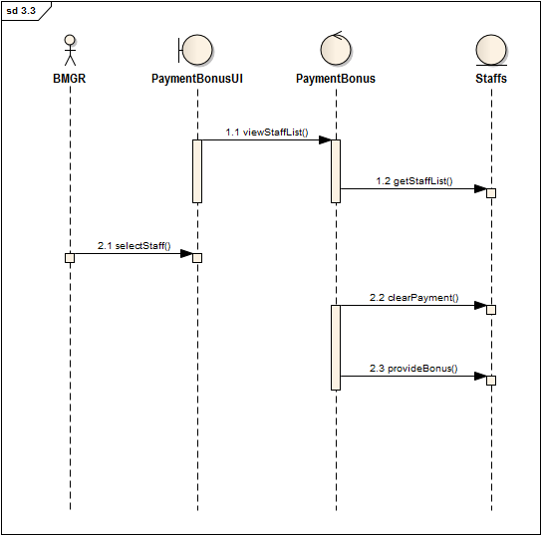
Sequence Diagram 3.3: Payment and Bonus

Slide 33
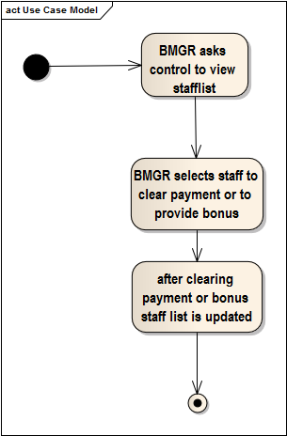
Activity Diagram 3.3: Payment and Bonus

Slide 34
State Chart: Staff

Slide 35
4. User and Branch Review Use Case Glossary:
Use-case ID > Name | Description | Participant Actors and roles
4.1>User Review | Branch gives review about a particular USR | USR, BMGR
4.2> Book Review | Review is given on a particular book | USR, MB
4.3> Branch Review | According to branch services USR gives review about corresponding branch | USR, MB

Slide 36
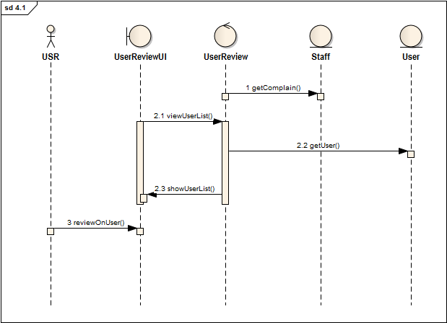
Sequence Diagram 4.1: User Review

Slide 37
State Chart: User

Slide 38
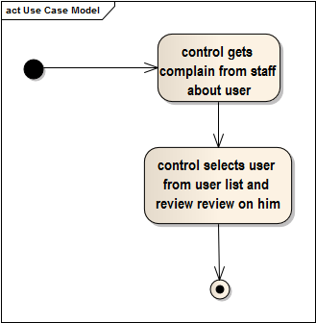
Activity Diagram 4.1: User Review

Slide 39
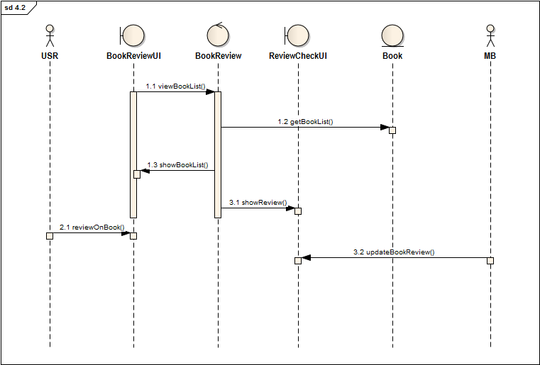
Sequence Diagram 4.2: Book Review

Slide 40
State Chart: Book

Slide 41
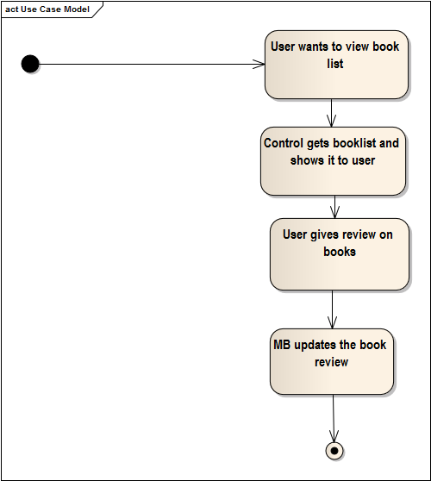
Activity Diagram 4.2: Book Review

Slide 42
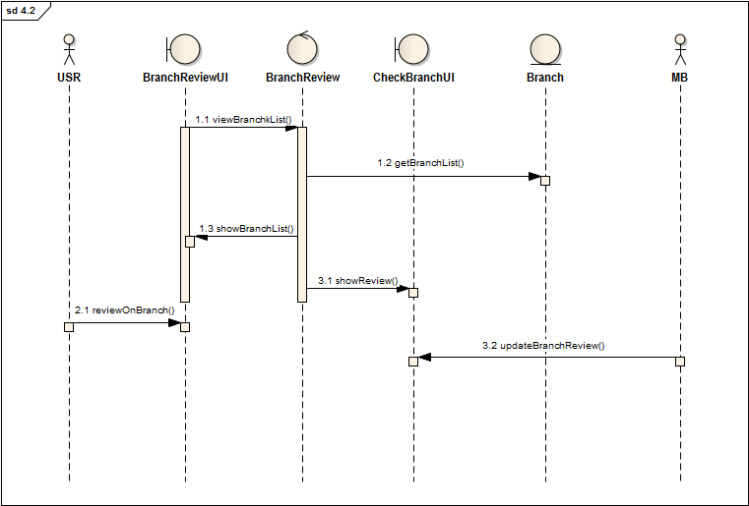
Sequence Diagram 4.3: Branch Review

Slide 43
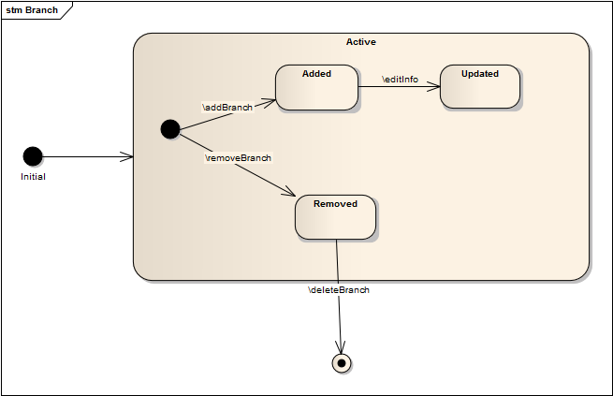
State Chart: Branch

Slide 44
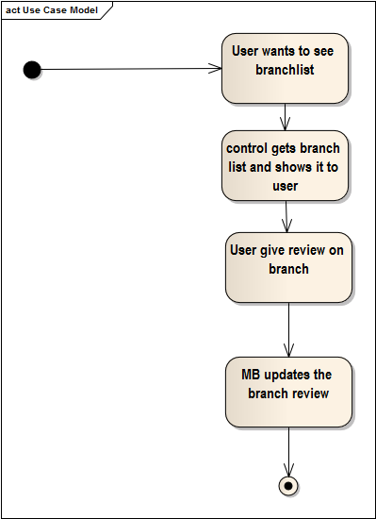
Activity Diagram 4.3: Branch Review

Slide 45


