Slide 1
eBook Shop
ERD
Trigger
Procedure
Group: 03
Group Members:
1005033
1005037
1005038
1005058
1005059

Slide 2
Outline
ER Diagram
ERD Details
Relational Schema Tables
Triggers
Procedures

Slide 3
ER DIAGRAM

Slide 4
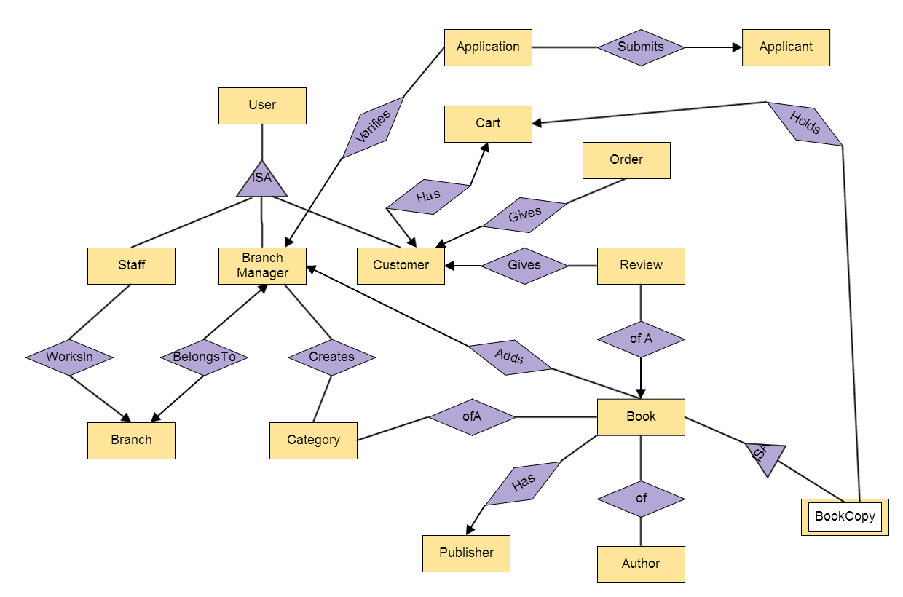

Slide 5
ERD Details

Slide 6
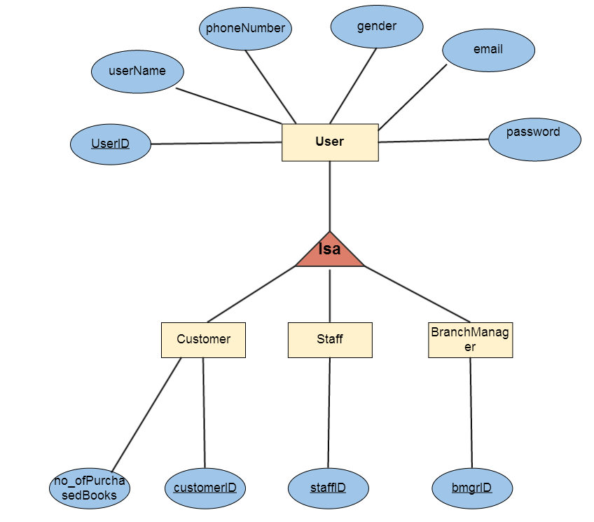

Slide 7
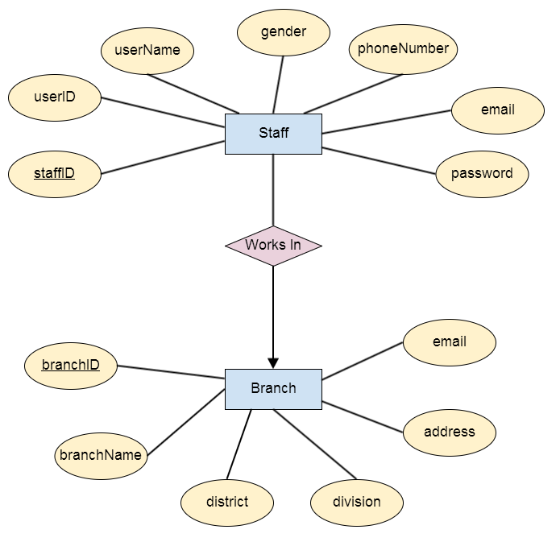

Slide 8
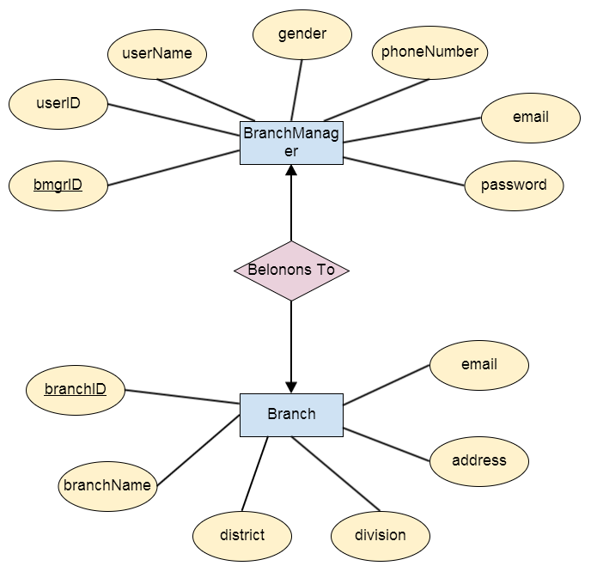

Slide 9
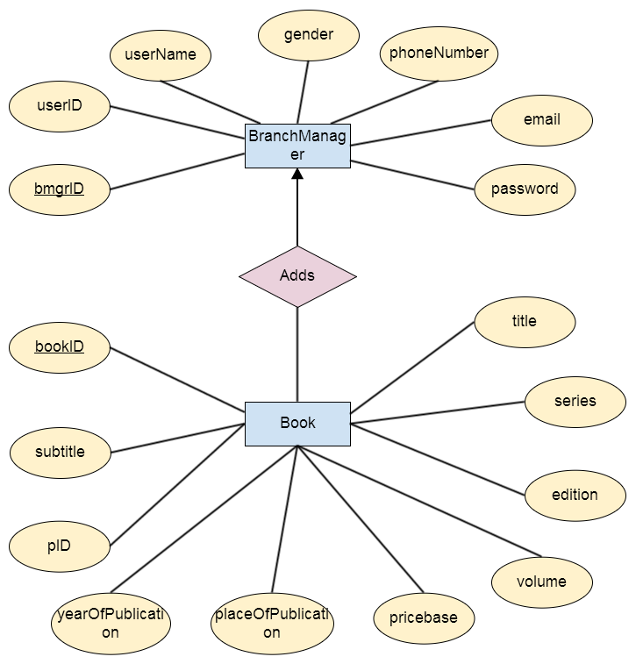

Slide 10
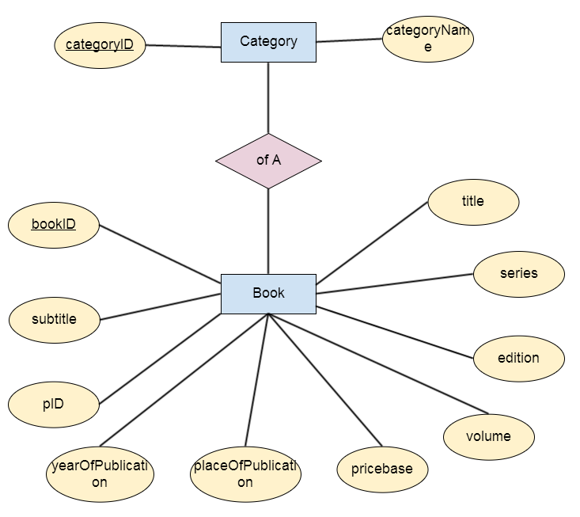

Slide 11
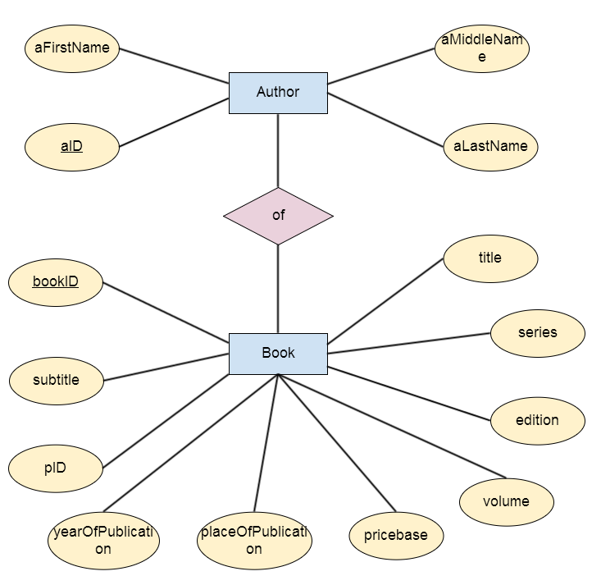

Slide 12
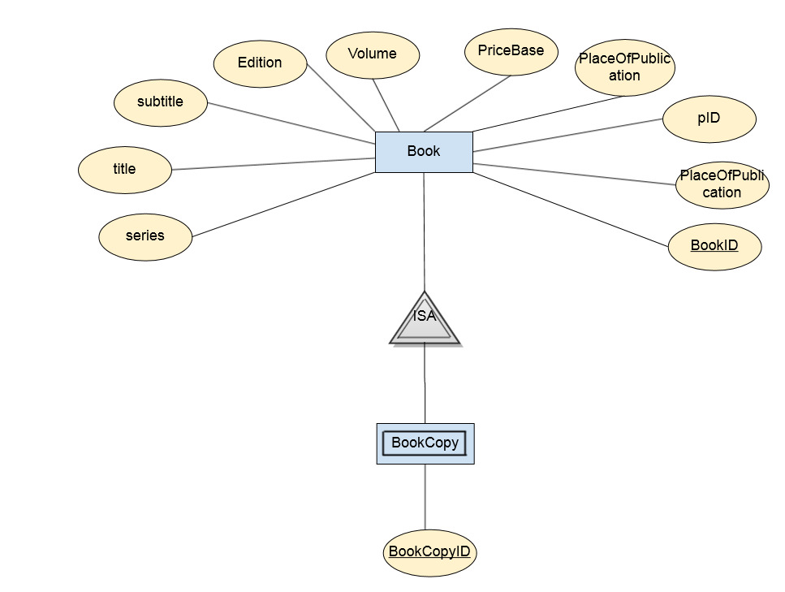

Slide 13
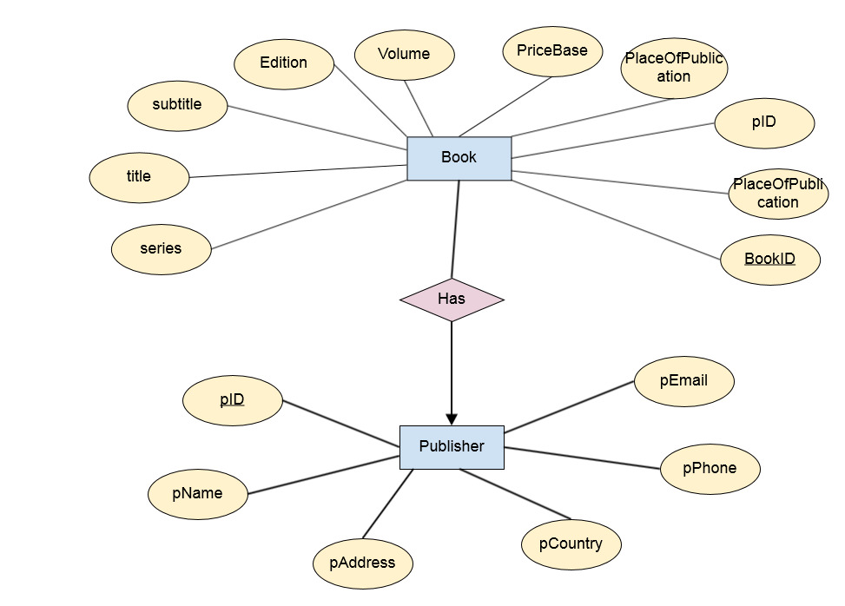

Slide 14
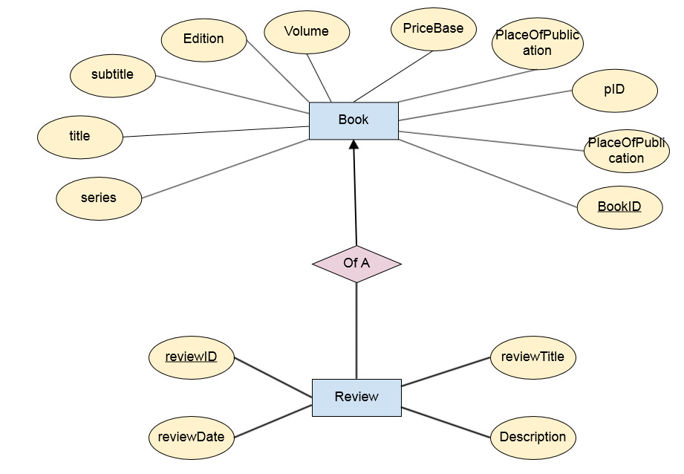

Slide 15
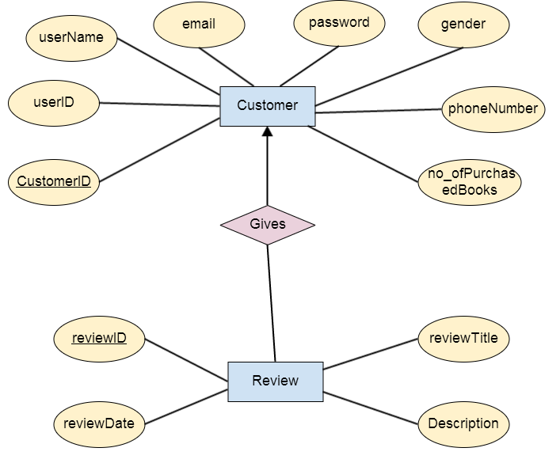

Slide 16
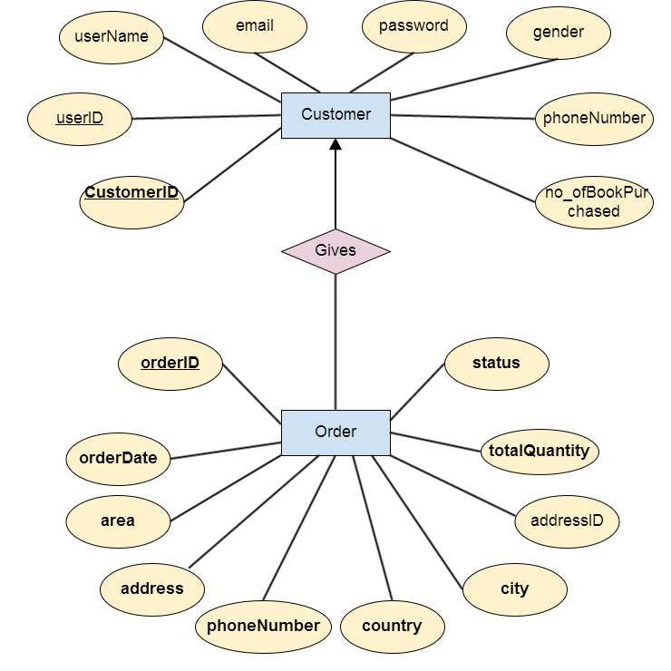

Slide 17
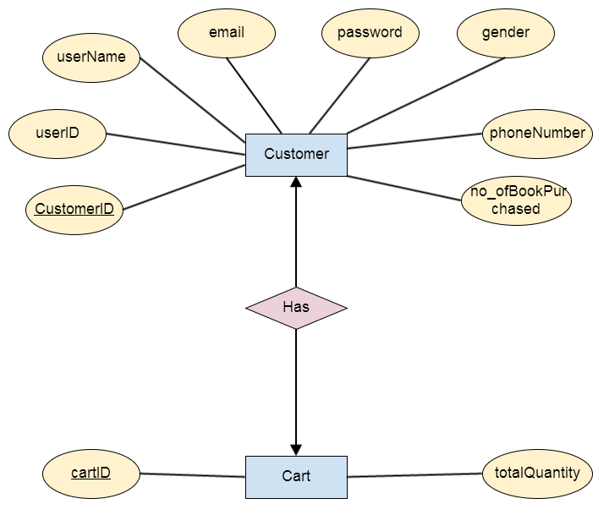

Slide 18
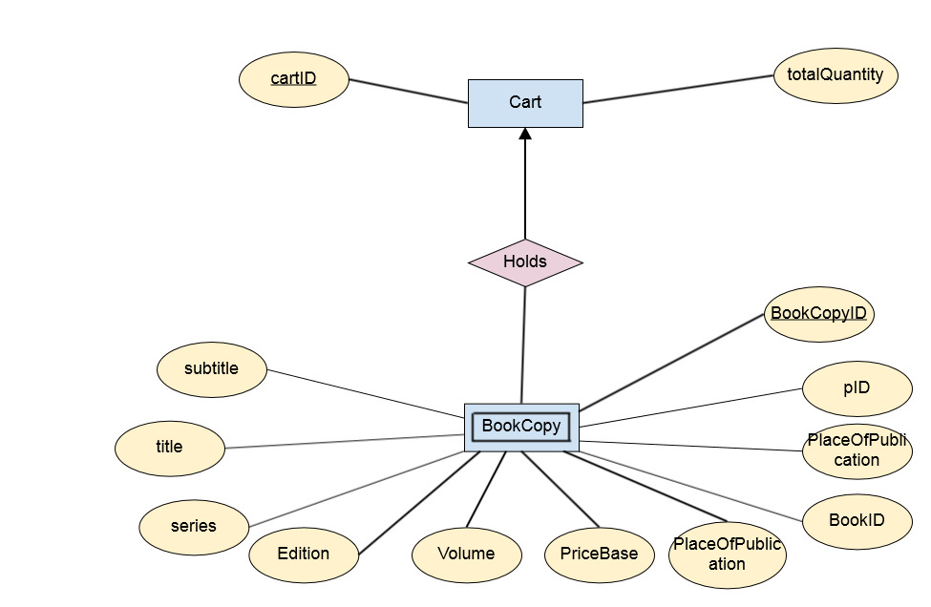

Slide 19
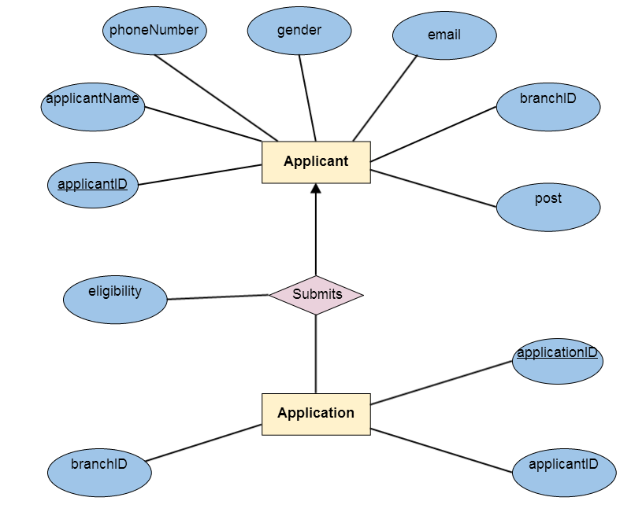

Slide 20
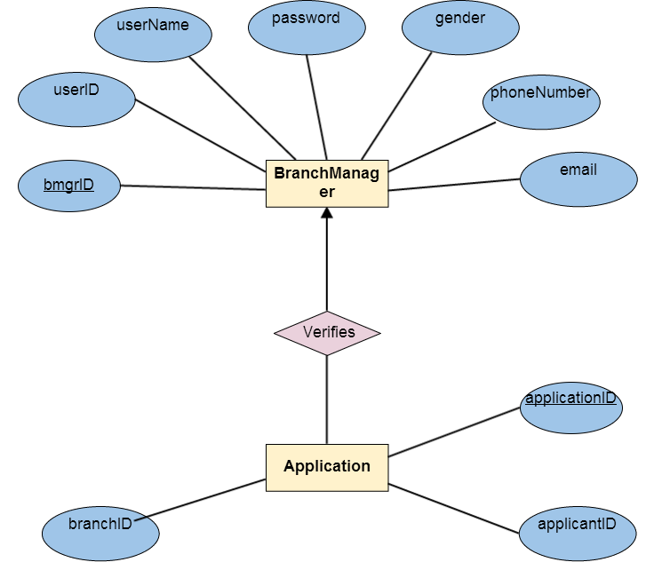

Slide 21
Relational Schema Tables

Slide 22
User
UserID varchar2(50) PRIMARY KEY UserName varchar2(50) Gender varchar2(8) PhoneNumber number(11) Email varchar2(20) Password varchar2(50)

Slide 23
BranchManager
bmgrID varchar2(50) PRIMARY KEY UserID varchar2(50) FOREIGN KEY UserName varchar2(50) Gender varchar2(8) PhoneNumber number(11) Email varchar2(20) Password varchar2(50)

Slide 24
Staff
staffID varchar2(50) PRIMARY KEY UserID varchar2(50) FOREIGN KEY UserName varchar2(50) Gender varchar2(8) PhoneNumber number(11) Email varchar2(20) Password varchar2(50)

Slide 25
Branch
BranchID varchar2(50) PRIMARY KEY BranchName varchar2(50) District varchar2(20) Division varchar2(20) Address varchar2(50) Email varchar2(20)

Slide 26
Category
CategoryID varchar2(50) PRIMARY KEY CategoryName varchar2(50)

Slide 27
Book
BookID varchar2(50) PRIMARY KEY Title varchar2(50) SubTitle varchar2(50) Edition varchar2(10) Volume varchar2(10) PriceBase number(30) YearOfPublication date PlaceOfPublication varchar2(20) Series varchar2(10)

Slide 28
Author
AID varchar2(50) PRIMARY KEY AFirstName varchar2(20) ALastName varchar2(20) AMiddleName varchar2(20)

Slide 29
BookCopy
BookCopyID varchar2(50) PRIMARY KEY BookID varchar2(50) FOREIGN KEY Title varchar2(50) SubTitle varchar2(50) Edition varchar2(10) Volume varchar2(10) PriceBase number(30) YearOfPublication date PlaceOfPublication varchar2(20) Series varchar2(10)

Slide 30
Publisher
pID varchar2(50) PRIMARY KEY pName varchar2(50) pAddress varchar2(50) pCountry varchar2(50) pPhone number(11) pEmail varchar2(20)

Slide 31
Review
ReviewID varchar2(50) PRIMARY KEY ReviewTitle varchar2(50) ReviewDate date Description varchar2(1000)

Slide 32
Triggers

Slide 33
Trigger(1)
Trigger Name | Check_Applicants_Eligibility
Time of Execution | After the submission of application form
Actions
Commands | UPDATE
Attributes | Eligibility
Tables | Submits
Remarks | Checking eligibility of those who submitted application form but not appointed as a STF

Slide 34
Trigger(2)
Trigger Name | Finding_Nearest_Branch
Time of Execution | AFTER SELECT get customer location
Actions
Commands | SELECT
Attributes | DeliveryAddress,Address
Tables | Order , Branch
Remarks | When order is placed , system finds the nearest branch corresponding to the customer

Slide 35
Trigger(3)
Trigger Name | Update_User_Profile_of_Purchase
Time of Execution | After delivery process
Actions
Commands | UPDATE
Attributes | No_of_Book_Purchased
Tables | Customer
Remarks | When the order is given, No_of_Book_Purchased attribute of Customer table will be incremented automatically which helps to find the customer buying maximum book, helps to award him

Slide 36
Trigger(4)
Trigger Name | Send_Info_of_Book_Run out
Time of Execution | After confirming a particular book with a BookId has no BookCopyId
Actions
Commands | UPDATE
Attributes | BookId , BookCopyId
Tables | Book
Remarks | When no BookCopy of a praticular book exists, a notification is sent to BMGR

Slide 37
Trigger(5)
Trigger Name | Sending_E-Mail_to_Faulty_Customer
Time of Execution | AFTER INSERT of user review in Review table
Actions
Commands | UPDATE
Attributes | email
Tables | Customer
Remarks | When a complain is filed against a customer, a review is added and then an email is sent to warn him by the system

Slide 38
Trigger(6)
Trigger Name | Update_Staff_List
Time of Execution | After new tuple in Staff table is CREATED
Actions
Commands | UPDATE
Attributes | StaffId
Tables | Staff , Branch
Remarks | When a worker is transferred, his branch must be updated.

Slide 39
Procedures

Slide 40
Procedure (1)
Procedure Name | Get_Book_List
Time of Execution | When MB/BMGR/STF wants to view booklist.
Input | NULL
Output | List of book title along with author name, edition.
Apply on | Books
Actions |  | Remarks
SELECT info from Book and Author table |  | MB/BMGR/STF can view Booklist for updating Booklist

Slide 41
Procedure (2)
Procedure Name | Get_Branch
Time of Execution | When customer places an order
Input | Userid
Output | Nearest branch address
Apply on | Branch,Customer
Actions |  | Remarks
SELECT address from Customer and Branch table |  | Corresponding BOMGR receives the order

Slide 42
Procedure (3)
Procedure Name | Review_on_Books
Time of Execution | When User reviews on books
Input | BookId,Review_description
Output | Adds new Book review
Apply on | Book,Review
Actions |  | Remarks
SELECT info from Book and Author table |  | MB/BMGR/STF can view Booklist for updating Booklist

Slide 43
Procedure (4)
Procedure Name | Update_Book_List
Time of Execution | When STF update booklist.
Input | Is_added
Output | Updated booklist
Apply on | Book
Actions |  | Remarks
INSERT info into Book table DELETE books from Book table |  | Collecting books from PBS ,STF add books to booklist(is_added=‘true’).Again when a book is delivered,STF remove this book from booklist(is_added=‘false’)

Slide 44
Procedure (5)
Procedure Name | ViewCustomerInformation
Time of Execution | When MB/USR/BMGR wants to see profile
Input | CustomerID
Output | Customer all whereabouts
Apply on | Every CustomerID whose information are requested
Actions |  | Remarks
SELECT name,gender,phonenumber,email and other informations from Customer Table where requested CustomerID is matched |  | Customer himself can see basic information

Slide 45


