Slide 1
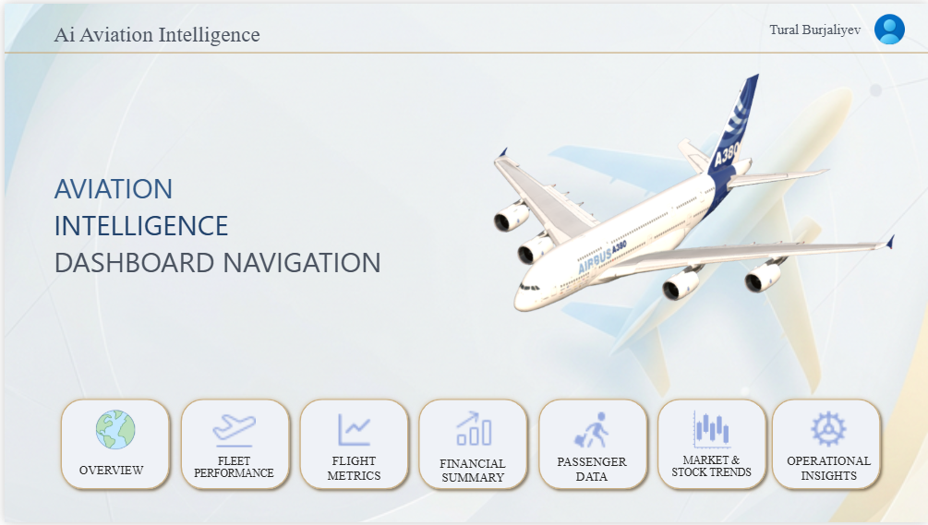
AVIATION INTELLIGENCE
Data-Driven Analysis of the Global Aviation Industry — Data Analytics Final Project 2026
Tural Burjaliyev

Slide 2
AVIATION INTELLIGENCE
SLIDE 2 / 6
Data-Driven Analysis of the Global Aviation Industry | Data Analytics Final Project — 2026
PROBLEM STATEMENT
ANALYSIS OBJECTIVES
The aviation sector generates $67+ billion in total
revenue yet remains financially volatile and high-risk
Fuel cost fluctuations & fleet management pose
critical strategic challenges for airlines worldwide
The 'Aging Paradox': older fleets drive higher costs,
yet some carriers offset this through high profitability
Investors struggle to assess genuine financial value
due to limited transparency across the sector
Comparative analysis of airline financial performance
Uncover correlation between oil prices and airline stocks
Identify the link between fleet age, fuel efficiency & profit
Detect financially undervalued (hidden gem) carriers
Generate deep insights via a 7-page interactive Power BI dashboard
TARGET AUDIENCE
KEY RESEARCH QUESTIONS
Group | Use Case
Aviation Analysts | Fleet performance & technical comparison
Financial Investors | Stock valuation & P/E ratio assessment
Airline Executives | Operational efficiency improvement
Researchers & Students | Academic study of the aviation sector
Q1 What effect does fleet age have on profitability?
Q2 How do rising oil prices impact airline stock performance?
Q3 Which airline achieves the highest fuel efficiency?
Q4 Which carriers are financially strong but undervalued by the market?
Q5 Are future fleet orders aligned with each airline's financial capacity?
Tural Burjaliyev | Aviation Intelligence Dashboard | Power BI & Python
Data Analytics Final Project — 2026

Slide 3
METHODOLOGY, DATA & TOOLS
SLIDE 3 / 6
Data Pipeline, Technologies Used & Dataset Statistics
DATA SOURCES
Source | Data Collected | Method
planespotters.net | Fleet matrix for 50 airlines (613 rows) | Web Scraping — SeleniumBase + BeautifulSoup
aerocorner.com | Technical specifications for 54 aircraft models | Web Scraping — requests + BeautifulSoup4
Yahoo Finance API | Stock history for 27 airlines 2015-2026 (~70K rows) | yfinance API
Yahoo Finance API | Brent & WTI crude oil prices (~5,600 rows) | yfinance API
OpenFlights (GitHub) | Metadata for 6,000+ airlines worldwide | pandas.read_csv(url)
Yahoo Finance — Fin. | Revenue, profit, debt, EBITDA per airline | yfinance Fundamental Data
TOOLS & TECHNOLOGIES
DATASET STATISTICS
DATA COLLECTION
• Python 3.11 — core programming language
• yfinance — Yahoo Finance API integration
• SeleniumBase (UC Mode) — anti-bot scraping
• BeautifulSoup4 — HTML parsing & extraction
• requests — HTTP request handling
ANALYTICS & VISUALISATION
• pandas, numpy — data processing & engineering
• SQL (Oracle) — 10 analytical VIEWs
(Window Functions, CTEs, JOINs)
• Power BI — 7-page interactive dashboard
• Gemini API — AI Chatbot integration
17
75K+
50
CSV Files
Total Rows
Airlines
54
11 Yrs
27
Aircraft Models
Time Series
Stock Exchanges
DASHBOARD STRUCTURE:
Navigation -> Overview -> Fleet Performance -> Financial Summary -> Passenger & Cabin Comfort -> Market & Stock Trends -> Executive Insights
Tural Burjaliyev | Aviation Intelligence Dashboard | Power BI & Python
Data Analytics Final Project — 2026

Slide 4
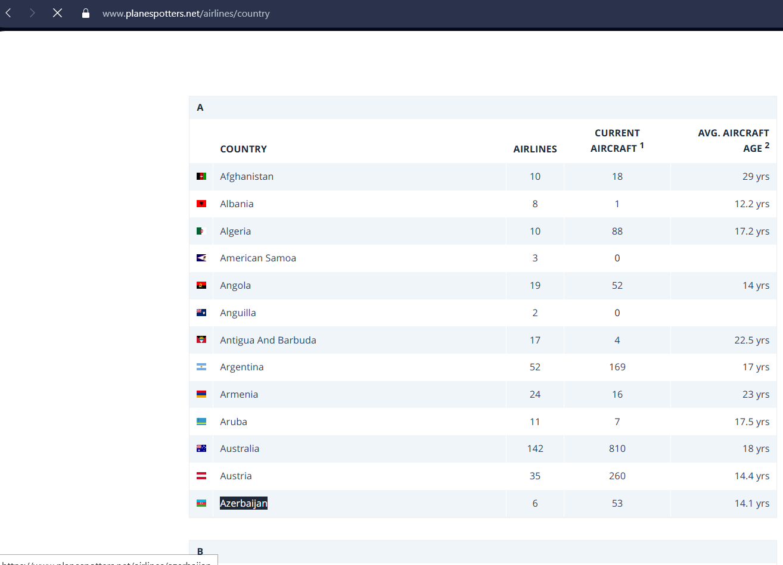
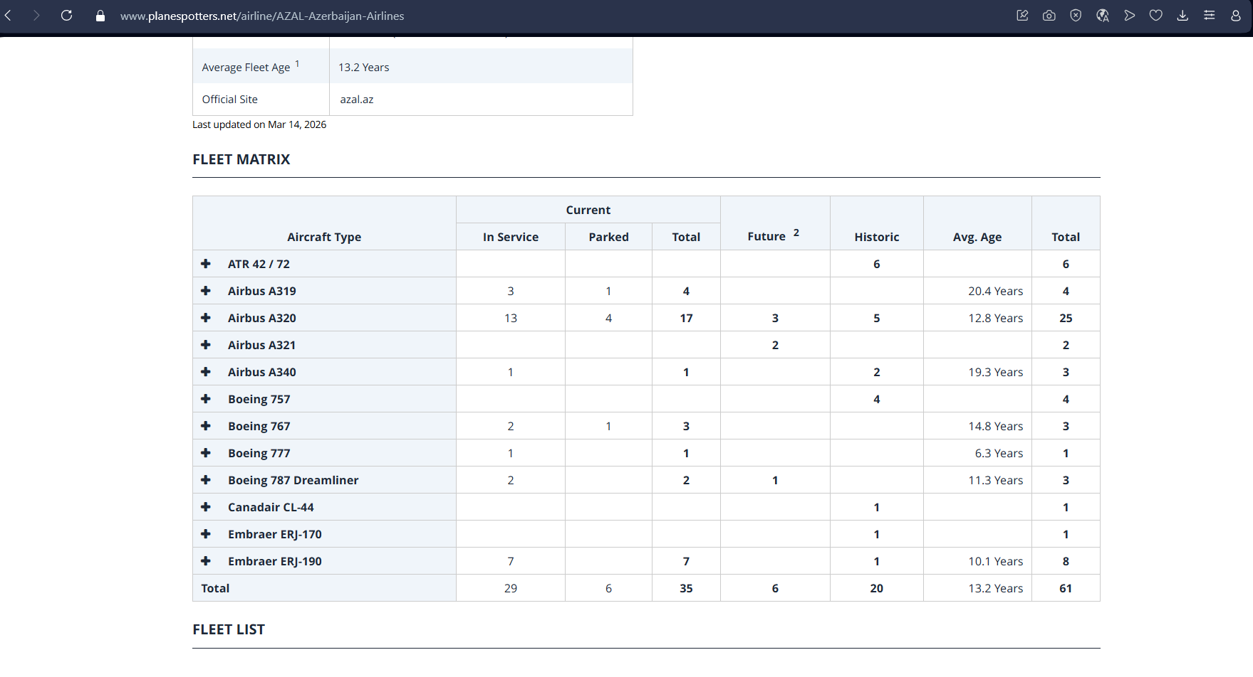
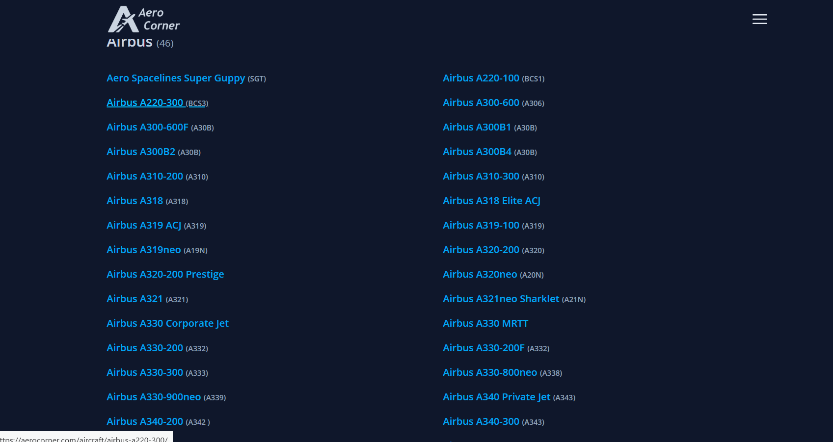
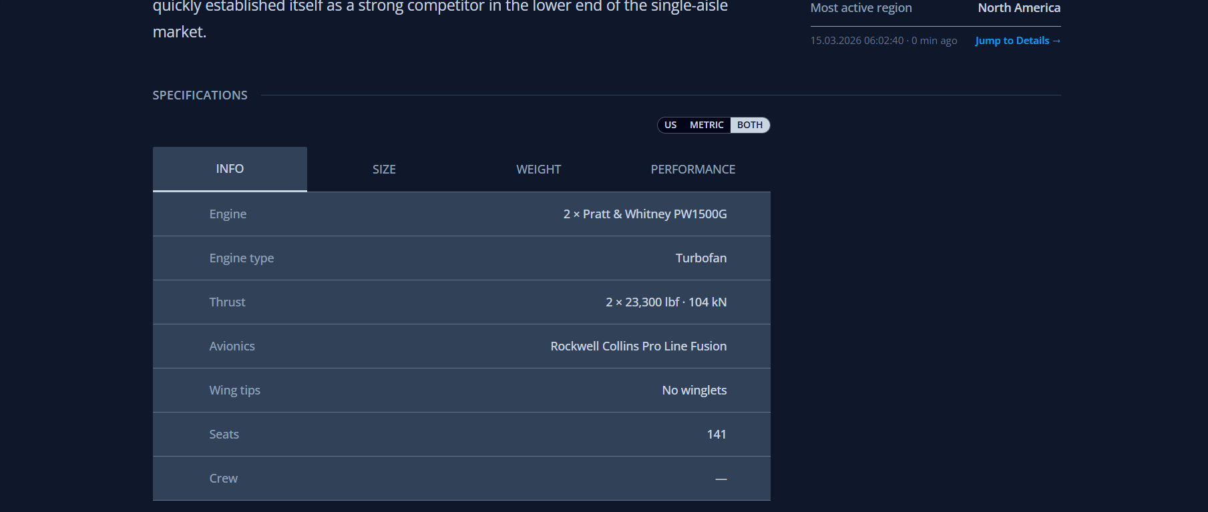
DATA COLLECTION — WEB SCRAPING
SLIDE 4 / 6
Live data samples from scraped websites — planespotters.net & aerocorner.com
planespotters.net — Airlines directory by country
planespotters.net — AZAL Azerbaijan Airlines fleet matrix
aerocorner.com — Full Airbus aircraft model listing
aerocorner.com — Airbus A220 technical specifications (INFO tab)
Tural Burjaliyev | Aviation Intelligence Dashboard | Power BI & Python
Data Analytics Final Project — 2026

Slide 5
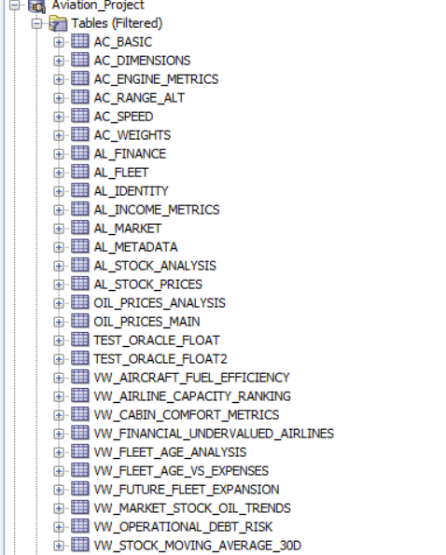
DATA NORMALIZATION & SQL STRUCTURE
SLIDE 5 / 6
Table decomposition, 3NF normalization strategy and Oracle SQL analytical VIEWs
NORMALIZATION PROCESS
10 ANALYTICAL VIEWs
Raw data arrived in a merged, unstructured format.
Following 3NF principles, tables were decomposed
into domain-specific normalized entities:
AIRCRAFT Group — 6 tables:
AC_BASIC Core specs — engine, avionics
AC_RANGE_ALT Flight range & altitude
AC_SPEED Speed performance metrics
AC_ENGINE_METRICS Fuel burn & thrust data
AC_WEIGHTS Payload & max takeoff weight
AC_DIMENSIONS Cabin area, wingspan metrics
AIRLINE Group — 7 tables:
AL_FLEET Fleet matrix (model, age, orders)
AL_IDENTITY Ticker, currency, exchange
AL_FINANCE Op. margin, debt, cash position
AL_INCOME_METRICS Revenue, expenses, EBITDA
AL_MARKET Market cap, P/E ratio
AL_METADATA IATA, ICAO, country
AL_STOCK_PRICES Daily OHLCV + rolling volatility
OIL Group — 2 tables:
OIL_PRICES_MAIN Brent & WTI daily prices
OIL_PRICES_ANALYSIS Monthly averages, volatility
SQL Features Used:
Window Functions (RANK, OVER)
Common Table Expressions (CTEs)
Multi-table JOINs
CASE / NULLIF / COALESCE
VW_FLEET_AGE_ANALYSIS
VW_AIRLINE_CAPACITY_RANKING
VW_MARKET_STOCK_OIL_TRENDS
VW_FINANCIAL_UNDERVALUED
VW_AIRCRAFT_FUEL_EFFICIENCY
VW_OPERATIONAL_DEBT_RISK
VW_FLEET_AGE_VS_EXPENSES
VW_FUTURE_FLEET_EXPANSION
VW_CABIN_COMFORT_METRICS
VW_STOCK_MOVING_AVERAGE_30D
Aviation_Project — Oracle SQL Tables & VIEWs
Tural Burjaliyev | Aviation Intelligence Dashboard | Power BI & Python
Data Analytics Final Project — 2026

Slide 6
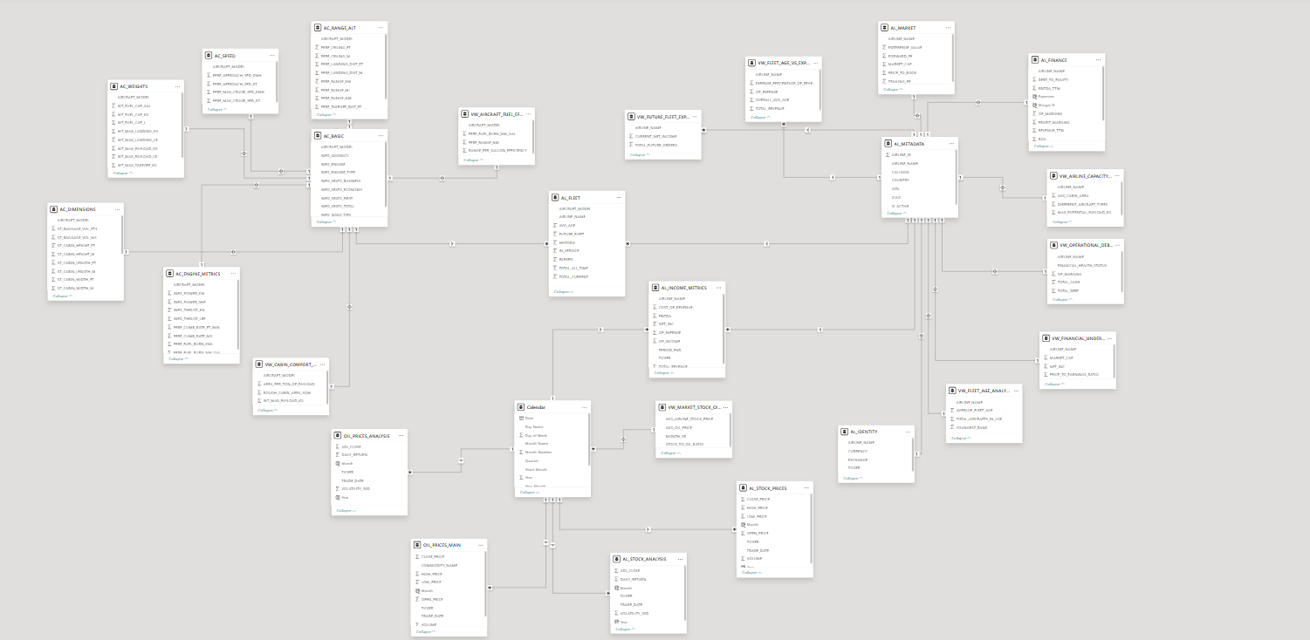
DATA MODELLING — Power BI Schema
SLIDE 6 / 6
Snowflake schema design, table relationships and the Calendar dimension table
SCHEMA HIGHLIGHTS
Schema Design: Snowflake
Fact tables at the centre;
dimension tables connected
via 1:N relationships
Table Groups:
AIRCRAFT — 6 dimension tables
AIRLINE — 7 fact/dimension
OIL — 2 time-series tables
Join Keys:
AIRCRAFT_MODEL (primary key)
AC_BASIC -> AC_SPEED,
AC_WEIGHTS, AC_DIMENSIONS...
AIRLINE_NAME (join key)
AL_FLEET -> AL_FINANCE...
Calendar Table:
Columns included:
• Date, Month, Year
• Quarter, Day of Week
• Month Name, Short Month
• Is_Week_Month (bool)
Why it was created:
To bridge stock price and oil
time-series tables, enabling
Power BI Time Intelligence
functions: YoY, MoM, rolling
averages and period slicers.
Tural Burjaliyev | Aviation Intelligence Dashboard | Power BI & Python
Data Analytics Final Project — 2026

