Slide 1
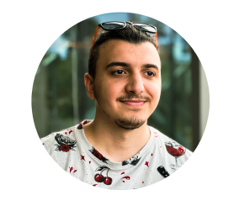
Tural Hajiyev
Software Developer

Slide 2
Profile
I am a qualified Software Engineer with four years of experience who worked in teams of varying sizes and scopes. I prefer to describe myself as a developer who specializes as a frontend developer but also has a solid background in backend and mobile development.

Slide 3
Education
I studied in Information Technologies at Azerbaijan State Oil and Industry University from 2016 to 2020.
Currently, I’m doing my master's in Computer Engineering at Wroclaw University of Science and Technology. The estimated time to get my master's degree is 2023 October.

Slide 4
Technical Kowledge
As Software Developer, I am experienced mainly in web technologies. I have solid knowledge and experience in the:
Planning and implementing User interfaces.
Designing and implementing web applications, from the user end to the backend.
Documenting and QA testing web applications.

Slide 5
Soft skills
Communication: No matter of professional skills, I’m able to communicate with every member of the team that I’m working with.
Problem-solving: I’m good at problem-solving and solution investigating. Based on my previous experiences, I can divide complex software problems and issues into small chunks and work w/ my team to fix them.
Time Management: I’m good in estimating times for planned works and finish tasks on time.

Slide 6
Tools & Technologies I like to work
Web technologies: HTML, CSS, Javascript, React, Redux, context API, electron.
Testing technologies: Knowledge and experience with the testing frameworks – Jest, Enzyme, react-testing-library.
VCS: Knowledge and experience with version control systems - Git, Github, Gitlab.

Slide 7
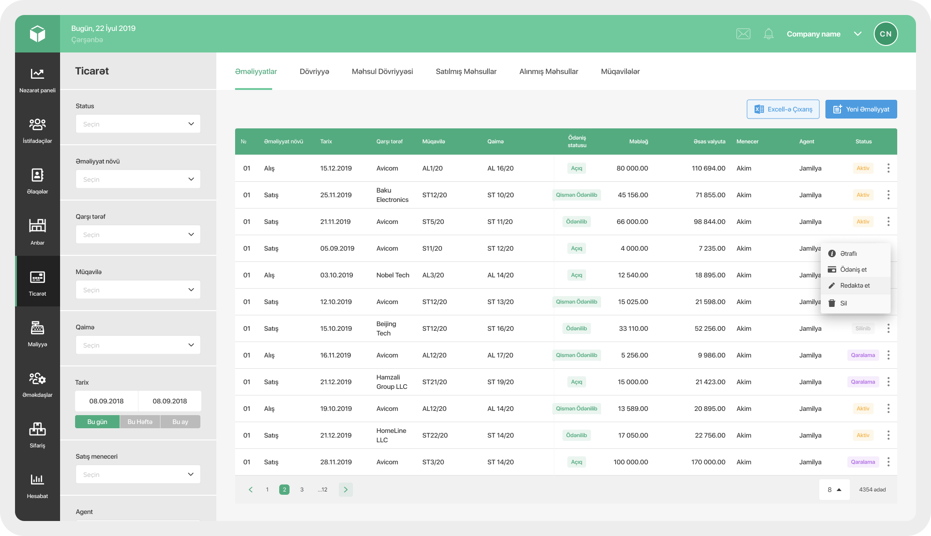
Work experience – Prospect SMB
It’s an ERP project which helps to manage businesses from one point. Each module of Prospect serves solutions in different areas like Users, Relations, Warehouses, Trades, Finance, HR, Orders, Call center, Reports, Tasks, and so on.

Slide 8

Work experience – 10BE5
We are building a natural language processing-powered platform that automates drafting capital markets disclosures and related processes. Our solutions automate substantive legal work.

Slide 9
References
Website
Linkedin
Github
Twitter

