Slide 1
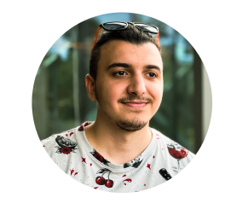
Tural Hajiyev
Software Developer

Slide 2
Profile
My name is Tural and I'm 22 years old guy who lives in Poland. Describing myself as a developer who specialized as a frontend developer but also has a huge interest in backend and mobile development.

Slide 3
Education
I studied in Information Technologies at Azerbaijan State Oil and Industry University from 2016 to 2020.
Currently I’m doing my master in Computer Engineering in Wroclaw University of Science and Technology. I will get my master degree in 2023 October.

Slide 4
Work
I studied in Information Technologies at Azerbaijan State Oil and Industry University from 2016 to 2020.
Currently I’m doing my master in Computer Engineering in Wroclaw University of Science and Technology. I will get my master degree in 2023 October.

Slide 5
Technical Nowledge
As Software Developer I experienced mainly in web technologies. I have solid knowledge and experience in:
Planning and implementing User interfaces.
Designing and implementing web applications, from user end to backend.
Documenting and QA testing web applications.

Slide 6
Soft skills
Communication: No matter of professional skills, I’m able to communicate with every member of the team that I’m working.
Problem solving: I’m good in problem solving and problem investigating. I’m able to divide complex software problems and issues to small chunks and work w/ my team to fix them.
Time Management: I’m good in estimating times for planned works and finish tasks on time.

Slide 7
Tools & Technologies I like to work
Web technologies: HTML, CSS, Javascript, React, Redux, context API, electron.
Testing technologies: Knowledge and experience with the testing framework – Jest, Enzyme, react-testing-library.
VCS: Knowledge and experience with version control systems - Git, Github, Gitlab.

Slide 8
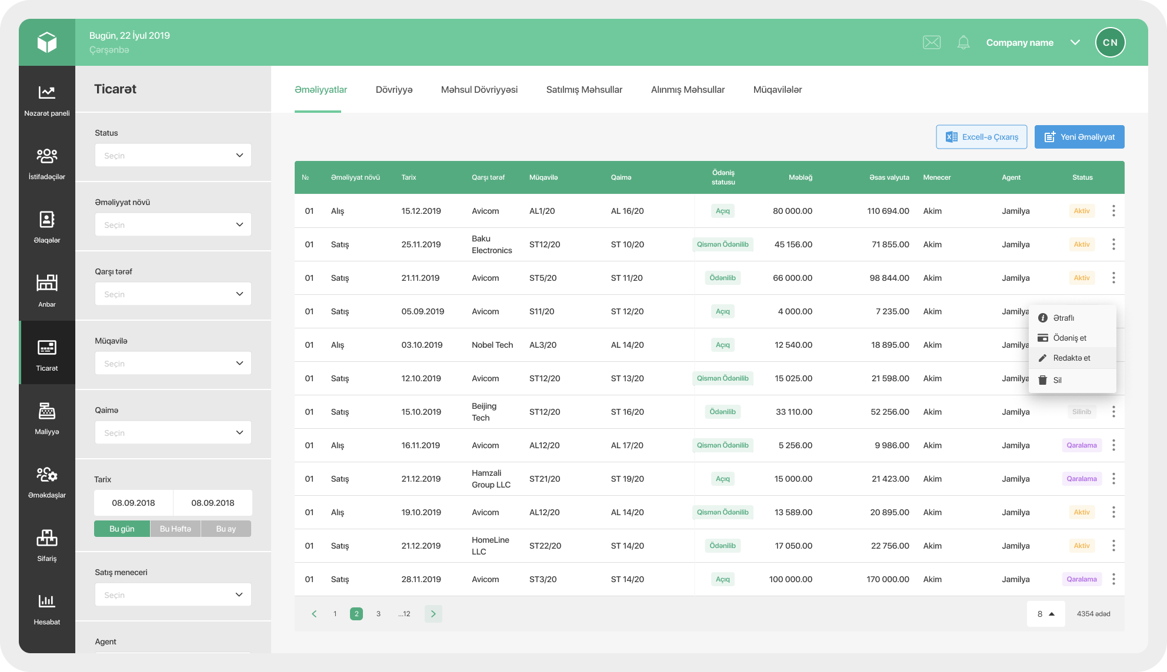
Work experience – Prospect SMB
It’s an ERP project which helps to manage businesses from one point. Each module of Prospect serves solutions in different areas like Users, Relations, Warehouses, Trades, Finance, HR, Orders, Call center, Reports, Tasks, and so on.

Slide 9

Work experience – 10BE5
We are building a natural language processing-powered platform that automates the drafting of capital markets disclosures and related processes. Our solutions automate substantive legal work.

Slide 10
References
Website
Linkedin
Github
Twitter

