Slide 2
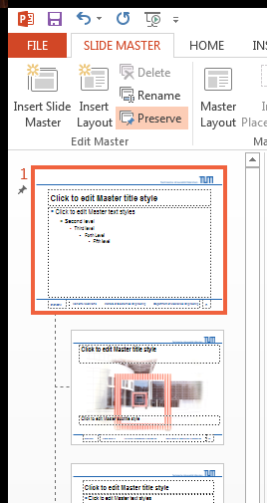
Changing the Footer
To change the name in the footer:
  Go to „View » Slide Master“
  Choose the Slide Master (see image)
  On this slide edit the footer
  Click „Insert » Header & Footer“
    Click „Apply to all“
  Click „Slide Master » Close Master View“
Select the Slide Slide Master

Slide 3
Design & Colours
Colouring of graphs or text should use the follow accent colours, the colour scheme is called „BioVT“
Bullet points are automatically formatted
  in standard content fields
    (but two levels should be sufficient)
One
Two
Three
rgb
0, 101, 189
229, 52, 24
80, 116, 60

Slide 4
General
The minimum font size used should be 20pt.
Opt for 24pt or more
Additional information, which is not important (e.g. literature), may be added in smaller font size (12-14pt)
The standard font should be Arial Narrow
Avoid Tables
“One picture says more than thousand words”
Illustrate slides, don’t have too many pure-text slides

Slide 5
Title and Content
Title
  #1: The title should always be a one-liner
  #2: If the title is longer than one line, rule #1 applies.
  In the rare and undesirable case that two lines are required, add an empty content line in this text field. Also note that a special place in Hell might be reserved for you
Content
  The width of the content field is extended to the right, to allow for fewer line breaks with long words
  However, you should also use common sense when it comes to long lines on where to break them

Slide 6
PowerPoints Shortcuts
Jump to slide by typing the slide number and pressing <enter>
Press <b> or <w> to temporarily get a black or white screen. Press again to return to your presentation
Press <F5> to start the presentation form the
beginning
Slide number to access slide easily

Slide 7
Pictures
It is a good idea to have pictures with a transparent or at least white background, to better “blend in”
Don’t have to many pictures on one slide. One Graph should be enough, at most two for comparison
Generally pictures should also be in Arial Narrow and the font size of the surrounding text (see General)

Slide 8
Outline
Example Outline
Match the actual topics to what you want to present
Introduction
Objective
Methods
  Experimental
  Theoretical
Results
Conclusion
Outlook

Slide 9
Outline
Use 80% transparent white boxes to hide the non-current part
Introduction
Objective
Methods
  Experimental
  Theoretical
Results
Conclusions
Outlook

Slide 10
Example
Normally text should not be that low in your presentation.
Due to the fact that the average human has approx. one head and sits in front of you, the lower third of the slide should be considered to not be visible to everyone.
The following slides are an example presentation

Slide 11
Outline
Introduction
Objective
Methods
  Experimental
  Theoretical
Results
Conclusion
Outlook

Slide 12
Introduction
To understand what you did, you should see that everyone is one the same level
Assume people are dumb, and hope for the best

Slide 13
Outline
Introduction
Objective
Methods
  Experimental
  Theoretical
Results
Conclusion
Outlook

Slide 14
Objective
It always is important to show why you are doing what you are doing.
So list:
  Reasons
  Problems
  Possibly failed “solution”

Slide 15
Outline
Introduction
Objective
Methods
  Experimental
  Theoretical
Results
Conclusion
Outlook

Slide 16
Methods
Experimental methods and conditions
For an experiment you should give all necessary data, e.g.
  Temperature
  pH
  Gassing
  Volume
  …

Slide 17
Methods
Theoretical Methods include e.g. mathematical approaches
Describe
  Algorithms
  Evaluation methods
  (Required) assumptions

Slide 18
Outline
Objective
Introduction
Methods
  Experimental
  Theoretical
Results
Conclusion
Outlook

Slide 19
Results
Show your results. This should hopefully be the longest part
Showing the results also includes discussion what you learned from them

Slide 20
Outline
Objective
Introduction
Methods
  Experimental
  Theoretical
Results
Conclusion
Outlook

Slide 21
Conclusion
You should summarize the interpretation of your result here on one slide:
  What can you conclude from the results?
  What have you achieved?
  What new information about the process you have observed can be gained from the data

Slide 22
Outline
Objective
Introduction
Methods
  Experimental
  Theoretical
Results
Conclusion
Outlook

Slide 23
Outlook
What else should be done
Are you planning to do anything further (in longer projects)
Did something fail to work, and can be investigated further?
What improvements in the described project could be made?

Slide 24
Acknowledgements
Prof. Dr.-Ing. Dirk Weuster-Botz
That great guy over there
…
The whole BioVT, SBT and STT Team

Slide 25
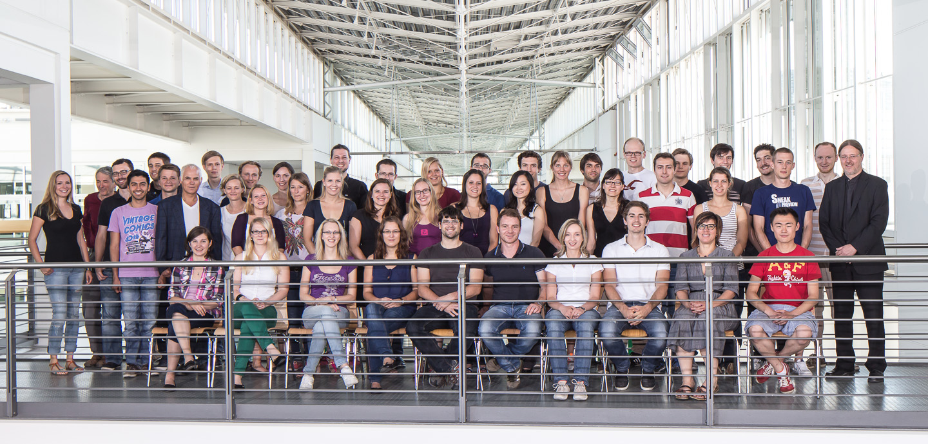
Thank you for your attention!

Slide 26
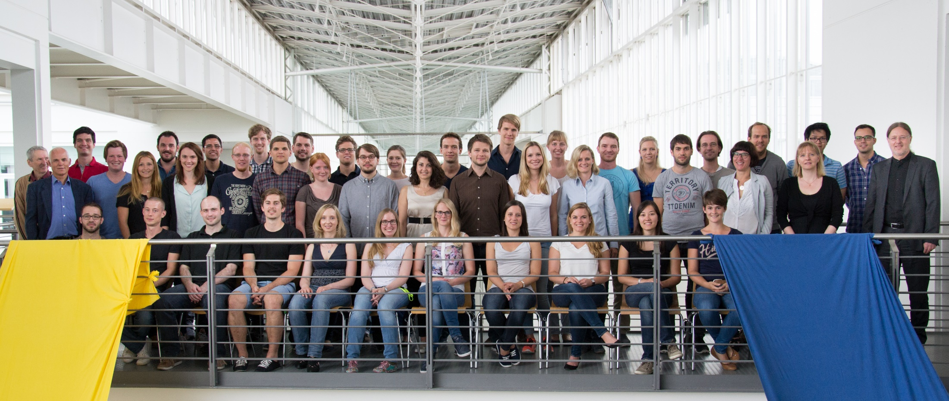
Thank you for your attention!

Slide 27
Backup
Slides like this one only act as a separator for the author, and are not supposed to be visible by the auditorium.
The following slides are for backup purpose only

Slide 28
Bibliography
Entry | Source
Pythagoras 570BC | About the Three Sides of a Triangle

Slide 29
Quotes
Mark Twain
  There are lies, damned lies and statistics.
Unknown
  In the end, everything will be fine. And if it’s not fine, it’s not the end.

Slide 30
Current Version
2016-06-10

Slide 31
Changes
2016-06-10
  Moved Slide header up
  Increased width of content field
2015-05-08
  Automatic shrinking of text size for content field has been deactivated
  Minor spelling correction

Slide 32
Changes continued
2015-03-27
  Removed date, changed colour of page number
  Some structural changes for the content
  Further corrected formatting details
  Added PowerPoint shortcuts
2014-11-07
  Changed first accent colour to TUM Blue (rgb 0 101 189)
  Edited Footer (removed fixed name)

Slide 33
Changes continued
2014-07-28
  Example Presentation
  General formatting (Pictures, Font, Guidelines)
  Minor
    Starting Slide = #1, easier mapping to <number>+<enter>
2014-07-07
  Initial Version based on previous BioVT template
  Added
    Slide numbers
    Date
    Modified text fields on title slide

