Slide 1
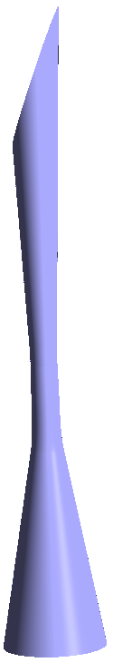
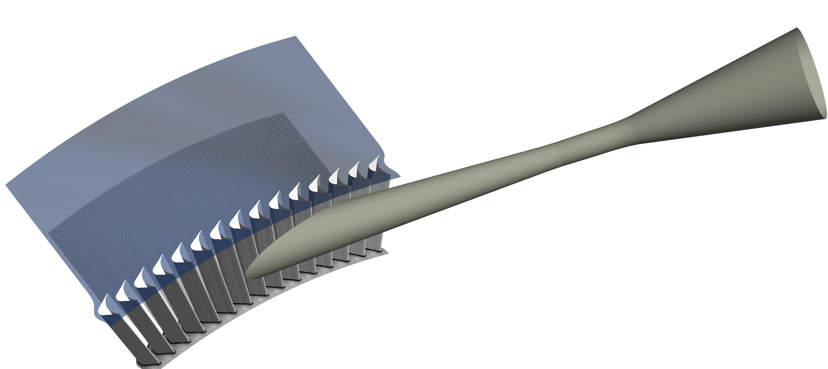

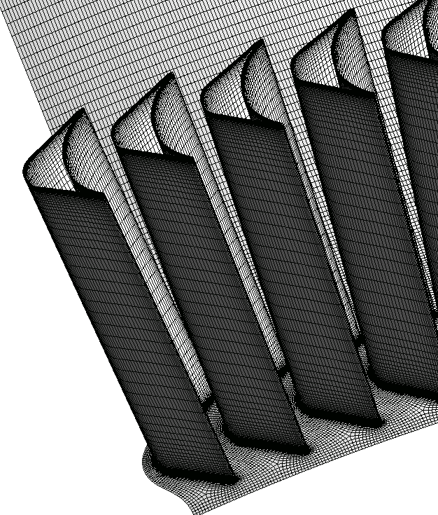
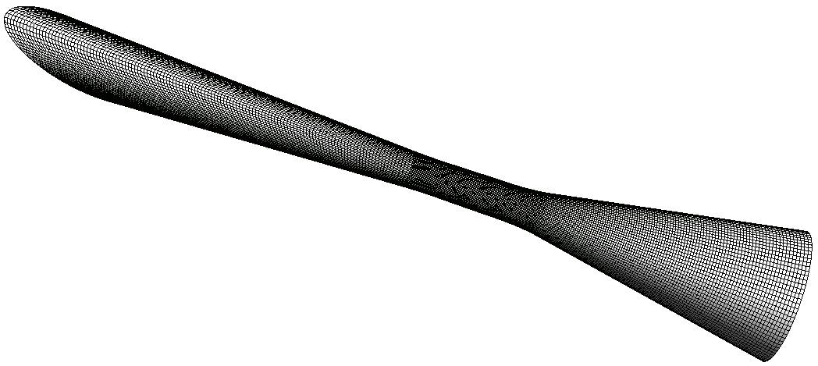
Shroud
Outlet
Periodic
Nozzle
inlet
Nozzle inlet
Hub
Rotor
(a)
(b)
(c)

Slide 2
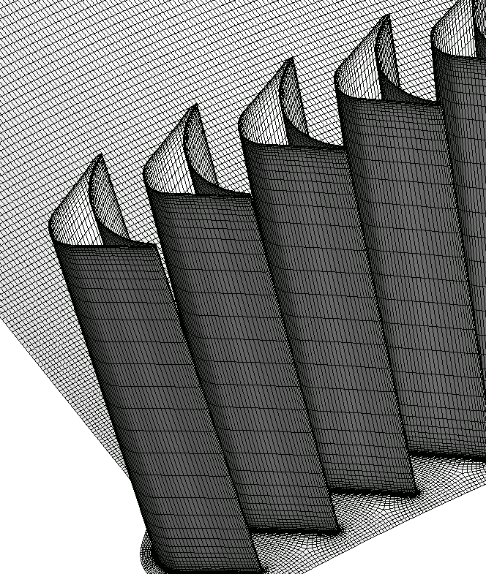

Slide 3
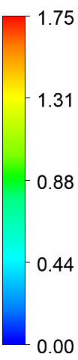

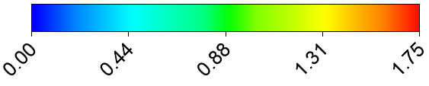


Slide 4
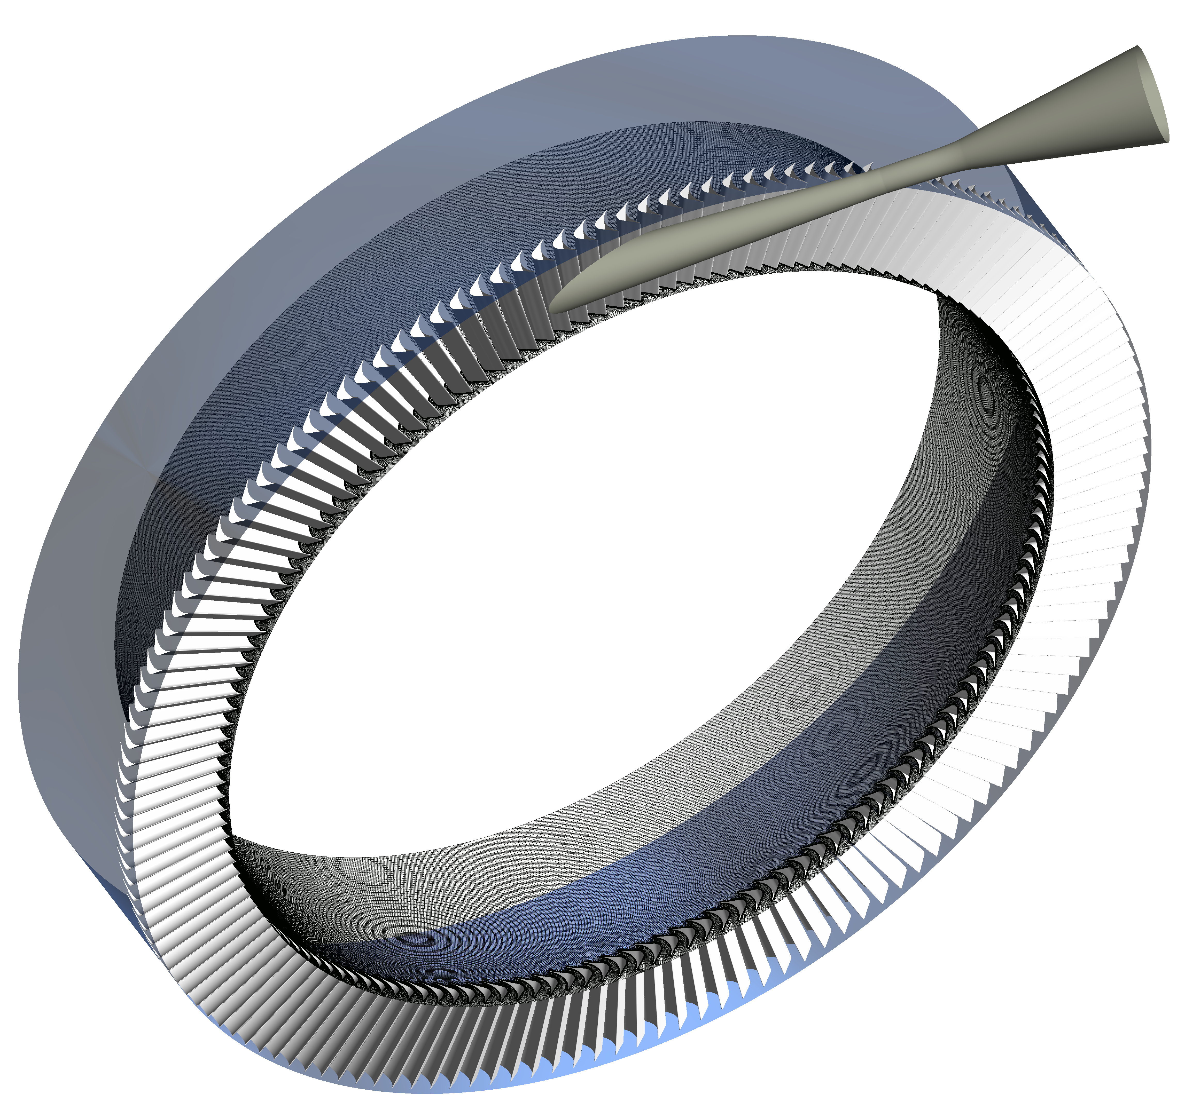

Slide 5


(a)
1
2
3
4
5
6
7
8
9
10
11
12
13
14
15
(b)
1
2
3
4
5
6
7
8
9
10
11
12
13
14
15
[KPa]
(a) Mixture model
(b) Barotropic model

Slide 6




(a)
1
2
3
4
5
6
7
8
9
10
11
12
13
14
15
(b)
1
2
3
4
5
6
7
8
9
10
11
12
13
14
15
(a) Mixture model
(b) Barotropic model

Slide 7



(a)
1
2
3
4
5
7
8
9
10
11
12
14
15
6
13
(b)
1
2
3
4
5
6
7
8
9
10
11
12
13
14
15
(b) Barotropic model
(a) Mixture model

Slide 8
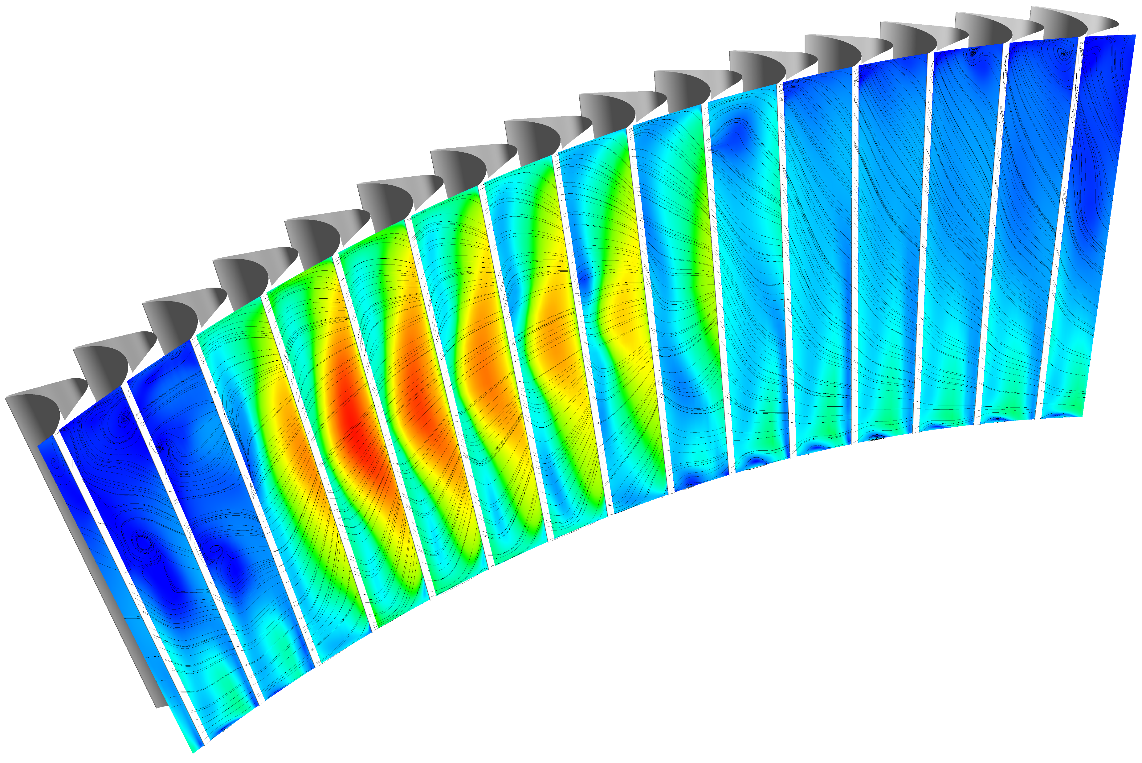
12
13
14
15
10
11
9
8
7
6
5
4
3
2
1
Mach number

Slide 9
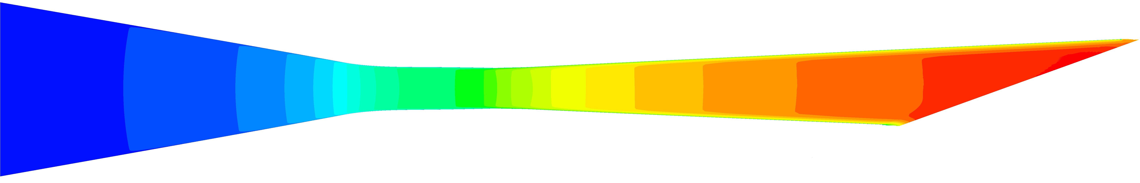
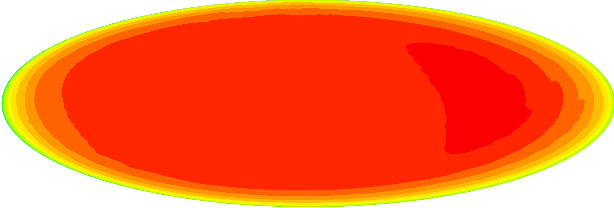
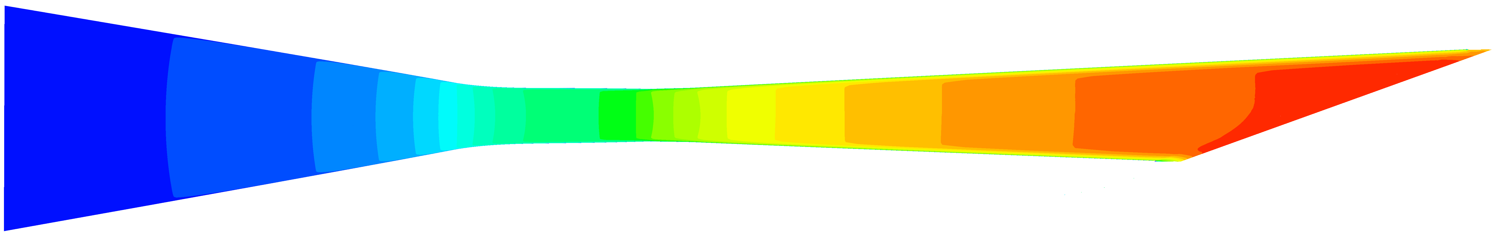
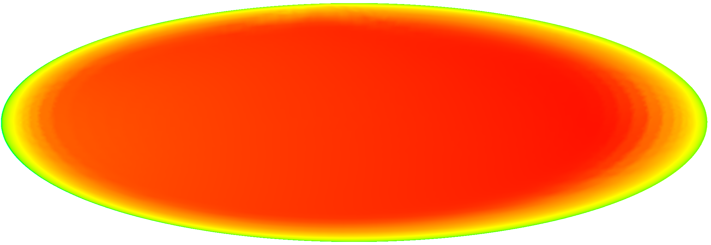

(a)
(b)

Slide 10



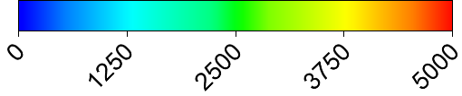

Slide 11


Shock boundary layer separation loss
1
2
3
4
5
6
7
8
9
10
11
12
13
14
15
1
2
3
4
5
6
7
8
9
10
11
12
13
14
15
(a)
Mixing loss
Flow separation
loss in inactive passages
(b)
Wall friction loss
Shock loss
1
2
3
4
5
6
7
8
9
10
11
12
13
14
15
Wake loss
Coalescence of bow shock and passage shock

Slide 12





Slide 13
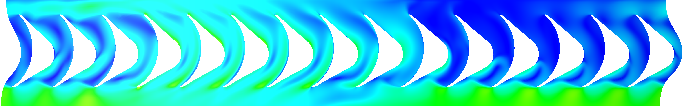
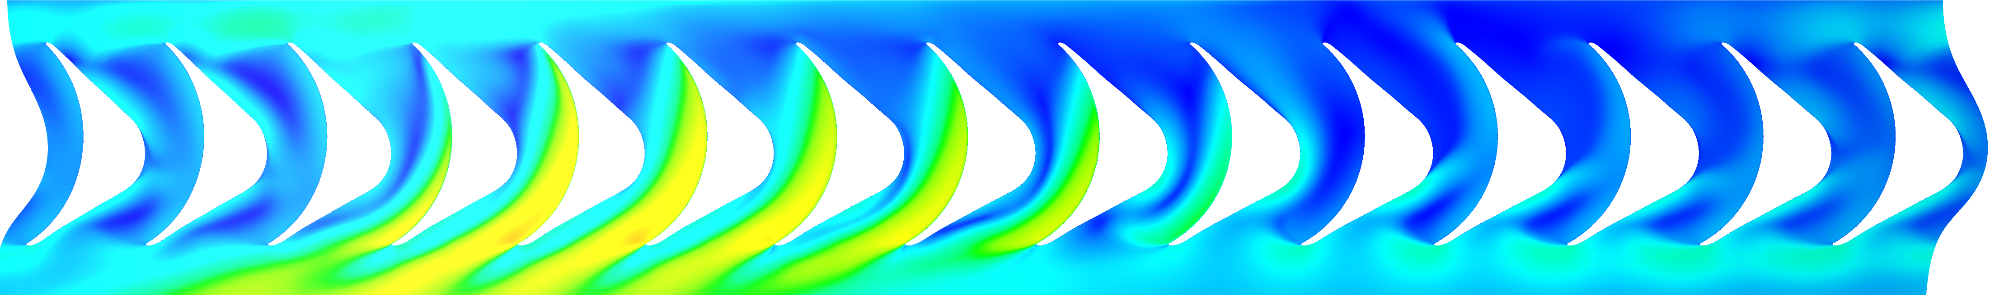



1
2
3
4
5
6
7
8
9
10
11
12
13
14
15
5%
25%
1
2
3
4
5
6
7
8
9
10
11
12
13
14
15
LE bow shock
50%
1
2
3
4
5
6
7
8
9
10
11
12
13
14
15
Expansion fan
75%
1
2
3
4
5
6
7
8
9
10
11
12
13
14
15
Coalescence of bow shock and passage shock
Shock boundary layer interaction
90%
1
2
3
4
5
6
7
8
9
10
11
12
13
14
15

Slide 14
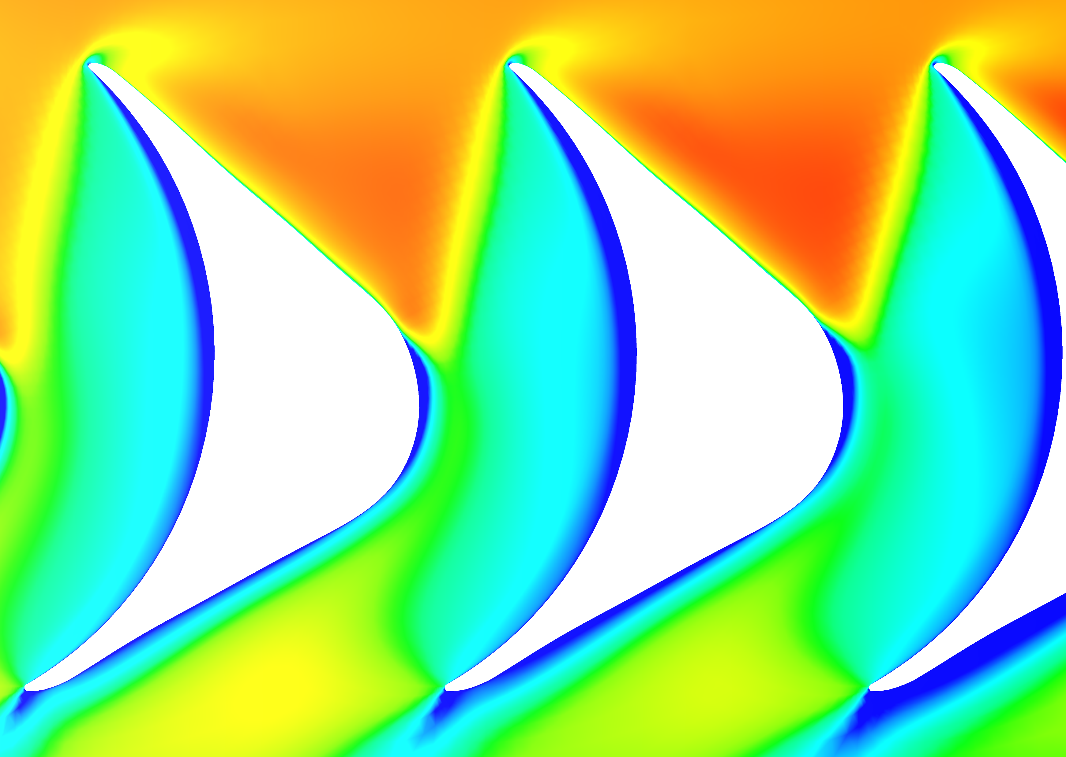
Pressure leg of bow shock
Suction leg of bow shock
Leading edge
bow shock
Coalescence of bow shock and passage shock
Shock
boundary layer interaction
Expansion fan

Slide 15
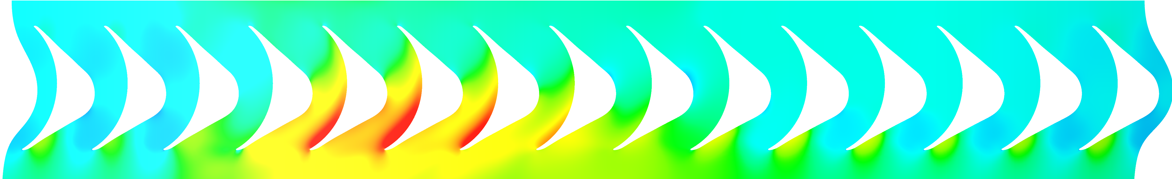




5%
1
2
3
4
5
6
7
8
9
10
11
12
13
14
15
[KPa]
25%
1
2
3
4
5
6
7
8
9
10
11
12
13
14
15
50%
1
2
3
4
5
6
7
8
9
10
11
12
13
14
15
75%
1
2
3
4
5
6
7
8
9
10
11
12
13
14
15
90%
1
2
6
8
9
10
11
12
13
14
15
3
4
5
7

Slide 16
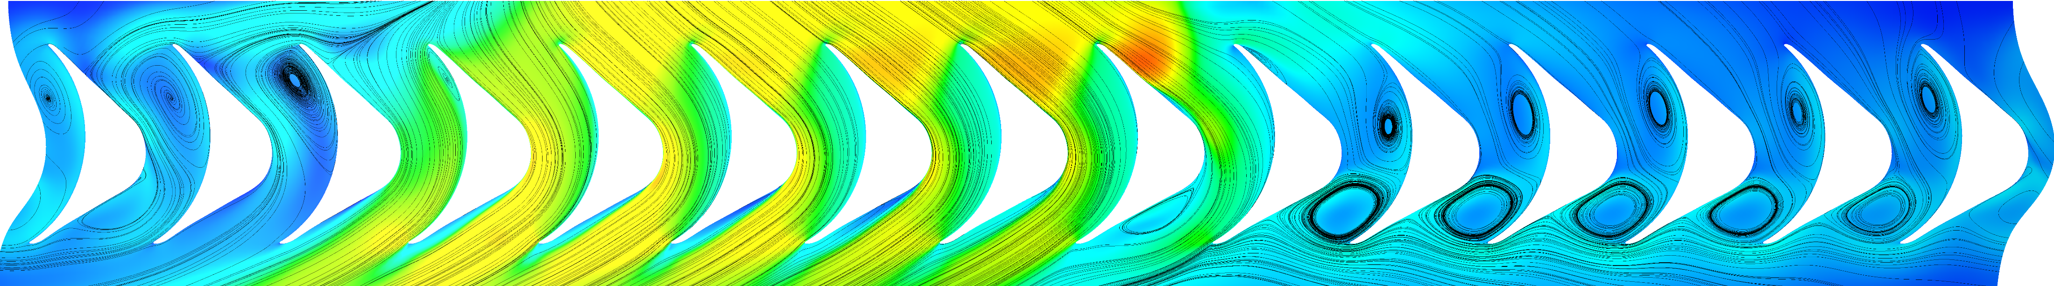
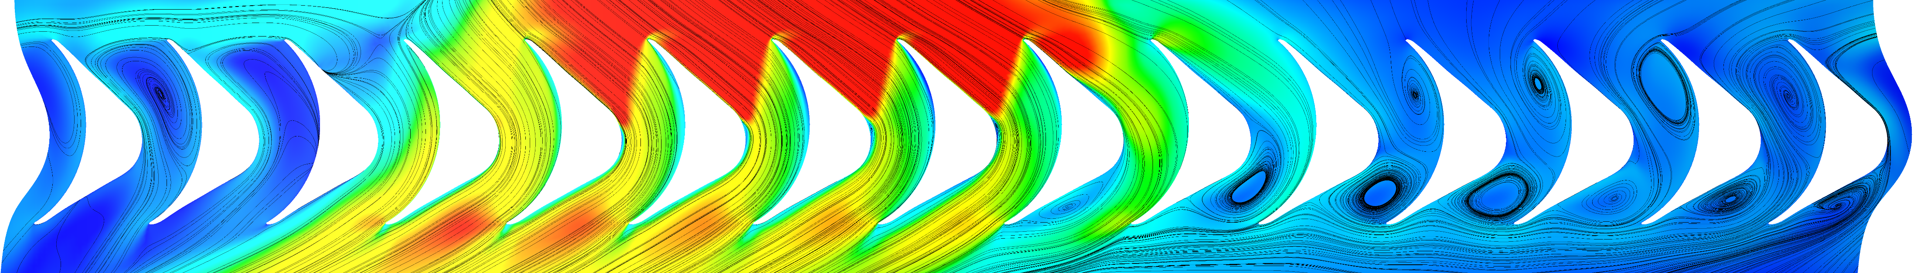
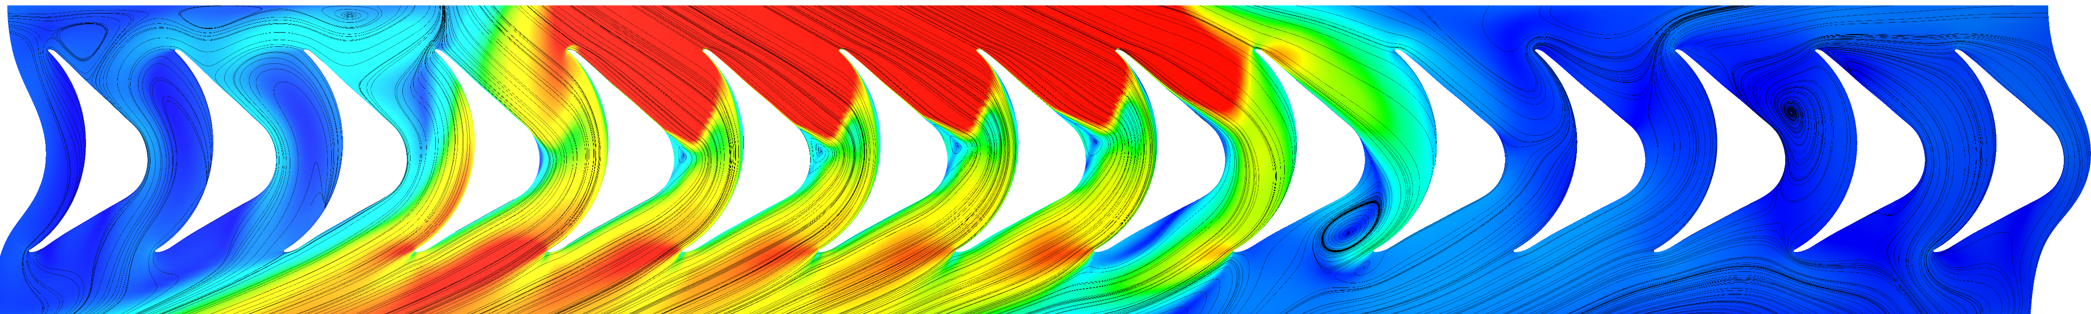
(a)
1
2
3
4
5
6
7
8
9
10
11
12
13
14
15
(b)
1
2
3
4
5
6
7
8
9
10
11
12
13
14
15
(c)
1
2
3
4
5
6
7
8
9
10
11
12
13
14
15

Slide 17
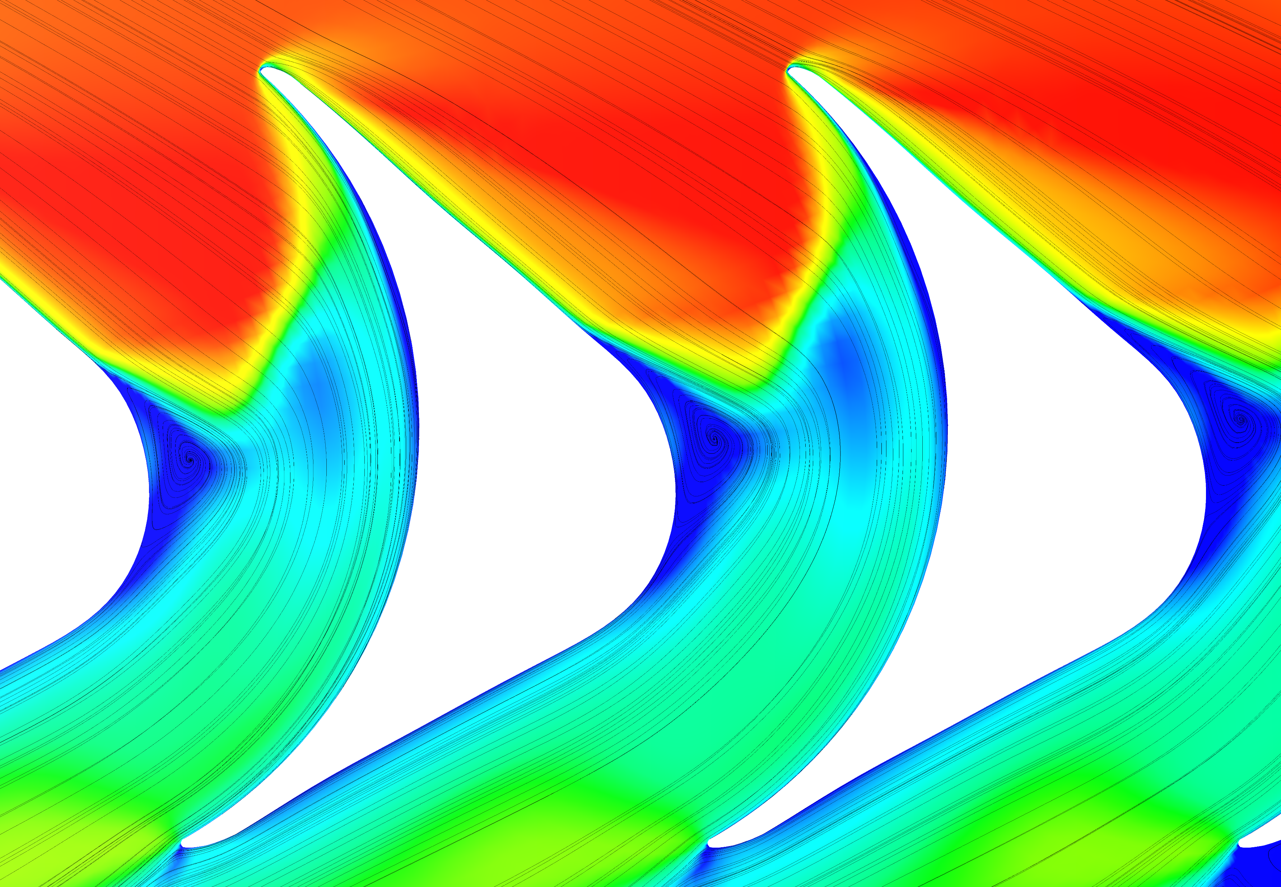
Leading edge bow shock
Coalescence of bow shock and passage shock
Separation bubble
Expansion
fan

