Slide 1
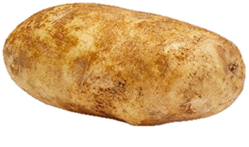




枇杷膏 by 涡轮土豆
Have you ever been frustrated because there are no solutions to past year papers? Fret no more!
Introducing PYPagao by Turbocharged Potato, a website providing crowdsourced solution for past year papers!

