Slide 1
Linux 101 “Ab Initio” (From First Principles)
A history of Unix → Linux..
How did we get here?
Where are we going?
Why it matters!
General Unix Philosophy!

Slide 2

In the beginning..
Ken Thompson and Dennis Ritchie

Slide 3
Created a simple “clean” operating system
Created in Bell Labs by programmers for programmers.
Written in the then new “C” programming language.
Initially not multi-tasking or multi-user!
Follow some basic principles:
  Make each program do one thing well.
  Expect the output of each program to become the input to another.
  Design and build solutions to be tested early and often, be willing to throw away what doesn’t work.
  Use tools in preference to manual labor.

Slide 4
What did the first “unix” run on?
PDP-11
Designed in opposition to Multics which many saw as a overly complicated bulky
  Some of the people working on Multics (Paul Green, etc) would go on to write the VOS Operating system that runs on Stratus hardware.
“4th” version was written almost entirely in C and could run on other systems.

Slide 5
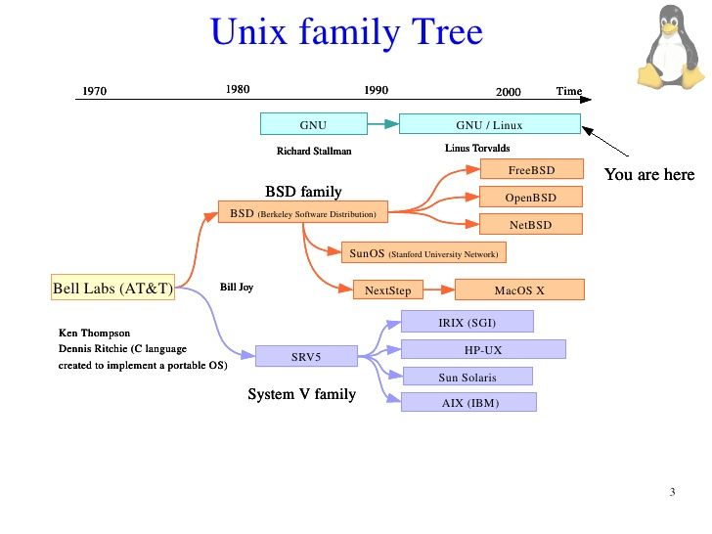
!!THIS IS A VERY SIMPLISTIC PICTURE!!
FtUnix

Slide 6
We could go on and on
That picture only has the “major” versions of unix
There were SO many players we could go on and on..
  Tru64 / Ultrix (Digital).. yes Digital managed to spawn at least 3 different varients of unix!!
  EWS-UX (NEC)
  Xenix (Microsoft)
  SCO (Santa Cruz Operations)
  A/UX (Apple’s first wack at it..), iOS
  QNX (Embedded hardware, blackberry)
  FtUnix (Stratus version of fault tolernate SRV5)

Slide 7
Dun dun.. Helsinki Finland 1991..
Linus Torvalds after taking a Unix course, frustrated with the licensing limitations of Minix, sets about writing his own unix clone.
Initially called “Freax” (a portmanteau of free and x (of unix)) by Linus, the guy admining the ftp server where he uploaded it to renamed it to “Linux.”
Licensed with the GPL and using the GNU tool stack, the rest is where we are.. (yes it’s WAY more complicated then that..)

Slide 8
Distributions
As the popularity of Linux grew, people began creating “distributions” that combined the kernel and programs into a cohesive installable operating system.
The original players
  Redhat (Suse is derived from Redhat)
  Debian
  Slackware
  Gentoo
Things then um.. went crazy from there..

Slide 9
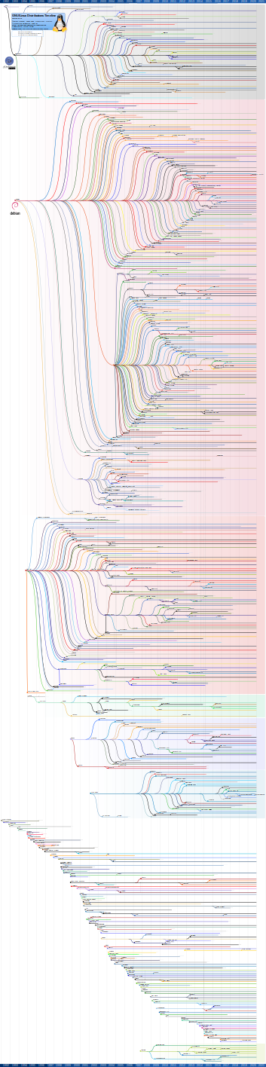

Slide 10
There are more distros than you can imagine
Andy, the guy who started WLUG has his own distribution based off of Ubuntu for ham radio
https://sourceforge.net/projects/kb1oiq-andysham/
Latest version actually just runs on top of Ubuntu, he found it easier than maintaining his own version of Ubuntu..

Slide 11
But what “is” Linux!?!
Userland Applications
System Utilities
Linux Kernel / Hardware Drivers
Hardware
I get asked this question a lot. This “mechanically” is what it is, but it’s more than that.

Slide 12
Slide about privacy, ownership, etc.
Let’s shit on Micro$oft for a bit..
  Win{10,11} is a spying machine, period.
    I could rant unfettered about CoPilot..
    I could also rant unfettered about Recall.
  You have ZERO control on the inner workings of Windows, it’s how MS wants it to be, that will change at their whim..
  MS can push patches to your machine, if you like it or not.
    Ask any windows admin how they handle patching and sit back and enjoy the screaming session..

Slide 13
Ownership..
IF you’ve attended any WLUG meetings at the past you’ll know we’ve talked ALOT about this.
It’s clear to many of us that the direction Apple / MS is going is to a pay as you go model.
  That’s a nice OS you’ve got there, sure would be shame if it stopped working..
  The whole cloud model.. why own things when you can rent them forever?
I’m fearful of a future where everything is locked down for “security.”
Sources available after a paying 1x10^(huge-num) license fee and signing an phone book sized NDA..

Slide 14
Everything is (mostly) a file. NO really.
To work with files, there are five operations: Open / Close / Read / Write / Seek. That’s it!
  Not all apply.. (how do you write to a usb keyboard?)
    Then again.. maybe you write to change the RGB?
All things are exposed through the file system name space.
  All things originate from “/”
  The keyboard.. is file: “/dev/bus/usb/003/006”
  The mouse is file: “/dev/bus/usb/003/003”
  The wifi network interface is.. “/sys/class/net/wlp4s0”
Really.. everything is a file..
  If your machine has an internal drive it’s likely “/dev/sda”
    That’s a file path that refers to the entire disk.
    “/dev/sda1” is the file path to the first partition on a disk.

Slide 15
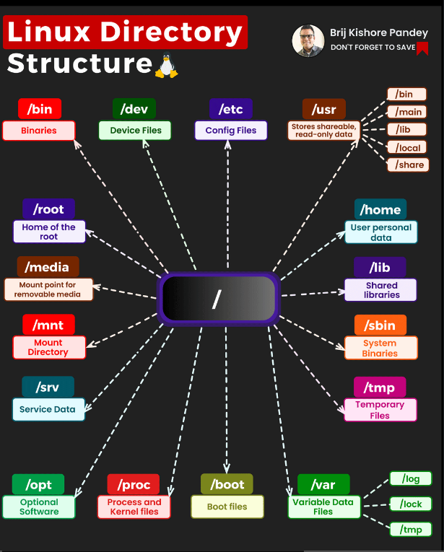

Slide 16
Everything is (mostly) a file.
File tools work on everything.
Oh, you want to take an entire partition and create a compressed file out of it? Sure
  “cat /dev/nvme0n1p1 | gzip > boot-filesystem.gz”
Oh.. instead of the raw filesystem, you want the files..
  “tar cvzf boot_fs.tar.gz /boot”
  “tar cvzf - /boot | (cd /disk1/boot; tar -xvf -)"
Unix works on the idea of “streams of bytes”
  You take the output from one stream and you stream it into the input of another.
  Tar stands for "tape archive" but to unix user a file and a tape device look exactly the same.. however you can seek much faster in a file..

Slide 17
A word about /proc and /sys
If you look at a linux “root” file system you won’t see /sys or /proc
These pseudo file systems created by the kernel and represent things in the kernel (that are just files)
/proc contains all the process ids (PID) as directories
  Inside each of these directories are (you guessed it) files that represent the running processes on the system.
  Even kernel threads show up as processes with their own directories.
/sys represents kernel subsystems, hardware devices, and device drivers interfaces that are exposed to userspace.
  My keyboard is: “/sys/bus/usb/devices/3-1.2.3 /dev/bus/usb/003/006”
  You can dynamically modify the linux kernel by writing data into certain files.
    ‘echo “- - -” > /sys/class/scsi_host/host0/scan’ will force the kernel to rescan the scsi bus for new devices.
    This is because the drives have exposed interfaces that are files.

Slide 18
Okay, that’s cool.. so things are files, who cares.
Imagine you create an application with all the files you need to run it.. and you create a “tarball” out of it.
Let’s imagine the linux kernel could create a virtual file system container to mount this file system container in the tarball? So you could dock that container to your system..
  Let’s also create namespaces (ns) under “/proc/pid/ns”
    This lets us complete isolate this container with it’s own pids and mount points and signals and syscalls and let’s limit what it can see on the system..
  How about we call this whole thing, um.. docker.
  Hold up.. that whole namespace thing seems really cool..

Slide 19
Name spaces.. the coolest shit your kernel is doing you probably didn’t know about..
Not your father or grandfather’s unix anymore..
The linux kernel has the capacity to isolate processes into their own process trees with limited access to system calls, signals, network interfaces, file systems, etc.
Your browser is running in a name space.
I could do a whole talk on name spaces.. do an “lsns” you’ll be surprised.
Snaps make heavy use of name spaces..
All containerization technology on linux makes use of it

