Slide 1
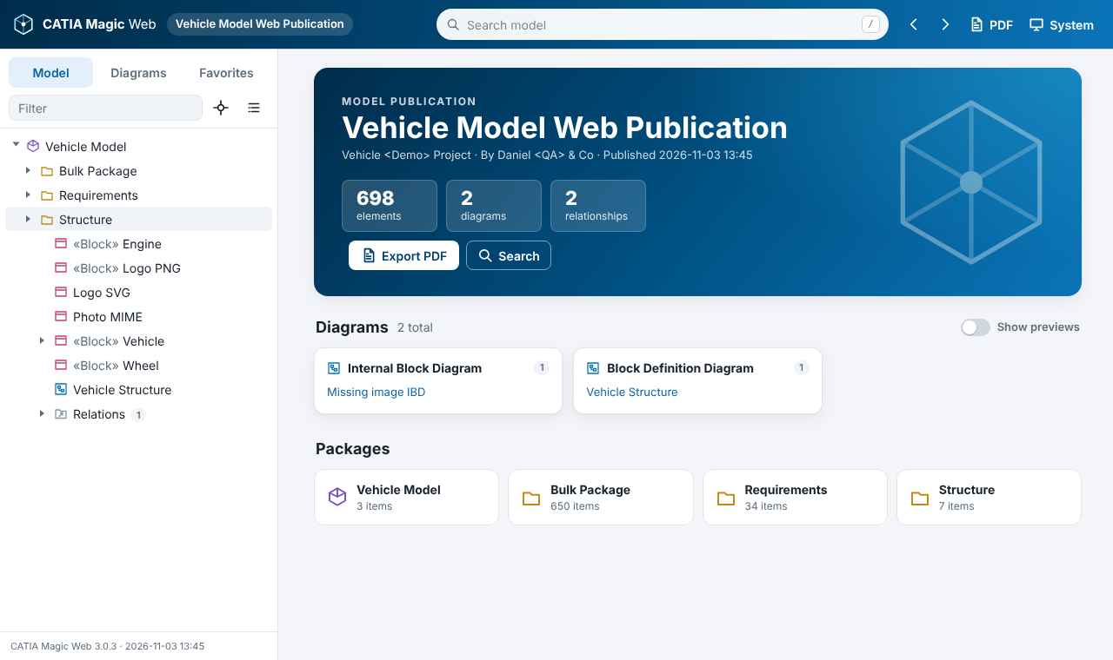
CATIA Magic Web 3.0
Publishing Cameo / CATIA Magic models as a fast, self-contained website: install, generate, and use the interface
Report Wizard template · version 3.0.4 · MIT license
github.com/turbogeek/Magicdraw-Web-Publisher-Replacement
Notes:
This deck walks through the CATIA Magic Web 3.0 Report Wizard template: why it was built, how to install it and generate a report in Cameo / CATIA Magic, how to use the generated website, and how it works under the hood. Screenshots come from a synthetic test model.

Slide 2


Why a new web template
Web Publisher 2.0
CATIA Magic Web 3.0
Loads hundreds of XML files with XMLHttpRequest, so browsers block it when opened from disk
Needs a web server or special browser flags
Flash audio/video, GIF icons, IE-era scripts, eval()
Documentation HTML injected without sanitizing
One fixed look, no PDF output
Data loads as <script> files, so double-clicking index.html just works
Same output works on any static web server
Modern ES2022, no frameworks, strict security policy
Rich text sanitized with DOMPurify
Diagram viewer, search, PDF export, Light / Dark / Kawaii themes
Result: one publication that can be opened by double-click, emailed as a zip, or hosted, with the same files.
Notes:
Web Publisher 2.0 depends on XMLHttpRequest to read its XML data files. Browsers treat file:// pages as unique origins and block those requests, which is why reports had to be hosted. 3.0 removes that dependency entirely.

Slide 3
Built for large models
13.9 s → 1.7 s
185 MB → 30 KB
9.5 s → 0.1 s
until the model is usable
size of the HTML page
longest browser freeze
Synthetic 60,000-element model with 150 diagrams, opened from disk in Chromium: first redesign 3.0.1 (single file) compared with 3.0.4 (model tree first, details in the background)
A small page paints a loading screen instantly; startup reads only the model tree (data/e*.js, 1,500 elements per file)
Documentation and diagram details are indexed in the background (about 6 s here); properties (about 60 % of the data) load on demand
Large tree folders render 300 items at a time; thumbnails are opt-in and load one by one
Notes:
These numbers come from the template test suite: the same synthetic model generated with the earlier single-file version and with the current version. Real models vary, but the shape of the improvement is the same: no single long freeze, and visible progress from the first moment.

Slide 4



The GitHub repository
https://github.com/turbogeek/Magicdraw-Web-Publisher-Replacement
Public · default branch main · MIT license · Copyright © 2026 Daniel Brookshier
Magicdraw-Web-Publisher-Replacement/
├─ README.md quick start
├─ LICENSE MIT
└─ catia-magic-web/
├─ README.md full user guide
├─ CHANGELOG.md
├─ template/ the Report Wizard template
├─ source/ Velocity sources + build.py
├─ tests/ mock + browser tests
└─ docs/ screenshots, sample PDF
Documentation
catia-magic-web/README.md: user guide, architecture, variables, troubleshooting
Community project
Not supported by Dassault Systèmes. Use at your own risk; no warranty (MIT).
Notes:
The repository is public on GitHub under the MIT license. The root README has the quick start; the full guide is catia-magic-web/README.md. As the README says, this is a personal project, not a Dassault Systemes product, and comes with no warranty.

Slide 5



Clone it from a console
Windows
winget install --id Git.Git -e # once; or the installer from git-scm.com
cd $HOME\Documents
git clone https://github.com/turbogeek/Magicdraw-Web-Publisher-Replacement.git
PowerShell / Command Prompt
macOS
xcode-select --install # once; installs git (or: brew install git)
cd ~/Documents
git clone https://github.com/turbogeek/Magicdraw-Web-Publisher-Replacement.git
Terminal
Linux
sudo apt install git # once; dnf / pacman on other distros
cd ~
git clone https://github.com/turbogeek/Magicdraw-Web-Publisher-Replacement.git
bash / zsh
GitHub CLI: gh repo clone turbogeek/Magicdraw-Web-Publisher-Replacement
Update later: cd Magicdraw-Web-Publisher-Replacement then git pull
Result: a Magicdraw-Web-Publisher-Replacement folder; the template is in catia-magic-web/template/
Notes:
Any recent Git works. On Windows, winget installs Git for Windows; the Git for Windows installer from git-scm.com works too. On macOS, xcode-select --install installs the command line tools including git (Homebrew users can run brew install git). On Linux use the distribution package manager. Clone into a folder you can find again; the Report Wizard will point at a file inside it. git pull fetches updates later.

Slide 6





Clone it with a Git app
GitHub Desktop
Visual Studio Code
Windows, macOS
Windows, macOS, Linux
File ▸ Clone repository ▸ URL tab ▸ paste the address ▸ choose a local path ▸ Clone. Or on GitHub: Code ▸ Open with GitHub Desktop.
Ctrl/Cmd+Shift+P ▸ "Git: Clone" ▸ paste the address ▸ pick a folder ▸ Open.
Sourcetree / Fork / GitKraken
TortoiseGit
Windows, macOS (GitKraken: Linux too)
Windows Explorer
Clone (or New ▸ Clone from URL) ▸ paste the address ▸ choose the destination folder.
Right-click a folder ▸ Git Clone… ▸ paste the address in URL ▸ OK.
No Git? Open the repository page, click Code ▸ Download ZIP, and unzip it. (Unblock the ZIP in Windows file Properties first if Windows flags it.) Use git pull or a new ZIP to update.
Notes:
Every Git app does the same thing: paste the repository address and choose a destination folder. The address to paste is https://github.com/turbogeek/Magicdraw-Web-Publisher-Replacement (with or without .git). Download ZIP works without Git but cannot be updated with git pull.

Slide 7
Install and generate
In Cameo / CATIA Magic: register the template, run the Report Wizard, open the result
Notes:
Next: getting the template into the modeling tool and producing a report.

Slide 8




Quick start
Step 1
Step 2
Step 3
Clone the repository
Create a template
Run it, with SVG
git clone with the repository address, a Git app, or Download ZIP (previous slides)
Report Wizard ▸ new template ▸ set the template file to index.html in catia-magic-web/template/CATIA Magic Web 3.0/web/
Generate as usual, but choose SVG rather than PNG or JPG for diagram images
Point the template at the cloned folder; don’t copy index.html alone. The data sub-templates (cmw-*.txt), js/, css/ and images/ must stay next to index.html.
Very large model? The page shows the model tree in seconds and indexes the rest in the background; for a first try, a package or two is still the quickest check.
Notes:
These are the three steps from the repository README. Step 2: in the Report Wizard, create a new template and set its template file to index.html inside catia-magic-web/template/CATIA Magic Web 3.0/web. Keep that folder intact, because index.html runs the cmw-*.txt sub-templates and copies the viewer files from it. The README note about a single web page describes versions before 3.0.2; the page is now a small shell and the model is in data files, but trying a smaller scope first is still good advice.

Slide 9

Two ways to add the template to Cameo
A. New template → index.html (README)
catia-magic-web/template/
CATIA Magic Web 3.0/
├─ template.xml name, variables
├─ reports/built-in.xml defaults (SVG)
└─ web/
├─ index.html ← template file
├─ cmw-elements.txt data sub-template
├─ cmw-diagrams.txt data sub-template
├─ cmw-props.txt data sub-template
├─ cmw-docs.txt data sub-template
├─ js/ cmw.js, vendor/purify.min.js
└─ css/ images/
Report Wizard ▸ create a new template, name it, and set the template file to the cloned index.html. Quick, and updates with git pull. Variables you don’t define use the built-in defaults.
B. Copy the template folder
Copy catia-magic-web/template/CATIA Magic Web 3.0 into <install dir>/data/templates/ (or Report Wizard ▸ Import). Brings template.xml and built-in.xml, with all variables and SVG preset.
Notes:
Option A is the README quick start and is the easiest to keep current: pull the repository and the Report Wizard uses the new files. Option B registers the template with its template.xml, so all variables appear in the Report Wizard with descriptions and defaults, and the image format is preset to SVG.

Slide 10




Generate a report
1
2
3
4
5
Choose template
Report data
Select scope
Output
Generate
Tools ▸ Report Wizard ▸ your CATIA Magic Web template
Built-in, or your own copy with Title, Author and options set
Pick the packages to publish (recursive)
File name, e.g. C:\publish\MyModel.html; image format SVG
Then double-click MyModel.html
Tip: on the output step, set the image format to SVG. The template ships with SVG as the default, but a saved report data set can override it. See the next slide for why.
Notes:
Walk through the Report Wizard pages. The image format is chosen on the output page of the wizard; the template defaults to SVG, but report data sets saved earlier (for example from Web Publisher 2.0) may still say JPG or PNG.

Slide 11




Recommendation: export diagrams as SVG
Smaller publications
Sharp at every zoom
Box-and-line diagrams are mostly shapes and text, which SVG stores as compact vector instructions instead of millions of pixels. Diagram images usually make up most of the output folder, so this keeps the publication light to zip, email or host.
The diagram viewer zooms up to 800 %. Vector images stay crisp; raster JPG/PNG blur and need higher resolution (and larger files) to compensate.
Better PDFs
Accurate hotspots
SVG figures print as vectors in "Save as PDF", so text in diagrams stays crisp on paper.
Clickable shapes are aligned at 100 % scale; vector export keeps the image size identical to the diagram coordinates.
Exception: diagrams that embed large photos or bitmaps produce large SVGs (the bitmap is embedded). If one diagram dominates the output size, export it to PNG instead. To shrink further, set IncludeAllProperties = false.
Notes:
Note what SVG does and does not shrink: the HTML page itself is already tiny (about 30 KB) because the model data lives in separate data files. The bulk of a publication is diagram images and data files. SVG reduces the image part for typical SysML diagrams and keeps zooming and printing sharp. Large bitmaps embedded in a diagram are the exception. The other big lever is IncludeAllProperties, which removes about 60 percent of the data.

Slide 12
Key template variables
Variable | Default | What it controls
Title, Author | — | Header, home page and PDF cover (Title falls back to the project name)
HomeImage | empty | Diagram name to show on the home page, or mdel://ID, file://path, https://URL
DataFiles | true | Progressive data/*.js files. false = everything in one page (small models only)
IncludeAllProperties | true | Full Specification properties, loaded on demand. false shrinks output about 60 %
DiagramHotspots | true | Clickable shapes on diagrams
UseContextMenu | true | Right-click menu on diagram shapes
DiagramPreviews | false | Home-page thumbnails switched on by default
ExportLinkedFile | true | Copy attached files into the output and link them
SkipElementContext | false | Must stay false: the template iterates $elements and $Diagram
Notes:
These are set on the report data page of the Report Wizard. The two size levers are DataFiles (leave on) and IncludeAllProperties.

Slide 13


What gets generated, and how to open it
MyModel.html page shell, about 30 KB
MyModel_files/
├─ css/ js/ images/
├─ data/
│ ├─ e*.js model tree (startup)
│ ├─ o*.js documentation (background)
│ ├─ d*.js diagram details (background)
│ └─ p*.js properties (on demand)
└─ *.svg diagram images
Keep the .html next to its _files folder
Open from disk
Double-click MyModel.html in any current browser. No server, no flags.
Host it
Copy both items to IIS, Apache, nginx or any static host; turn on compression.
Share it
Zip the page and its _files folder together; recipients unzip and open.
Notes:
The most common support issue is copying only the HTML file. The page is a shell: the viewer, styles, images and model data live in the _files folder.

Slide 14
Using a generated report
Browse, search, read diagrams, share links and export PDFs
Notes:
Now the generated website itself.

Slide 15


A tour of the interface
Header
Search ( / ), Back / Forward, PDF, theme menu
Sidebar
Model tree, Diagrams by type, Favorites; filter and locate
Home
Summary, diagrams by type, packages; optional previews
About
Footer link: data files, load times, counts
Notes:
The header holds global actions; the sidebar holds navigation; the content area changes with the route. The sidebar can be resized by dragging its edge, and on phones it becomes a drawer.

Slide 16
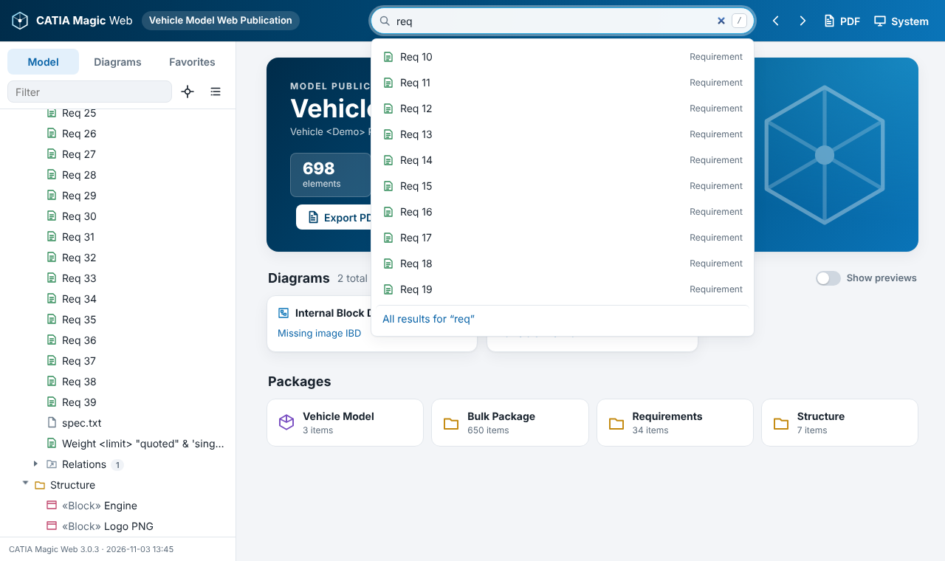
Find anything: model tree and search
Type | Finds
brake | Names containing "brake" (any case); types and stereotypes too
/^REQ-\d+$/ | A regular expression: wrap the pattern in slashes
/pump|valve/ | Either word
torque | + Include documentation: also searches docs and comments
Press / anywhere to jump to search
Tree keys: ↑ ↓ move, → expand, ← collapse, Enter open
Relations folder per owner, as in Cameo; big folders page by 300
Suggestions appear as you type; Enter shows all results
Notes:
Search runs entirely in the browser. Regular expressions are case-insensitive by default. The tree supports full keyboard navigation and shows relationships in a Relations folder like the Cameo containment tree.

Slide 17
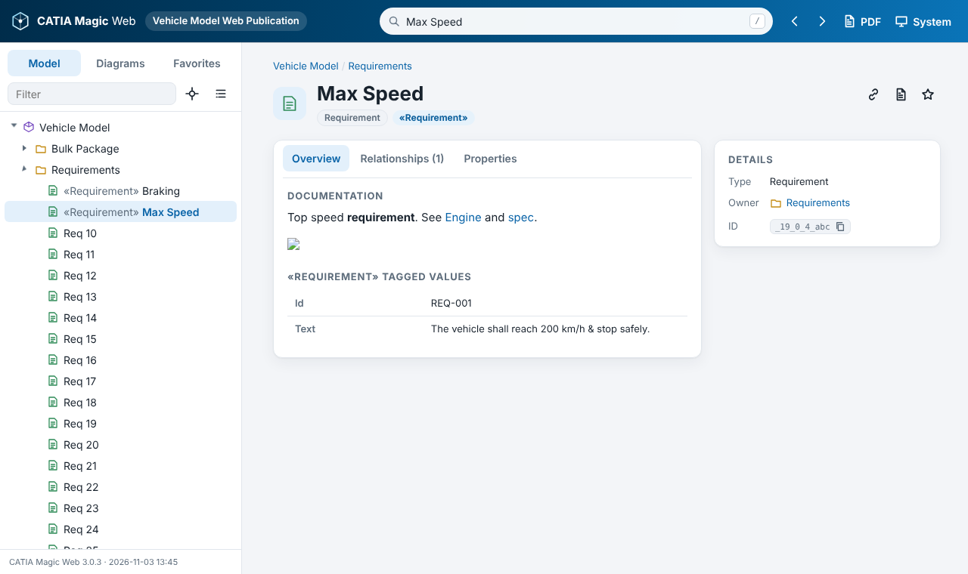
Element pages
Overview
Documentation, comment text, image, tagged values, contents
Relationships
Type, direction (→ to, ← from, — with) and related element
Properties
Full Specification list, loaded on demand, filterable
Details
Type, owner, copyable ID, Appears in (diagrams)
Header actions: copy link, export this element to PDF, add to favorites
Notes:
Every element and diagram has a page with the same structure. The tab you choose is remembered. Properties load from the p data files only when the tab opens, which keeps large publications fast.

Slide 18
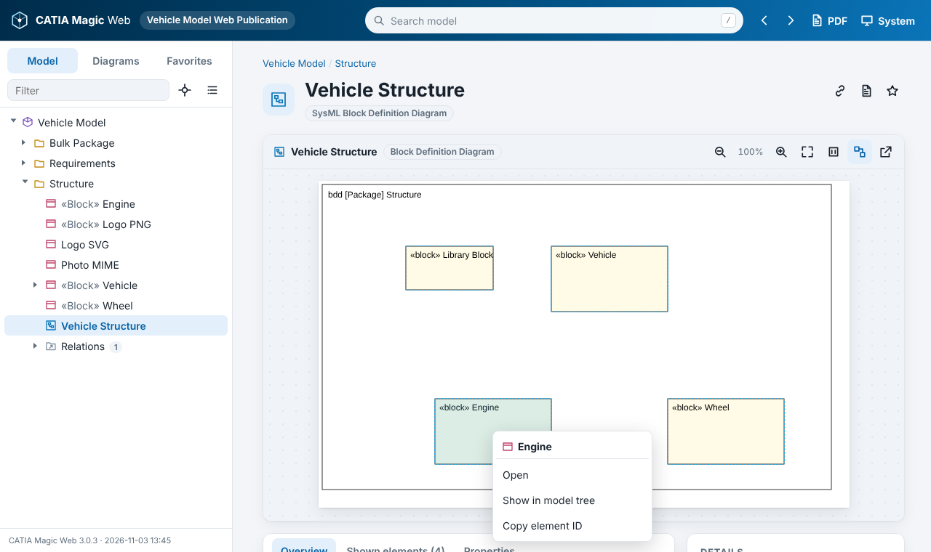
Reading diagrams
Action | How
Open an element | Click its shape
Zoom | ± buttons, Ctrl + wheel, + / − keys
Fit / actual size | Toolbar, or 0 / 1 keys
Pan | Drag the background
Show clickable shapes | Outline toggle
Full-size image | Open in new tab
Elements on diagram | Shown elements tab
Right-click a shape: Open, Show in model tree, Copy element ID
Notes:
Clickable areas come from the shape bounds in the model, aligned to the exported image. If a diagram has unusual export margins and a hotspot looks offset, the Shown elements tab lists every element on the diagram.

Slide 19
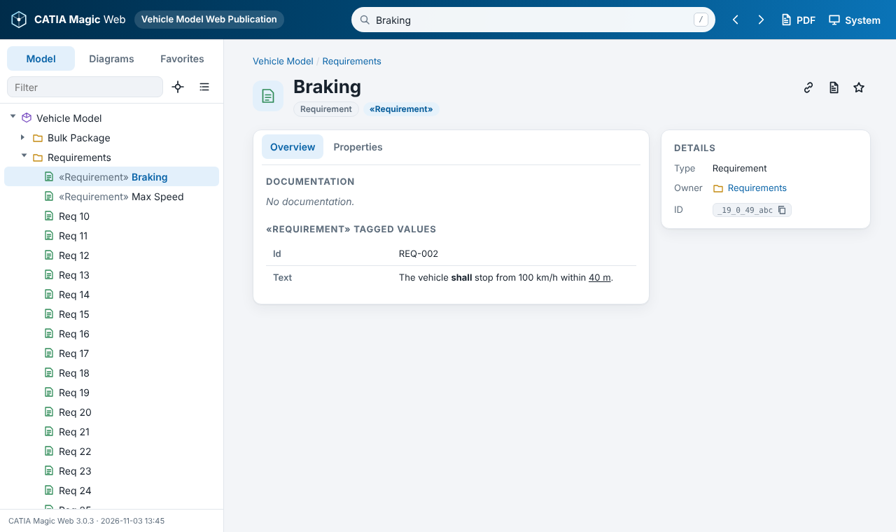
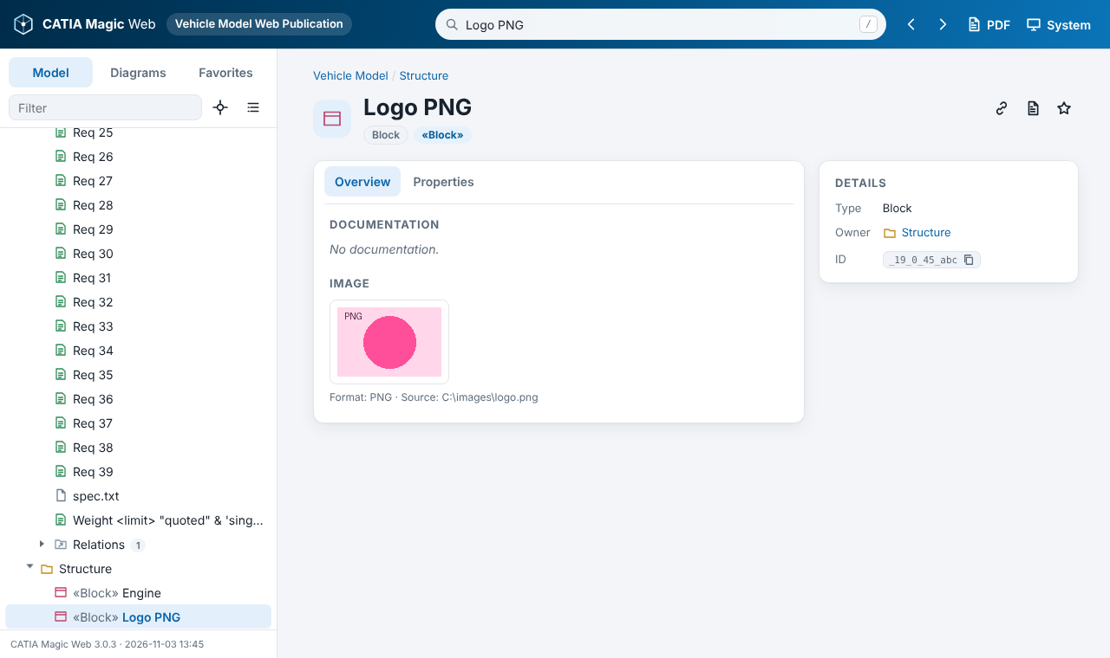
Rich text and images from the model
HTML tagged values (requirement Text) render formatted
«CustomImageHolder» image decoded from its tagged values
Documentation, comments and notes, tagged values and properties written as HTML render as formatted text, sanitized with DOMPurify (no scripts, forms or frames)
mdel:// links in documentation become links inside the publication
Custom images: base64 PNG / GIF / JPEG / BMP / WebP, SVG text or MIME formats; the raw encoding is never shown
Notes:
Cameo stores rich text as HTML. The viewer renders it safely. Comments use their body text, which the template exports explicitly, and their plain text becomes the label in the tree.

Slide 20


Share links to anything
Add after MyModel.html | Opens
#/ | Home page
#/e/<elementId> | An element or diagram page
#/search/<text> | Search results (URL-encode regular expressions)
#/book/all/-/dr | PDF preview of the whole model: d = diagrams, r = relationships
#/book/branch/<id>/drp | PDF preview of one package and its contents, p = properties
#/about | About this publication: data files, load times, counts
?refid=<elementId> | Legacy Web Publisher 2.0 link, still supported
Copy link
The link button on any element page copies its address to the clipboard.
Back / Forward
Every page is a URL, so browser history works, even from disk.
Notes:
Links work from disk and from a server. Element IDs are the Cameo element IDs, so a link stays valid across regenerations as long as the element exists.

Slide 21
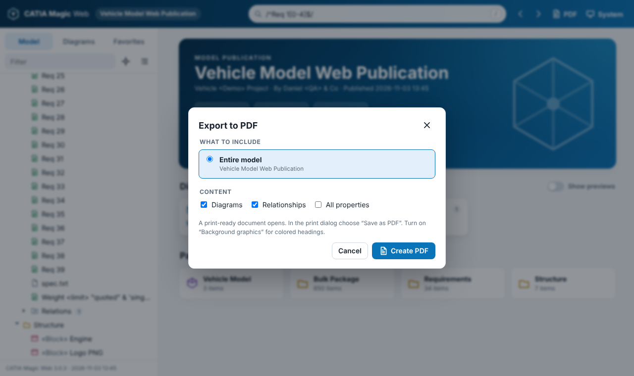


Export to PDF
This page only
Prints the current page with all tabs expanded
Element and contents
A report for one package and everything inside it
Entire model
Cover, clickable contents, numbered sections and figures, page numbers
PDF button: header, home page or any element page
A print preview opens; choose Save as PDF in the print dialog
Turn on Background graphics for colored headings
Reports over 2,500 sections ask for confirmation first
Notes:
Diagrams, relationships and properties can be switched on or off in the dialog or on the preview toolbar. Ctrl+P on any page also prints it cleanly.

Slide 22
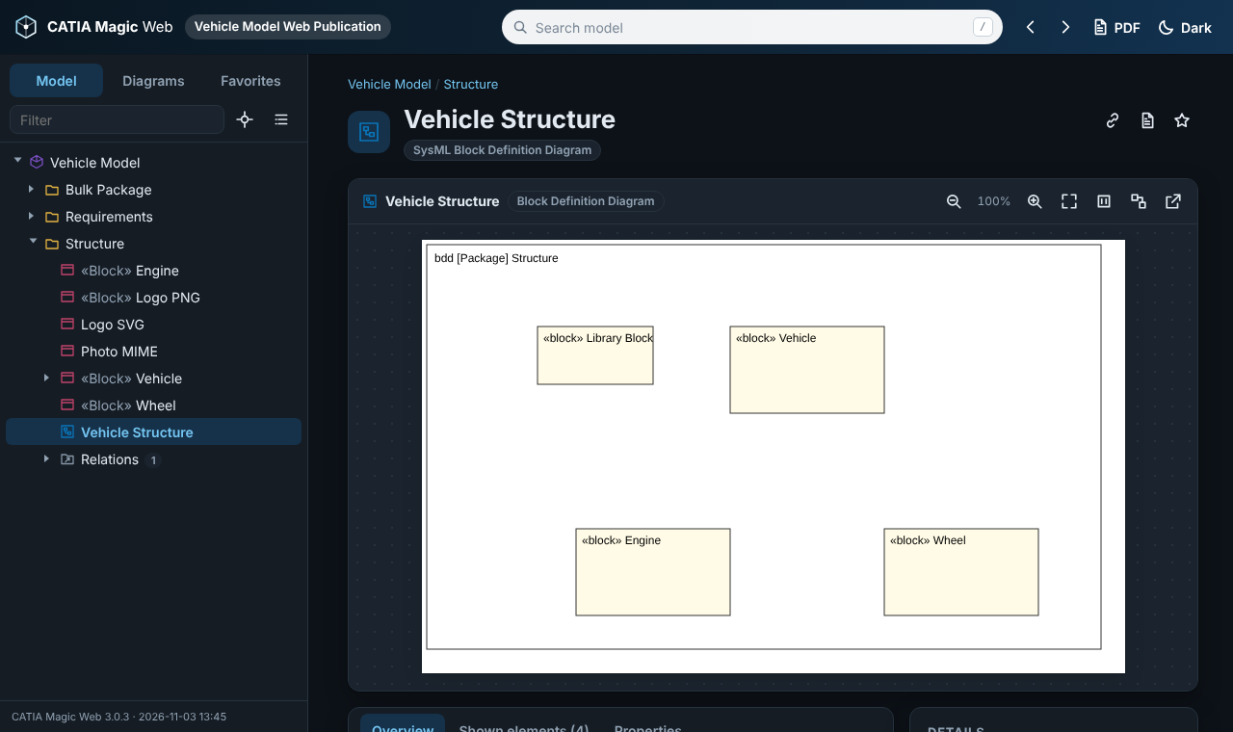
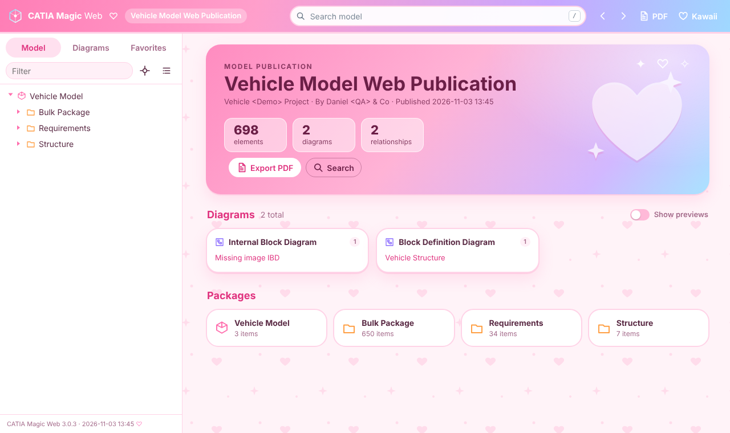
Themes: System, Light, Dark, Kawaii
Dark: easy on the eyes, diagrams keep a white canvas
Kawaii: an original pastel theme with hearts and sparkles
Pick from the theme menu in the header; the choice is remembered per browser
System follows the operating system light/dark setting
Printing and PDFs always use clean light colors
Notes:
Themes are pure CSS variables. Kawaii is an original design, not based on any licensed character.

Slide 23
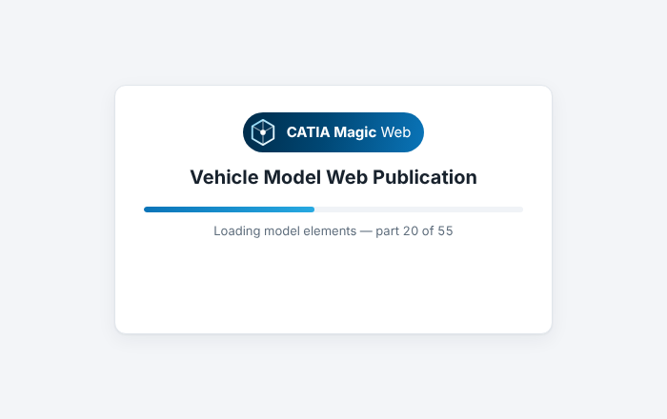
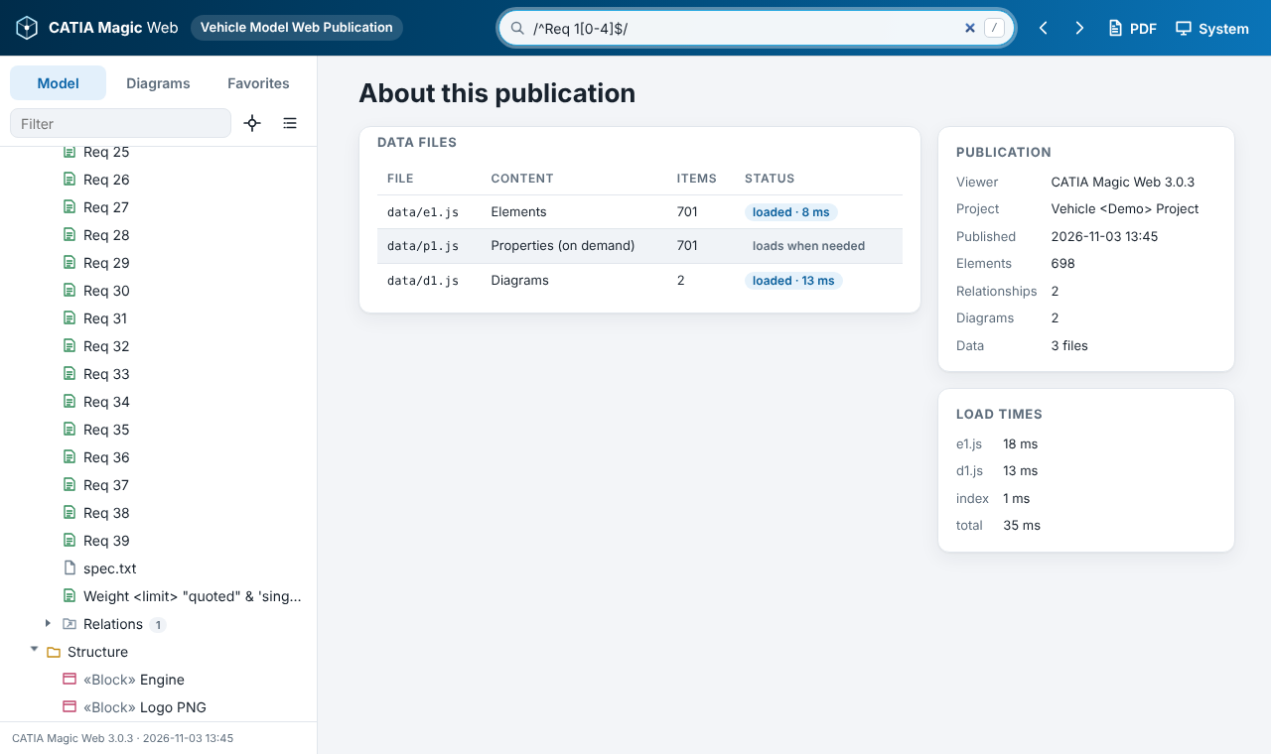
Loading feedback and diagnostics
Appears instantly; a troubleshooting checklist fades in after 10 s
About this publication (#/about): every data file, status and load time
After startup, "Indexing documentation and diagrams… 40 %" shows at the bottom of the sidebar; documentation search, Appears in and PDF update when it finishes
Missing data file: a warning banner, and the rest still opens. Missing _files folder: a clear error screen, never a blank page
Notes:
If something looks incomplete, the About page is the first stop: it lists which data files loaded and how long each took.

Slide 24



How it works
Report Wizard
Output folder
Browser
Cameo / CATIA Magic
static files
file:// or https://
index.html runs
cmw-elements.txt
cmw-docs.txt
cmw-diagrams.txt
cmw-props.txt
via $file.create()
MyModel.html (shell +
diagram skeletons)
data/e* o* d* p*.js
SVG diagram images
viewer + styles
model tree first
(<script> data files)
docs + diagrams in
the background
pages load on demand
Concern | Approach
Opening from disk | No fetch/XHR: data files are scripts, CMW_CHUNK(...) with a String.raw payload
Escaping | One Velocity macro (#x) escapes & < > " $ ` without backslashes, so Velocity 1.7 and 2.x behave the same
Diagram images | Image printed directly in the HTML template, which is what makes Report Wizard export the file
Security | CSP, no inline scripts or eval, textContent for model text, DOMPurify for HTML
Notes:
The key design decision: browsers allow script tags from file:// but block fetch and XHR. Each data file is a tiny script that hands an escaped markup string to the viewer, which parses it into an inert template element. Properties are loaded lazily.

Slide 25
Troubleshooting
Symptom | Cause and fix
Stays on "Opening publication…" | Scripts did not run: keep the .html next to its _files folder; press F12 for errors
"No model data found" | data/ folder missing: check the Report Wizard log, or set DataFiles = false as a fallback
Yellow banner: files not loaded | Some data files missing; #/about lists which ones
"No image was exported" | Report made with 3.0.0: regenerate with 3.0.1 or later
Hotspot slightly offset | Unusual export margins: use the Shown elements tab, report the diagram
Output too large | Use SVG images; set IncludeAllProperties = false
Hosted report loads slowly | Turn on gzip/Brotli compression on the web server (IIS, Apache, nginx)
Favorites or theme not remembered | Browser blocks localStorage for local files; everything else works
Notes:
Most issues come from moving the HTML without its companion folder, or from report data sets carried over from older templates.

Slide 26
Get started
Clone the repository, point the Report Wizard at index.html, generate with SVG, and share the link
https://github.com/turbogeek/Magicdraw-Web-Publisher-Replacement
1
Clone
2
Add template
3
Generate
4
Share
git clone, a Git app, or Download ZIP
New template → web/index.html
Report Wizard, image format SVG
Open #/about to verify, then zip, host or link
Notes:
Close with the four steps and the repository address. The repository README has the quick start; catia-magic-web/README.md has the full user guide, architecture notes and changelog.

