Slide 1
VMWare VCOPS
Competitive brief

Slide 2
Summary
VMware VC Operations is the primary VMware management suite positioned as the most comprehensive solution for SMB, enterprises and cloud providers
Consists of several semi-integrated products based on products acquired by EMC and VMware in the last 5 years.
Offered in 4 editions:
Standard (small VC environments, SMB) - $50/VM, < 500 VMs
Basic monitoring and reporting, vCenter only
Advanced (large VC environments, SMB) - $125/VM, < 500 VMs
Adds capacity planning and modeling (former CapIQ), vCenter only
Enterprise (virtual and cloud, Enterprise) - $195/VM
Adds Infrastructure Navigator (app dependency mapping) and Chargeback
Enterprise Plus (cloud and heterogeneous env, Enterprise) - <$1000/VM
Ultimate solution including non-virtualized environments, custom adapters and professional services (hence very high price)

Slide 3
Bernd Harzog analysis
A good feature/issue analysis is given by Bernd Harzog article: http://www.virtualizationpractice.com/news-vmware-vcenter-operations-suite-5-0-now-available-14343/
Highlights
Pricing. While we did not get into price in this article, the per VM pricing for vCenter Operations is an issue for many customers. The bottom line is that if you have 10 VM’s per server and deploy Enterprise Edition you will pay around $195 per VM or $1,995 per host. When you take advantage of the efficiency gains delivered by the product and double your density to 20 VM’s per host you will pay an additional $1,995 to realize that gain. None of VMware’s competitors on the resource and availability management front like Quest Software, Veeam, ManageEngine, Netuitive, Phd Virtual, Reflex Systems, Solarwinds, VMTurbo, Xangati, or Zenoss price this way and therefore none of them implement a “Density Tax” in their products
.

Slide 4
Bernd’s analysis - cont
Scalability issues. One of the things that is not known at this point about vCenter Operations is how well it will scale up into very large environments that have hundreds, thousands, tens of thousands, or even over one hundred thousand VM’s. Management at this level is a completely different beast. Certain vendors like Netuitive and Reflex Systems have invested years in building highly scalable solutions for the most demanding use cases, and we just do not know how far VMware is up this curve yet.
Where is the Automation? At VMworld 2011 Paul Maritz laid out a vision of automated IT Operations driving reductions in OPEX through “monitor, fix, notify the humans”. This is an extremely ambitious strategy and an well integrated platform like what vCOPS is going to be after Configuration Manager is fully integrated is an essential starting point. But the fact is that right now, VMTurbo is the only vendor that can automatically adjust how the resources in the environment are allocated to workloads to ensure workload performance on the basis of priorities.

Slide 5
Bernd’s analysis - cont
Integration. We mentioned at Configuration Manager is not fully integrated yet. Therefore Enterprise and Enterprise Plus are still at the moment more bundles than they are fully integrated suites. This will certainly get addressed by VMware over probably the coming year – but it remains a consideration right now.
Platform Support. It is increasingly clear that many organization either have or are going to end up with multiple virtualization platforms. One of the reasons that management is such a mess in the physical world is that people bought a management product for every infrastructure element and application type that they owned. If you are going to have more than one virtualization platform you should absolutely not build two management stacks on top of those platforms. This is where a vendor like Microsoft with the nworks plugin from Veeam and the APM plugin from BlueStripe has a tremendous advantage.
Real Time, Continuous and Comprehensive visibility. The bottom line is that vC Ops is reliant upon the rollup interval for your data in vCenter. That is usually either 20 minutes or 5 minutes. Once your infrastructure grows to the point where a product like vC Ops Enterprise is justified, way too much can go wrong in 4 minutes and 59 seconds. One of the things that invalidates the legacy management frameworks is their reliance upon polling interfaces on 5 minute like intervals for data. The correct approach is to focus upon real time (right now), continuous (all of the time) and comprehensive (do not miss any spikes or anomalies due to sampling) data collection approaches.

Slide 6
Operations Management With vCOPS

Slide 7
VCOPS Operation Management In Virtualization
Define Policies & Constraints for the Operational Environment
Understand Current State
Manual Labor
Manual Labor
Manual Labor
Operations
Management
Process
Manual Labor
Measure & Report on Improvements
Determine Where I Have Performance Issues & Understand Their Impact
Manual Labor
Implement/ Execute Actions
Determine What Actions to Take to Resolve Issues & Proactively Improve Performance
Manual Labor

Slide 8
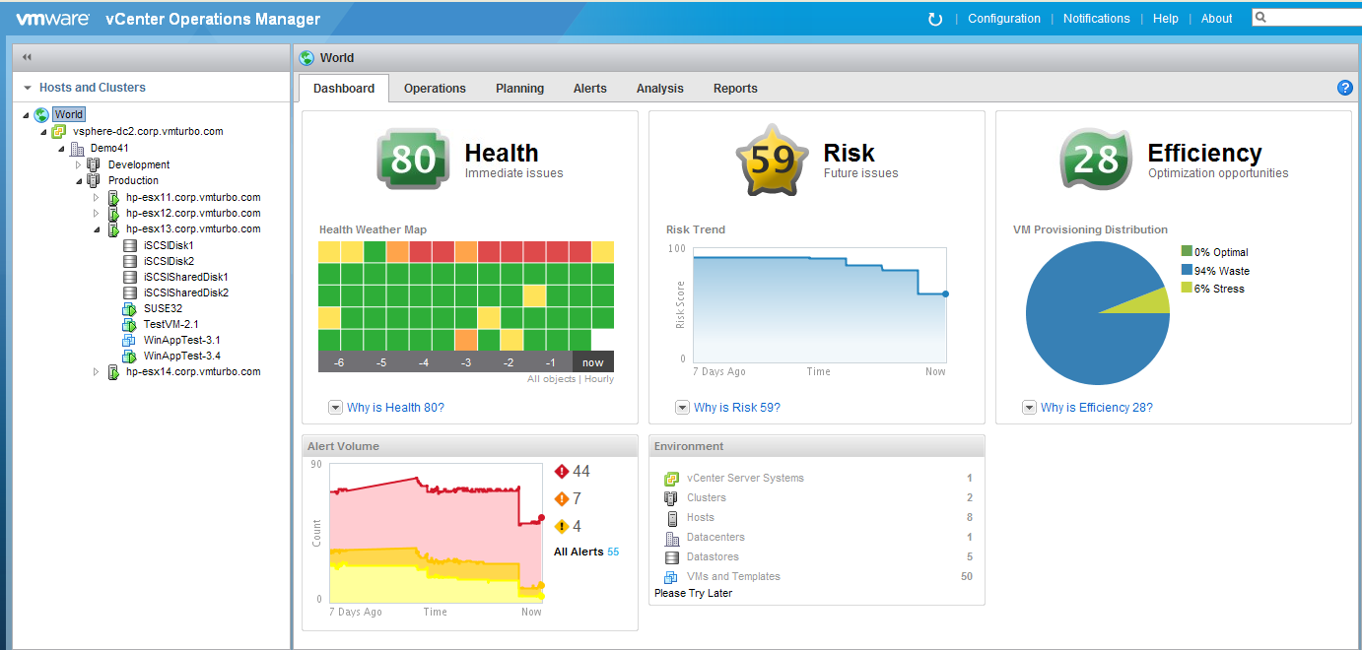
High level summaries requiring manual drilldowns and interpretation

Slide 9
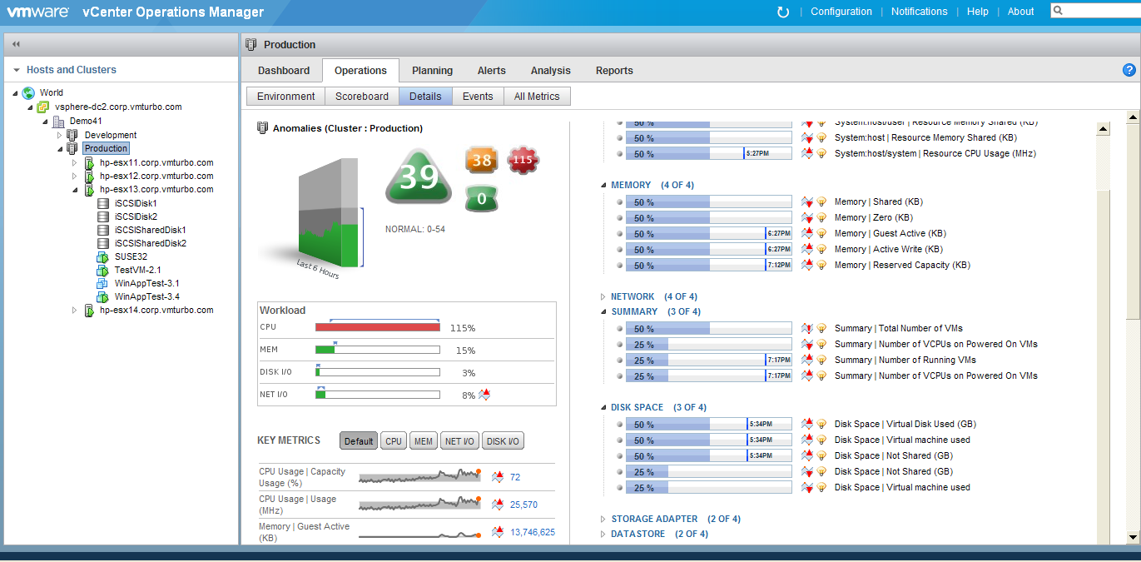
1000s Of Individual Data Points To Work Through
You have to interpret data and determine what what ACTIONS you should take

Slide 10
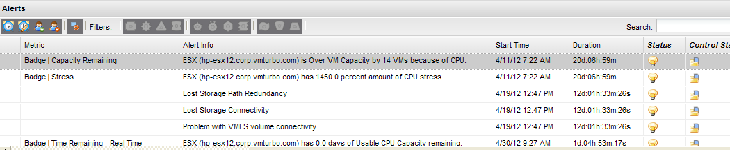
Not accurate and non-actionable diagnostic
What do these messages mean & what action do you take?

Slide 11
Operations Management With VMTurbo

Slide 12

VMTurbo Automates Operations Management
Define Policies & Constraints for the Operational Environment
Understand Current State
Operations
Management
Process
Measure & Report on Improvements
Determine Where I Have Performance Issues & Understand Their Impact
Implement/ Execute Actions
Determine What Actions to Take to Resolve Issues & Proactively Improve Performance

Slide 13
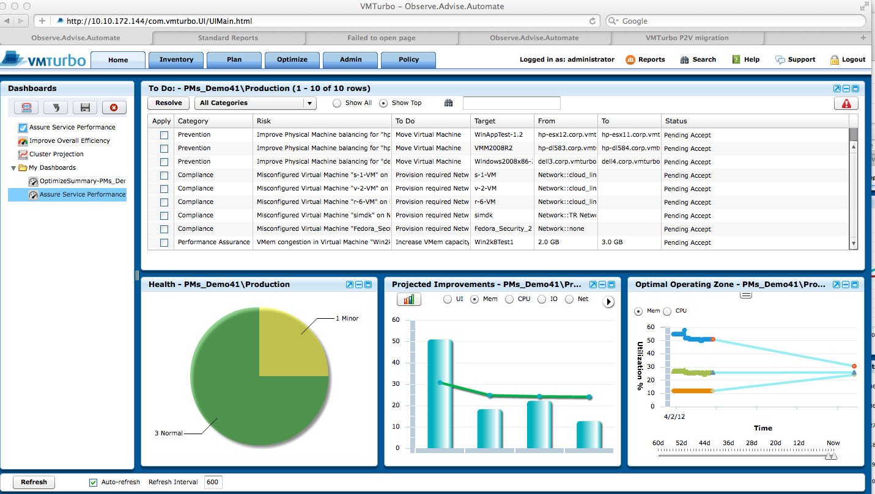
Intelligent Placement and Rebalancing for Performance Assurance
Present identified performance risks and a set of corrective actions to address them in real time and prevent in the future
Projected improvements and convergence of peak and min utilization levels to the optimal zone based on executed actions

Slide 14
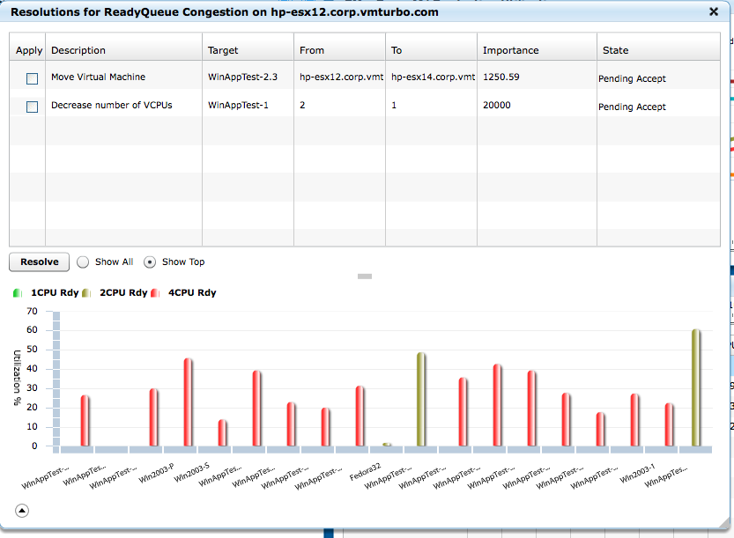
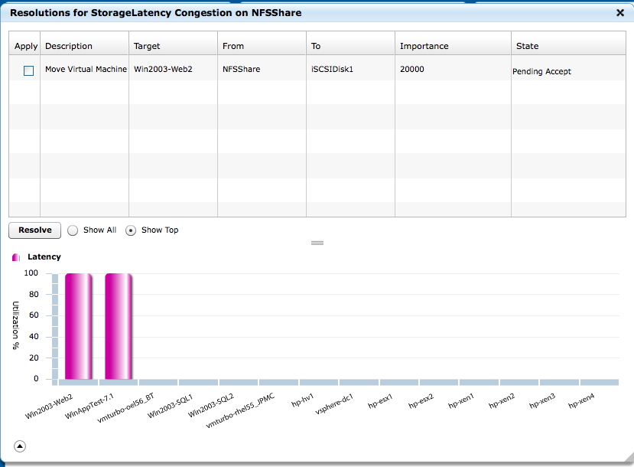
Real Time Performance Assurance: A rich set of accurate preventive actions
The best optimal actions managing the load across all layers
Actions can be executed manually or run automatically

Slide 15
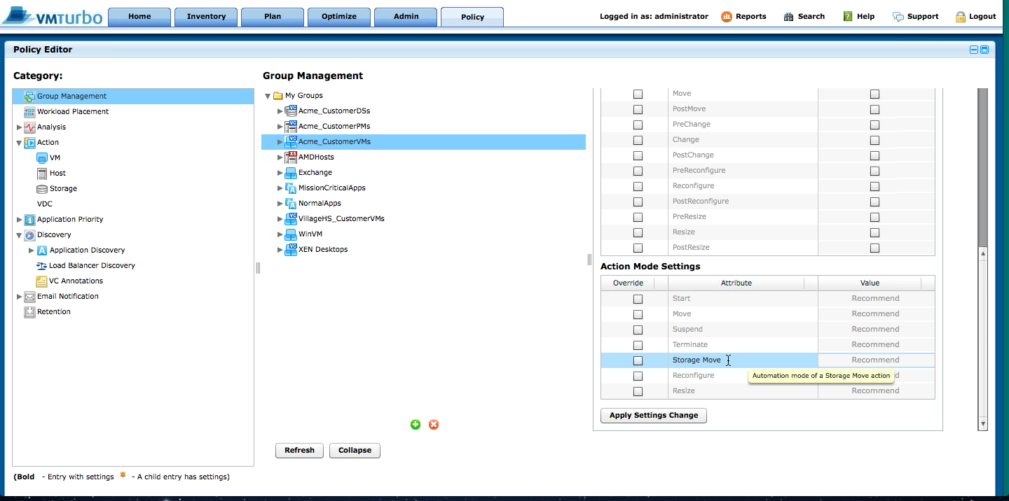
Optimization to fit your processes
VMTurbo allows you to control how you want optimization to execute: recommendations, manual, automated. Can define Globally or create policies specific to any groupings.

Slide 16
Capacity Planning With vC OPS

Slide 17
Holistic Capacity Planning
Typical Use Cases To Address:
What Questions Need to Be Answered as the Output from Planning?
Adding VM’s of Different Sizes
Can I accommodate the load or do I need to add more Server capacity?
Projecting Growth in Workload Demand
Re-balancing Workloads Across Servers
Can I accommodate the load or do I need to add more Storage capacity?
Answered Individually or In Combination
How will my workloads perform on different servers and/or storage?
Merging Clusters
Re-balancing Workloads Across Storage
Can I consolidate workloads on fewer Servers & Datastores and how will it perform?
Changing Server Hardware
Changing Storage Hardware
Where do I place workloads on servers & datastores to achieve optimal performance & utilization of available capacity?

Slide 18

Capacity Planning with VC OPS
vC OPS Use Cases Addressed:
What Questions Does vC OPS Answer?
Adding VM’s of Different Sizes
Can I accommodate the growth in utilization & when will I run out of a Resource?
Projecting Growth In Individual Metrics
Re-balancing Workloads Across Servers
Can I accommodate the load or do I need to add more Storage capacity?
Answered Individually or In Combination
How will my workloads perform on different servers and/or storage?
Merging Clusters
Re-balancing Workloads Across Storage
Can I consolidate workloads on fewer Servers & Datastores and how will it perform?
Changing Server Hardware
Changing Storage Hardware
Where do I place workloads on servers & datastores to achieve optimal performance & utilization of available capacity?

Slide 19
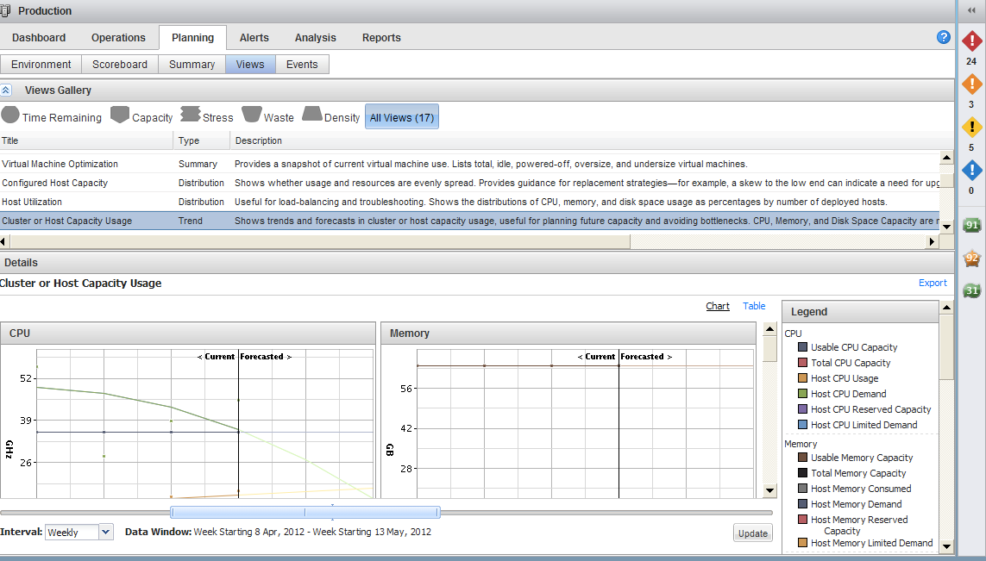
Hundreds Of Graphs Showing Trends In Resource Utilization But No Answers/Actions
User of the system have to interpret what these trends mean and answer some very complex questions based on their best guess what actions to take. Eg could I make the situation better by re balancing? how much hardware will I need to add to acccomodate the growth trend? what will be the optimal hardware configuration?

Slide 20
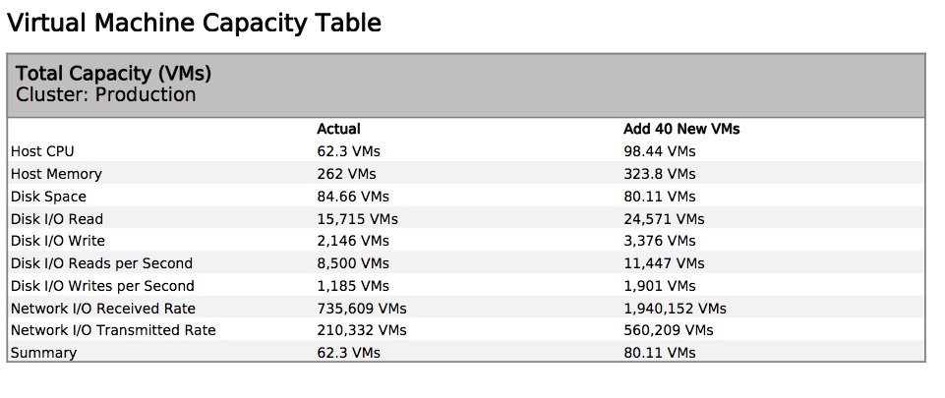
Results Of “What If” Analysis Adding VM’s Of Different Sizes Is Only Use Case Supported
vC OPS uses simple math to calculate how many VMs you can add to a cluster. This is not accurate because it provides different results for different resources, does not consider how to optimally place workloads or configuration constraints (eg vLAN, LUN or Affiniti/Anti Affiniti rules). No ability to simulate changes to workloads, hosts, storage or constraints.

Slide 21
Capacity Planning With VMTurbo

Slide 22
Holistic Capacity Planning
Typical Use Cases:
What Questions Need to Be Answered as the Output from Planning?
Adding VM’s of Different Sizes
Can I accommodate the load or do I need to add more Server capacity?
Projecting Growth in Workload Demand
Re-balancing Workloads Across Servers
Can I accommodate the load or do I need to add more Storage capacity?
Answered Individually or In Combination
How will my workloads perform on different servers and/or storage?
Merging Clusters
Re-balancing Workloads Across Storage
Can I consolidate workloads on fewer Servers & Datastores and how will it perform?
Changing Server Hardware
Changing Storage Hardware
Where do I place workloads on servers & datastores to achieve optimal performance & utilization of available capacity?

Slide 23
Capacity Planning with VMTurbo
Typical Use Cases:
What Questions Does VMTurbo Answer?
Adding VM’s of Different Sizes
Can I accommodate the load or do I need to add more Server capacity?
Projecting Growth in Workload Demand
Re-balancing Workloads Across Servers
Can I accommodate the load or do I need to add more Storage capacity?
Answered Individually or In Combination
How will my workloads perform on different servers and/or storage?
Merging Clusters
Re-balancing Workloads Across Storage
Can I consolidate workloads on fewer Servers & Datastores and how will it perform?
Changing Server Hardware
Changing Storage Hardware
Where do I place workloads on servers & datastores to achieve optimal performance & utilization of available capacity?

Slide 24
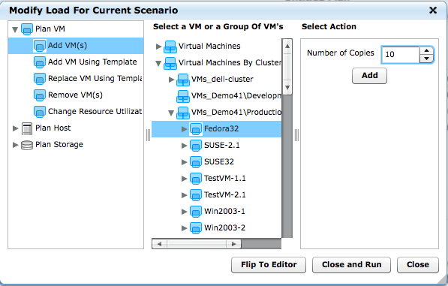
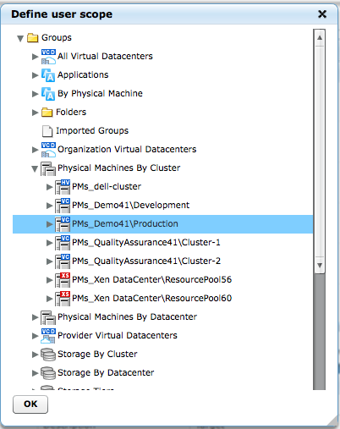
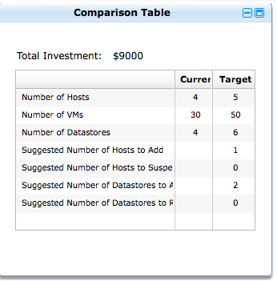
Intelligent Workload Placement: Simple steps to achieve results (adding load scenario)
1. Define a scope
2. Add load
3. Analyze the results

Slide 25

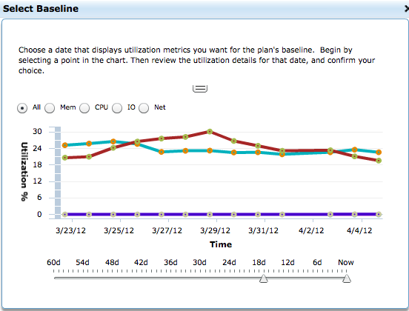
Flexible Capacity Planning Configuration: Scope and Time
Typical capacity planning cases require flexible specification of the managed scope and the baseline period:

Slide 26
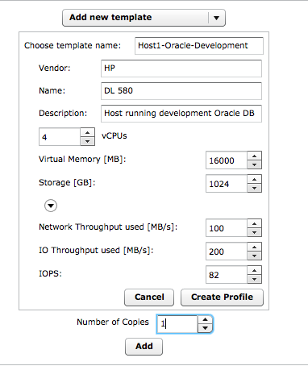
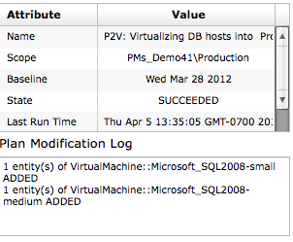
Flexible Capacity Planning Configuration: Input Load
The load could be added by importing physical hosts as VMs
Or by cloning the existing VMs including their baseline consumption

Slide 27
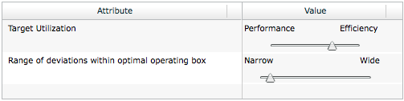
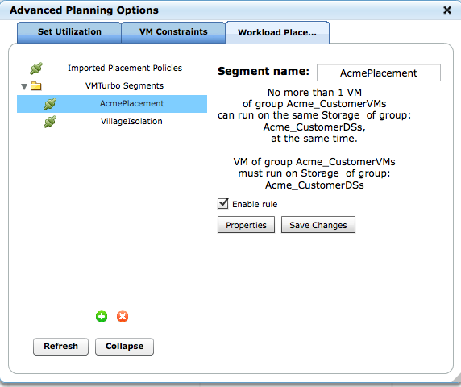
Flexible Capacity Planning Configuration: Goals and Policies
Various management goals could be selected to address the balance between efficiency and performance
As well as applying workload placement policies and constraints

Slide 28
Planning Results: High level summaries and facts
Total cost of investment
Changes in number of hosts
and in number of VMs and datastores

Slide 29
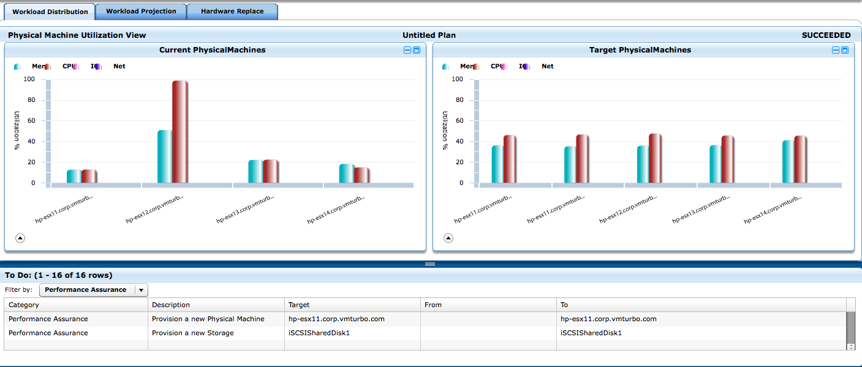
Planning Results: Details and action plans
Detailed before and after comparison to illustrate the improvements
Accurate and executable action plans to implement the proposed change

Slide 30
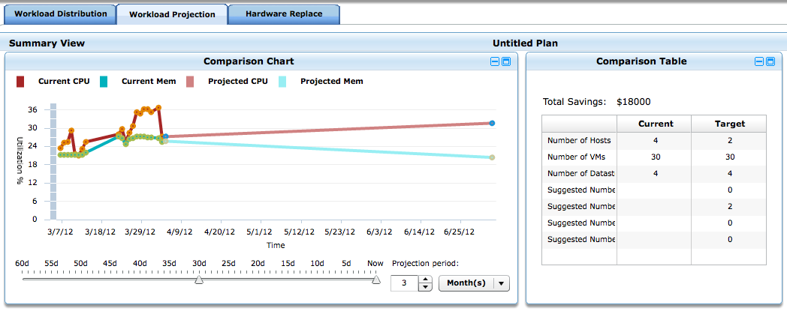
Intelligent future capacity projections based on Workload Demand
Easily select the period in the past and future planning interval
Using workload demand projection and analysis to derive the optimal number of resources and optimal operating zone – not just physical resource data which is an incomplete picture

Slide 31
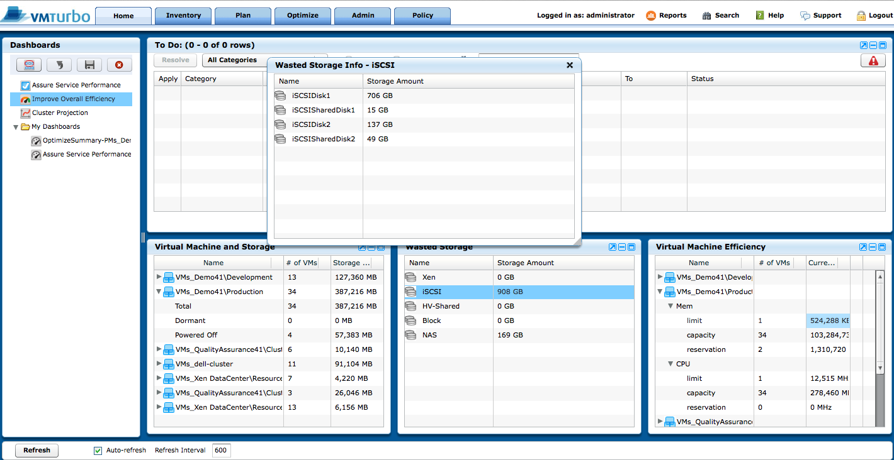
Improve Efficiency with Intelligent Rightsizing
Summary of Storage Resources that can be recovered by removing dormant & zombie VM’s, rightsizing storage allocations, and eliminating waste
Summary of Memory & CPU Resources that can be recovered through Virtual Machine rightsizing

Slide 32
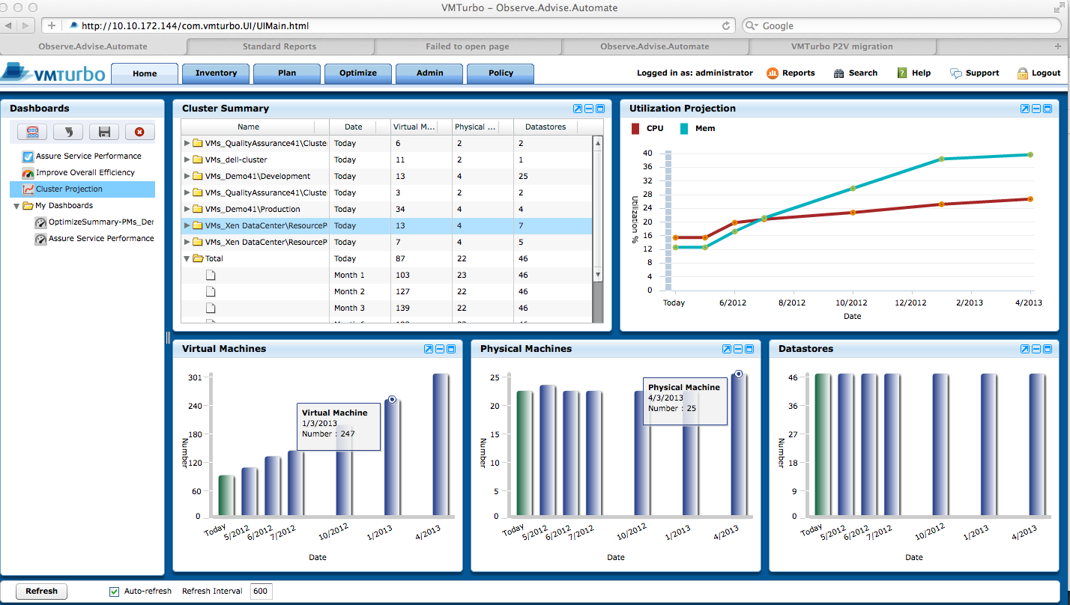
Intelligent Capacity Projections that Respond to Changing Demand
Project the optimal required number of hosts and datastores, and optimal utilization levels
Periodic cluster analysis based on changes in the workload demand and number of VMs

Slide 33
Improve Efficiency with Intelligent Rightsizing
Summary of Storage Resources that can be recovered by removing dormant & zombie VM’s, rightsizing storage allocations, and eliminating waste
Summary of Memory & CPU Resources that can be recovered through Virtual Machine rightsizing

Slide 34
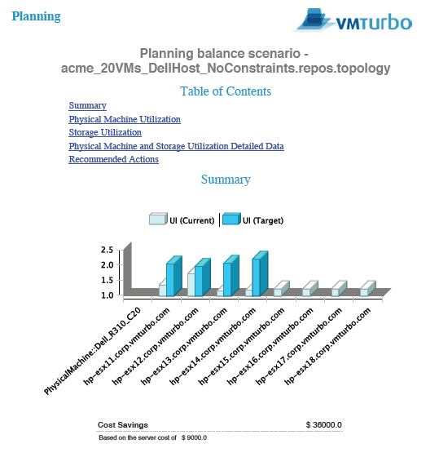
Capacity Plan Reporting: Easily communicate Performance and Workload Optimization Plans
Detailed Action Plans produced, along with a representation of current and optimized future state and projected Cost Savings or Investment.
Wide range of detailed reports in Capacity and Performance Management, Workload Planning – all across Storage, VMs and Physical Machines

Slide 35
Conclusion

Slide 36
vCOPS vs VMTurbo - Summary
vCenter Operations Manager
Gathers 1000s Of Different Metrics
Trend Growth In Individual Metrics To Provide & Indicator Of When Specific Resources Are Going To Run Out
Limited “What If” Analysis To Try & Determine How Many Average Sized VM’s Can Be Added To A Cluster
Produces Inaccurate/Misleading Results, Do Not Account For Workload Placement Or Configuration Constraints
Rely On Your Best Staff To Analyze Thousands Of Data Points & Make Decisions About How To Optimally Allocate Resources
Licensing Costs Escalate With Number Of VMs Added To The Environment
Poor ROI/Time To Value - Require Professional Services To Deploy & Tune To Gain Real Benefits
VMTurbo
Focuses On Collecting The Important Metrics Required To Drive Analysis & Decisions
Built In Analytic To Compute Optimal Resource Allocation & Provide Specific Action Plans That Can Be Executed Manually And/Or Fully Automated
Powerful “What If” Analysis To Simulated Changes In Workload Characteristics, Hardware & Configuration Constraints & Understand The Impact On Utilization, Capacity & Workload Placement
Licensing Costs Based On Number Of CPU Sockets Resulting In Lower Ongoing Costs Due To Increased VM Density With New Server Architectures & VMTurbo Workload Optimization
Rapid Deployment & Instant Results = In Year ROI

