Slide 1

Inkscape

Slide 2
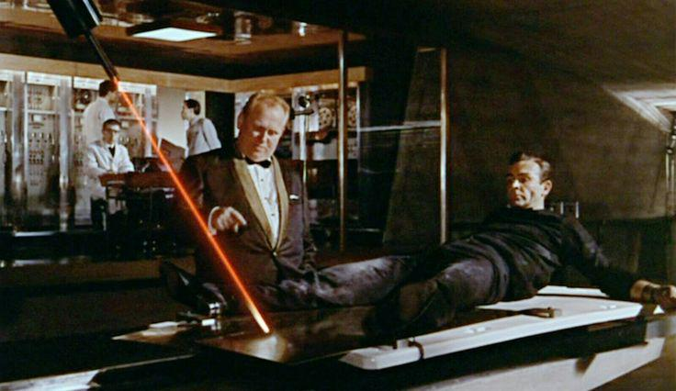

Slide 3
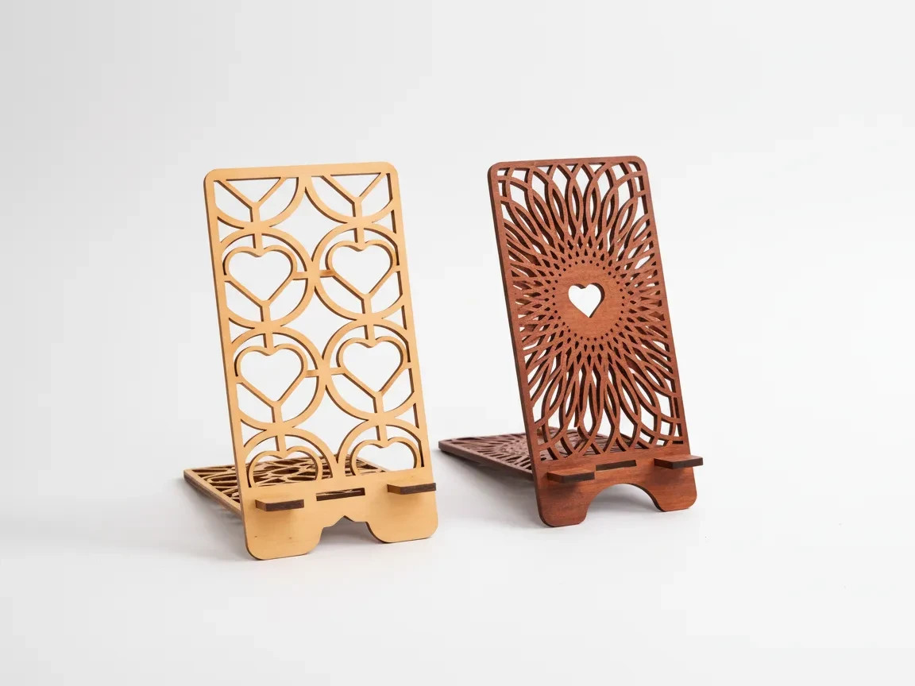
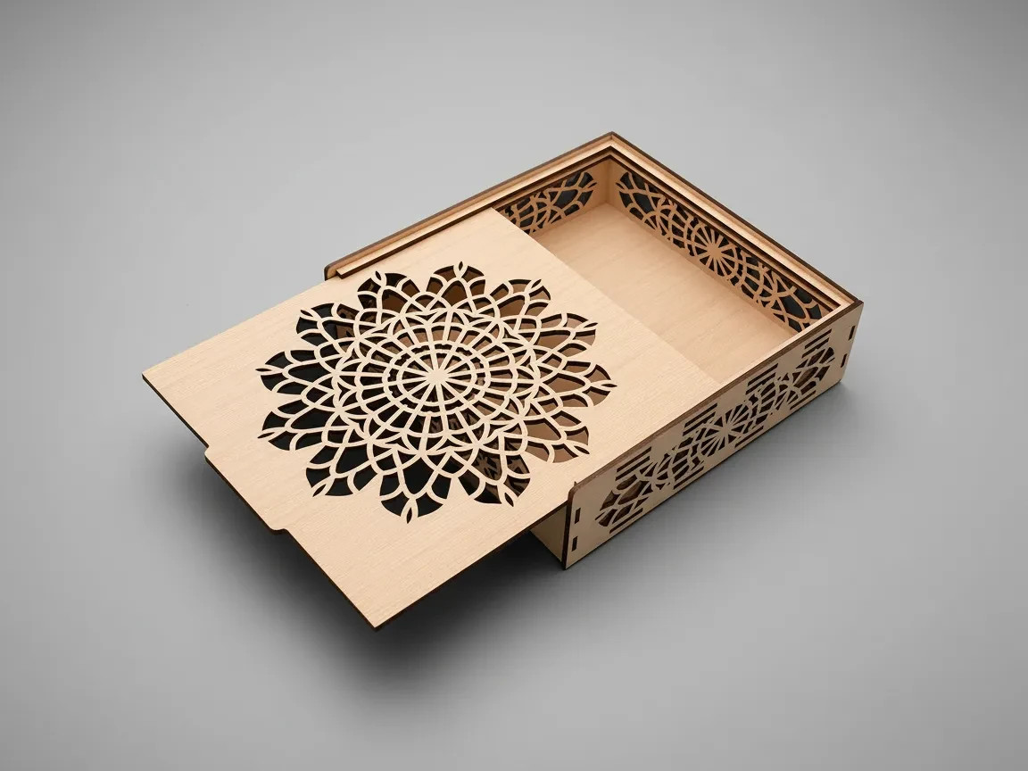
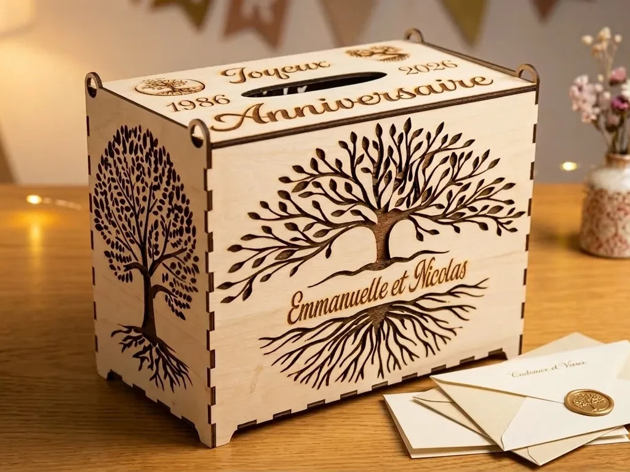
Examples

Slide 4



Beginners error 1, the jpeg

Slide 5

Bitmap: the wrong format

Slide 6
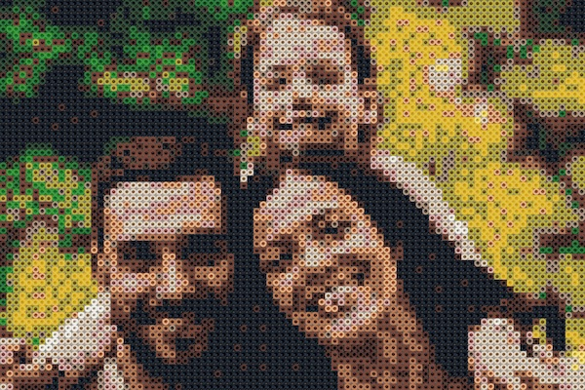
Bitmap: the wrong format

Slide 7
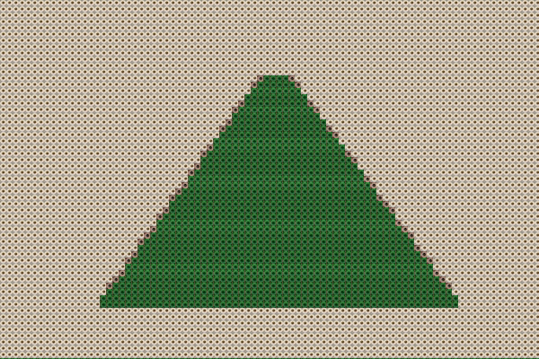
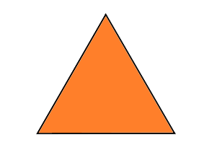
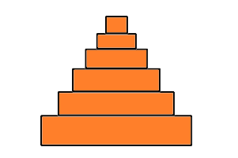
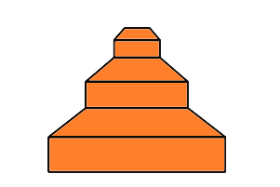
Bitmap: the wrong format

Slide 8
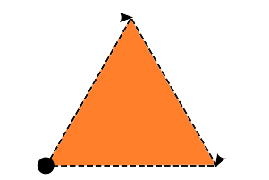
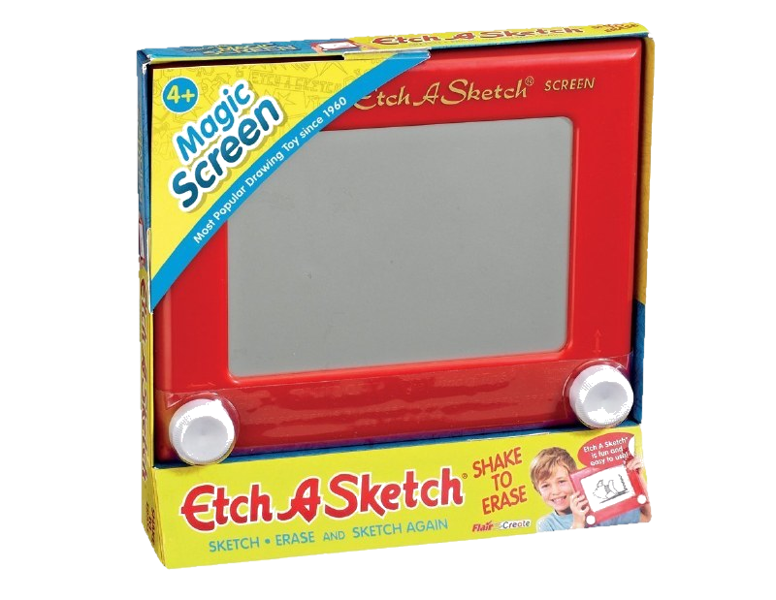
Vector: the correct format
<path d="M 35.250675,73.364054 73.976122,6.0394945 112.91818,73.238995 Z" />

Slide 10
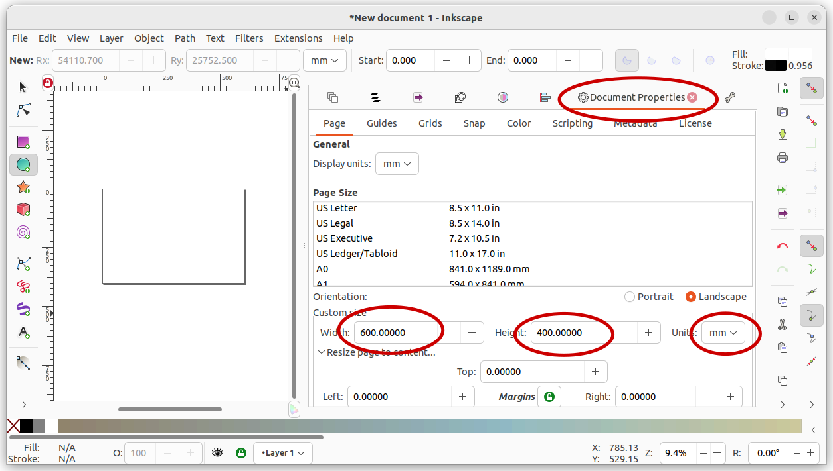
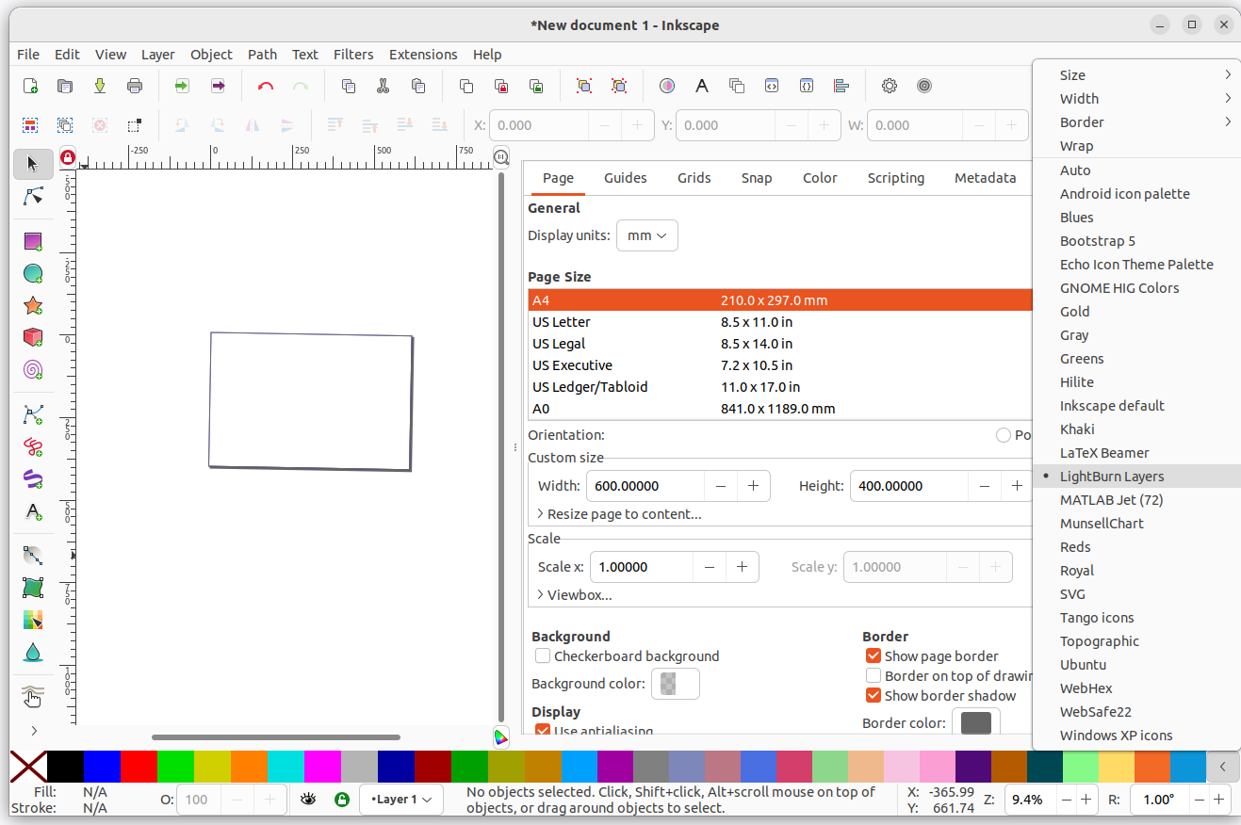
Before we start
1. Install the lightburn palette
2. Set document size to bed

Slide 11
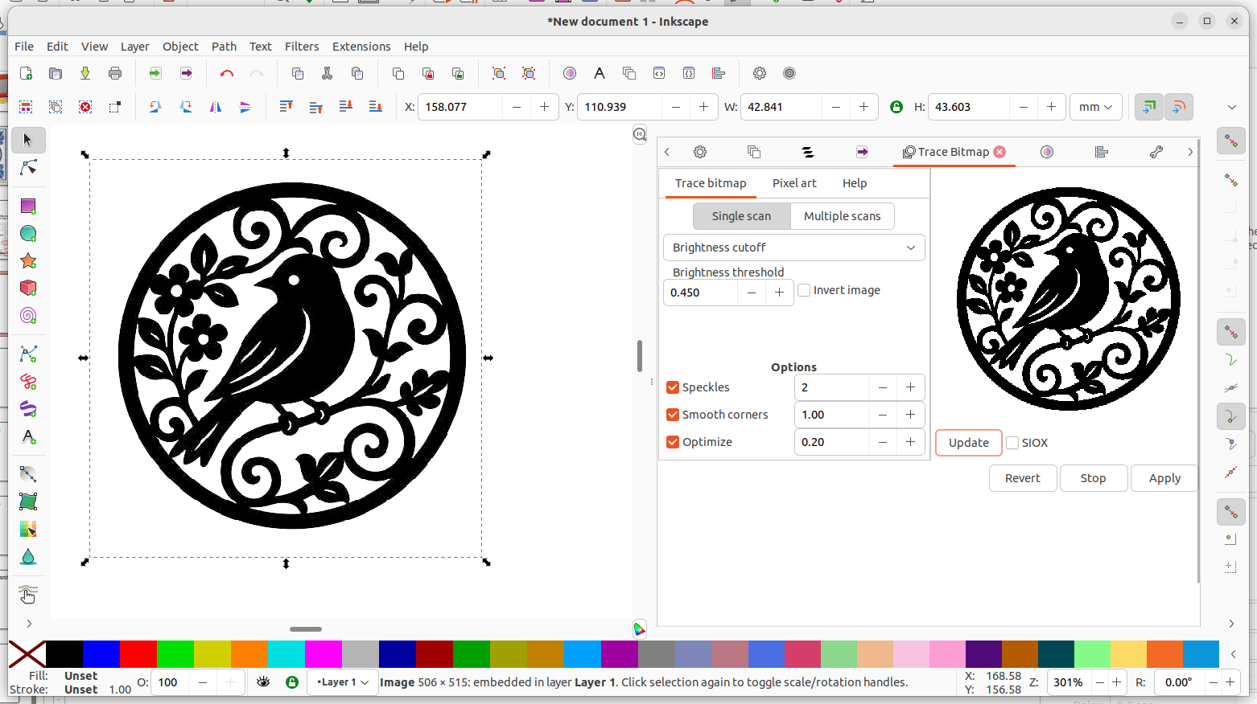
Tracing bitmap

Slide 12
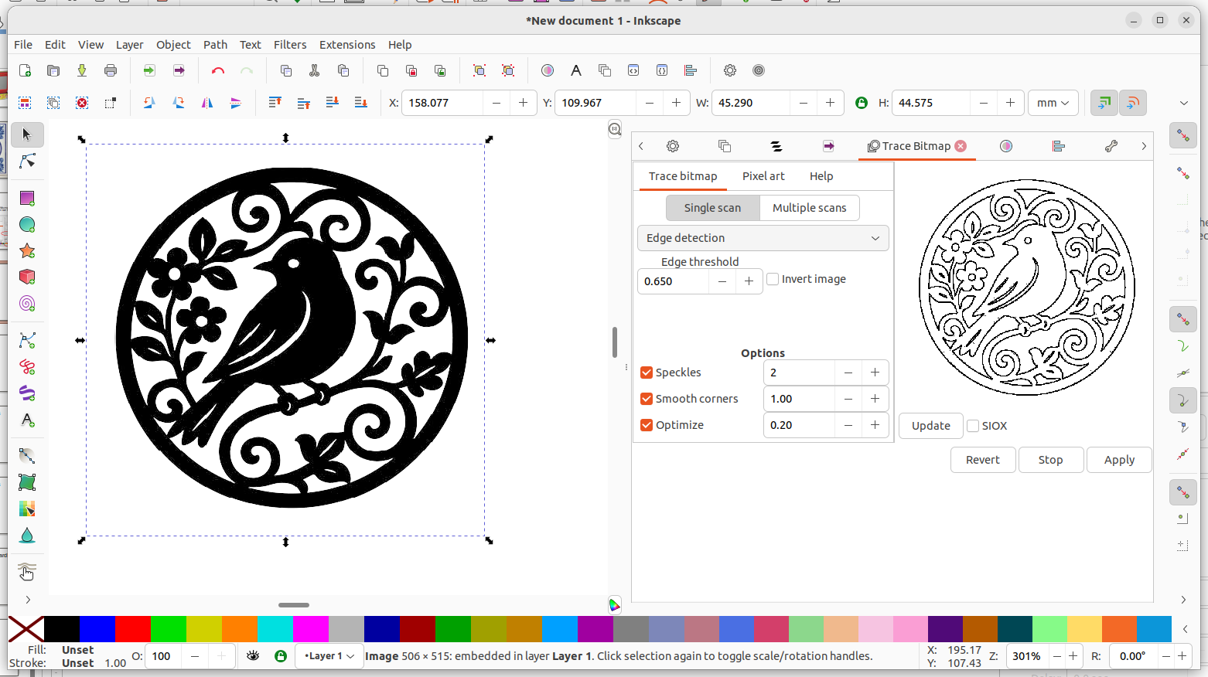
Tracing bitmap

Slide 13
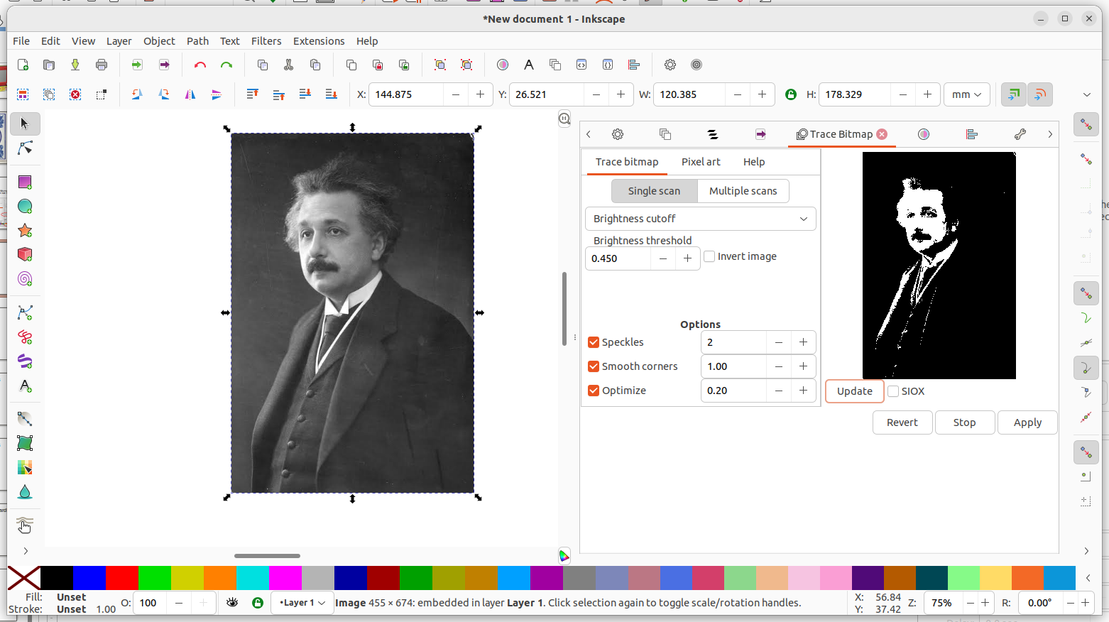
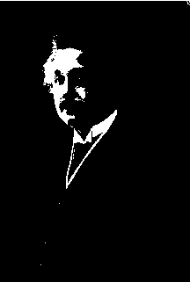
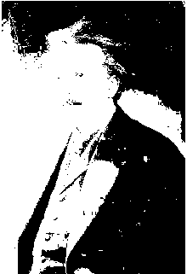
Tracing bitmap

Slide 14
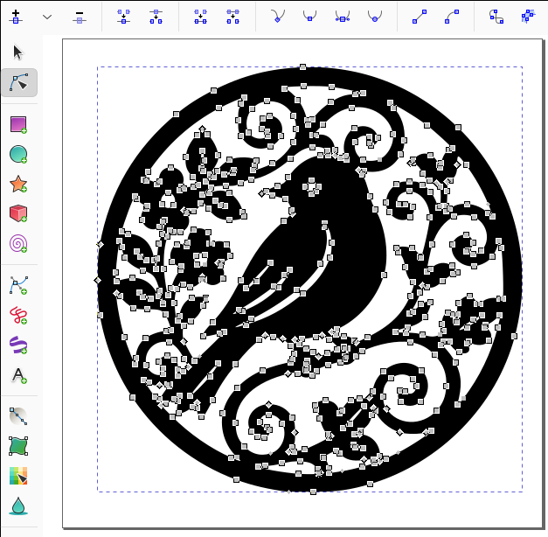
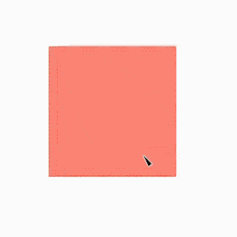
Nodes

Slide 15
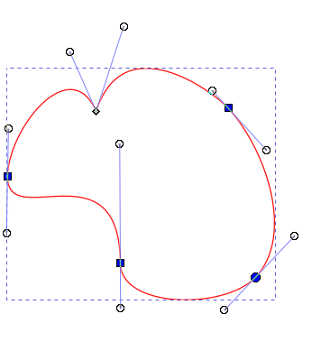
Nodes
Handles are independent. Each side can point in a different direction and have a different length.
Handles are collinear and generally stay aligned through the node, but their lengths can differ.
Handles are collinear and equal in length on both sides of the node.
Inkscape automatically calculates the handles to create a smooth curve through the node.

Slide 16

Important keys on your keyboard!
Ctrl Alt Delete
Shift
Ctrl + Z

Slide 17
My 3 main tips
Use small stroke, no fill
Convert everything to objects
Combine paths
Click set fill color,
Shift+click set stroke color

Slide 18
My 3 main tips
Use small stroke, no fill
Convert everything to objects
Combine paths
Click set fill color,
Shift+click set stroke color

Slide 19

Creating your own designs

Slide 20

Creating your own designs

Slide 21
Creating your own designs

Slide 22
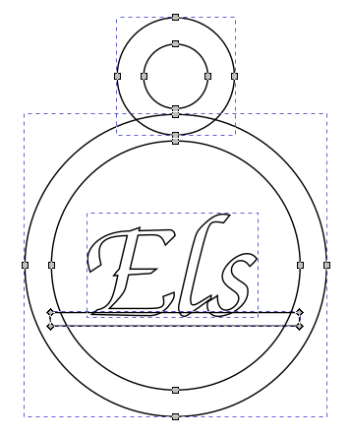
Creating your own designs

Slide 23
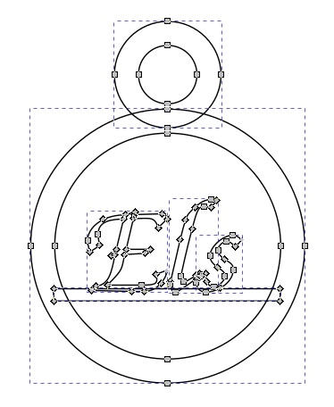
Creating your own designs

Slide 24
Creating your own designs

Slide 25
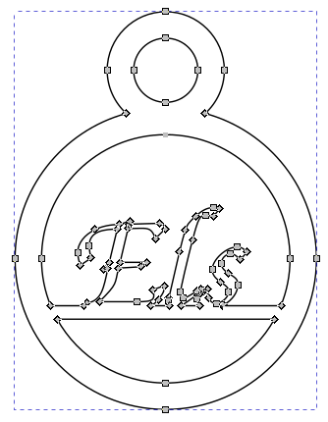
Creating your own designs

Slide 26

Creating your own designs

