Slide 1

Interleaved Sequence RNNs for Fraud Detection
Bernardo Branco, Pedro Abreu, Ana Sofia Gomes,
Mariana S. C. Almeida, João Tiago Ascensão, Pedro Bizarro
KDD '20, August 23–27, 2020, Virtual Event, USA

Slide 2
Contribution
We identify a new type of problem: a sequence composed of many interleaved, unbounded sub-sequences.
(2) We propose an efficient batch training technique, sorting per subsequence and time, processing scorable and nonscorable events.
(3) We introduce an efficient streaming inference technique, saving and restoring the GRU state, caching, and expiring events.
(4) We evaluate the solution in two real-life use.

Slide 3
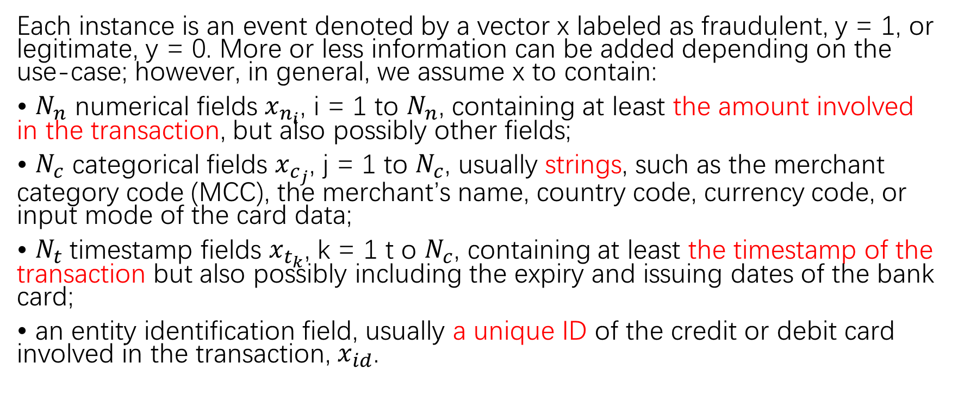
Problem formulation
Each instance is an event denoted by a vector x labeled as fraudulent, y = 1, or legitimate, y = 0. More or less information can be added depending on the use-case; however, in general, we assume x to contain:
• $N_{n}$ numerical fields $x_{n_{i}}$, i = 1 to $N_{n}$, containing at least the amount involved in the transaction, but also possibly other fields;
• $N_{c}$ categorical fields $x_{c_{j}}$, j = 1 to $N_{c}$, usually strings, such as the merchant category code (MCC), the merchant’s name, country code, currency code, or input mode of the card data;
• $N_{t}$timestamp fields $x_{t_{k}}$, k = 1 t o $N_{c}$, containing at least the timestamp of the transaction but also possibly including the expiry and issuing dates of the bank card;
• an entity identification field, usually a unique ID of the credit or debit card involved in the transaction, $x_{id}$.

Slide 4
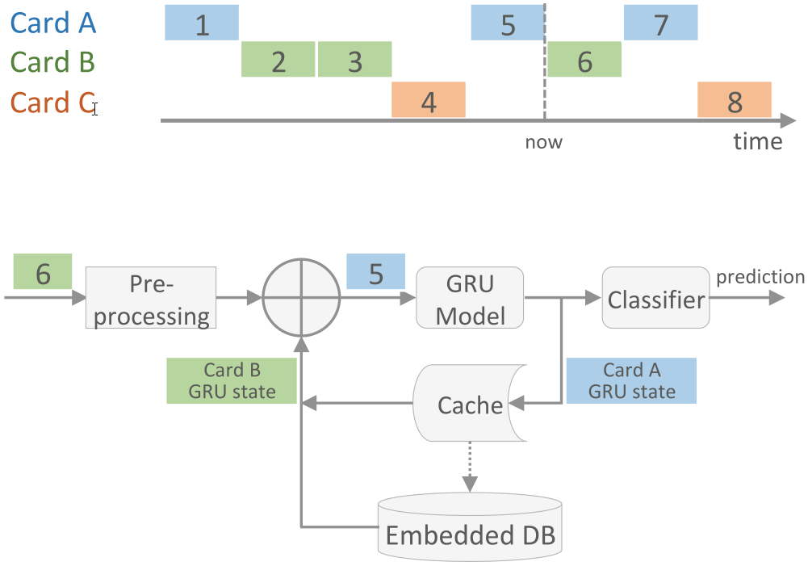
Model architecture

Slide 5
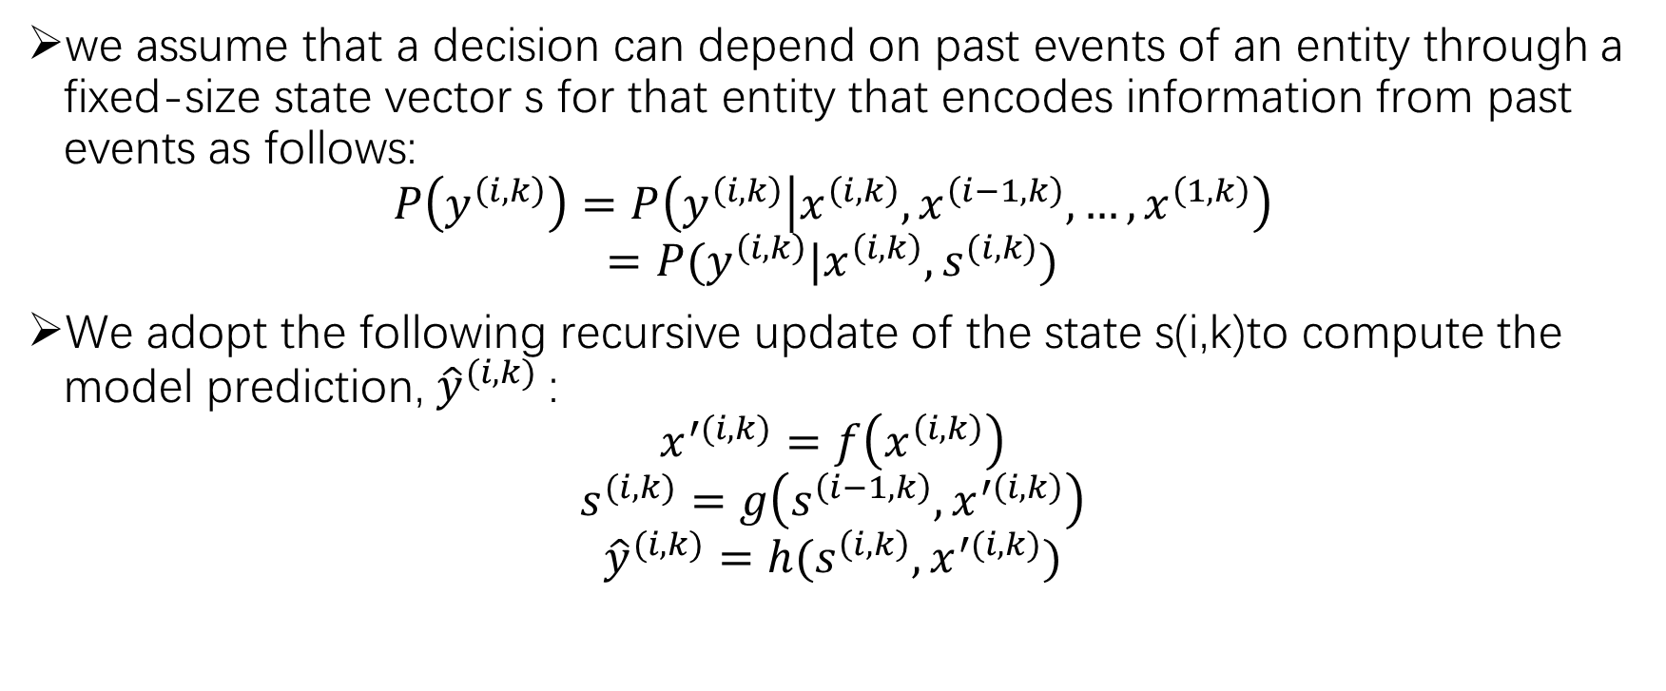
Model architecture
we assume that a decision can depend on past events of an entity through a fixed-size state vector s for that entity that encodes information from past events as follows:
$$P\left(y^{\left(i,k\right)}\right)=P\left(y^{\left(i,k\right)} | x^{\left(i,k\right)},x^{\left(i−1,k\right)},…,x^{\left(1,k\right)}\right)$$
$$=P(y^{\left(i,k\right)}|x^{\left(i,k\right)},s^{(i,k)})$$
We adopt the following recursive update of the state s(i,k)to compute the model prediction, ${\hat{y}}^{(i,k)}$:
$$x^{′(i,k)}=f\left(x^{\left(i,k\right)}\right)$$
$$s^{(i,k)}=g\left(s^{\left(i−1,k\right)},x^{′\left(i,k\right)}\right)$$
$${\hat{y}}^{(i,k)}=h(s^{\left(i,k\right)},x^{′(i,k)})$$

Slide 6
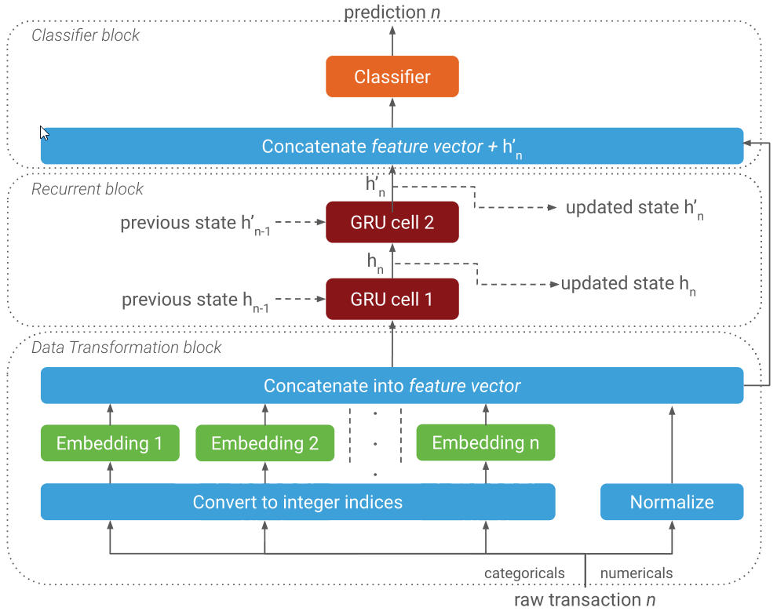
Model architecture

Slide 7
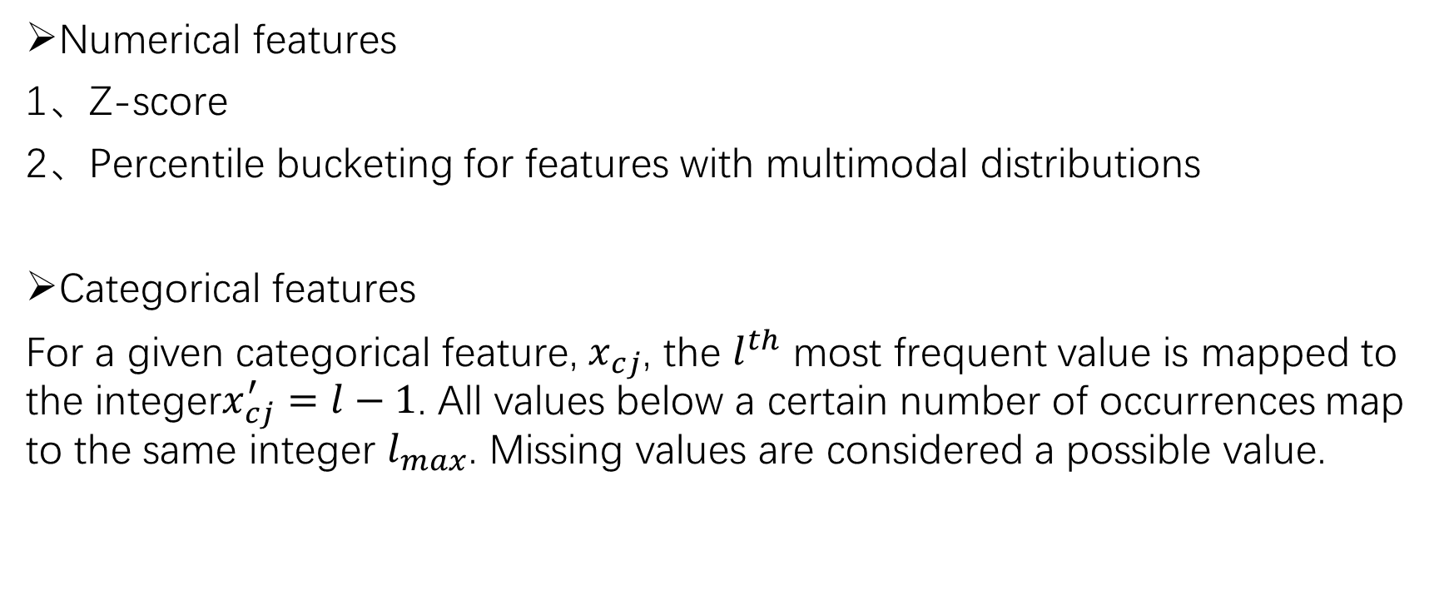
Offline preprocessing
Numerical features
1、Z-score
2、Percentile bucketing for features with multimodal distributions
Categorical features
For a given categorical feature, $x_{cj}$, the $l^{th}$ most frequent value is mapped to the integer$x_{cj}^{′}=l−1$. All values below a certain number of occurrences map to the same integer $l_{max}$. Missing values are considered a possible value.

Slide 8
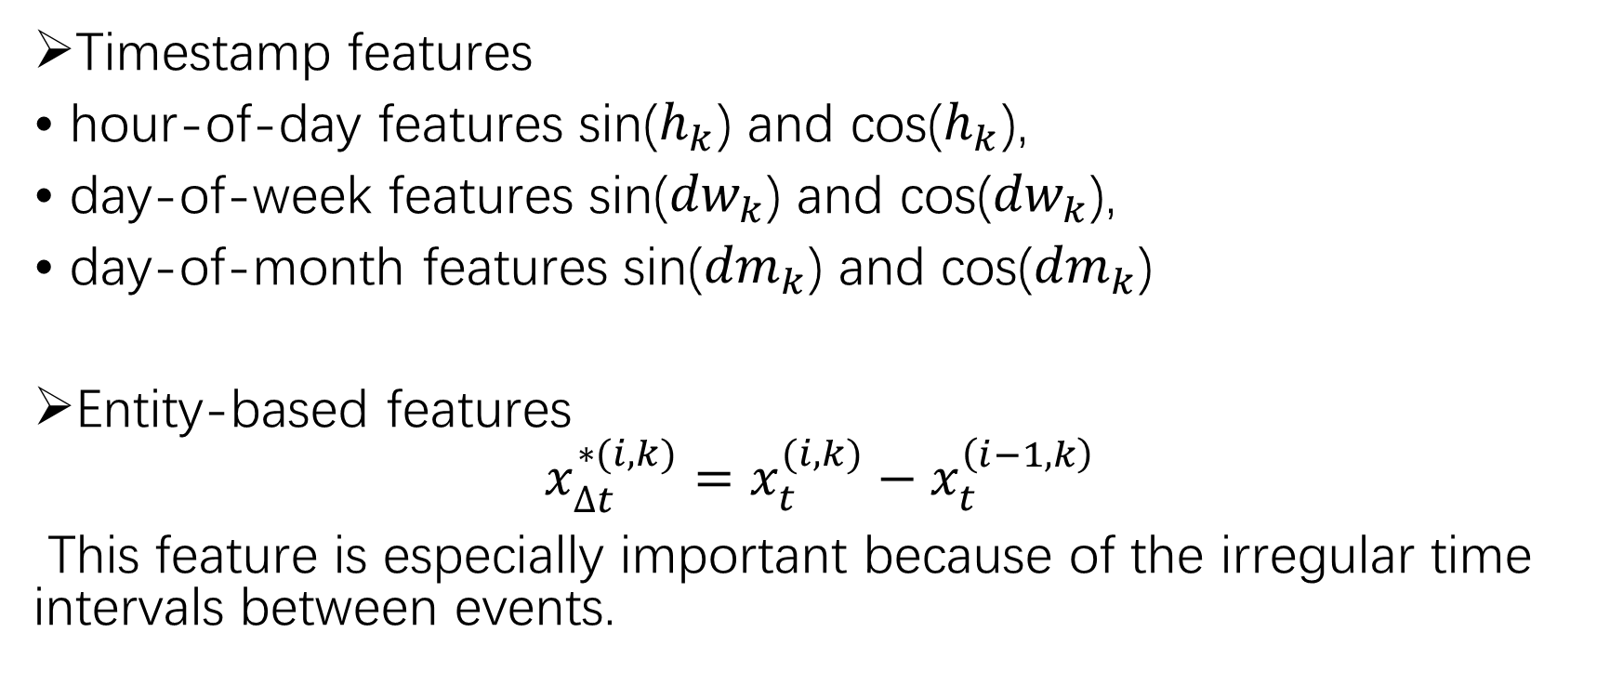
Offline preprocessing
Timestamp features
• hour-of-day features sin($h_{k}$) and cos($h_{k}$),
• day-of-week features sin(${dw}_{k}$) and cos(${dw}_{k}$),
• day-of-month features sin(${dm}_{k}$) and cos(${dm}_{k}$)
Entity-based features
$$x_{∆t}^{∗(i,k)}=x_{t}^{(i,k)}−x_{t}^{\left(i−1,k\right)}$$
This feature is especially important because of the irregular time intervals between events.

Slide 9
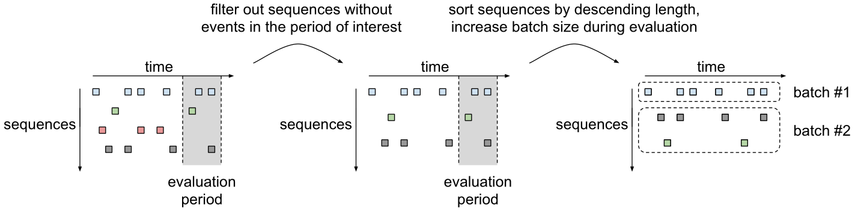
Offline preprocessing

Slide 10
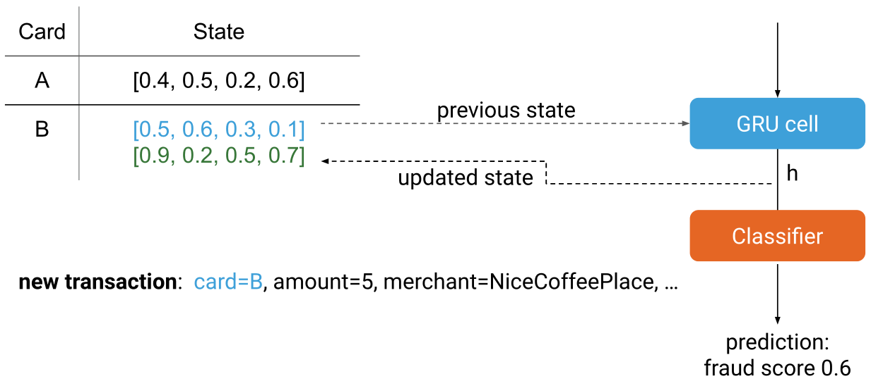
Offline preprocessing

Slide 11
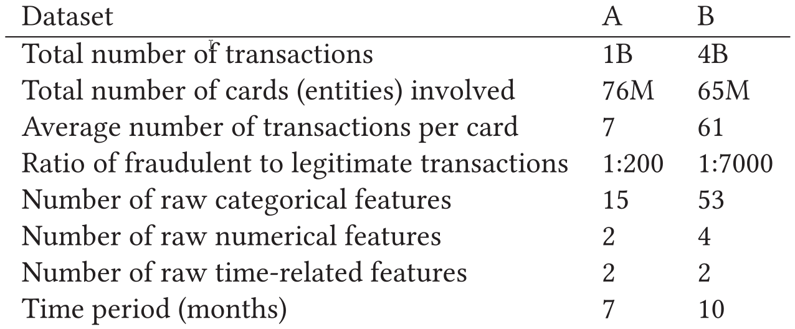
Dataset

Slide 12
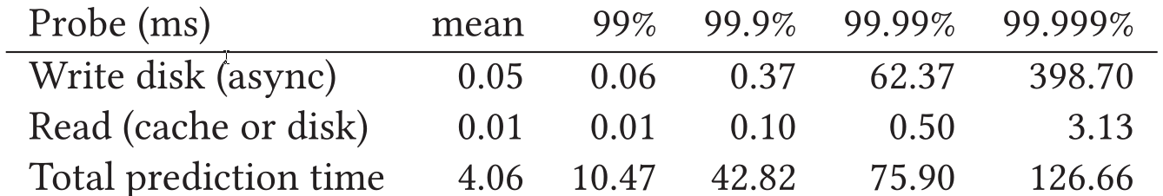
Results

Slide 13
Thanks

