Slide 1




UX/UI DESIGN
WEB ICONS

Slide 2
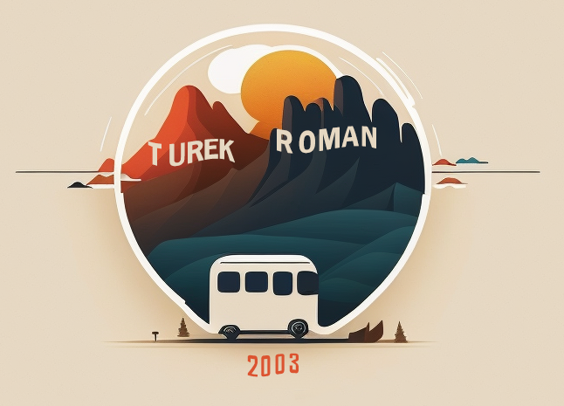



Which LOGO ?

Slide 3

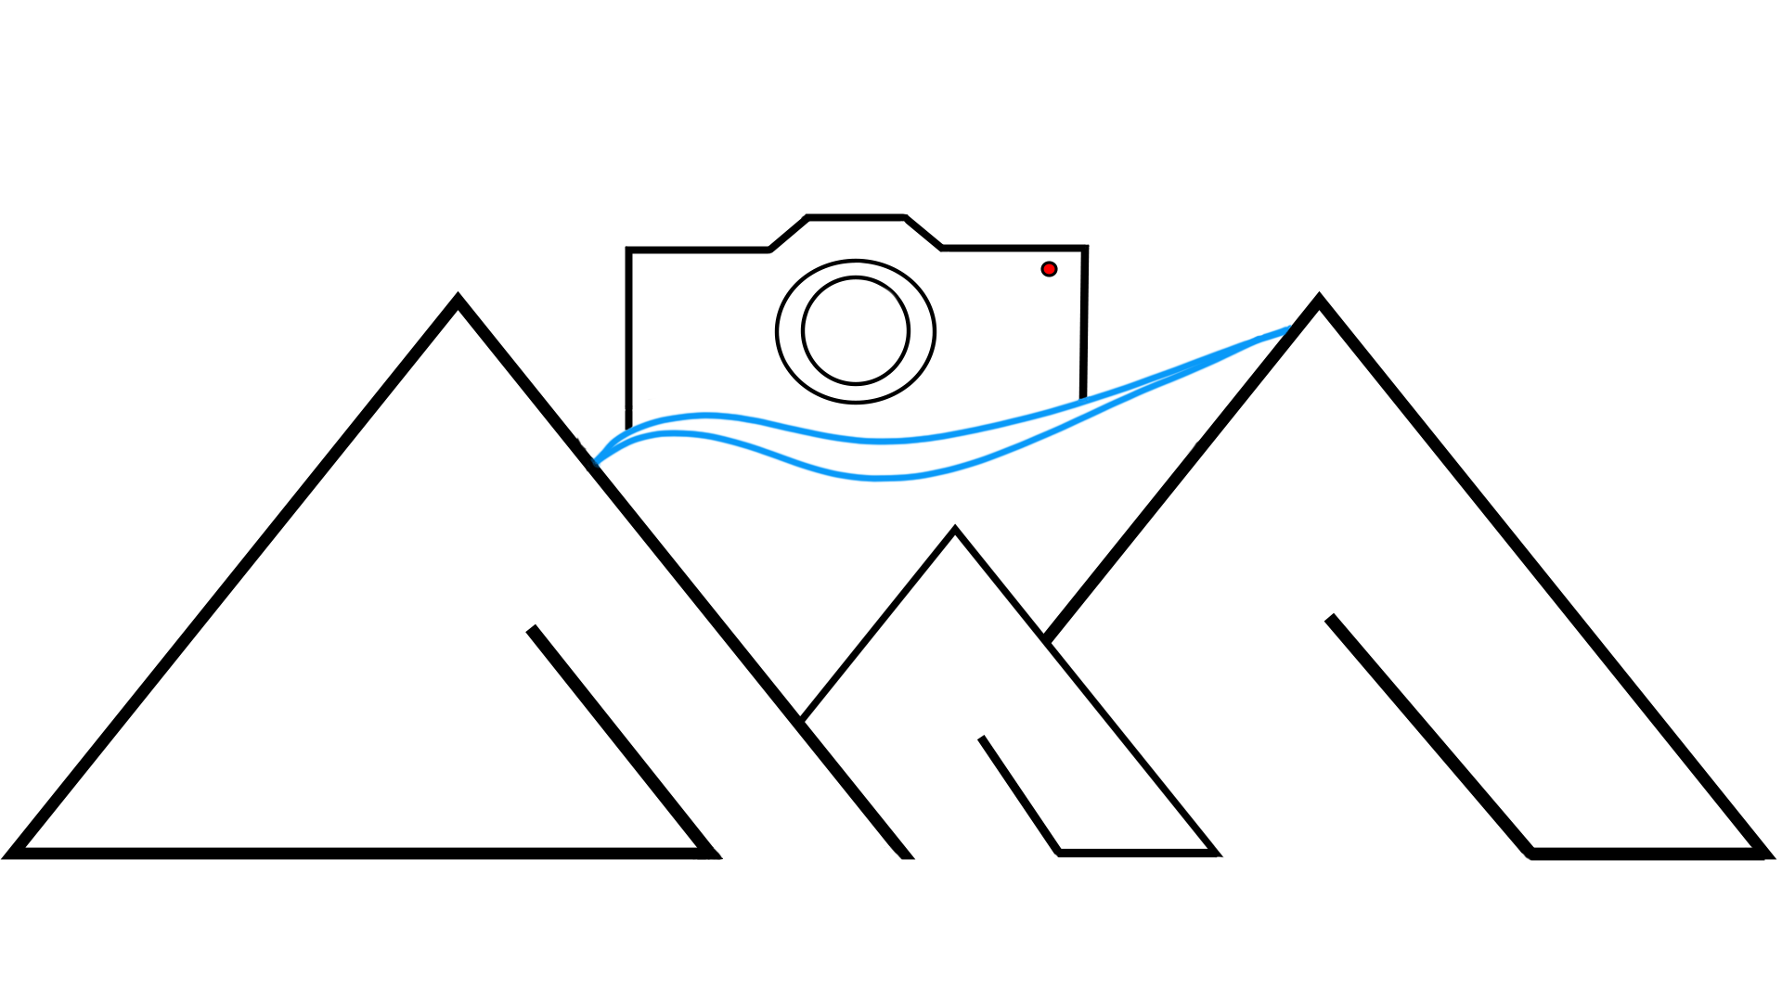
ROMAN TUREK Mallorca

