Slide 1
MAREA
Marine Reserve Evaluation App
By TURFeffect

Slide 2
What is this?
Not a presentation check
Not a project review
Not a “change your color scheme” thing
Show ONE of the deliverables, and ask for comments

Slide 3
Quick description of our project
Framework to evaluate the effectiveness of no-take marine reserves
Scalable
Replicable
Traceable
Easy / cheap to implement
Include ecological, socioeconomic, and governance indicators

Slide 4
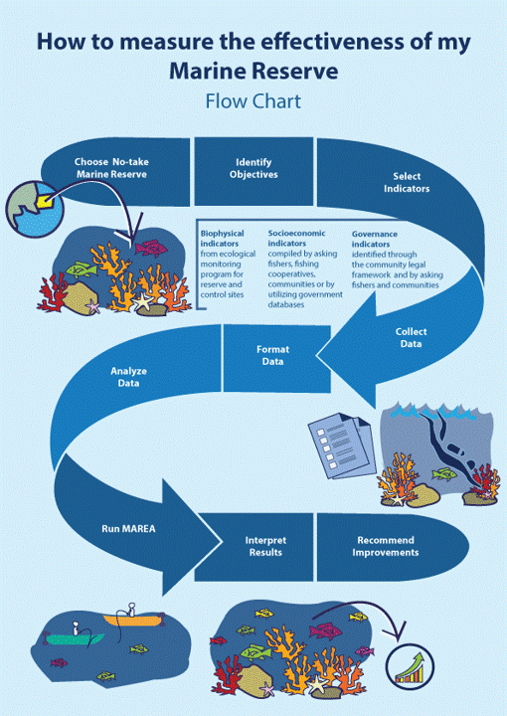
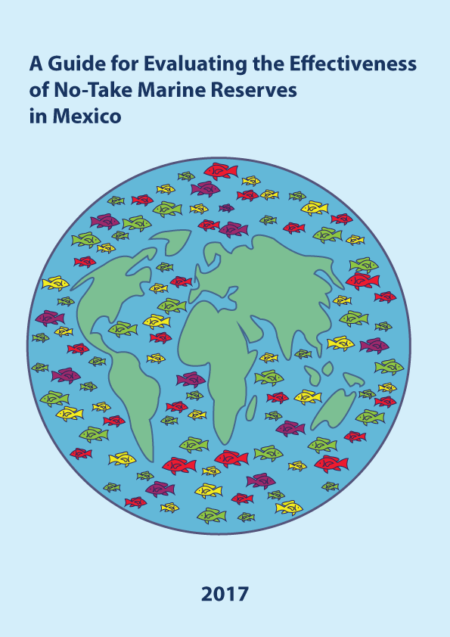
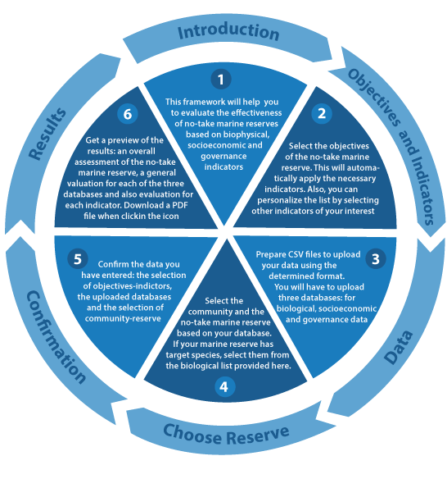
More than just a guidebook

Slide 6
What we are looking for?
Comments on how intuitive the app is
Any issues (red error messages, something broken / not showing)
Any ideas on how to make the app better
MAREA channel on Slack
https://github.com/turfeffect/AppDraft
How?

