Slide 1


Methods of Clustering Single-Cell RNA Sequencing Data
Intern: Turhan Can Kargın
Supervisor: Dr. Michał Marczyk - Silesian University of Technology
Project Starting Date: 16.11.2020

Slide 2
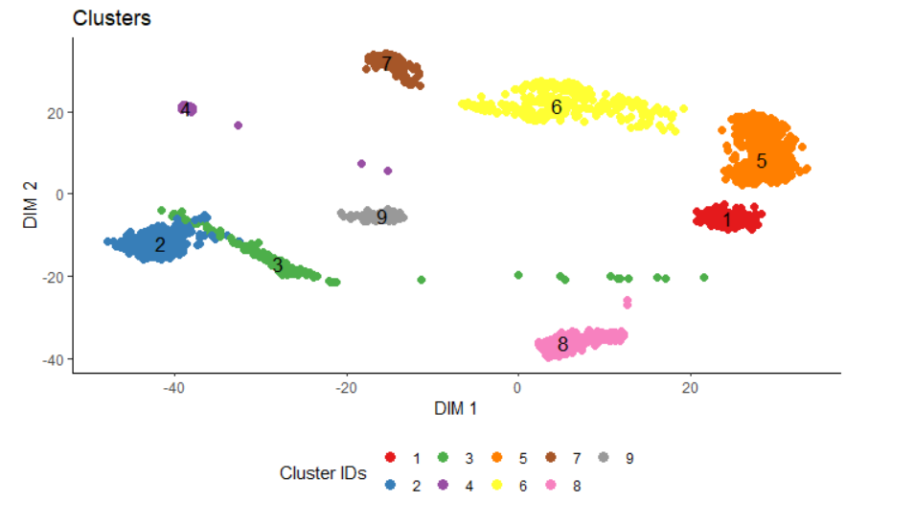
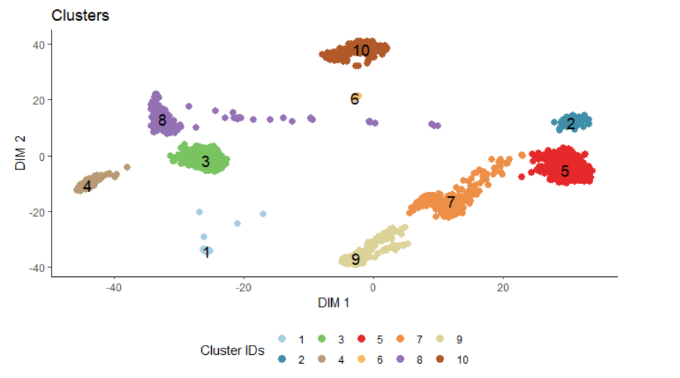
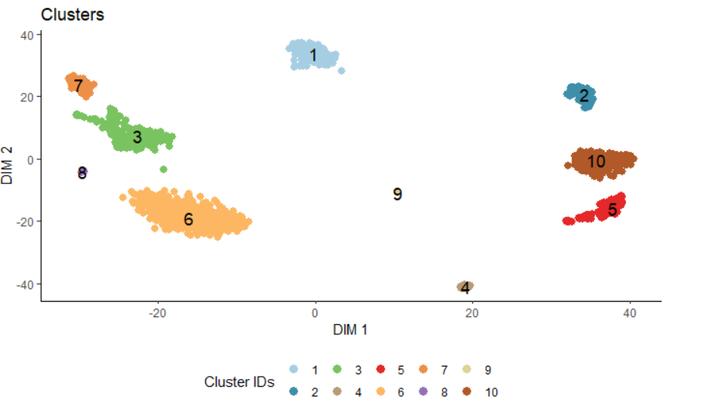
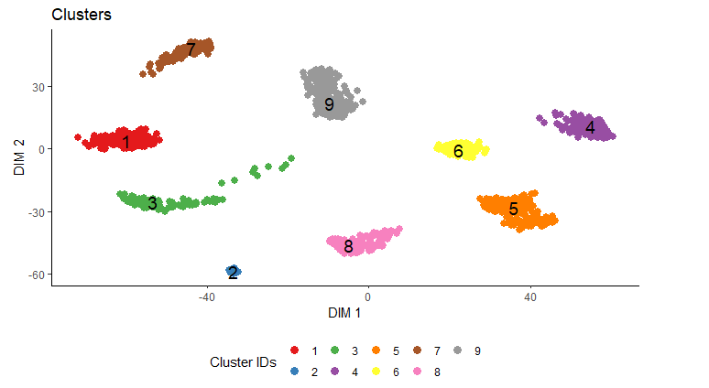
PBMC Dataset Results
Default Parameters
Tuned 1 – no PCA
0.3528529
0.3970656
Tuned 3 – with PCA
Tuned 2 – with PCA
Dunn index values
0.5424643
0.5084614

Slide 3
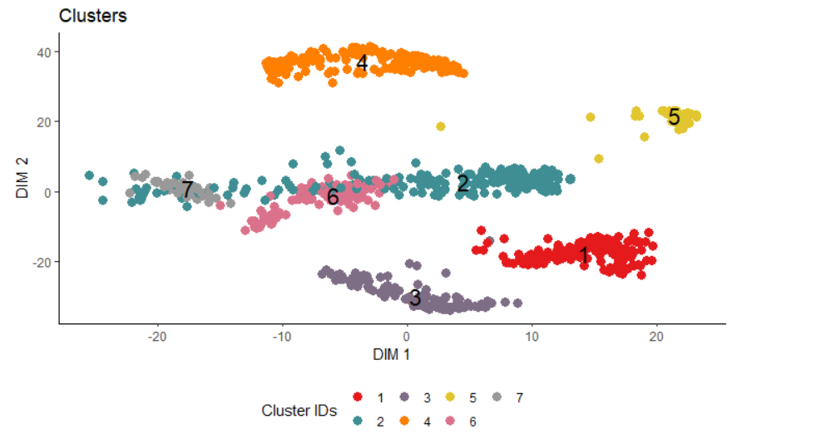
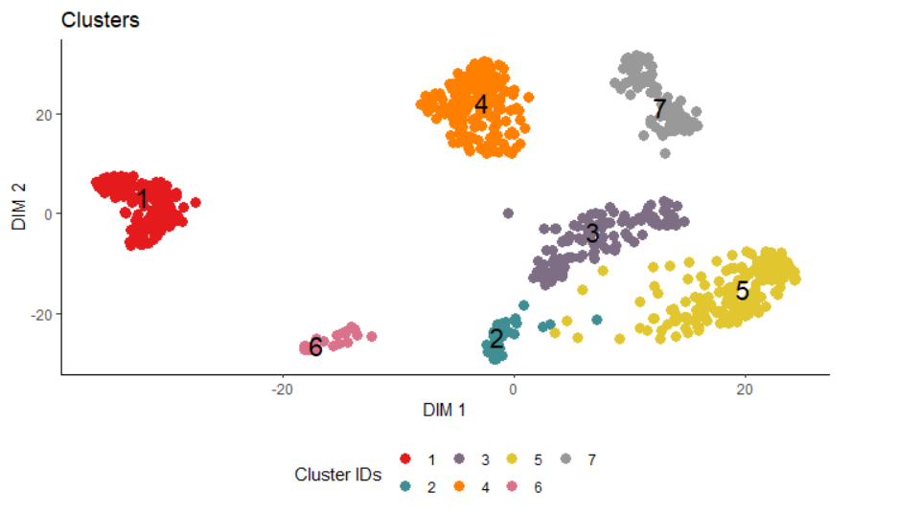
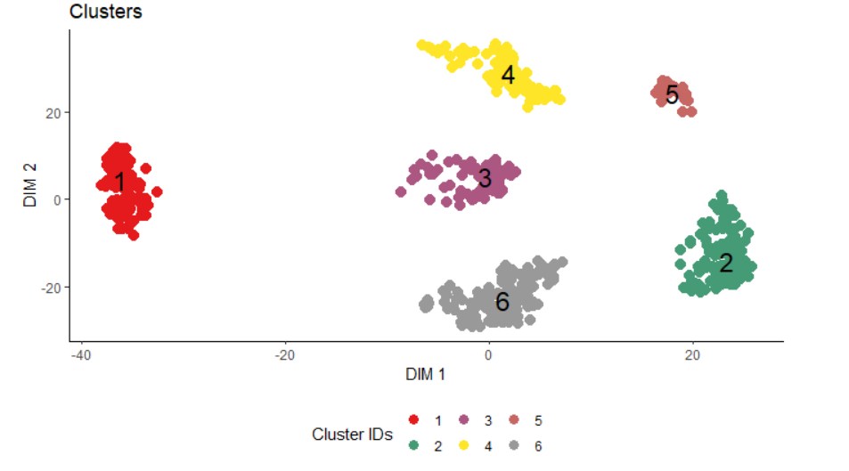
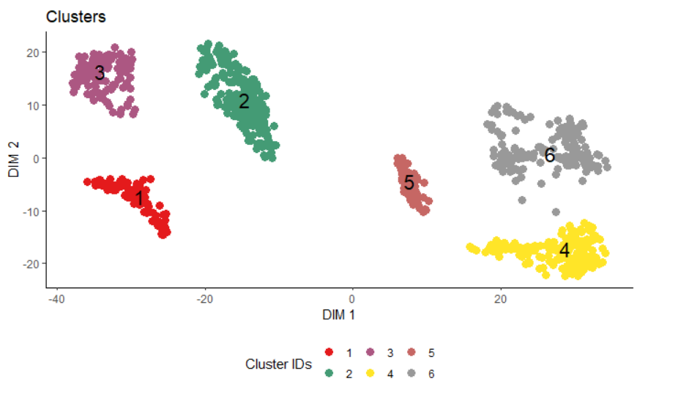
ABT Dataset Results
Default Parameters
Tuned 1 – no PCA
0.06497668
0.03907904
Tuned 2 – with PCA
Tuned 3 – with PCA
Dunn index values
0.1199416
0.1240345

