Slide 1


Database Management 100 Lecture 1
Instructor: Greg Hay
January 14th 2015

Slide 2

Agenda
Introductions
Overview of Dataman 100 objectives
Intro to Data, Information and Database Systems
History of data management: hierarchical & network

Slide 3

Instructor & TA
Greg Hay
gthay@uw.edu
TA: Melissa Parsons
melpars@uw.edu

Slide 4
Instructor Background
UW Husky
Undergrad degrees in History & Anthropology
MSIM from iSchool
Industry IT
27+ years
Microsoft, HP, Bill & Melinda Gates Foundation
Pro Basketball Referee

Slide 5
Instructor Background
Teaching
University of Washington
University of Chicago
Northeastern University

Slide 6

Questions?

Slide 7
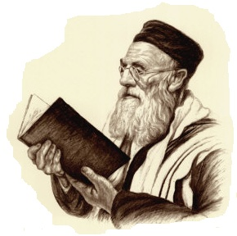
Words of Wisdom #1
From an ancient DBA elder

Slide 8

Words of Wisdom #1
“If the technology industry is like the ocean…”

Slide 9

Words of Wisdom #1
“and a technician is like being a fish in that ocean…”

Slide 10

Words of Wisdom #1
“…it is best to be the biggest and meanest fish in that ocean”

Slide 11

Words of Wisdom #1
Database knowledge: Top of the technology food chain

Slide 12

Many Positions in IT
Technical and non-technical positions
Program Manager
Product Manager
Developer
Tester
Administrator
Analyst
Infrastructure
System Engineer
Operations Engineer

Slide 13
Overview of DataMan 100 objectives
Describe functions of database management systems
Describe features/benefits of the relational model
From problem statements, derive SQL statements for querying and modifying data
Create Entity-Relationship Diagrams (ERD)
Read an ERD to implement a database system
Describe data redundancy and modification anomalies
Be able to normalize a database to 3NF to avoid issues
Describe a three-tier information system
Outline methodology for designing database applications

Slide 14
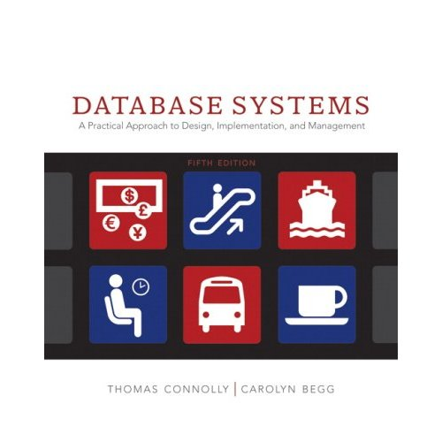
Primary Text
Connolly, T. M. & Begg, C. E. (2009). Database Systems: A Practical Approach to Design, Implementation, and Management (5th Edition) New York: Addison-Wesley Publishing. [ISBN-10: 0321523067]

Slide 15
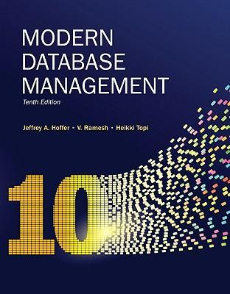
Secondary Text
Hoffer, Ramesh, Topi ;Modern Database Management (2010) Prentice Hall. [ISBN-10: 0136088392]

Slide 16
Dataman 100: Assessment
Assessment % Grade
4 Assignments 40%
4 Coding Assignments 40%
Final 2-week Project 20%

Slide 17


Slide 18
Three Tracks
Lecture
Academic context to data & transaction mgmt
Design principles
Tegrity-recordings are posted for entire quarter
SQL
Language of databases (design & administration)
Project
Practical implementation

Slide 19
Lecture Track
Intended to provide foundation
Attention is required
Reading will allow for extreme learning
Ask questions (instructors as well as peers)

Slide 20
SQL Track
Language of Databases
Practice is required (!!!)
Independent learning (online research is best)
Best coders, musicians and artists are self-taught

Slide 21
Project Track
Practical Application of course concepts
Benefit proportional to effort
Take it serious!!

Slide 22
Software Required
Available on DreamSpark (https://www.dreamspark.com/)
Create account
Sign-in
Download software
Microsoft Visio 2010 (MUCH better than 2013)
Microsoft SQL Server 2012

Slide 23

How to excel in this class
Stay current with reading
Ask questions when things are not clear
Take advantage of extra credit

Slide 24

Questions?

Slide 25

Information Management
What are data?

Slide 26
Information Management
What is information?

Slide 27
Information Management
What is knowledge?

Slide 28
Information Management
What is a system?

Slide 29
Information Management
What are the goals of a system?

Slide 30
Information Management
“Organize or Die”
Human learning based on organizing & analyzing
Those that were effective at building systems survived
Examples?

Slide 31
Information Management
Development of systems allowed learning!!
Farming
Animal husbandry
Specialization of labor
Industrial revolution…assembly line…Internet

Slide 32
Information Management
Clifford Stoll:
Data
Information
Knowledge
Understanding
Wisdom

Slide 33
Information Management
Clifford Stoll:
Data
Information
Knowledge/Understanding >> ‘Learning’
Wisdom

Slide 34
Learning = Competitive Advantage
Allows for specialization of labor
Emergence of experts
Innovation & process optimization
People become interchangeable resource
Organizations that ‘learn’ will out-perform other organizations that do not

Slide 35
Learning = Competitive Advantage
Examples?

Slide 36
Learning = Competitive Advantage
What about Starbucks?
Amazon?
Tully’s?

Slide 37
Questions?

Slide 38
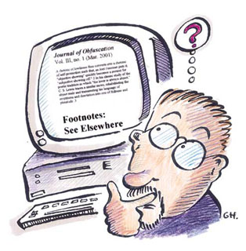
High-Level Question
What is the role of Database Management System (DBMS)?

Slide 39
What is the role of DBMS?
Back-end of N-tier Application
Holds data securely
Presents answers to ‘queries’ = information
Allows for learning/gaining knowledge

Slide 40
N-Tier Architecture
Front-end
‘Presentation layer’ or client
most often web-based
Collects data from user
Middle-Tier
‘Logic layer’ or Business Rules
Validates data
Back-end
‘Data layer’ or Server
Database Management System

Slide 41
High-Level Question
Has there always been an N-Tier architecture?

Slide 42
High-Level Question
Has there always been an N-Tier architecture?
No. There originally was just a single “Tier”
There was just a single large computer (called a mainframe) where users would connect directly.
Generally bound from 1950’s through 1970’s

Slide 43
High-Level Question
Has there always been an N-Tier architecture?
Then there was 2-Tier (‘client-server’)
Generally used 1980’s-90’s

Slide 44
Questions?

Slide 45

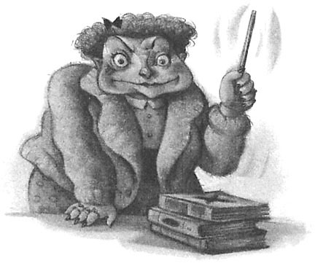
History of Database Theory
‘File Cabinet’ Database (paper systems)
Hierarchical Database
Network Database
Relational database

Slide 46

File Cabinet Databases
Think of communication limitations of 1950’s:
No cell phones
No email
No faxes
No Kinko’s
Few televisions even…
How procedural did businesses have to be?

Slide 47
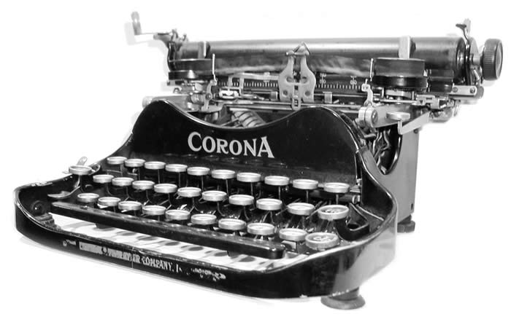

File Cabinet Databases
How fast was business in time of type writers?

Slide 48
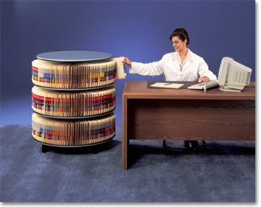
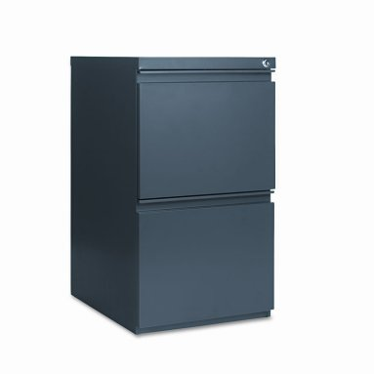
‘File Cabinet’ Databases
Structure of Organization
Drawer
Hanging File Folder
Folding Files
Receipts

Slide 49

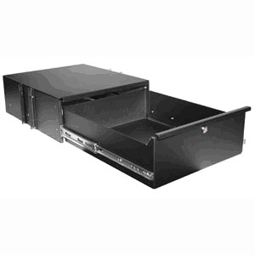
File Cabinet Database Terms
Drawer = database (very loosely)

Slide 50
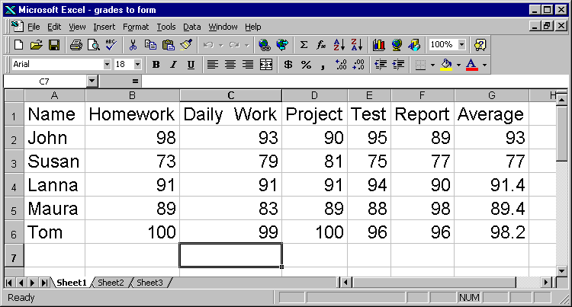
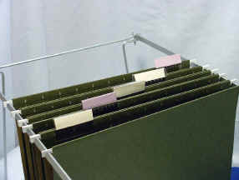
File Cabinet Database Terms
Hanging File Folder = ‘table’ or ‘entity’

Slide 51

File Cabinet Database Terms
Individual Folder = ‘column’ or ‘field’

Slide 52
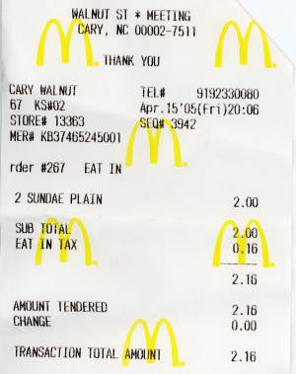
File Cabinet Database Terms
Receipt = ‘row’ or ‘record’

Slide 53
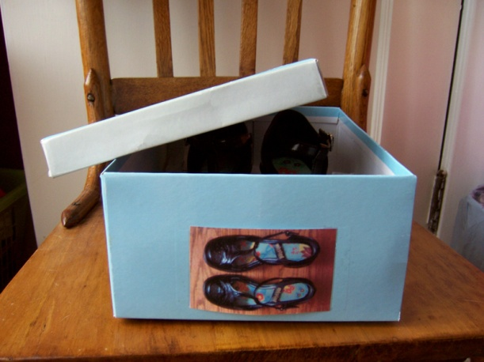
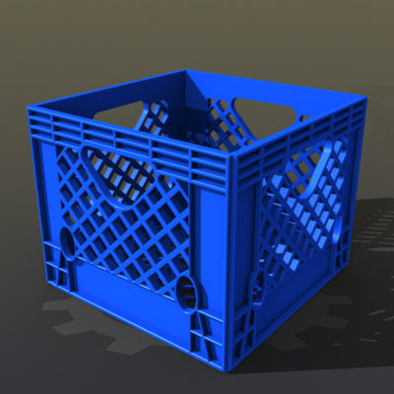
‘File Cabinet’ Databases
Advantages
Quick to establish
a shoebox or milk crate to get started
Easy to use
Does not require specialized skill or professional training
Cheap
$100 is ‘Top of the Line’

Slide 54
‘File Cabinet’ Databases
Disadvantages
Vulnerable
Single-copy of important, mission-critical data
Fire, theft, accidental misplacement, age of paper, spilled coffee…
Difficult to query
Not easy to compare and analyze ranges of data
Difficult to transfer data
Mail a hardcopy
Tough to maintain organization of logical data sets (‘context’)
Scalability limitations
Limited to physical ability of people

Slide 55
Questions?

Slide 56
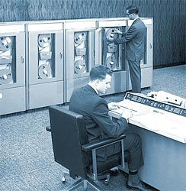
Scalability limits raised question...
“What can be done to take advantage of computers to improve data management?”

Slide 57
Hierarchical Databases
Introduced by IBM in late 1950’s & early ‘60s
Followed ‘File Cabinet’ line of thinking
Records linked together like an Org Chart
each record type has only one owner
widely used in the first mainframe databases
Very structured organization
Top-down way of viewing business entities

Slide 58
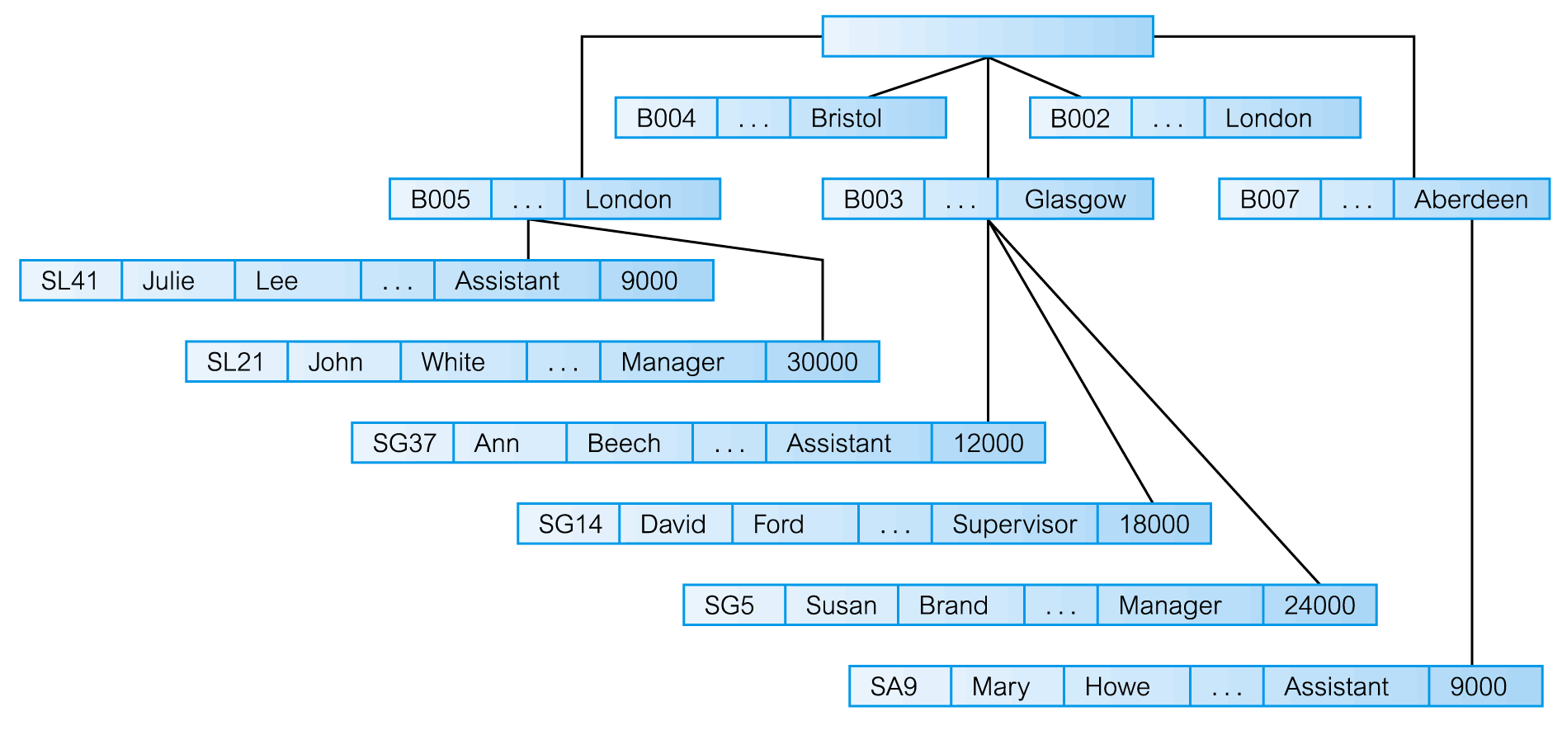
Hierarchical Data Model
Pearson Education © 2009

Slide 59
Hierarchical Databases
Advantages
Relatively easy to understand
Similar conceptually to File Cabinet system
Easy to ‘migrate’ to electronic system
Business processes did not have to change much
Relatively easy to develop & get started
Many entities or objects were similar structure
Easy to expand data storage folders

Slide 60
Hierarchical Databases
Disadvantages
Lousy performance with large data collection
Inefficient navigation in addition to bloated data
VERY expensive
$ Millions on mainframes
Large staff required to maintain system
Specialized skills required to obtain information
Experts controlled access to data
inefficient to the speed of business

Slide 61
Hierarchical Databases
Disadvantages
VERY difficult to modify
Easy only if wanting to replicate file cabinet storage
Difficult to account for complex relationships
Developers had to be able to predict all possible access patterns in advance and design the database accordingly
Prone to anomalies and bad data
Difficult to archive data due to dependent parent-child relationships of the data structures

Slide 62
Hierarchical Databases
Complications over time
Redundant data stored
People tried to avoid performance limits of system
Less efficient system maintenance
People were required to look for and clean up mess
Inconsistent data
What folders held the ‘real’ data?
What would happen if ‘bad’ data was trusted?

Slide 63
Network Databases
Introduced by IBM in late 1960’s & early ‘70s
Intended to fix problems of hierarchical model
Records linked together like a family tree
each record type can have more than one owner
Less structure compared to Hierarchical
‘Multi-connection’ way of viewing business entities

Slide 64
Network Databases
Multiple ‘connections’ for each entity
Not usually ‘balanced’
Not top-down by nature

Slide 65
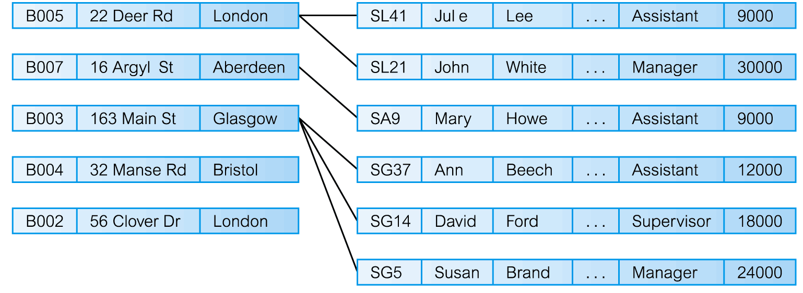
Network Data Model

Slide 66
Network Databases
Advantages
Still relatively easy to understand
Similar conceptually to hierarchical system
Able to adapt to business processes
Able to capture more-complex relationships better than hierarchical databases

Slide 67
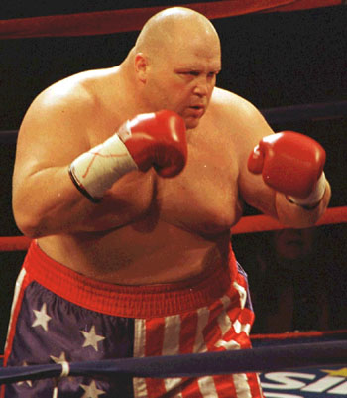
Network Databases
Disadvantages
Did not eliminate hierarchical database problems
Slow to adapt or modify
Heavy reliance on experts
Bloated data\anomalies
Expensive

Slide 68


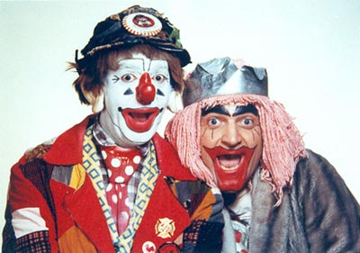


Hierarchical & Network Databases
Due to limitations no longer prevalent after 1980…

Slide 69

How to fix problems of databases?
Less expensive to implement & maintain
Able to customize to business processes
Adapt to CHANGES in business processes
Less dependent on experts
Simple for ‘non-technicians’ to obtain information

Slide 70
How to fix problems of databases?
Efficient use of physical resources
No redundant data
Able to scale
No measurable performance loss as data grows
Guaranteed accurate data
No anomalies, orphans or ghosts

Slide 71


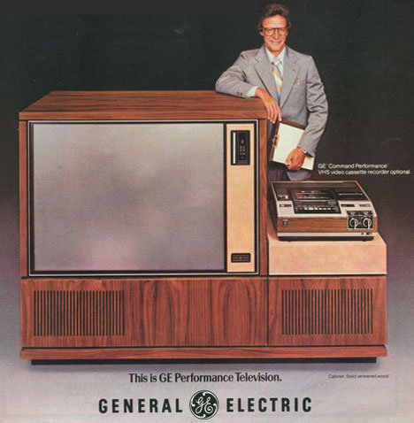
It is 1970…
Is it possible?
Decades of thinking the same way
Thousands of ‘experts’ can’t find solutions

Slide 72

It is 1970…
It happened!
A single person thought differently and changed the lives of millions forever!!

Slide 73
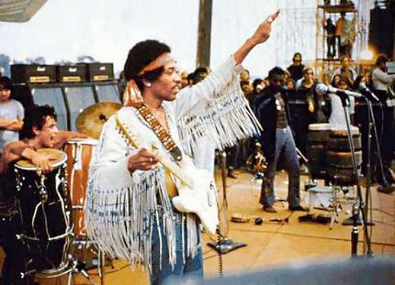
Jimi Hendrix

Slide 74
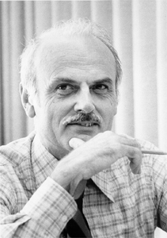
Dr. Edgar Codd

Slide 75
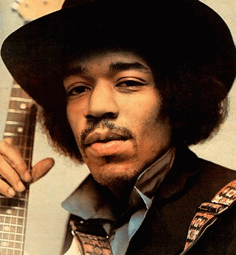
Very similar impact…
Giants…Innovators…legends
Creativity and brilliance changed decades of status quo
Single-handedly revolutionized their industry
40 years later still not only current but highly influential

Slide 76
Relational Data Model
Introduced in early ‘70s and gradually implemented beginning ~1980
ELIMINATED (almost) all previous problems
Records linked together by ALL relationships
each record type has no explicit owner

Slide 77
Relational Data Model
Advantages
Relatively easy to understand
Similar conceptually to ‘real world’ (Entities & Relationships)
Able to improve and optimize business processes
Able to capture complex relationships
Easy to obtain information quickly
No more experts ‘blocking’ data
Decisions supported at speed of business (very nimble)

Slide 78
Relational Data Model
More Advantages
Efficiency in data storage
3rd Normal Form suggests no redundancy
‘Guaranteed’ data integrity
Efficiency in implementation
ANSI standards allowed platform-independence
Easy to customize initially as well as modify later
VERY affordable
Scalability
Relationship structure allows for large data sets
Easy to archive data

Slide 79
Big Picture on Relational Model
Efficiency: Data is stored in exactly ONE place
Data storage (collection)
Data retrieval (presentation)
Data security (protection)
Standards Developed
Computer language used to manage systems (SQL)
Design methodology (Normalization)
Data Independence
Data not tied to hardware
Column order no longer significant

Slide 80
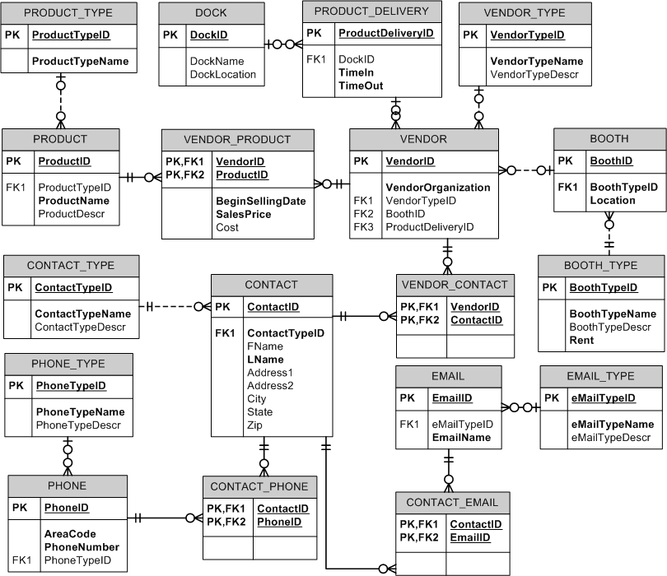

Slide 81
Big Picture on Relational Model
Efficiency: Data is stored in exactly ONE place
Data storage (collection)
Data retrieval (presentation)
Data security (protection)
Standards Developed
Computer language used to manage systems (SQL)
Design methodology (Normalization)
Data Independence
Data not tied to hardware
Column order no longer significant

Slide 82
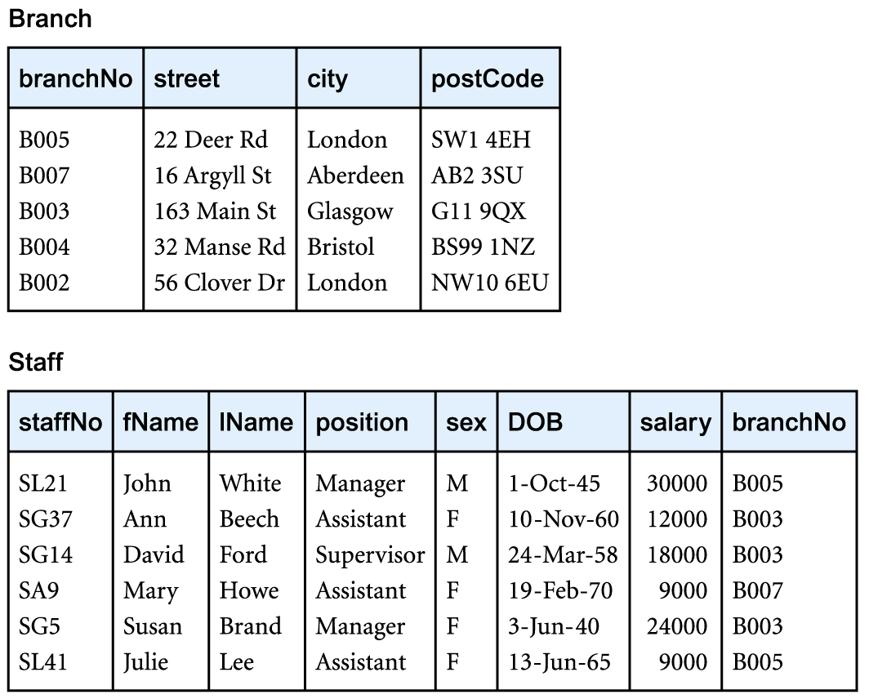
Relational Model

Slide 83

Additional Learning Resources
Introduction to Database Theory
http://www.smallbusinesscomputing.com/emarketing/article.php/3364381
http://databases.about.com/od/administration/u/database_basics.htm
http://dotatmac.mcmaster.ca/db_basics/db_01_home.htm
http://www.geekgirls.com/menu_databases.htm
http://www.simple-talk.com/sql/database-administration/ten-common-database-design-mistakes/

Slide 84
Questions?

Slide 85


Break: 10-minutes

Slide 86
Structured Query Language (SQL)
Method of managing databases
Even if using the Graphical User-Interface
The better we can read and execute code the better we will be at managing databases!

Slide 87
Structured Query Language (SQL)
Very stable language
Developed in late 1960’s by IBM
Still in use today by all major RDBMS
Considered easy to learn and use
Uses English terms in near sentence manner
Fourth-generation language (4GL)

Slide 88
T-SQL: Data Modification Language
Data Modification Language (DML)
INSERT
UPDATE
DELETE
Technically also SELECT

Slide 89
T-SQL: Data Modification Language
SELECT
FROM
WHERE
ORDER BY

Slide 90
T-SQL: Data Modification Language
SELECT → list of column(s)
FROM → list of table(s)
WHERE → some logic or condition
ORDER BY → one or more columns

Slide 91
T-SQL: Data Modification Language
SELECT StudentFname, StudentLname
FROM STUDENT
WHERE StudentLname = ‘Johnson’
ORDER BY StudentLname, StudentFname

Slide 92
T-SQL: Data Modification Language
SELECT StudentFname, StudentLname
FROM STUDENT
WHERE StudentLname LIKE ‘Jo%’
ORDER BY StudentLname, StudentFname

Slide 93
T-SQL: Data Modification Language
SELECT I.InstructorID, I.InstLname
FROM CLASS C
JOIN INSTUCTOR I
ON C.InstructorID = I.InstructorID
WHERE C.CourseID = 53524
ORDER BY InstructorID

Slide 94
T-SQL: Data Modification Language
SELECT I.InstructorID, I.InstLname
FROM CLASS C JOIN INSTUCTOR I
ON C.InstructorID = I.InstructorID
WHERE C.CourseID LIKE ‘3__4%’
ORDER BY InstructorID

Slide 95
Questions?

Slide 96
T-SQL: Data Modification Language
1) SELECT ‘Data are cool’
2) SELECT 24 + 32.12
3) SELECT GetDate()

Slide 97
Structured Query Language (SQL)
Take-aways:
SELECT is list of columns
FROM is list of one or more tables
WHERE is a condition to filter rows
ORDER BY is sorting results set

Slide 98
Structured Query Language (SQL)
Checkout web tutorials
WWW.W3Schools.com/SQL/default.asp

Slide 99
Additional Learning Resources
http://www.smallbusinesscomputing.com/emarketing/article.php/3364381
http://databases.about.com/od/administration/u/database_basics.htm
http://dotatmac.mcmaster.ca/db_basics/db_01_home.htm
http://www.geekgirls.com/menu_databases.htm
http://www.simple-talk.com/sql/database-administration/ten-common-database-design-mistakes/
http://www.mahipalreddy.com/dbdesign/dbqa.htm
http://www.agiledata.org/essays/dataModeling101.html

Slide 100
Common Terms and Concepts
ACID Properties | Bitmap | Client | CPU
Affinity Mask | Bookmark lookup | Clustering | Cursor
Agile Development | Bottleneck | cmd | DBCC
API | B-Tree | Column | DDL
Array | Buffer Pool | COM | De-Normalization
Asynchronous | BUS | Compilation | DIMM
Atomicity | Byte | Conceptual Model | Disaster Recovery
Attribute | Cache | Concurrency | DLL
AWE | Cardinality | Consistency | DML
Bit | Checkpoint | Constraint | Domain

Slide 101
Common Terms and Concepts
DRI | Filegroup | I/O | Logical Model
Durability | Firmware | Implicit | Login
Encryption | Foreign Key | Index | LUN
Entity | Fragmentation | Index Seek | Master Database
ER Diagram | Function | Isolation Level | Megabyte
Execution Plan | Gigabyte | JOIN | Memory
Explicit | Hashing | Kernel Mode | Mirroring
Extent | Heap | Lock | Motherboard
Field | Hierarchial Model | Log file | NAS
File | HTML | Log Shipping | Network Model

Slide 102
Common Terms and Concepts
NIC | Page File | Read-Only | SDLC
Normalization | Parameter | Record | Serializable
NTFS | Parsing | Relational Model | Stored Procedure
O/S | PerfMon | Replication | Synchronous
Object | Physical Model | Restore | Table
OLAP | Primary Key | Row | Thread
OLE | Profiler | RPC | Transaction
OLTP | Query | SAN | Trigger
OSI Model | RAID | SARG | T-SQL
Page | Read-Committed | SCSI | Virtual Machine

Slide 103
Questions?

Slide 104
Lab
Cluster in groups of 3 people
Consider a topic for a database
Hobby?
Work or family task?
1 paragraph description of topic for a database
Who uses the database?
What decisions are made from analyzing data?

Slide 105


Slide 106


