Slide 1
INF201 – Lecture 04
28th Sept 2026

Slide 2
Today’s topics
Brief recap
GenAI in INF201
Mandatory exercises
Version control
Git (and GitHub)
Common file formats

Slide 3
Brief recap for new (and old) students
We use Python and Visual Studio Coade (VSC)
We work in virtual environments
We write well-formatted code
  Follow PEP8 style guide
  Functions have doc-strings
  Functions have type-hints
We have discussed how Python is a dynamically typed language
We have done a deep dive into lists
  Copying lists (including deepcopy)
  List comprehension
  List unpacking
We learned how to work with files and directories in Python using the pathlib library
This is an advanced course, so I am assuming previous Python knowledge

Slide 4
How do we use GenAI in INF201?
Not allowed: Copy the entire assignment into a GenAI and just hand in whatever it gives you
Other use of GenAI for assignments is allowed, but we want to see your AI chat log
  For summarising a long log, prompt: “Could you list the questions I have asked you and give a short summary of our conversation?”
For now, we use GenAI as an advanced search engine, we will look at agentic coding later
Examples of good use:
  «Could you give me an overview of basic Python that I can review before my next course?»
  «I don’t understand what this specific line of code does, could you explain it? Could you give me a more beginner friendly alternative»
  «I have a file of <type>, how can I read this in Python?»
  «I am getting this error message, what could it mean?»
  «I am stuck on this assignment. Without solving it for me, could you give me a hint on how to start?»

Slide 5
Mandatory assignments (week 37- 40)
This is the last week of weekly exercises with mandatory attendance
Since we have a group of new students joining the course late, there will be an extra assignment in week 41
  You can also join this one if you are missing some points from the first four weeks
  This is in addition to the extra assignment that will be given at the end of the term
If you have at least 13 points from these first weeks, you are good
The rest of term will have mandatory deliverables every other week
  Attendance in groups for these weeks is not mandatory but absolutely recommended!

Slide 6


Slide 7
Why use version control
Keep track of changing code
Test new ideas without breaking working code
Provide alternative versions of code
Localize where bugs were introduced
Collaborate with others
Document contributions

Slide 8

How to use version control
Git
The by far most used version control system
Download git here: Git – Install
Git runs on your computer (local)
You interact with git to register changes in your work
This is done either on command line or directly in Visual Studio Code

Slide 9

How to use version control
Git
The by far most used version control system
Download git here: Git – Install
Git runs on your computer (local)
You interact with git to register changes in your work
This is done either on command line or directly in Visual Studio Code
GitHub
Server supporting git repositories
Off-site back-up
Collaborating with others
Other options: GitLab, Atlassian (BitBucket)
GitHub is owned by Microsoft and works well with VS Code
Start your journey - GitHub Docs
Quickstart: use source control in VS Code

Slide 10
Git Resources
ProGit by Scott Chacon and Ben Straub
  Free book about everything git
  From 2014, so some parts are a bit outdated
Quickstart: use source control in VS Code
  Guide for using git in VS Code
  Guide for setting up your first git repository
  Covers linking up with GitHub
Learn Git Branching
  Really good visual guide to git commands
Lecture 5: Version Control and Git
  Lecture on Git by The Missing Semester of Your CS Education at MIT
  Excellent overview on how git manages data
Introduction to Git - Training | Microsoft Learn

Slide 11
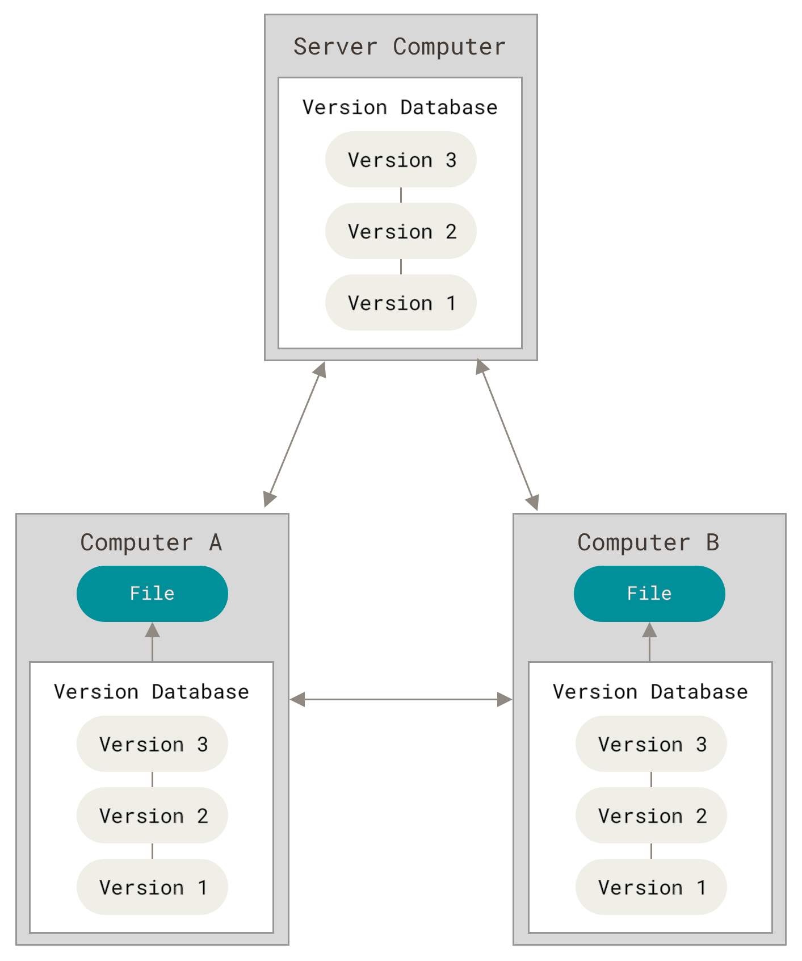
How does git work?
Git is an example of distributed version control
  The complete history of your project is stored locally on your computer
  Supports communication with remote servers
  If you use a server like GitHub, the complete history is available there after you sync with the server
  You can push your changes to the server
  You can pull changes from the server
  You can merge changes from several contributors
ProGit by Scott Chacon and Ben Straub

Slide 12
Git terminology
Repository
  A collection of folders and files managed by Git
  Git stores all information about history in a special folder .git (hidden folder)
  The .git folder is sometimes also called the repository
  Do not touch the .git folder!
Working directory
  Folder with files you work on
Cloning
  Copy an entire repository from a server to your computer
  Usually done once
  Automatically creates working directory with current version of project
Staging
  Tell Git which changes you want to register
Committing
  Tell Git to register (check in) changes in repository
  A commit refers to all changes registered simultaneously
  Each commit defines a version (also called snapshot)

Slide 13
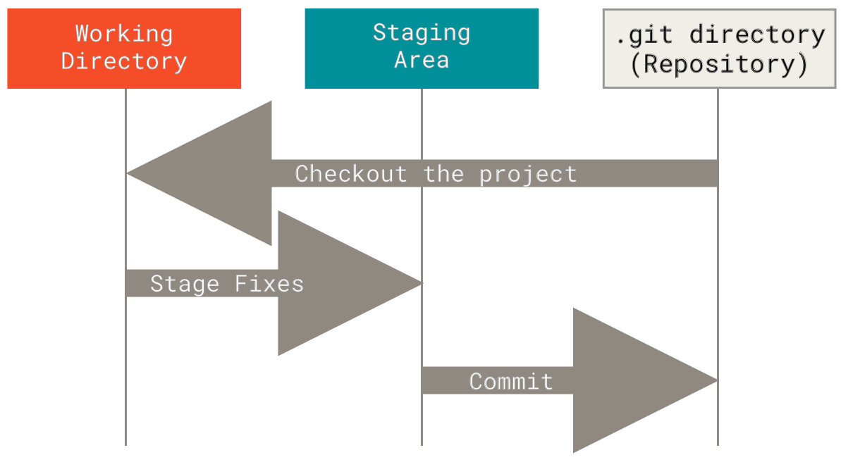
Basic Git workflow
Clone repository (only once)
Make changes to code
Stage changes: decide what to check-in
Commit changes: check-in and provide short message on changes made
Do this often and in small increments
ProGit by Scott Chacon and Ben Straub

Slide 14
Basic Git workflow
Clone repository (only once)
Make changes to code
Stage changes: decide what to check-in
Commit changes: check-in and provide short message on changes made
Do this often and in small increments
git clone
git add
git commit
ProGit by Scott Chacon and Ben Straub

Slide 15
What’s the deal with the staging area?
git add selects specific changes from your working directory and places them into the staging area.
git commit packages whatever is currently inside the staging area into a permanent record in the Git history log.
Having a separate staging area allows you to curate and inspect exactly which changes should be committed
ProGit by Scott Chacon and Ben Straub

Slide 16
What’s the deal with the staging area?
git add selects specific changes from your working directory and places them into the staging area.
git commit packages whatever is currently inside the staging area into a permanent record in the Git history log.
Having a separate staging area allows you to curate and inspect exactly which changes should be committed
If you have made several unrelated changes to your code, the staging area allows you to separate them into clean, logical commits
You can choose to leave experimental code, temporary print statements, or work-in-progress files out of a commit while still committing the clean parts that are ready
It gives you a checkpoint to review your work before locking it into history
Helpful during merge conflicts

Slide 17
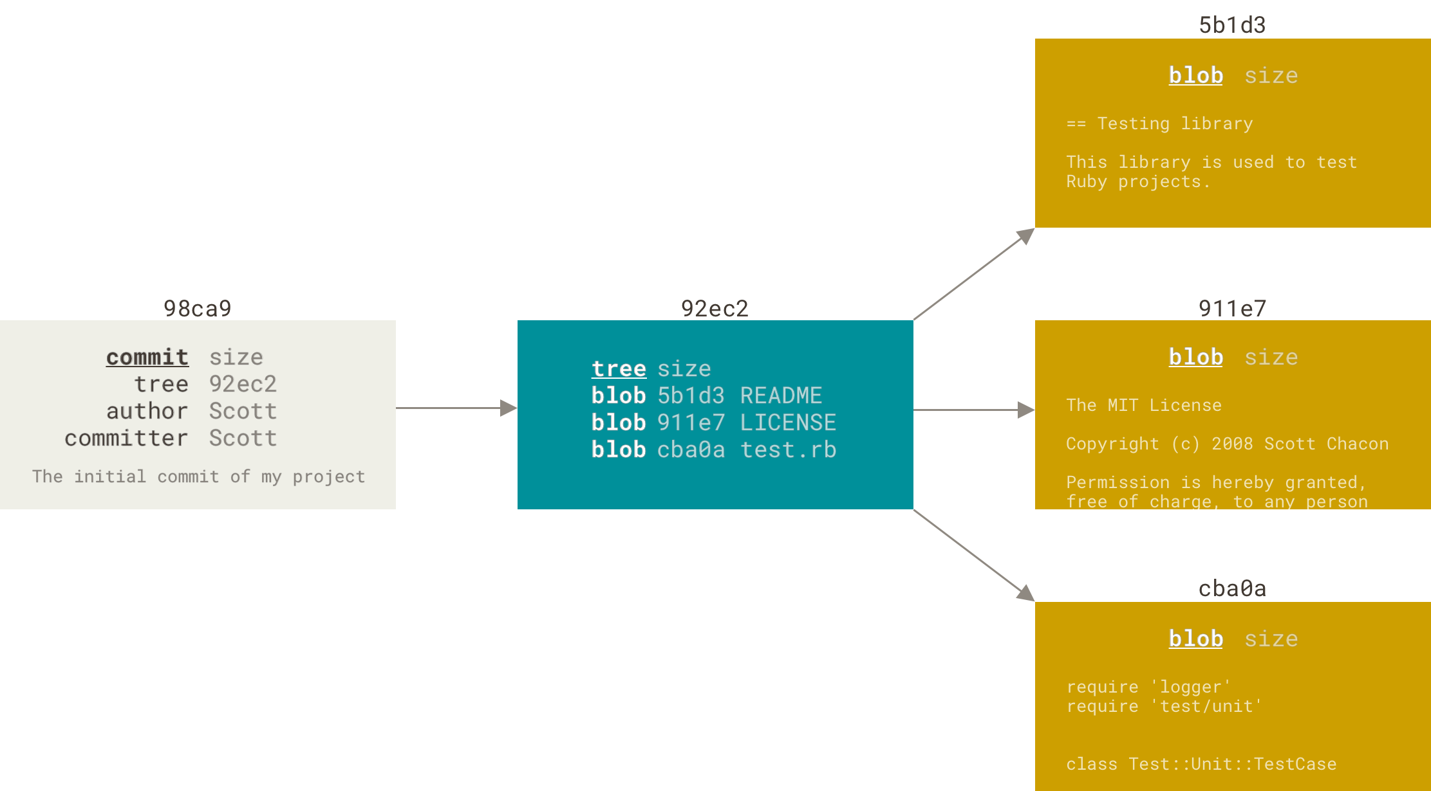
What is a commit?
ProGit by Scott Chacon and Ben Straub

Slide 18
What is a commit? Some more terminology…
Blob
  A localized change to a single file
  Multiple changes to a single file may be separate blobs if they are far enough from each other in the file
Tree
  Collection of all blobs in a commit
Hash
  A unique digital fingerprint of each blob, tree and commit
Commit
  Tree with all changes checked in with this commit
  Metadata
    Information about author
    Explanatory message about content of commit
    Hash of single parent or both parents (previous commit(s))
    Hash of commit itself
Git history as a blockchain
  By linking via hashes, Git builds a definite history
  One cannot change earlier commits without breaking the chain

Slide 19
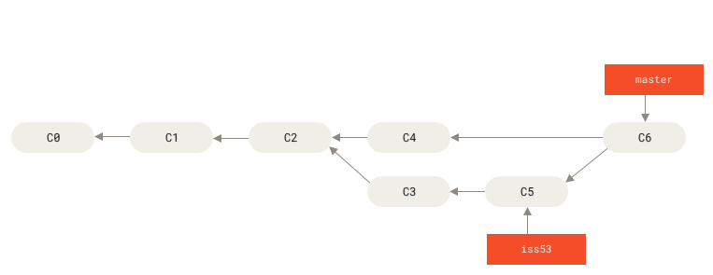
Braches are very useful
main
ProGit by Scott Chacon and Ben Straub

Slide 20
Braches are very useful
Extremely powerful feature to work on code in a controlled way
Changes made in a branch are kept separate from changes in other branches
  You can try out new things in a branch
  You can commit as many versions in a branch as you like
  If your new ideas work out, you can integrate them
  If they don't work out, you can just delete the branch
  You can share branches with others to collaborate
Special branch for "definite" version of project
  Historically called master, today usually called main
  Automatically created when you create a repository
  Changes from successful branches get integrated into main
ProGit by Scott Chacon and Ben Straub

Slide 21
More Git terminology
Branching
  Create a new branch
  E.g., to fix a bug or develop a new feature
  Usually want to ensure all changes are committed before creating a new branch
  Each branch is a pointer to a specific commit
Checking out
  Switching content of working directory between branches
  Usually want to ensure all changes are committed before checking out a different branch
  In newer versions of git there is more intuitive command called git switch
HEAD
  A pointer to the current branch (“You are here!”)
  Each new commit is added as a child of the commit HEAD points to
  Upon commit, the current branch pointer (HEAD) is moved to the new commit

Slide 22
More Git terminology
Merging
  Combine changes made on different branches
    from bug-fix branch into main
    merge new feature into main
    merge changes from remote server into your main
    merge changes from main into a branch to keep branch up-to-date
  Usually git handles necessary changes automatically
  If possible, git performs fast forward: changes from merged branch just put at head of current branch
  Otherwise, creates merge commit with two parents
Conflicts
  Sometimes, git cannot combine changes from two branches
  Usually if different changes to the same line of code
  Git flags a conflict
  Programmer must resolve conflict manually and then commit
  Note: Git can only detect conflicts in program text, not in program logic

Slide 23
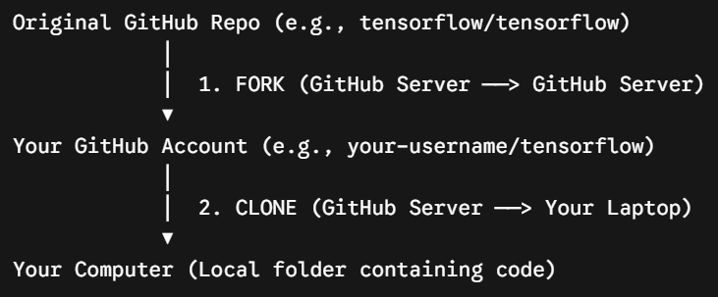
More Git terminology – Working with remote server
Git Server
  Any computer providing access to git repositories
  For example GitHub
Clone
  Copy repository from server to your machine
Fork
  Copy a repository, usually from a different user, on a server
  For example: Fork from another GitHub repository to your GitHub repository
  Not relevant for this course, but necessary if you want to contribute to a project

Slide 24
More Git terminology – Working with remote server
Git Server
  Any computer providing access to git repositories
  For example GitHub
Clone
  Copy repository from server to your machine
Fork
  Copy a repository, usually from a different user, on a server
  For example: Fork from another GitHub repository to your GitHub repository
  Not relevant for this course, but necessary if you want to contribute to a project
Remote
  A remote is a git server that you have told your local git repository about
  When you clone a project from a server, that server is automatically registered as the remote origin
Fetch
  Get information about all new changes available at a remote
  Does not change your working directory
Pull
  Merge changes from remote branch into your working directory
Push
  Send your commits to remote server
  Will fail if server has commits not yet in your history
  Need to pull first

Slide 25
Git commands – An overview
Setup and identity
Getting started
Daily local use
Syncing with remote (GitHub)
Inspecting changes
Branching
Safety and diagnosis

Slide 26
Git commands – An overview
Setup and identity
Getting started
Daily local use
Syncing with remote (GitHub)
Inspecting changes
Branching
Safety and diagnosis
The 5-command starter pack
git clone
git status
git add
git commit -m "..."
git push

Slide 27
Git commands – Setup and identity
Run once per machine
git config --global user.name "Your Name"
  Sets the author name attached to your commits.
git config --global user.email "email@example.com"
  Links local commits to your GitHub profile (must match your GitHub email).
git config --global init.defaultBranch main
  Ensures new local repositories start with main as the default branch name.

Slide 28
Git commands – Getting started
git clone <url>
  Downloads a repository from GitHub to your local machine.
git init
  Initializes a brand-new, empty Git repository in your current folder.

Slide 29
Git commands – Local daily use
git status
  Displays modified files, staged changes, and untracked files.
git add <file> (or git add .)
  Moves modified files into the staging area.
git commit -m "Descriptive message"
  Saves staged changes as a permanent snapshot in your local repository log.

Slide 30
Git commands – Syncing with remote (GitHub)
git push
  Uploads local commits to GitHub.
git pull
  Downloads and integrates changes from GitHub into your local branch.
  Combines git fetch (fetching new commits) and git merge (merge them into current branch)

Slide 31
Git commands – Inspecting changes
git log --oneline
  Displays a simplified, clean timeline of past commits.
git diff
  Shows line-by-line differences between your current code and the last commit.

Slide 32
Git commands – Branching
git switch -c <branch-name>
  Creates a new branch and immediately switches to it.
  More recently introduced command, use instead of git checkout
git switch <branch-name>
  Switches back and forth between existing branches (e.g., git switch main).
git merge <branch-name>
  Combines changes from the specified branch into your current active branch.

Slide 33
Git commands – Safety and diagnostics
git restore <file>
  Discards uncommitted local changes in a file, reverting it to the last saved commit.
git check-ignore -v <filepath>
  Shows why a file is being ignored by .gitignore rules.

Slide 34
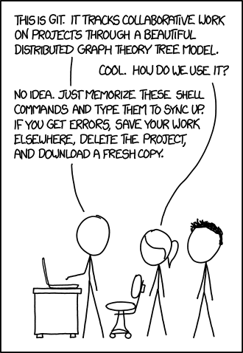
xkcd: Git

Slide 35
How do I get started?
In this week’s mandatory assignment, you will create your (first?) GitHub repository
VS Code allows you to manage your repositories well without having to memorise all the git commands
For the deliverables (two weeks projects starting next week) you will work in pairs and use version control
xkcd: Git

Slide 36
Setting up a GitHub repository
Easiest to create the repository on the web site and then clone it to your computer
Chose between a Public or Private repository
  When you hand in repos as part of an assignment, it must be public for us to be able to access it and grade your assignment
Include a README.md that explains what the repository is for
Include a .gitignore for files and directories that should not be tracked
  GitHub has a set of default .gitignore for different programming languages
  gitignore.io creates recommended .gitignore files for your specifications (for example: Python+VSCode+Windows)
We recommend starting a new repository for each new project
  Just as with virtual environments

Slide 37
A note on venv and git
The virtual environment is usually mentioned in .gitignore, and thus not tracked
  They are platform and OS dependent
  They include hard-coded paths
  The .venv directory is large and contains lots of files
  Potential security risk
Instead, include the recipe for your virtual environment
  Create requirements file in terminal using pip: python –m pip freeze > requirements.txt
  This writes all package name and versions to the file requirements.txt
  This file can be used to build an equivalent venv on another machine: python –m pip install -r requirements.txt

Slide 38
More about collaborative workflows next week…

Slide 39
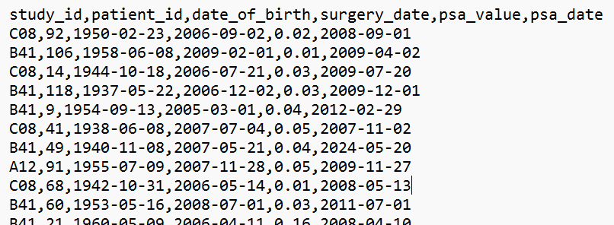
Common file formats
CSV (comma-separated value) files (.csv)
  Very common format for storing data
  Note: There should be no space around the commas separating the values
  Note: Can use other separators than comma (semicolon, space, tab)
Excel (and similar spreadsheets) (.xls, .xlsx, .ods)
  pandas is a very useful library for working with spreadsheet style data
Json (JavaScript Object Notation) (.json)
  Much used for data exchange between client and server applications
  Example: Jupyter Notebooks are JSON files (.ipynb)
  Looks a lot like Python lists and dictionaries
  The complete JSON grammar is described here: JSON

Slide 40
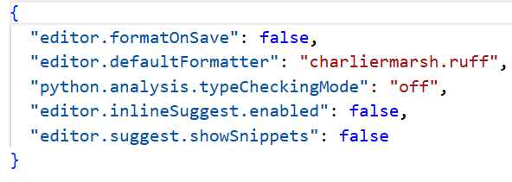
Common file formats
CSV (comma-separated value) files (.csv)
  Very common format for storing data
  Note: There should be no space around the commas separating the values
  Note: Can use other separators than comma (semicolon, space, tab)
Excel (and similar spreadsheets) (.xls, .xlsx, .ods)
  pandas is a very useful library for working with spreadsheet style data
Json (JavaScript Object Notation) (.json)
  Much used for data exchange between client and server applications
  Example: Jupyter Notebooks are JSON files (.ipynb)
  Looks a lot like Python lists and dictionaries
  The complete JSON grammar is described here: JSON

Slide 41
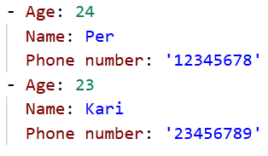
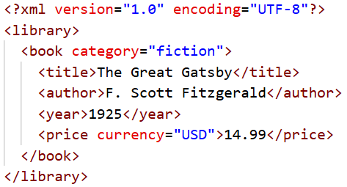
Common file formats
YAML (YAML ain't Markup Language) (.yml)
  Much used for configuration files
  Can be used to store data in general
  Has a similar indented block structure as Python code
  Very human-readable (and human-writable) format
  See also YAML Ain’t Markup Language (YAML™) Version 1.2 and pyyaml.org/wiki/PyYAMLDocumentation
XML (Extensible Markup Language) (.xml)
  Has been around for a long time, related to HTML
  Very powerful
  Verbose and complex and used less in data science contexts today
  We will not look at reading it here

Slide 42
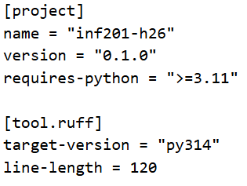
Common file formats
TOML (Tom's Obvious, Minimal Language, originally: Tom's Own Markup Language) (.toml)
  Much used for configuration files
  In Python we often include a pyproject.toml
  Designed to be easy to read and write

