Slide 1
Trainee Selection System
MD. Ariful Islam
Id-30076

Slide 2
Project Summary
Project Name: Trainee Selection System (TSS)
Project Purpose: The Trainee Selection System (TSS) is a web-based application developed to streamline the process of selecting trainees for various job positions at BJIT. The system aims to automate the entire trainee selection process, making it more efficient, transparent, and user-friendly for both applicants and administrators.
Key Objectives:
Simplify the application process for trainee selection.
Provide an intuitive and user-friendly interface for applicants and administrators.
Enhance the efficiency of the evaluation and selection processes.
Ensure the security and confidentiality of applicant information.
Target Audience: The system is designed for BJIT Academy and Applicants..
Expected Benefits: The TSS will significantly reduce the time and effort involved in the trainee selection process, improve the quality of selection, and provide a better experience for all stakeholders.

Slide 3
Feature List:
Applicants Registration:
Applicants can register by providing personal information such as first name, last name, gender, date of birth, a valid Gmail account, and a contact number.
Educational details like degree name, educational institute, CGPA, and passing year are required during registration.
The system allows applicants to upload their photo and CV/resume.
Apply for the Desired Circular:
Registered applicants can browse and apply for different job circulars based on their preferences.
After reviewing the available job posts, applicants can apply for the desired circular.
Approval of Applicants:
Admins can view all applicant information and sort it based on job post, gender, degree name, educational institute, CGPA, and passing year.
Admins can mark applicants as Approved for Interview for specific job circulars.
Admit Card Generation:
The system automatically generates unique admit cards for selected applicants.
Admit cards include a serial number and QR code for personal identification.

Slide 4
Feature List:
5. Track Participants in the Exams (Hidden Code on Copies):
The system generates a unique code for each participant's answer sheet during the written exam.
The unique code is stored for future reference.
6. Upload the marks of the Participants:
Assigned evaluators can upload marks for each candidate based on different evaluation categories.
7. Internal Mailing System to Send Necessary Emails:
The system integrates a mailing service to send emails to applicants regarding their application status, interview invitations, and exam results.

Slide 5
Feature List:
8. Applicant Dashboard, Notice Board: Applicants have access to a dashboard to view their application status and notices.The notice board displays updates on interview invitations, exam results, etc.
9. Upload Marks and Prepare Results:
BJIT admins can upload marks for the technical viva and HR viva rounds.
10. Select the Final Trainees List: A dashboard or page allows BJIT admins to view the final candidates for a specific job circular in a rank list format, sorted according to their scores.

Slide 6
Technologies/Tools:
The Trainee Selection System (TSS) is developed using the following technologies and tools:
Programming Languages:
Java: For backend development and data processing.
HTML, CSS, and JavaScript: For front-end user interface and interactivity.
Web Framework:
Java: Spring Boot
JavaScript: React.js
CSS: Bootstrap,Material-UI (Mui)
Database Management System:
MySQL: A powerful and reliable open-source relational database.
Version Control:
Git: For version control and collaboration among developers.

Slide 7
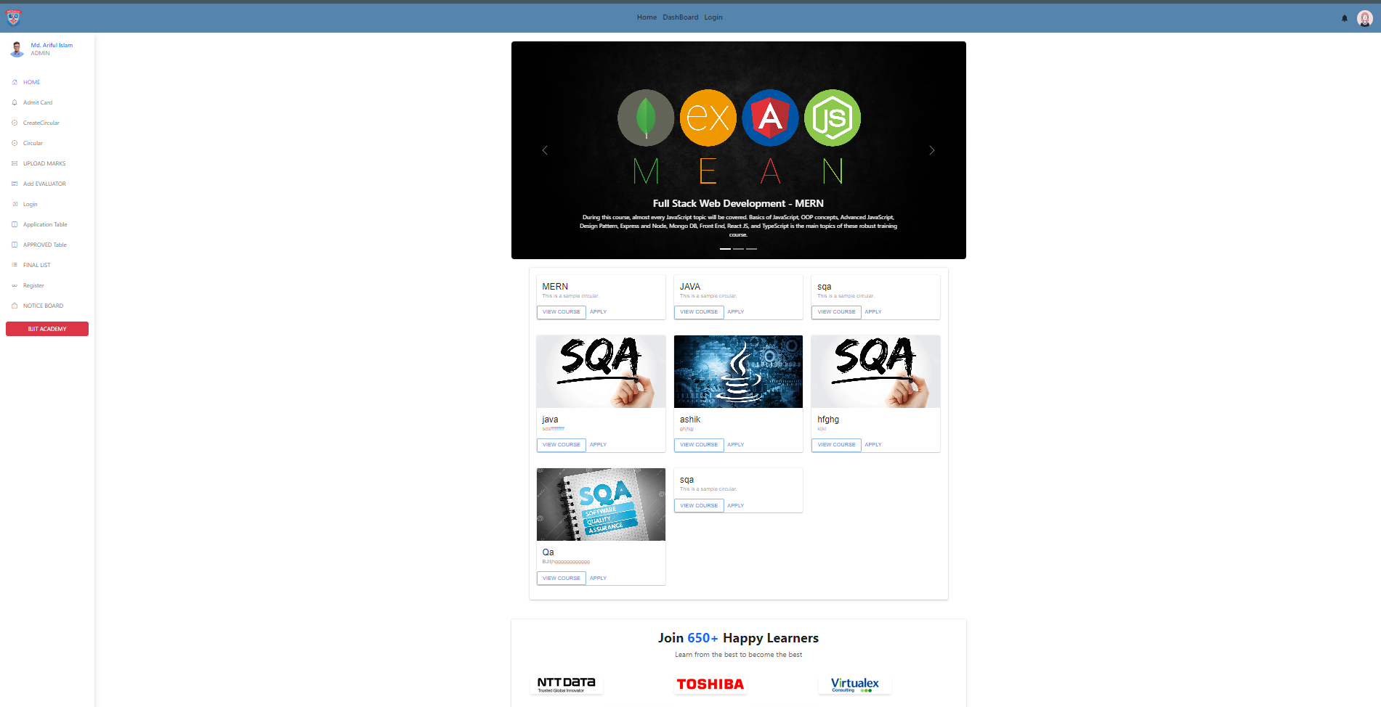
Home Page

Slide 8
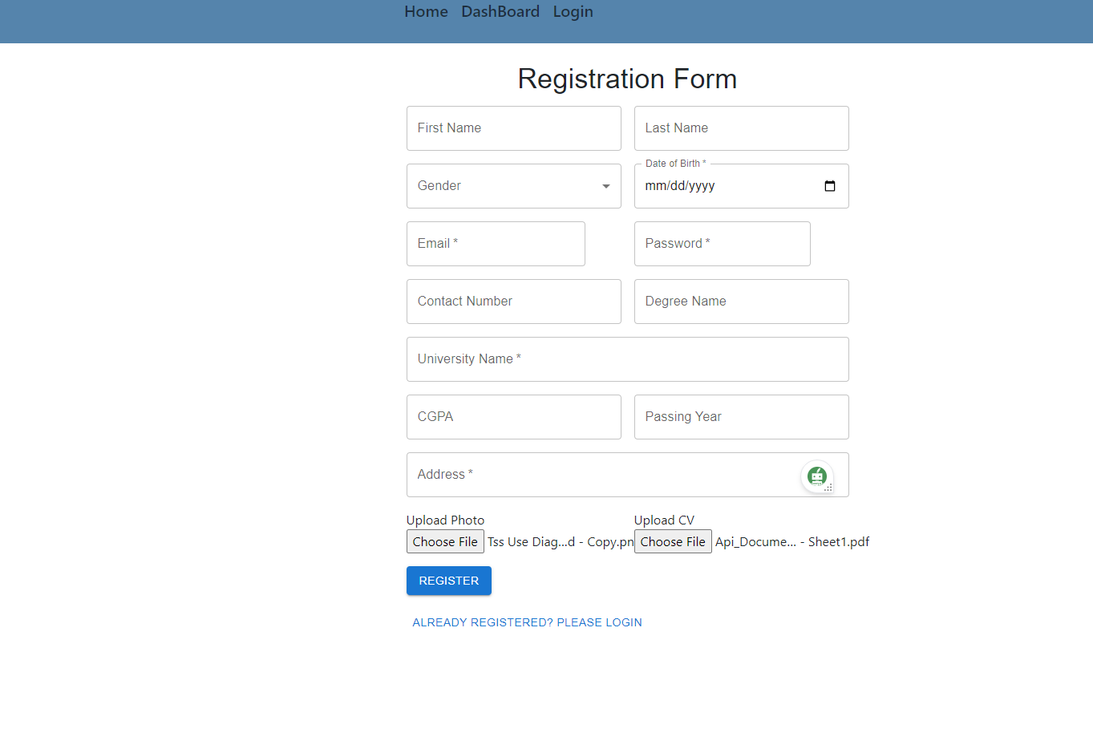
Registration From

Slide 9
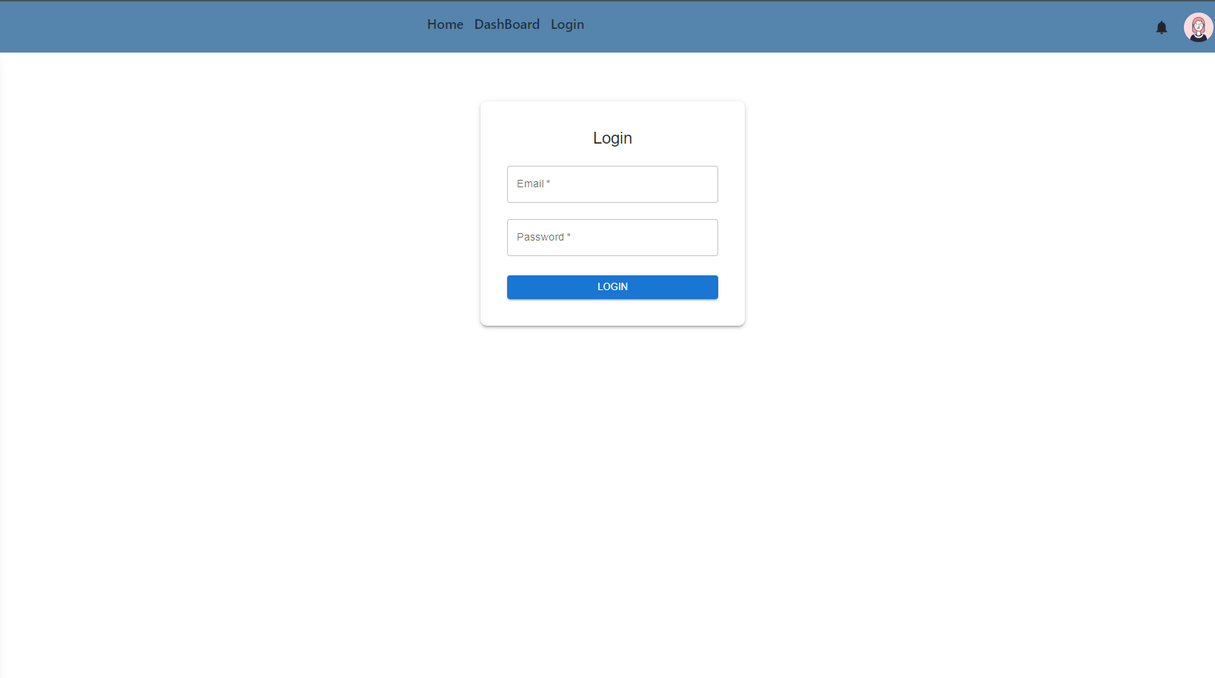
Login Page

Slide 10
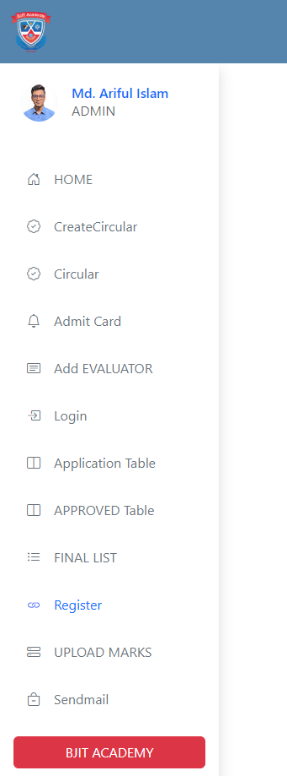
Side Bar

Slide 11
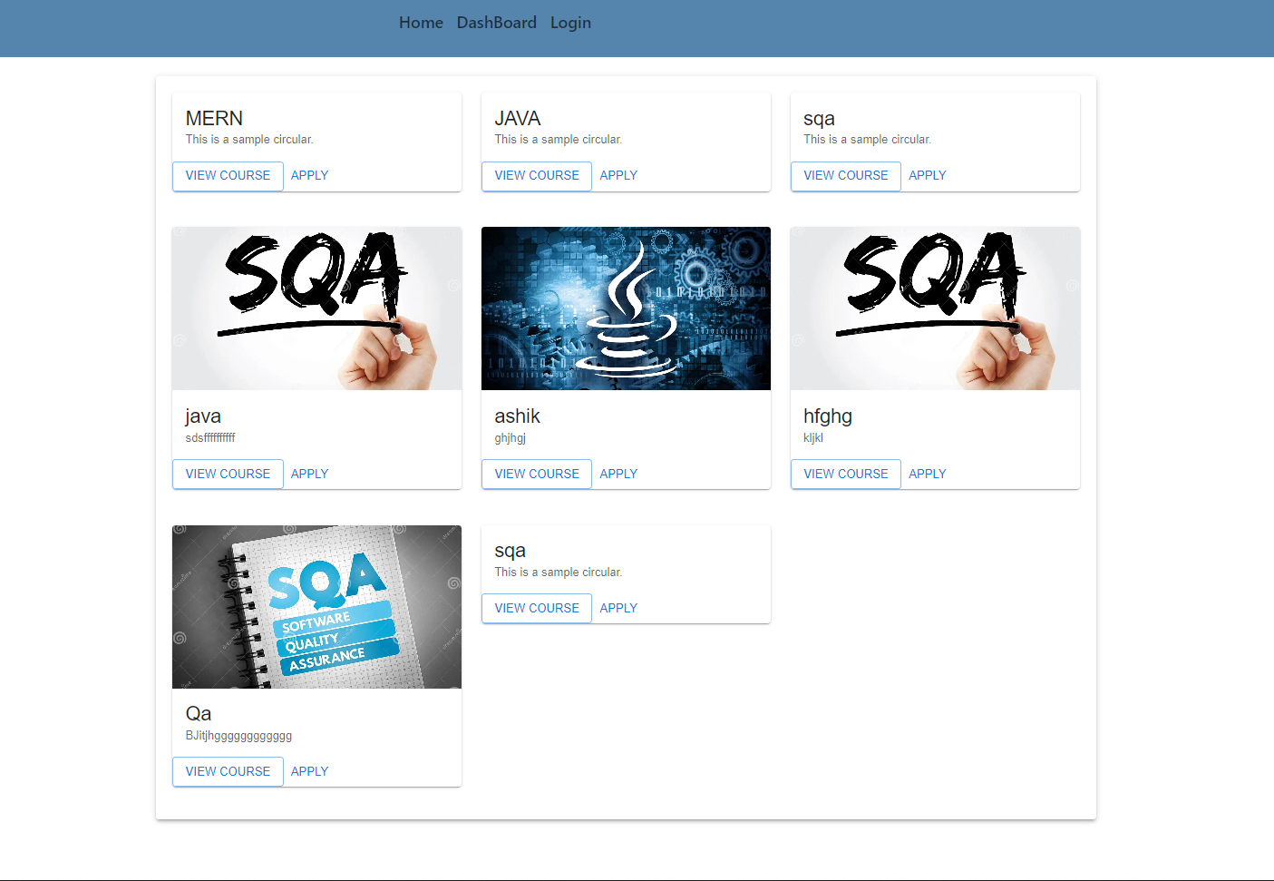
Circular Page

Slide 12
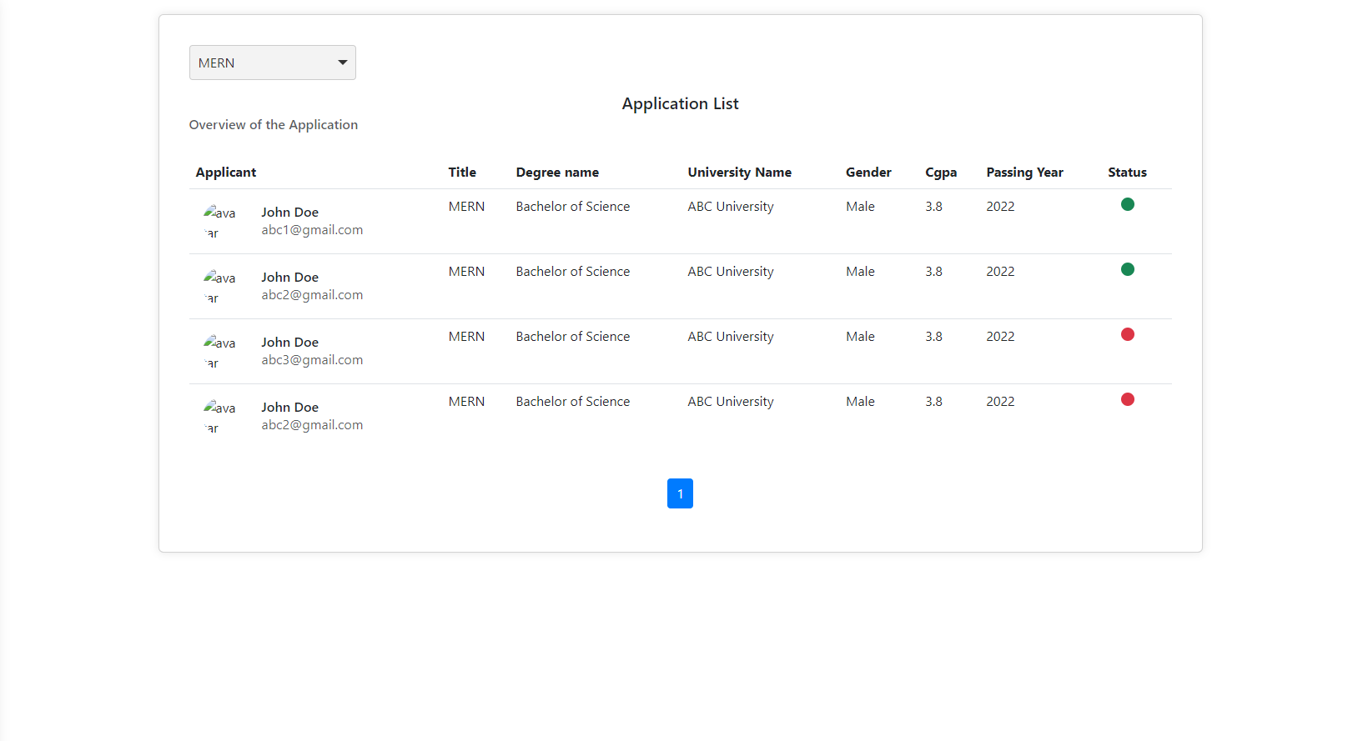
Application Page

Slide 13
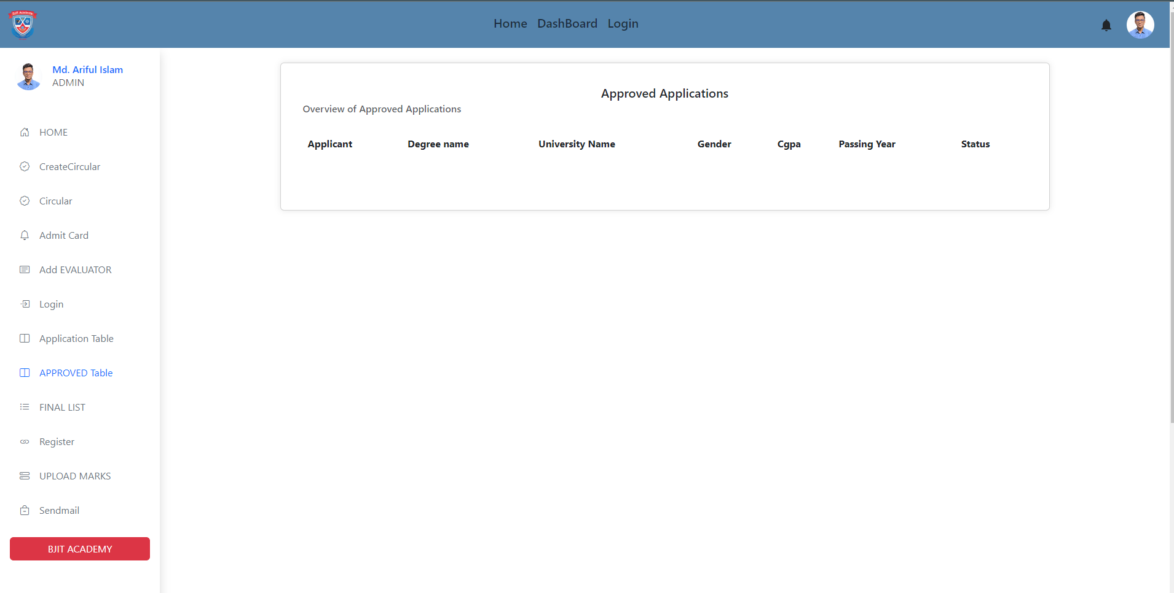
Approved Page

Slide 14
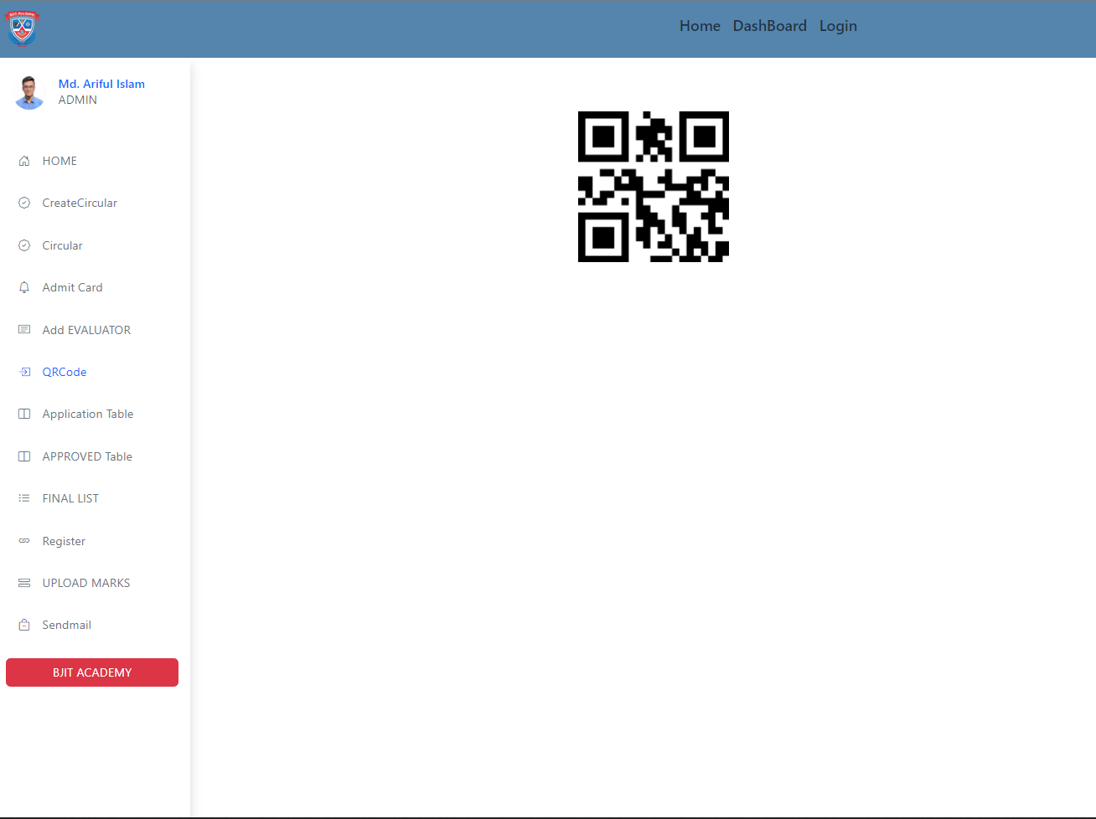
QR Code
The "QRCodeGeneratorAndScanner" component allows users to generate QR codes based on entered data and scan QR codes using the camera preview. It combines "qrcode.react" and "react-qr-reader" libraries for functionality..

Slide 15
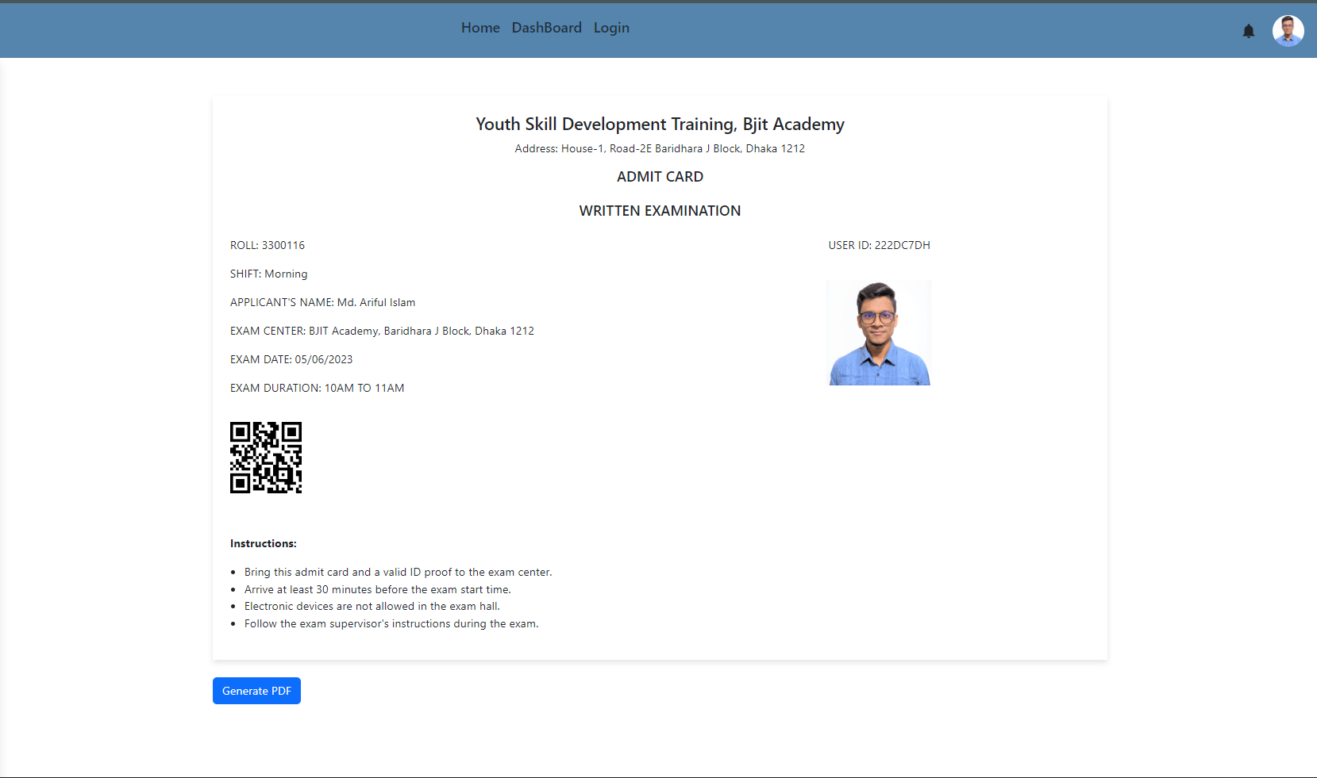
Admit Card Page
Install the required dependencies by running: npm install react react-bootstrap jspdf html2canvas qrcode.react
The "AdmitCard" component generates an admit card with exam details and a QR code. Clicking the "Generate PDF" button creates a downloadable PDF of the admit card.

Slide 16
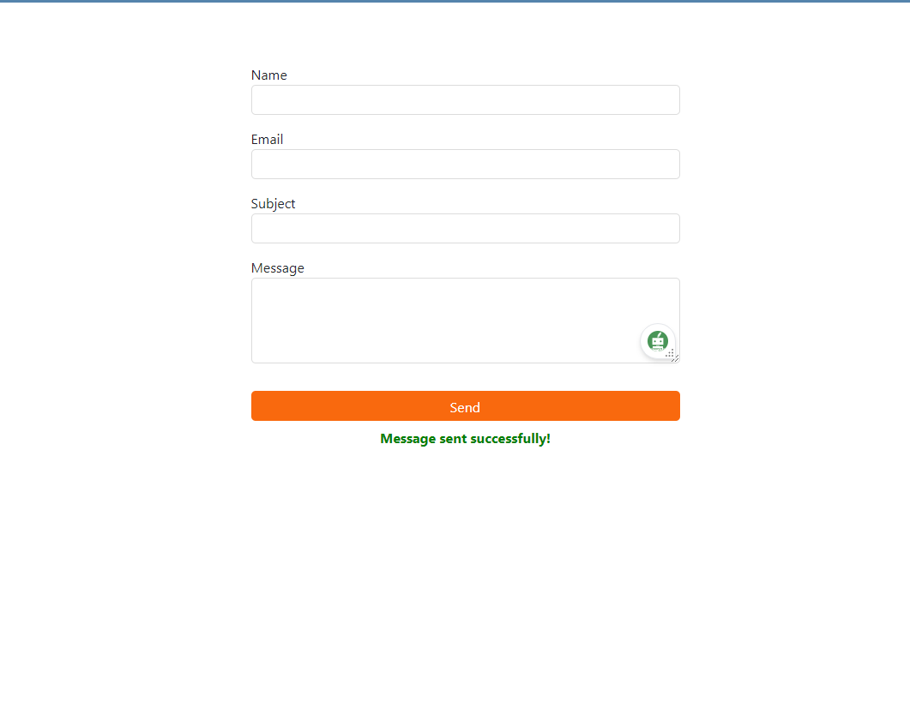
Email Sending Page
To use this code, import the component into your React application, render it, and fill out the form. Upon submission, the email will be sent using emailjs.

Slide 17
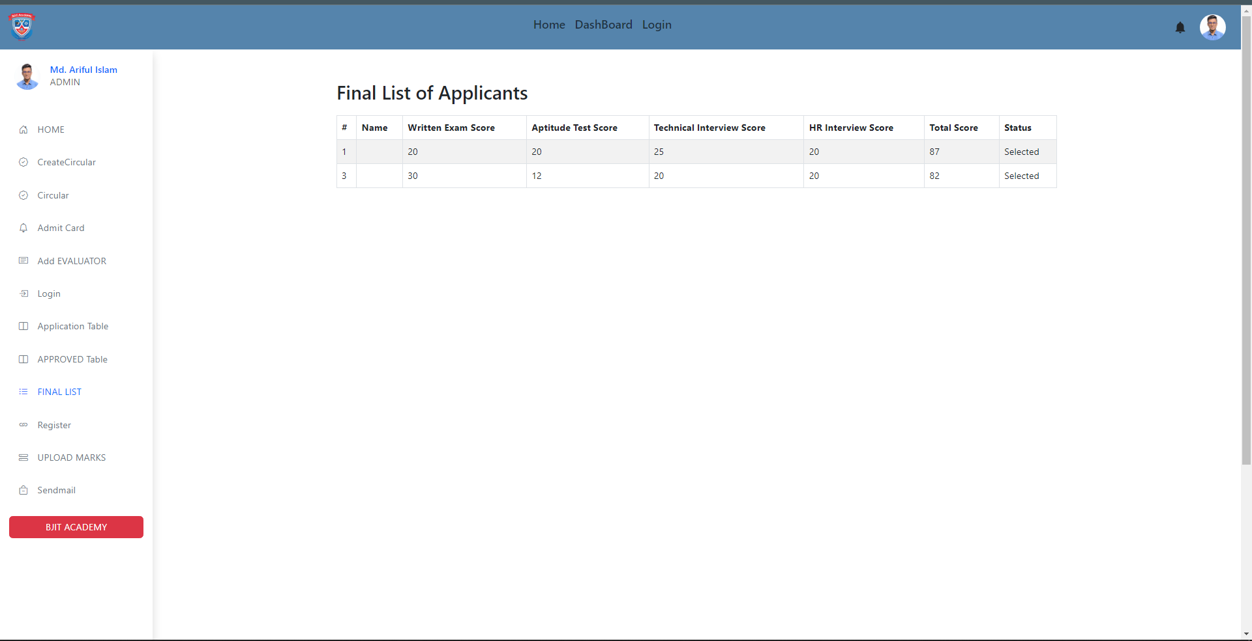
Final List Page

Slide 18
Learnings from this Project:
During the development of the Trainee Selection System (TSS), several valuable lessons were learned, including:
Understanding the Importance of User Experience: The project highlighted the significance of providing a user-friendly interface for applicants and administrators. User experience plays a critical role in the success and adoption of the system.
Insights into Selection Processes: Developing the TSS provided insights into the complexities of the Selection processes involved in candidate selection, evaluation, and final decision-making.
Security Considerations: Handling sensitive applicant data required a deep understanding of data security and encryption practices to ensure data confidentiality and integrity.
Project Management: Managing the development process, coordinating with team members, and adhering to project timelines were crucial aspects of successful project delivery.

Slide 19
Challenges and how to solve those:
The development of the Trainee Selection System (TSS) encountered several challenges, along with their corresponding solutions:
Data Security and Privacy: Ensuring data security and safeguarding applicant privacy required the implementation of spring security and access controls.
Scalability: To handle an increasing number of applicants and job circulars, the system architecture was designed for scalability using technologies like containerization and cloud hosting.
User Training: Providing training to users on how to use the system effectively was addressed through comprehensive user documentation and user training sessions.
Integration with Existing Systems: Integrating the TSS with existing HR management systems was achieved through well-defined APIs and data exchange formats.
User Feedback Incorporation: Regularly collecting user feedback and incorporating necessary changes was essential to enhancing the system based on user needs and preferences.

Slide 20
Enhancement Proposal - Future Features:
The Trainee Selection System (TSS) can be further enhanced by adding the following features in the future:
Automated Interview Scheduling: Integrate a scheduling system to automate the interview process, allowing applicants to select their preferred interview slots.
Automated Skill Assessment: Implement automated skill assessment tools to evaluate applicants' technical capabilities and knowledge.
Applicant Analytics: Provide analytics and insights to administrators on applicant demographics, qualifications, and performance in different stages of the selection process.Social Media Integration:Allow applicants to use social media profiles for quick registration and authentication, making the process more convenient.
Applicant Analytics: Provide analytics and insights to administrators on applicant demographics, qualifications, and performance in different stages of the selection process.
AI-driven Candidate Matching:Utilize artificial intelligence (AI) algorithms to match applicant skills and qualifications with job requirements for better candidate selection.

Slide 21
Thank You

