Slide 1
Evaluation Management System (EMS)

Slide 2
Ohayo Gozaimasu
Arif Akmal
30057(J2EE)
Bjit Academy

Slide 3
~ Background ~ Why EMS ~ Stakeholders

Slide 4
~ How EMS helps
~ Dependencies
~ Major Features
~ Sensitive Support

Slide 5
~ Technology For Backend
~ Technology For Frontend
~ Database
~ Supporting Tools

Slide 6
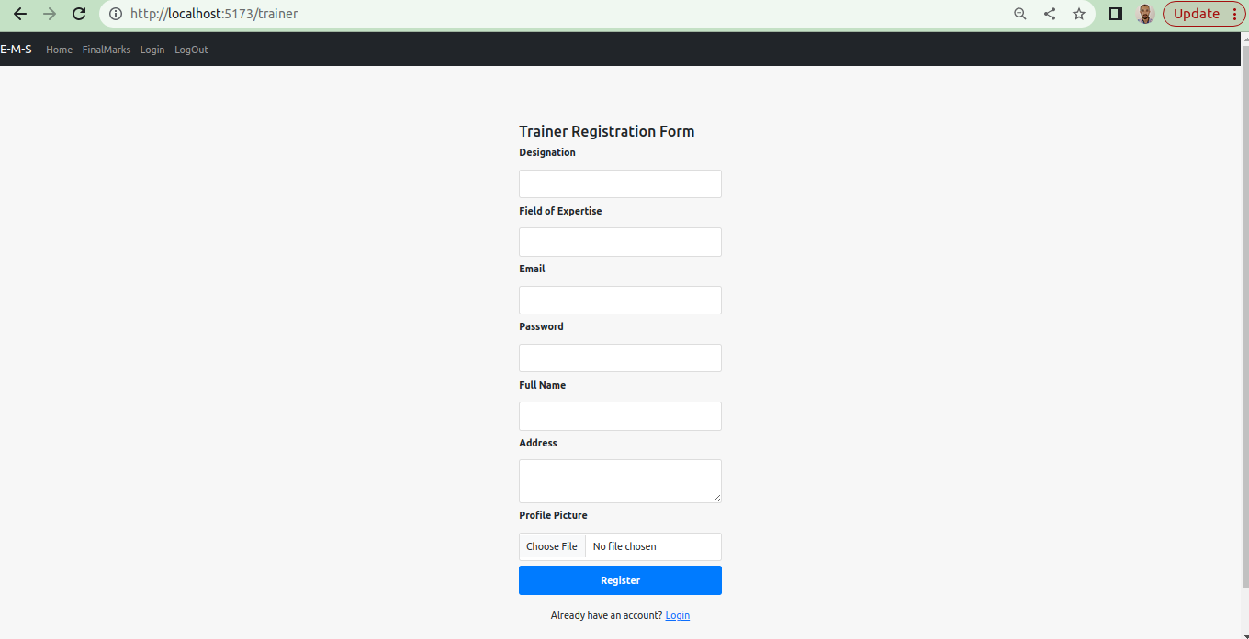

Slide 7
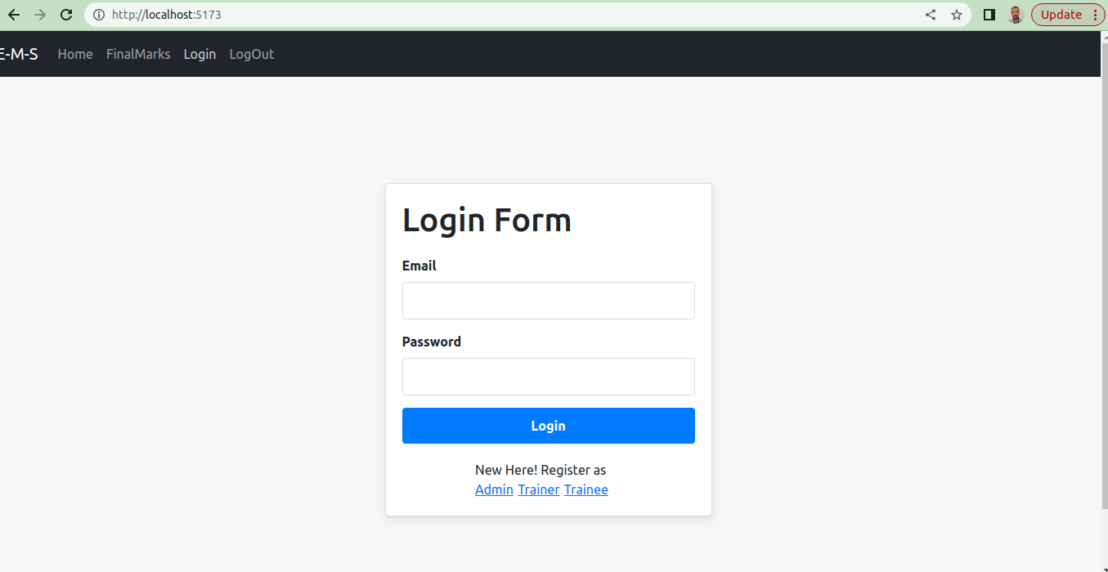
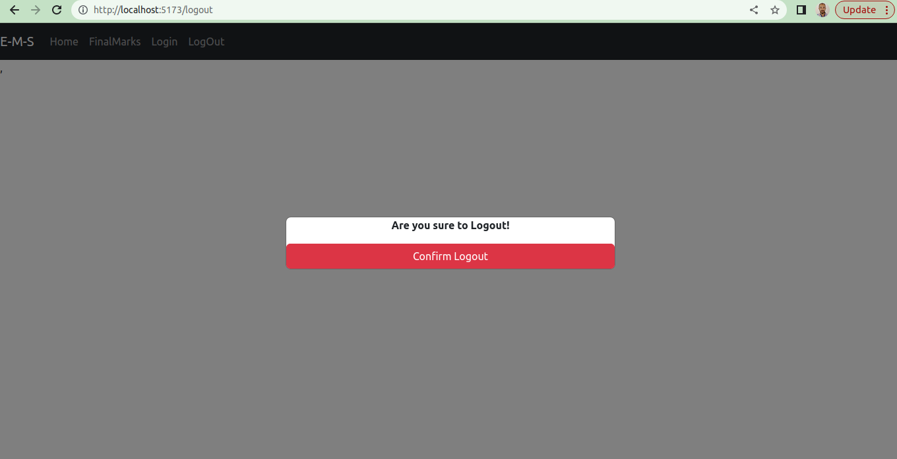

Slide 8
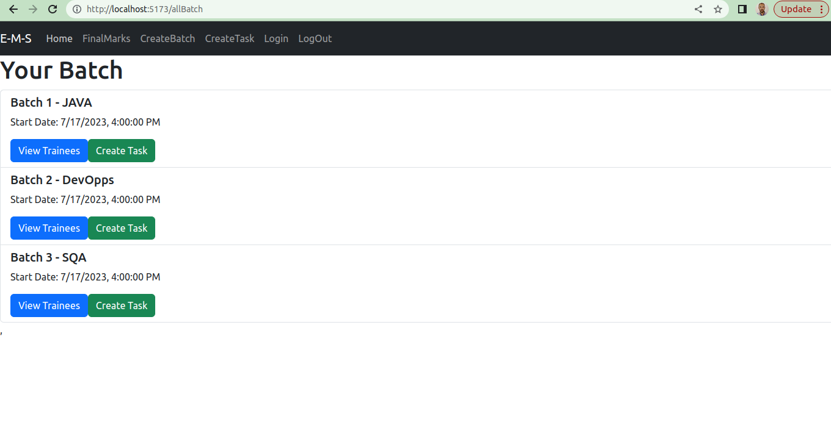
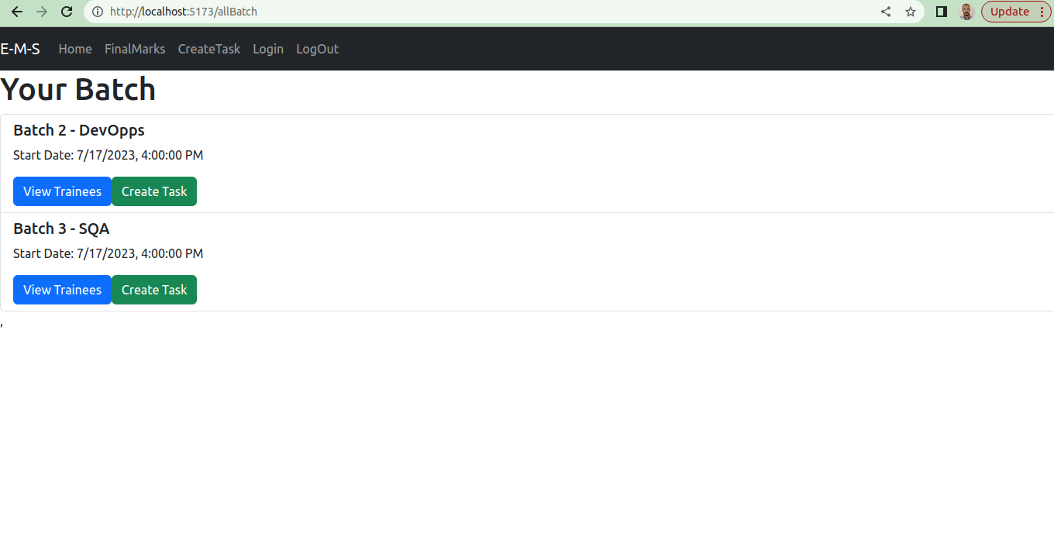
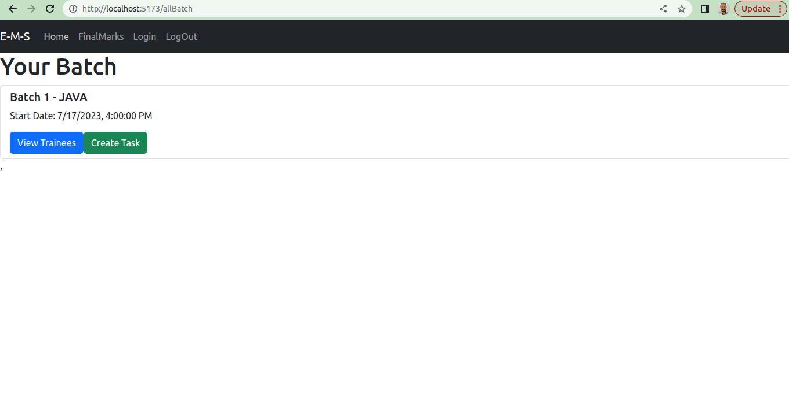

Slide 9
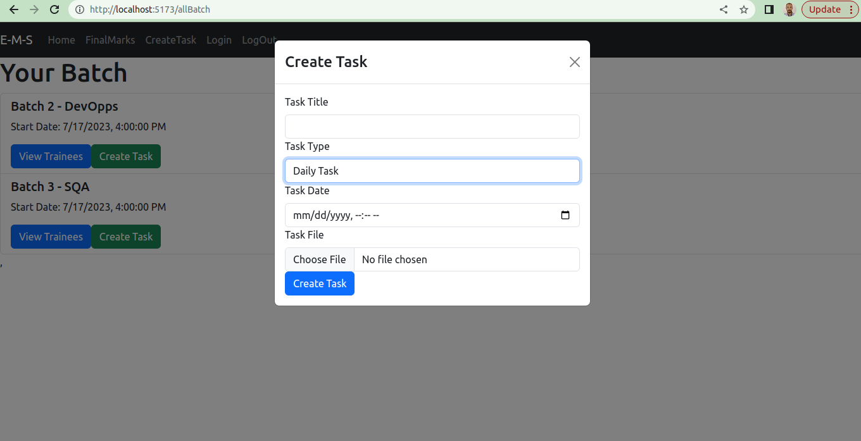

Slide 10
~ Learnings
Design Database
Integration
Scenario Analysis
Real life problem solving

Slide 11
~ Challenges
File Handling
Criteria Variations
Handling Security
Large Scale Production

Slide 12
~ Scope of Advancement
Analytical Response (Graph)
Regular Notification
Performance Analysis (ML)

Slide 13
Thank You

