Slide 1
EMS
Sajal Halder : 30061
Evaluation Management System

Slide 2
Table of Contents
1
2
3
4
Project Summary
Feature List
Technologies/Tools
5
Challenges
Learnings
6
Enhancements

Slide 3
EMS
EMS is an Evaluation Management System that streamlines Trainee tasks, tracking trainees' progress and trainers' roles effectively. It optimizes employee development and training processes, enhancing overall organizational efficiency.

Slide 4
Features
Evaluation
Security
Centralized Storage
Task and Evalution and Automated Final Score generation
Role based Authorization
All information in stored in databse for future needs

Slide 5
Technologies/Tools
Spring Boot
Flutter
01
02
Back End
Front End
MySQL
Redis
03
04
Database
Caching

Slide 6
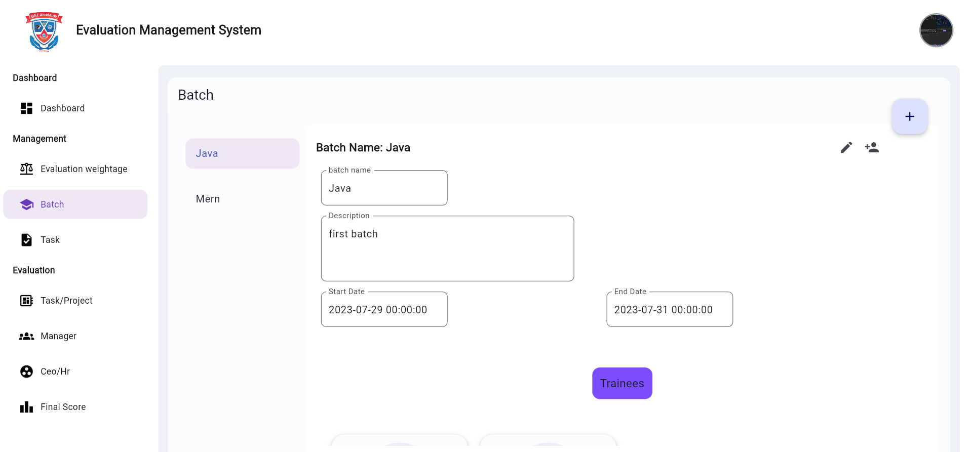
Batch Managent

Slide 7
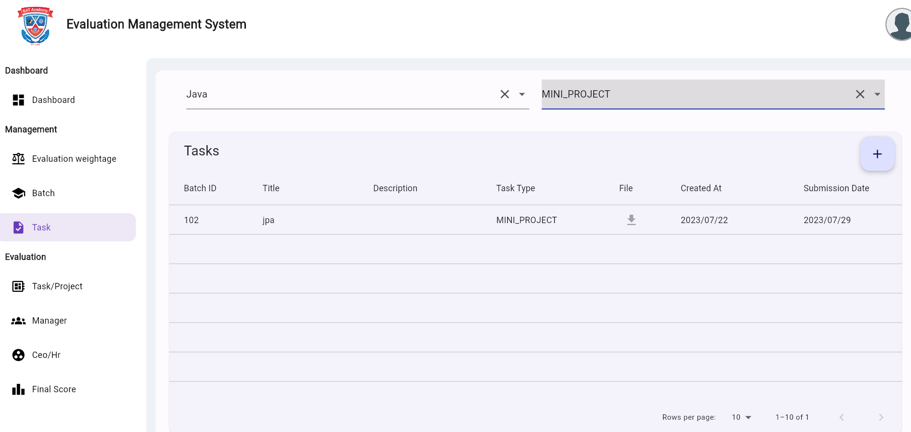
Evaluation

Slide 8
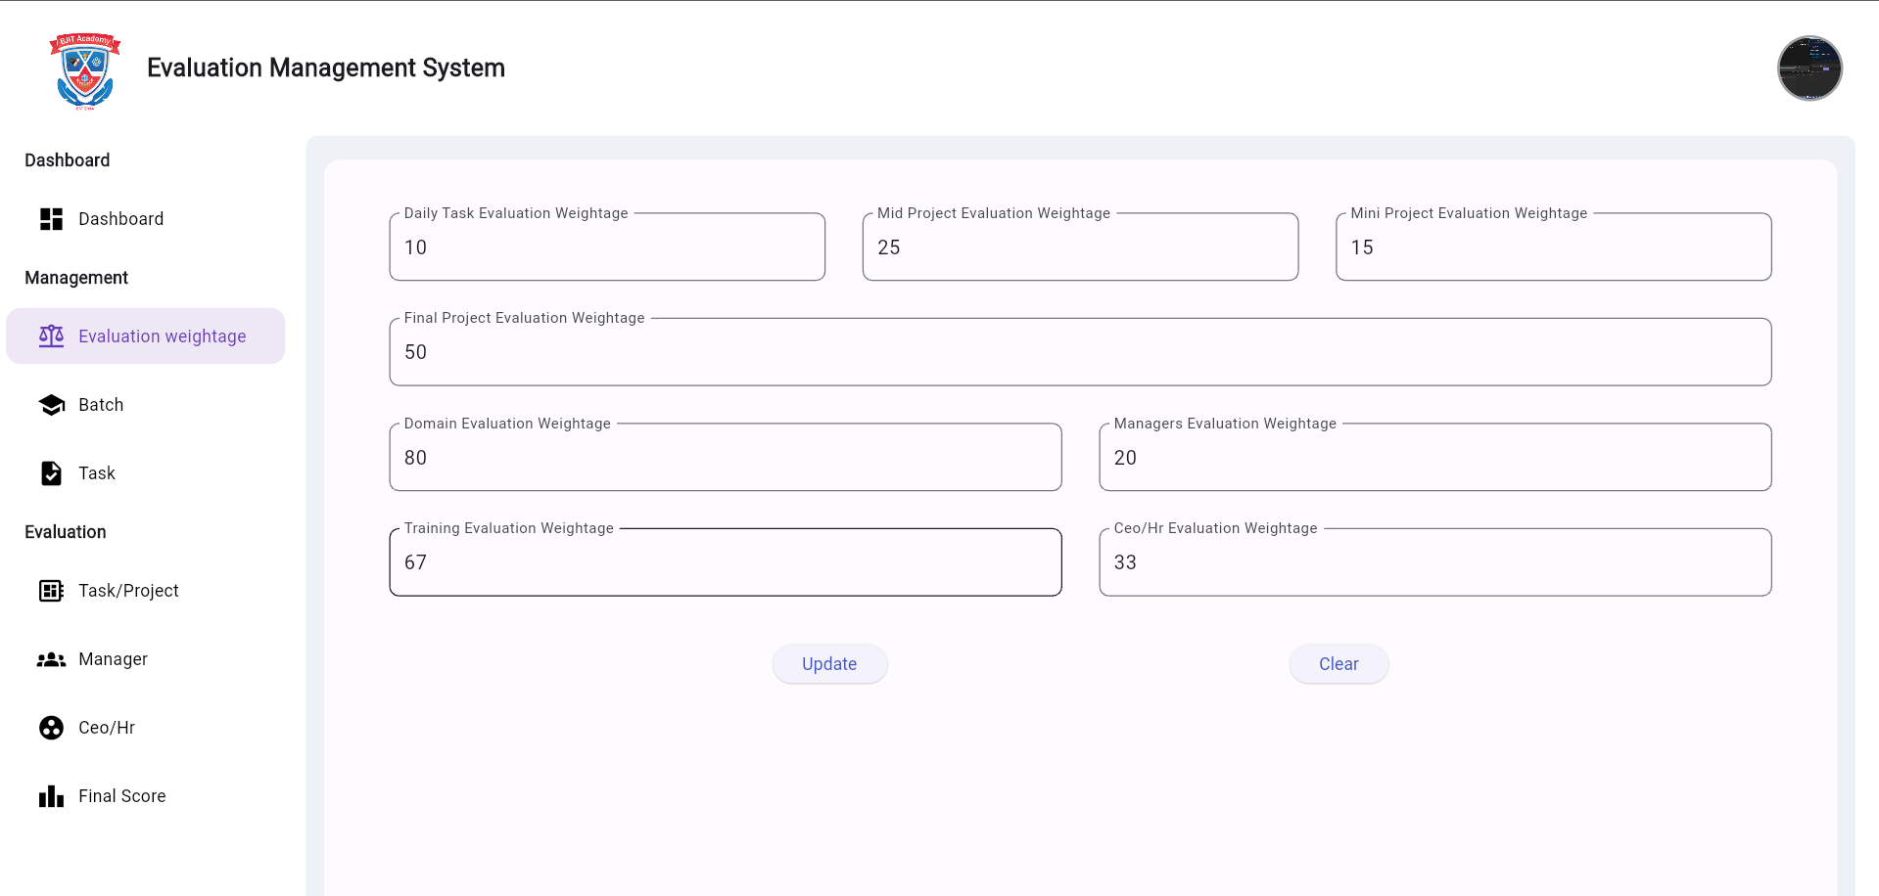
Weightage

Slide 9
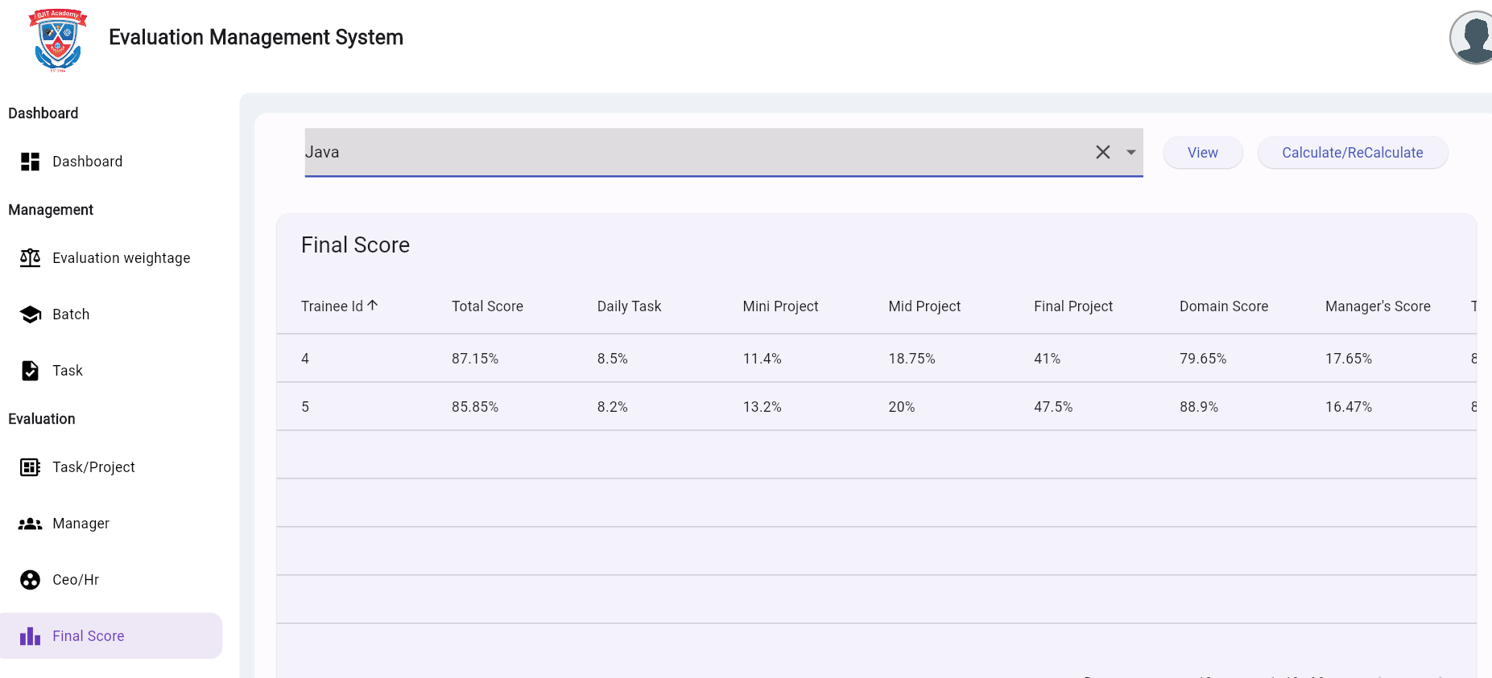
Final score Generation

Slide 10
Learnings
Spring Boot Proficiency
Web Development
Database Integration
Security and Authentication
Project Management
Testing and Debugging
Software Design Patterns
User Experience (UX)
Documentation

Slide 11
Challenges
Task Complexity and Diversity
Complex Score Calculation
User Experience and Interface Design!

Slide 12
Enhancement Proposal
Advanced Task Customization
Integration with External Evaluation Tools
Advanced Analytics and Reporting
Automated Task Reminders

Slide 13
Thanks!
Do you have any questions?
Sajal Halder
Please keep this slide for attribution

