Slide 1
Trainee Selection System
Project work by
Md. Mohidul Islam
ID: 30064
YOUTH SKILL DEVELOPMENT, J2EE 2nd Batch, BJIT Academy

Slide 2
Project Summary
The Trainee Selection System (TSS ) is a web application built using the Spring Boot framework for the backend and ReactJS for the front end. This system aims to automate the trainee selection process for BJIT Academy.
Applicant can apply, see notifications, get emails and admit card,
Evaluator can upload marks
Admin can handle the system.
The integration of Spring Boot and ReactJS empowers the platform with robust backend functionalities and a responsive, interactive user interface.

Slide 3
Feature List
Applicant Registration:
Register new applicants with personal details (first name, last name, gender, date of birth).
Capture contact information (valid G-mail account, contact number).
Record educational background (degree name, educational institute, CGPA, passing year).
Allow applicants to upload their photo and CV/resume.

Slide 4
Feature List
Training Circular Management:
Admin panel to create and manage training circulars.
Display open training circulars for applicants to apply.
Specify job requirements and qualifications for each circular.
Application Submission:
Applicants can apply for desired training circulars through the portal.
Allow applicants to submit their applications electronically.

Slide 5
Feature List
Approval of Applicants:
Admins can review applicant data and mark them as "APPROVED FOR INTERVIEW" for specific job circulars.
Filter and sort applicants based on job post, gender, degree, CGPA, and passing year.
Admit Card Generation:
Automatically generate unique admit cards for approved applicants.
Admit cards contain a serial number, QR code, and essential identification information.

Slide 6
Feature List
Tracking Participants:
Assign unique identification codes to answer sheets during written exams.
Store codes for future reference to track participants.
Evaluator's Mark Upload:
Evaluators can upload marks based on predefined categories for written exams and interviews.

Slide 7
Feature List
Internal Mailing System:
Integrated mailing service for communication with applicants.
Send automated emails to inform applicants of their application status and updates.
Applicant Dashboard & Notice Board:
Applicants have access to a personalized dashboard to view application status.
Display notifications on the notice board.

Slide 8
Feature List
Result Preparation:
Admins can securely upload marks for technical viva and HR viva rounds.
Calculate final scores based on the evaluation criteria.

Slide 9
Technologies & Tools
Back-End Framework: Spring boot
Testing: Mockito
Front-End Framework: React JS
Version controll system: Github
Project management tool: Redmine
Documentation: Microsoft Word, Excel, Lucidchart, draw.io

Slide 10
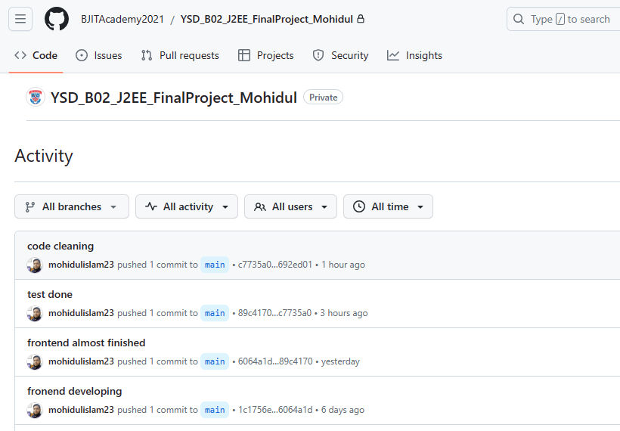
Github Activity

Slide 11
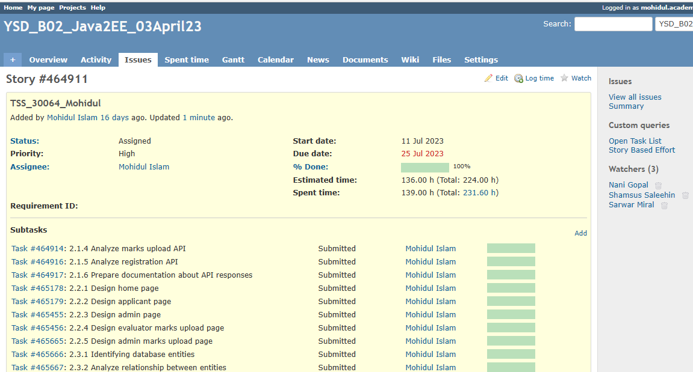
Redmine Activity

Slide 12
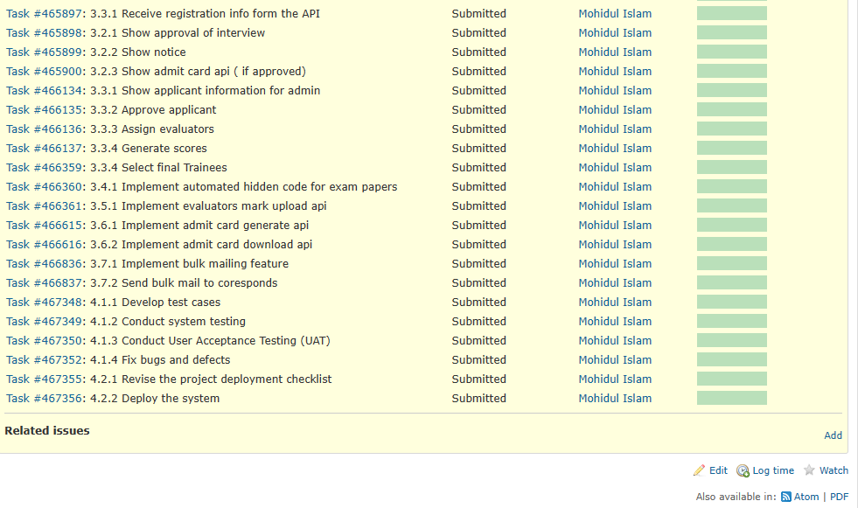
Redmine Activity

Slide 13
Screenshots of the UI

Slide 14
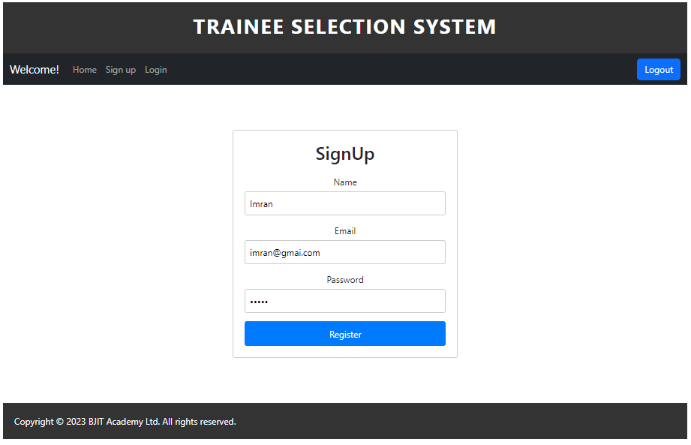
Register Page

Slide 15
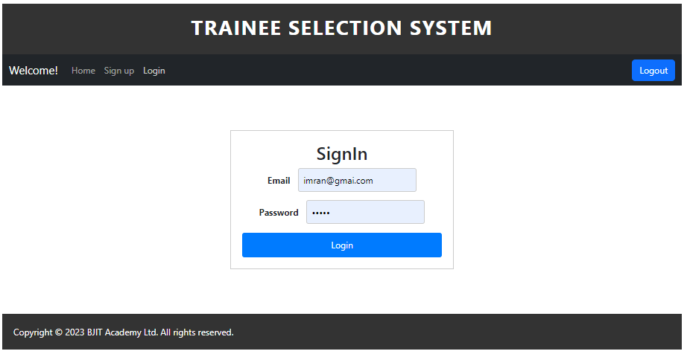
Login page

Slide 16
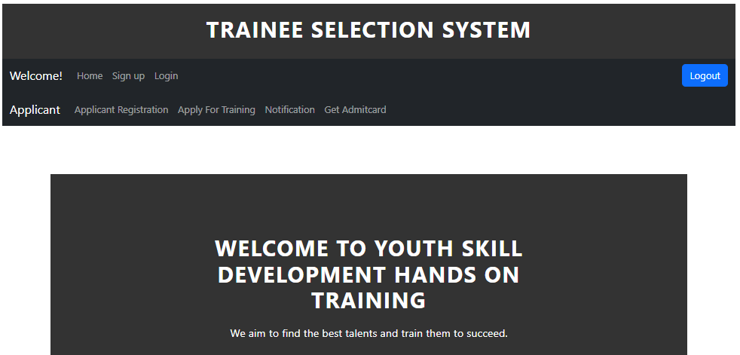
Applicant Dashboard

Slide 17
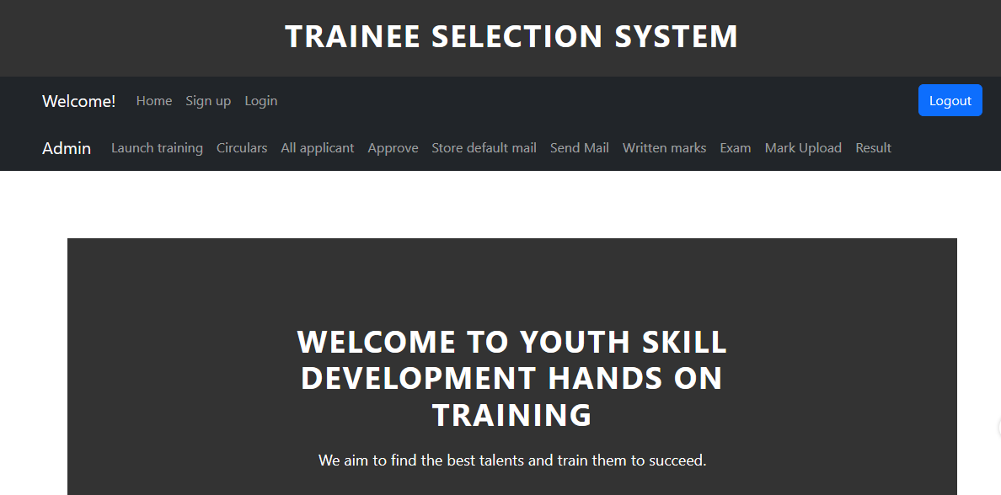
Admin Dashboard

Slide 18
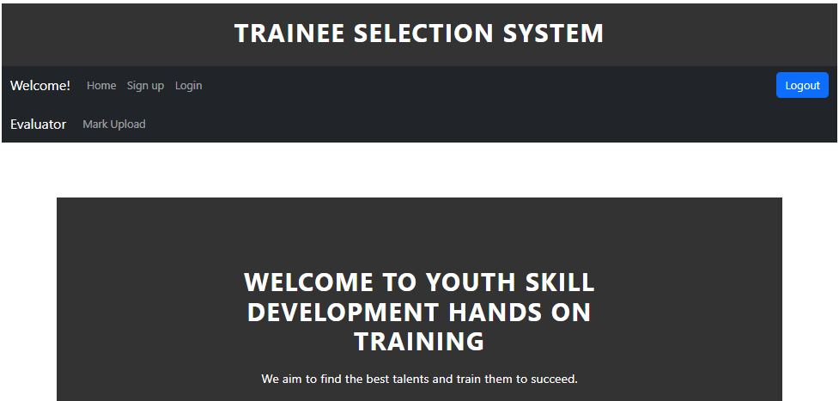
Evaluator Dashboard

Slide 19
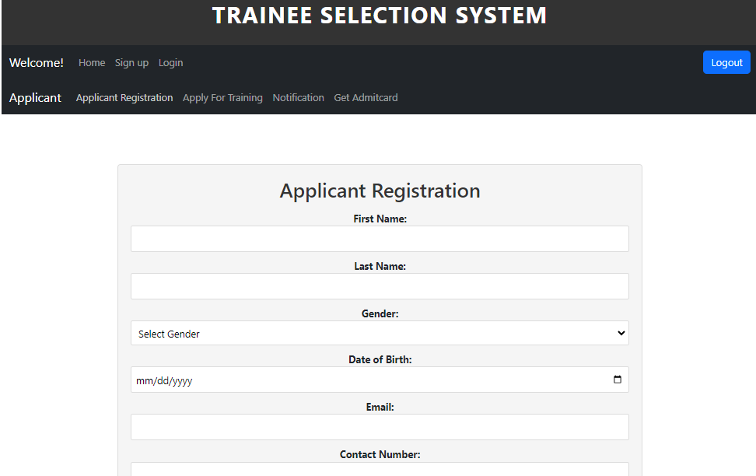
Applicant Register

Slide 20
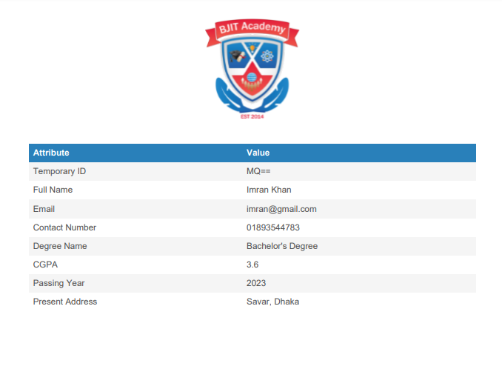
Applicant Card
After successful register applicant can download applicant card where he can get a temporary Id.

Slide 21
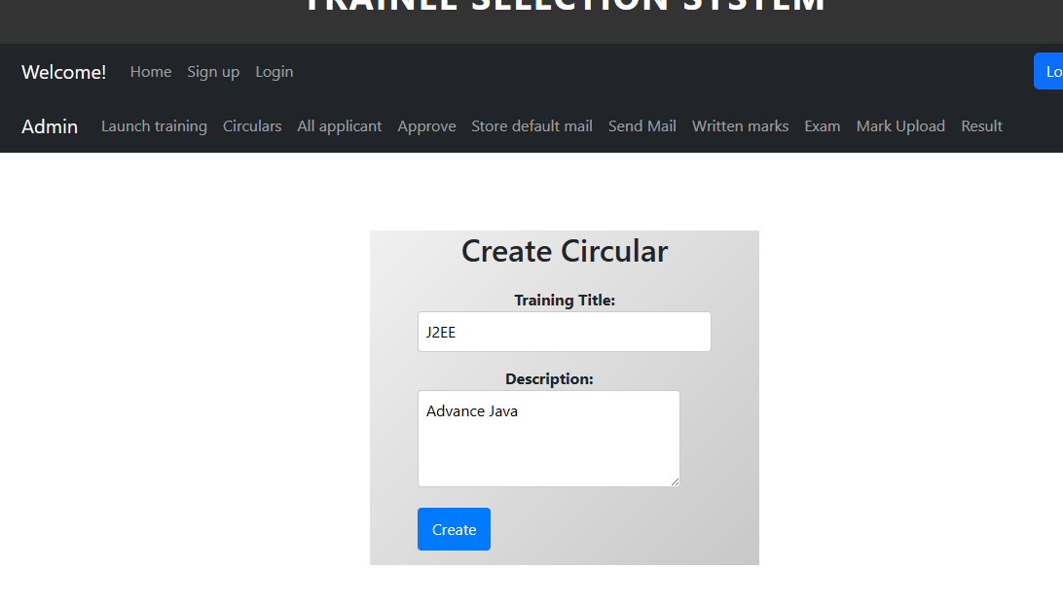
Admin create circulars

Slide 22
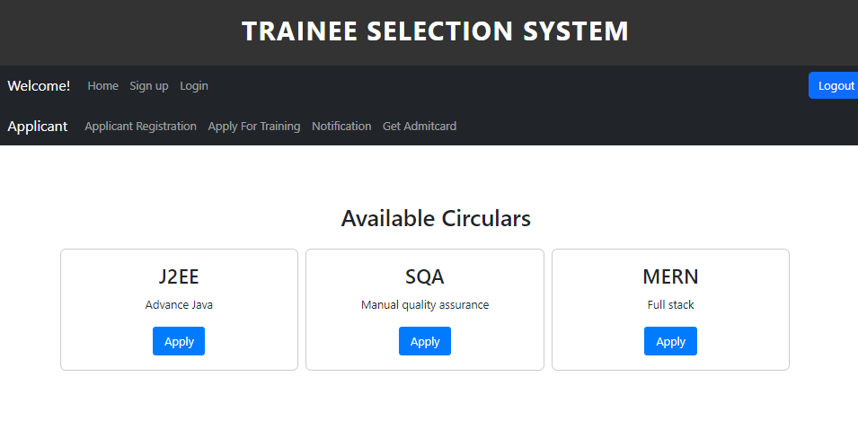
Applicant Apply for available circulars

Slide 23
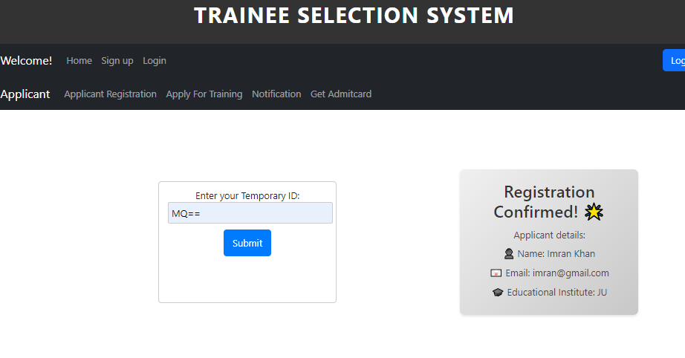
Applicant Notification

Slide 24
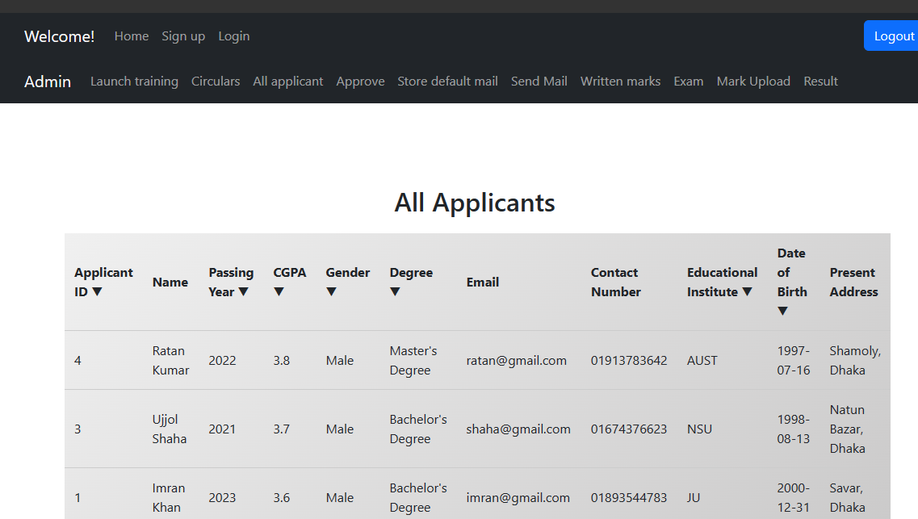
Admin See All Applicants

Slide 25
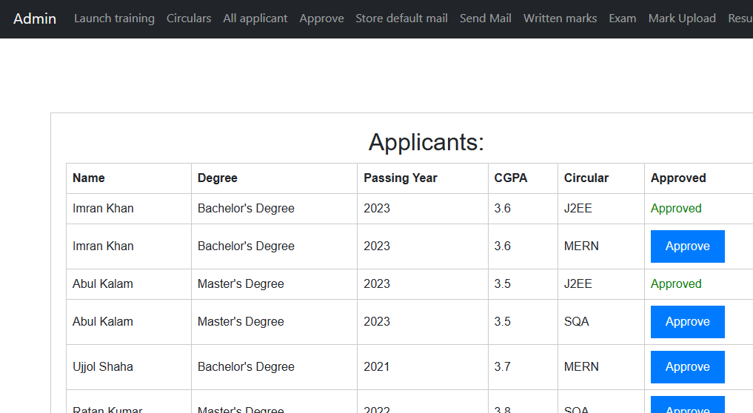
Admin Approve Applicant’s Applications

Slide 26
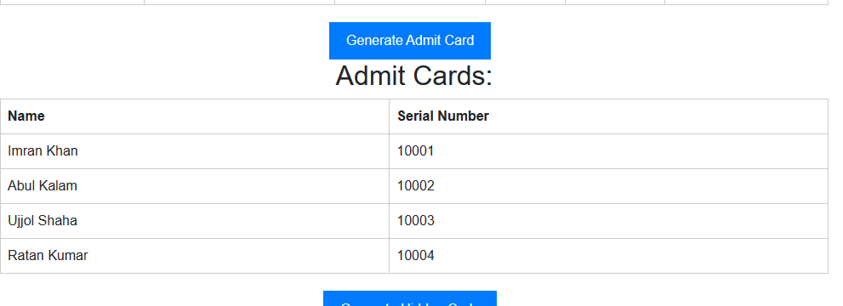
Admin Generate Admitcard
Admin just click on ‘Generate Admit Card’ button and system auto generate the admit cards for approved applicants.

Slide 27
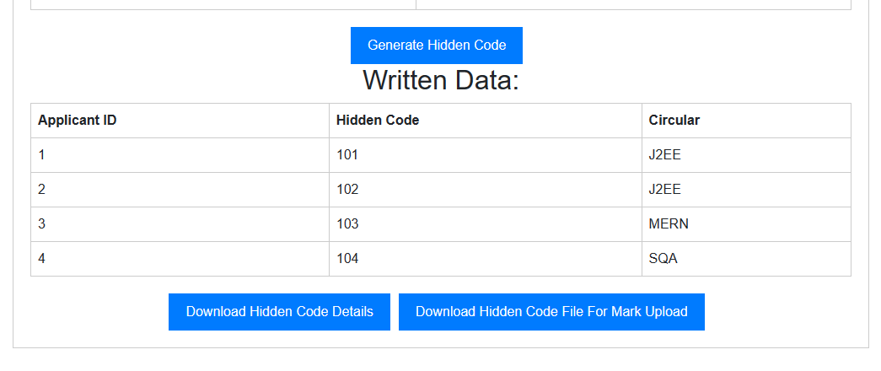
Admin Generate Hiddencode
Admin generate hidden code to track written exam answersheets

Slide 28
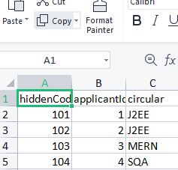
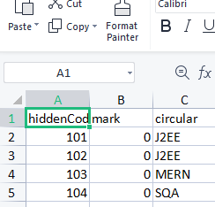
Track code file for mark upload
Hidden code datails
for mark upload

Slide 29
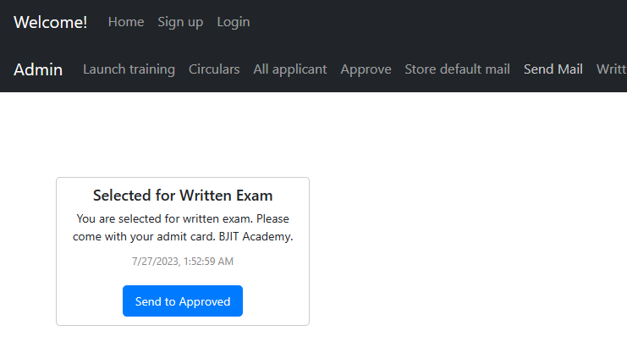
Send Mail To Approved

Slide 30
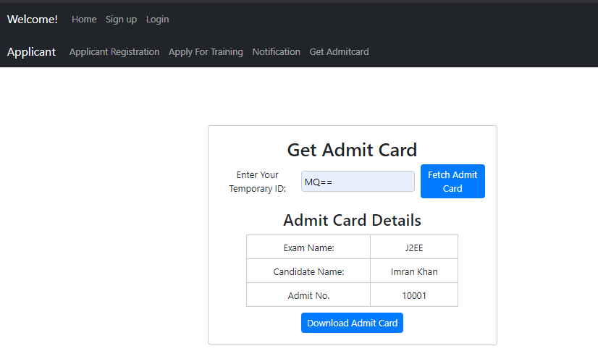
Applicant Download Admitcard

Slide 31
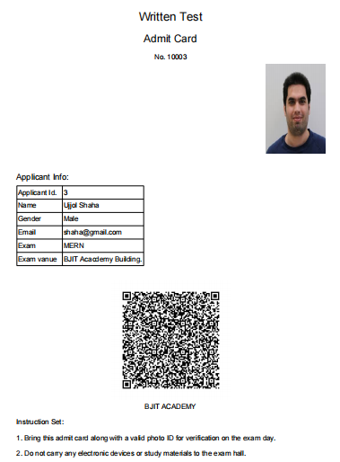
Admitcard

Slide 32
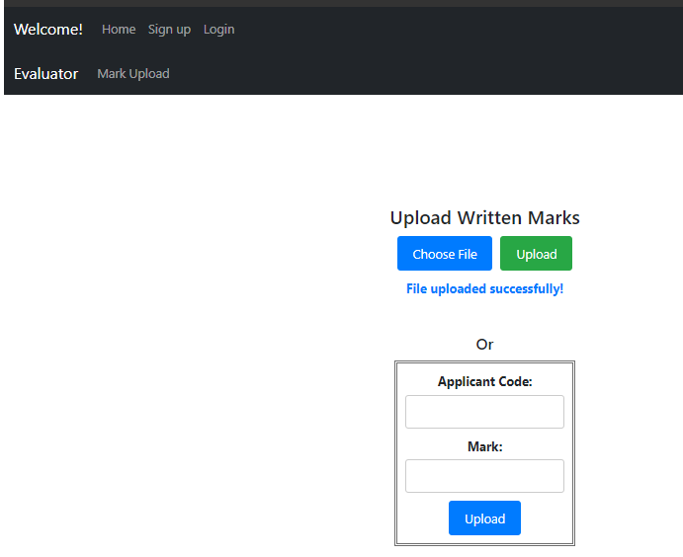
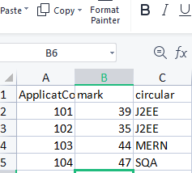
Evaluator Upload Written marks
mark upload file

Slide 33
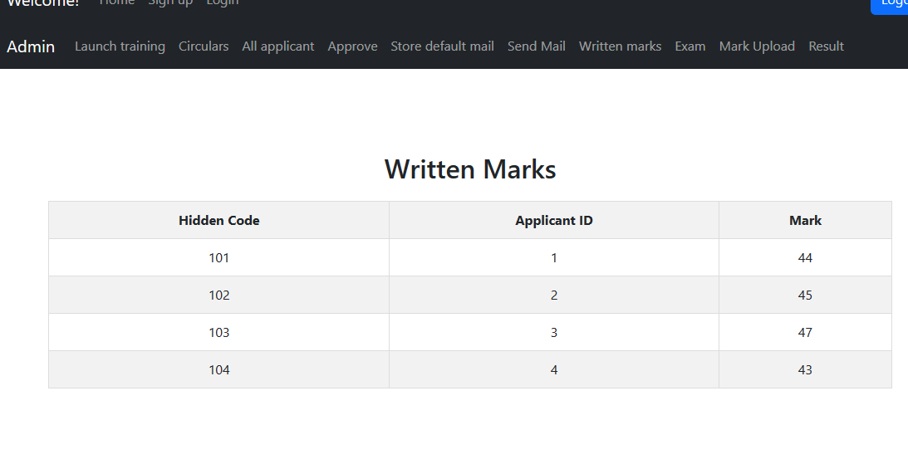
Admin Check Written Marks

Slide 34
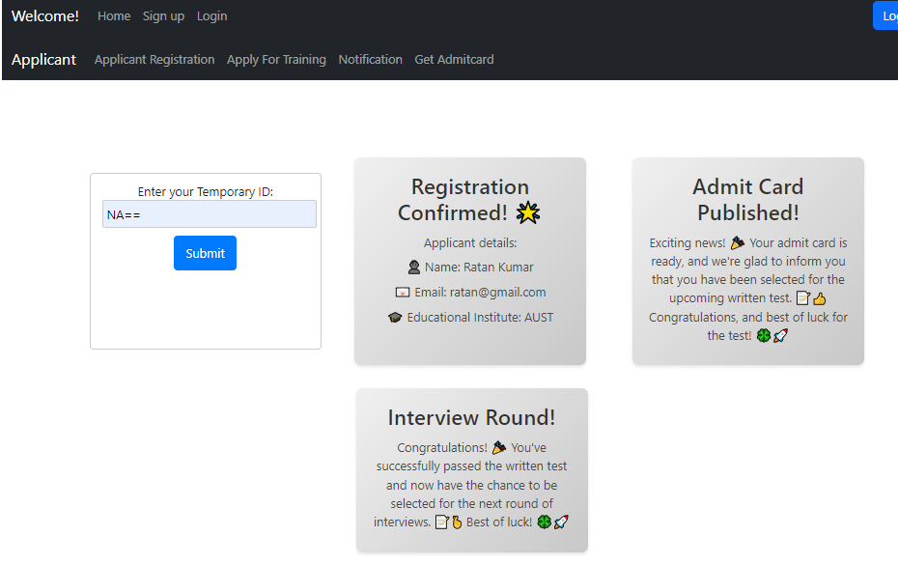
Applicant Get Notification Simultaneously

Slide 35
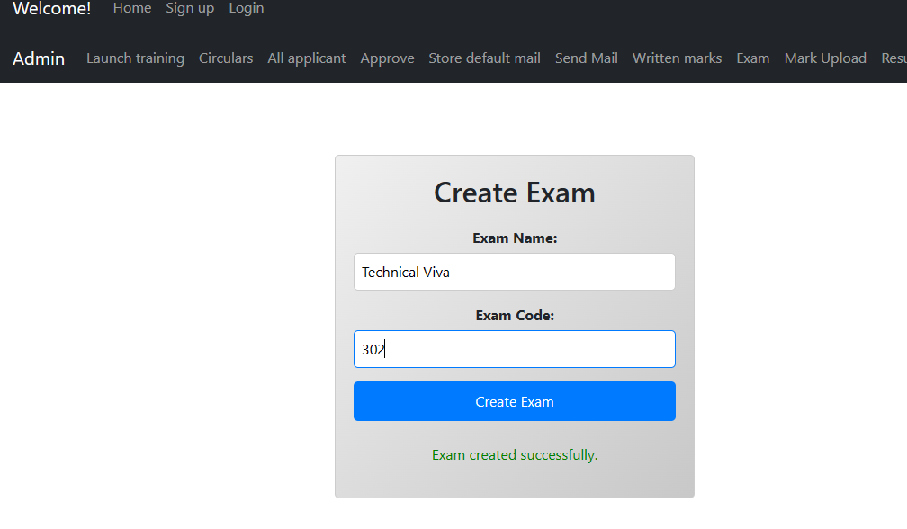
Admin Create Exam Round

Slide 36
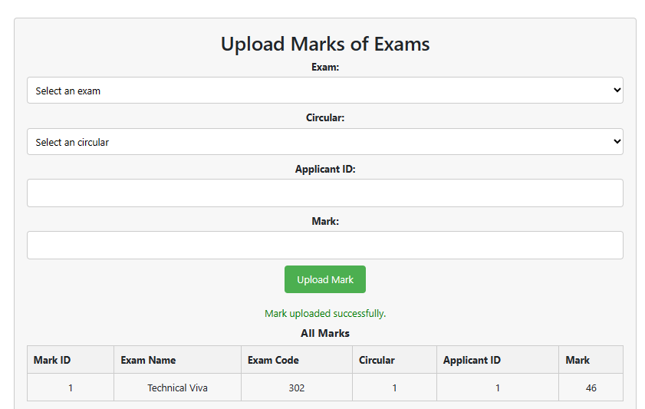
Admin Upload Marks For Exam Rounds

Slide 37
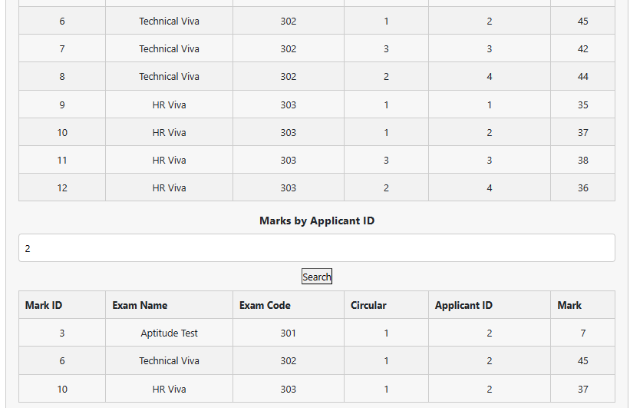
Admin See Marks by Applicant ID

Slide 38
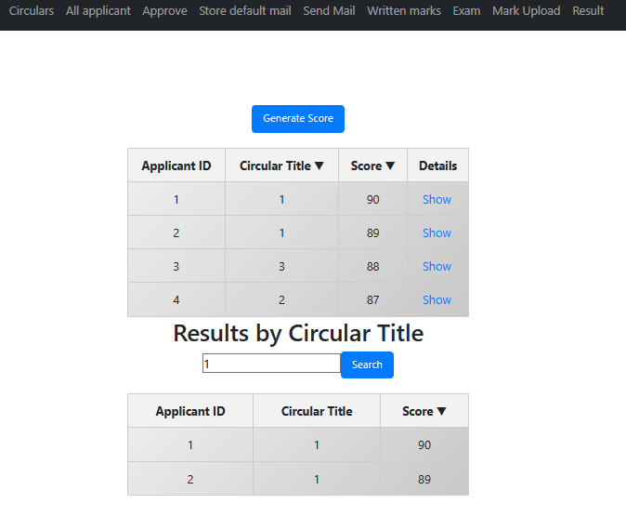
Admin Generate Score
The result is sorted. Also admin can see a particular applicant’s photo and cv by clicking ‘Show’ button

Slide 39
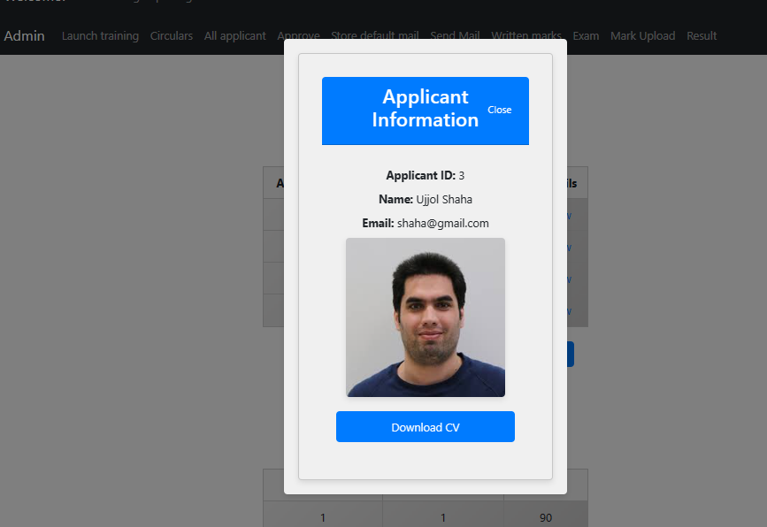
Admin See Applicant From Result Table

Slide 40
Learnings From This Project
Full-Stack Development
Integration of Technologies
Data Management and Security
User Experience (UX) Design
Database Design and Management
Automated Processes
Project Management
Testing and Quality Assurance

Slide 41
Learnings From This Project
User Feedback and Iterative Improvements
Domain Knowledge
Documentation

Slide 42
Challenges and how I solved those
File Data Upload: To upload photo, cv/resume ‘Multipartfile’ has to be used. Aslo ‘@Lob’ has to be used to take Large object.
Table Relation: using ‘@OneToOne’ or ‘@ManyToMany’ and ‘@JoinColumn’ one to another table relation has maintained.
CorsConfig: To serve apies from backend to frontend CorsConfig has configured.
Authentication and Authorization: In backend, jwttoken is used and in front end jwttoken is stored in localstorage. In fronend jwttoken has been decoded using ‘jwt-decode’ to show rolewise navbar.

Slide 43
Enhancement proposal
Interview Feedback System
Multi-Platform Compatibility
Candidate Ranking Algorithm
AI-Powered Candidate Matching
Real-time Application Status Updates
User Experience Refinement
Scalability and Performance Optimization
Machine Learning for Predictive Analytics

Slide 44
Any Questions?

Slide 45
Thanks to all!

