Slide 1





Slide 3
φ_{pinion}
φ_{steer}
T_{motor}
c_{sensor}
T_{driver}
J_{red}
J_{up}
T_{load}
b_{sensor}
b_{red}
b_{up}

Slide 4
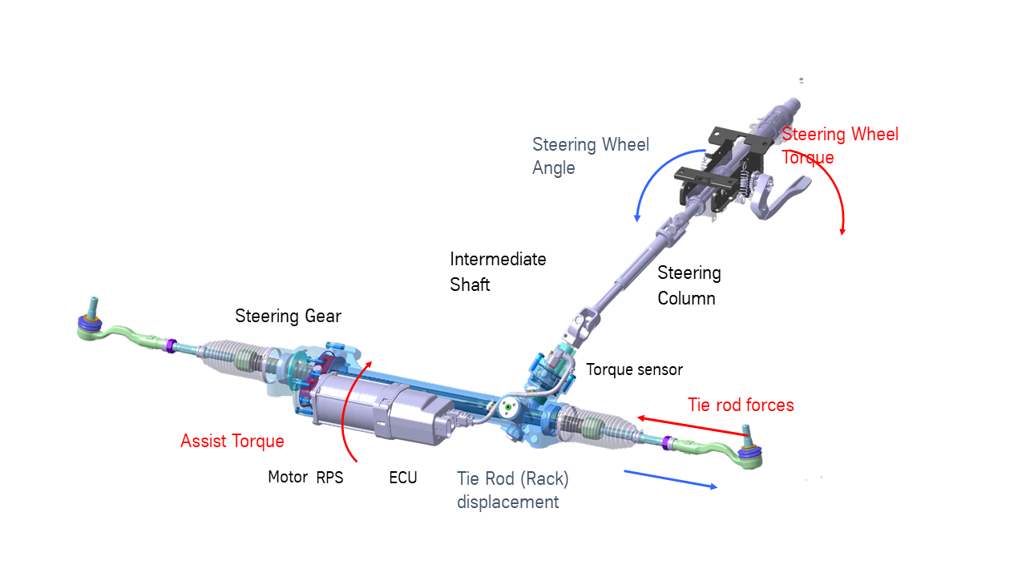

Slide 6
