Slide 1
CRYPTO: Predicting and arbitrage
Krista Muñoz, Reginald Robinson, Lance Vallis

Slide 2
INTRODUCTION
We developed a machine learning model that leverages historical cryptocurrency data from 2018 to May 2023 to predict future prices. Our goal is to provide users with real-time market insights and enable them to make informed decisions when it comes to buying cryptocurrencies.
By utilizing our predictive model, we can estimate future prices, helping users identify potential arbitrage opportunities and maximize their profit potential.

Slide 3
WHAT THE hECK IS arbitrage??
Arbitrage is a way of making money where one buys something for a low price in one place and then sells it at a higher price somewhere else.
Imagine Ryan Reynolds is at school and his friend offers him a candy bar for $1. He knows that the same candy bar costs $2 in the school cafeteria. So, he buys the candy bar from his friend for $1 and then sells it in the cafeteria for $2 making a $1 profit.

Slide 4
WHAT THE hECK IS Crypto??
Cryptocurrencies are a digital form of money that exist only in the digital world. They are decentralized, which means they are not controlled by any central authority like a government or a bank. Instead, they operate on a technology called blockchain. Blockchain is like a digital ledger that records all transactions made with cryptocurrencies. It is stored on computers all around the world, making it secure and transparent. Each transaction is verified by a network of computers called miners who ensure that the transactions are valid.

Slide 5
WHAT THE hECK IS Machine Learning??
Machine learning is the practice of applying computer algorithms and statistics to create models that can learn from data and then make decisions or predictions about future data.

Slide 6
Coin MARKETS
 | Binance | CoinGecko | Coinlayer
Bitcoin / BTC | $26,733.57 | $26,710.00 | $26,843.02
Tether/ USDT | $1.00 | $1.00 | $1.01
Cardano / ADA | $0.36 | $0.36 | $0.37
Ethereum / ETH | $1,851.83 | $1,850.15 | $1,859.31
Litecoin / LTC | $89.88 | $89.65 | $90.18

Slide 7
Historic prices
Open | High | Low | Close | Adj Close | Volume | Year | Month | Day
0.718847 | 0.730051 | 0.671941 | 0.728657 | 0.728657 | 150186000 | 2018 | 1 | 1
0.724676 | 0.794646 | 0.697856 | 0.782587 | 0.782587 | 289712000 | 2018 | 1 | 2
0.779681 | 1.08567 | 0.778578 | 1.07966 | 1.07966 | 657398016 | 2018 | 1 | 3
1.09403 | 1.32721 | 1.03765 | 1.11412 | 1.11412 | 593430016 | 2018 | 1 | 4
1.17115 | 1.25242 | 0.903503 | 0.999559 | 0.999559 | 508100000 | 2018 | 1 | 5
… | … | … | … | … | … | … | … | …
0.368242 | 0.368382 | 0.364512 | 0.366357 | 0.366357 | 118748065 | 2023 | 5 | 20
0.366352 | 0.367398 | 0.358336 | 0.360363 | 0.360363 | 116595379 | 2023 | 5 | 21
0.360382 | 0.373213 | 0.357263 | 0.367997 | 0.367997 | 177956408 | 2023 | 5 | 22
0.368004 | 0.375178 | 0.366596 | 0.370484 | 0.370484 | 141912382 | 2023 | 5 | 23
0.3705 | 0.370566 | 0.360984 | 0.364234 | 0.364234 | 175329362 | 2023 | 5 | 24
Crypto: investing & trading

Slide 8
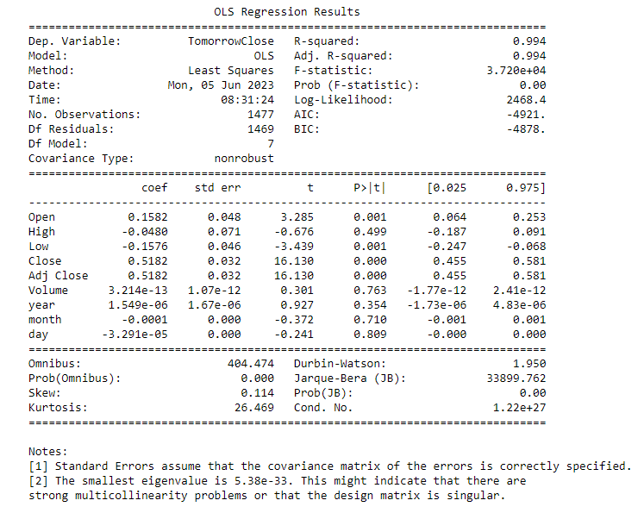
Training the models
Using price data from 2018 – 2023 we trained our models for each coin using Linear Regression.
Each model had an R-squared score of 0.99% accuracy, with the exception of one model for the coin Tether (USDT).

Slide 9
R-Squared Score
 | R-squared Score
Bitcoin / BTC | 0.997
Tether/ USDT | 0.543
Cardano / ADA | 0.994
Ethereum / ETH | 0.996
Litecoin / LTC | 0.990
Tether is a coin that is always $1.
It does change slightly from day to day from a minimum of $0.96644 to max of $1.053585
These very small variations caused the model to be less accurate at 54%
R^2 Score (R-squared score) : Used to evaluate how well the model is likely to make accurate predictions. It’s a number between 0 and 1, with 1 indicating the model perfectly predicts the dependent variable.

Slide 10
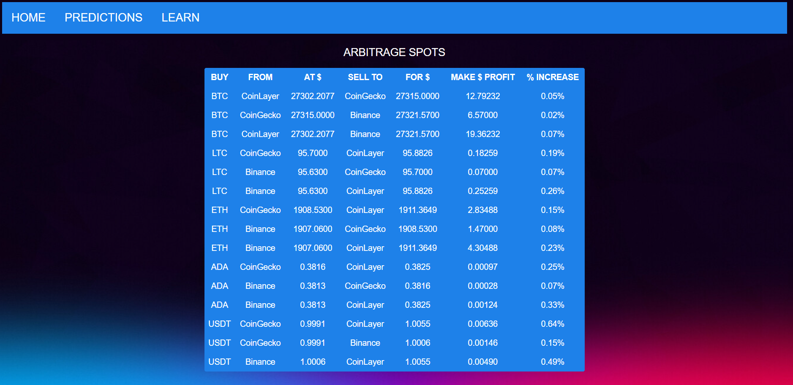
Web PAge
GO TO WEBPAGE

